Slide 1


HEALIX
Medical assistant overview

Slide 2



PROBLOM DEFINITION
DIFFICULTY IDENTIFYING THE RIGHT SPECIALITY BASED ON DISEASE SYMPTOMS, LEADING TO MISDIAGNOSIS, EXTRA NON NESSISARY VISITS AND EXPENSES
GAP BUILT BETWEEN PATIENT AND DOCTOR DUE TO LACKAGE OF PROPER SYMPTOM COMMUNICATION, LEADING TO WASTING TIME FOR DOCTOR AND PATIENT
PROBLEMS OF NOT KNOWING PATIENTS HISTORY AND MANGING APPOINTMENTS SYSTEM

Slide 3


PROBLEM SOLUTION
“HEALIX”, A MIDECAL ASSISTANT AI POWERED PLATFORM RESPONSIBLE FOR:
  interacting with patients to understand symptoms, suggest the right medical specialty, and recommend basic tests before their visit through an AI chatbot.
  booking appointments based on preferences like availability, fee, or doctor gender.
  sending the doctor a pre-diagnosis with previous tests or prescriptions for a smoother, more efficient consultation.

Slide 4


PROJECT SCOPE:
what the system preforms:
  Receives patient symptoms through chatbot.
  Extracts key medical entities (e.g., symptoms, duration, severity).
  Provides the doctor with a preliminary report that includes a summary of symptoms and top 3 possible conditions predicted by an ML model.
  Suggests the most suitable doctor and books an appointment.
  Manages test and scan results, linking them to the scheduled appointment.

Slide 5

what the system does not preforms:
  Issue a final diagnosis or prescribe treatment without the doctor’s approval.
  Display the preliminary report or model predictions directly to the patient (for ethical and legal reasons).

Slide 6
SYSTEM INTERFACE & COMPONENTS
PATIENT:
DOCTOR:
MANAGEMENT:
  Login / Registration Screen
  Chatbot Screen
  Doctor Recommendation & Booking Screen
  File Upload Screen
  Daily Appointments Dashboard
  Preliminary Report Screen
  Final Diagnosis Screen
  Doctor Management Panel
  System Records and Reports

Slide 7

FUNCTIONAL & TECH REQUIREMENTS
FUNCTIONAL:
TECH:
  Chatbot Interaction
  Image Storing
  Symptom Analysis & Prediction
  Doctor Recommendation Engine
  Appointment Scheduling
  Data Management
  Notification System
  Admin Dashboard
  Programming Language (Backend & ML)
  Frontend
  Chatbot / Dialogue System
  NLP Tools
  Clinical Models
  Databases
  Model Hosting
  Backend Hosting
  Authentication

Slide 8

SYSTEM REQUIREMENTS
INPUTS:
A. patient Inputs
  Text-based conversation
  File uploads:
  Doctor’s personal preferences:
B. Doctor & Hospital Database Inputs
  Doctor profiles.
  Hospital or clinic schedules and booking availability.

Slide 9




SYSTEM REQUIREMENTS
OUTPUTS:
A. Patient Outputs
  Suggested medical specialty based on the reported symptoms.
  Recommended list of available doctors filtered by patient preferences
  Appointment confirmation and details
  Reminders or test recommendations before visiting the doctor
B. Doctor Outputs
  Pre-diagnosis report generated by the system’s ML model, including:
    Extracted symptoms and their severity.
    Top-3 possible conditions.
    Uploaded test results and prescriptions attached to the patient’s case.
C. System Outputs
  Stored patient-doctor interaction records
  Analytics dashboard

Slide 10
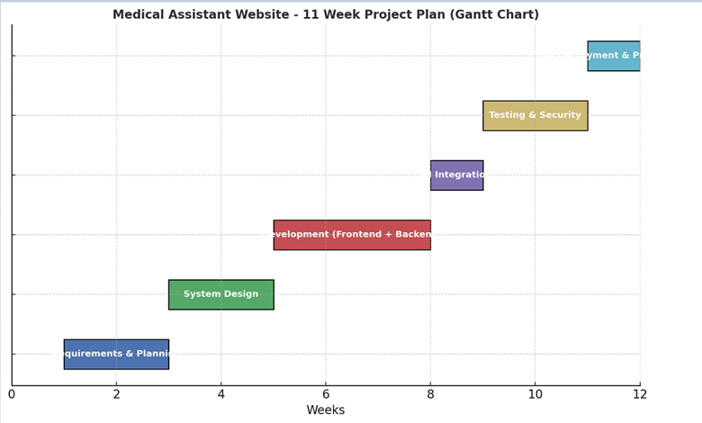
TIMELINE & GANTT CHART

Slide 11

OUR PROGRESS
  NLP
  Predictions
  Chatbot

Slide 12
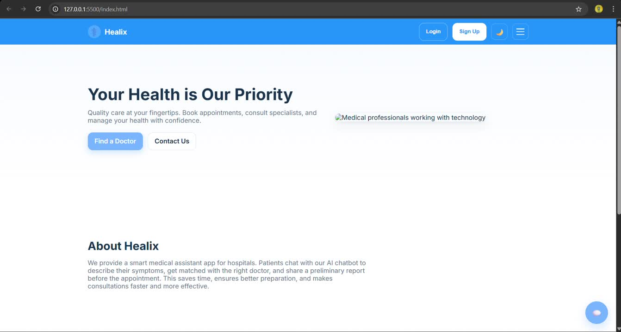
UI-UX PROGRESS

Slide 13

STAKEHOLDERS
  PATIENTS
  DOCTORS
  HOSPITAL ADMINSTRTION
  DATA SCIENTESTS
  IT TEAM

Slide 14

FOR FURTHER DETAILS
VIEW PROJECT DOCUMENTATION
HEALIX

Slide 15
THANK YOU

