Slide 1
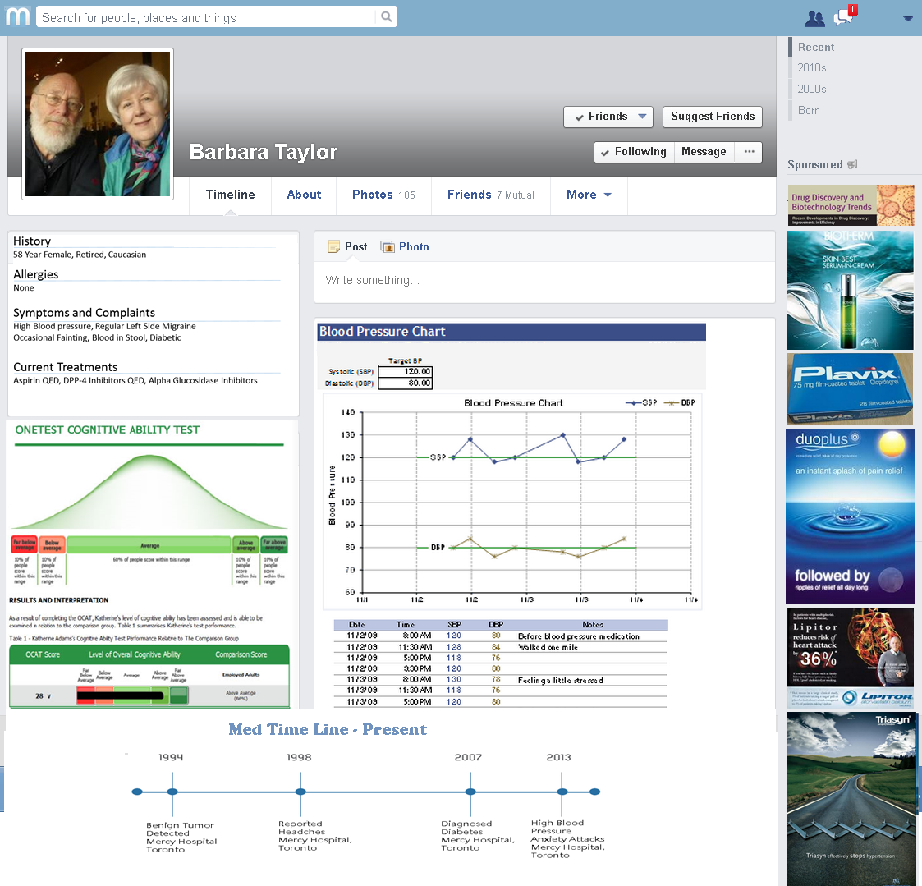
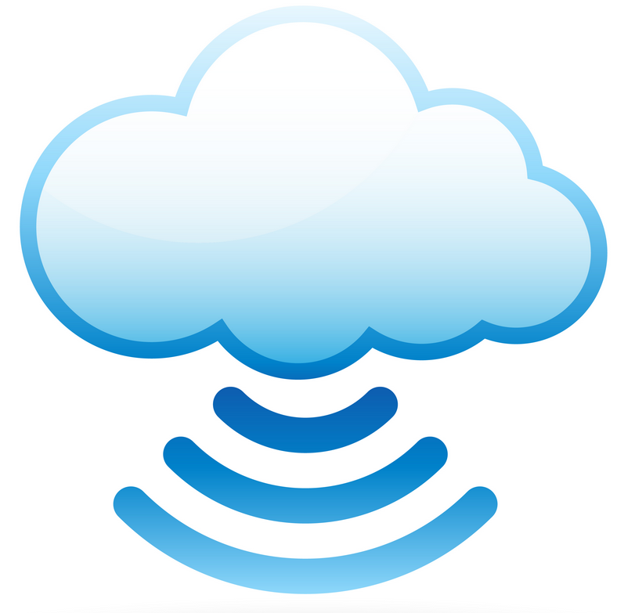






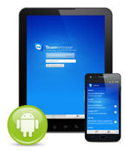


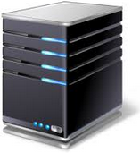


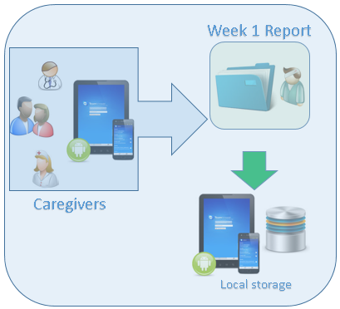
App 1 (Cognitive Screen App)
Patient 1
Week 1 Report
Caregivers
Hospital Server
Local storage
Patient 2
Patient 3
Patient N

Slide 2
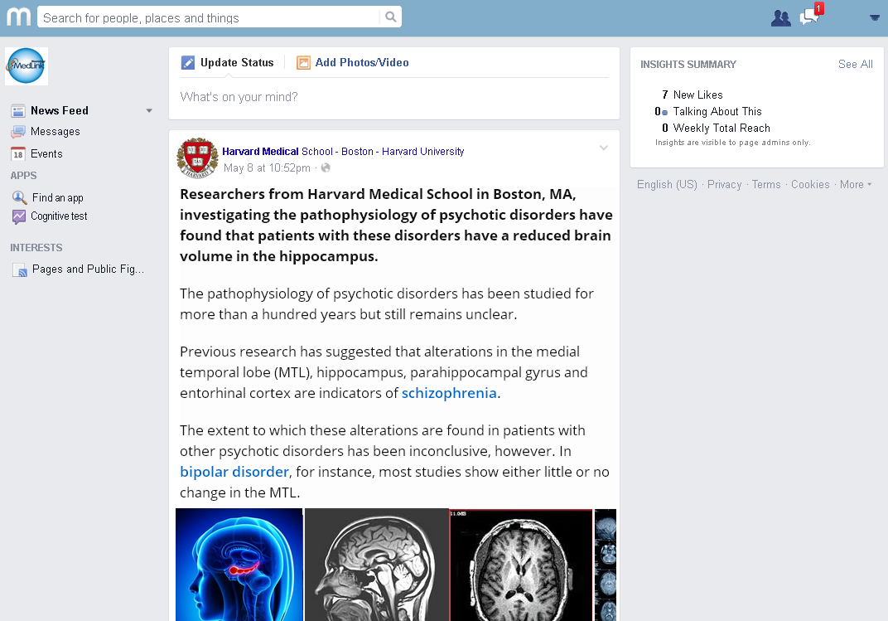
Notes:
- Medical network for doctor community and patients.
- Must be very simple. Messaging – App download
App can be easily downloaded and referred to play store (play store embedded link)
Doctors can access each patient (through User Page) page once given access (paired and linked) – Can see reports/MRI App to JPG.
Upload MRI reports
Upload CT scan reports
-

Slide 4
