Slide 1
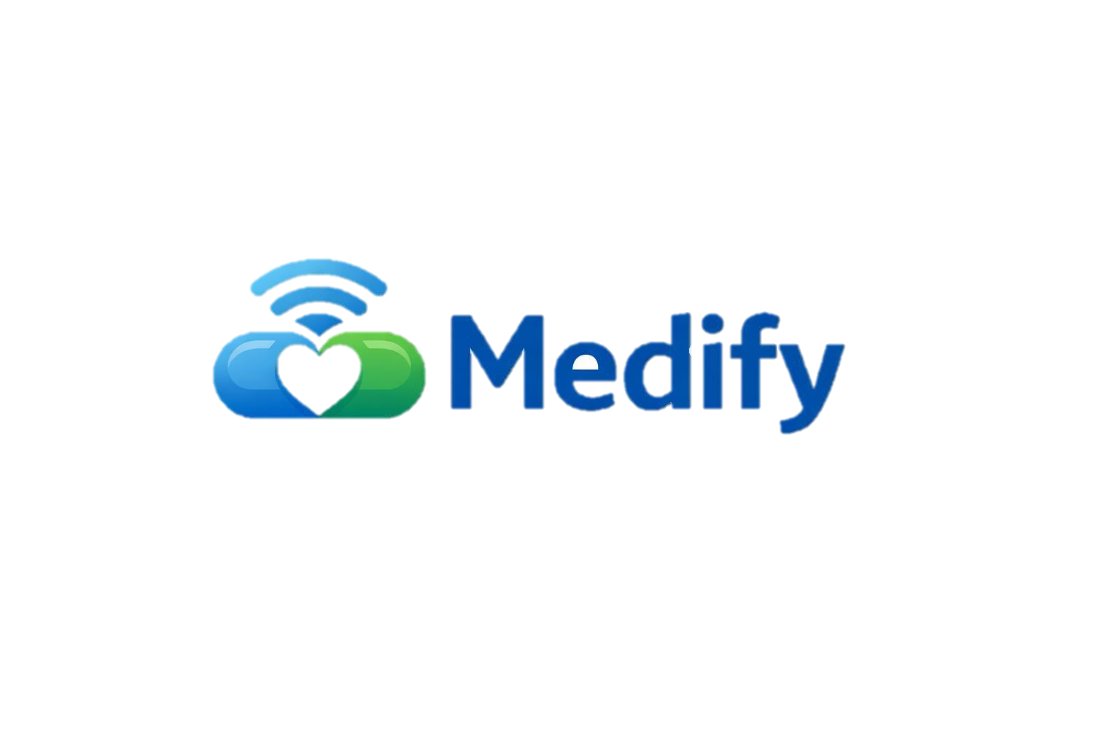
Medify
Smart Medication Management System
By Netta Spivak & Roy Tomer

Slide 2
The Problem
Why medication management is a critical challenge
Patients taking multiple medications face high risk of missed or incorrect intake
Passive solutions (pill organizers) provide no reminders or confirmation
Complex apps are not suitable for elderly or cognitively impaired users
Caregivers and family members have no visibility into daily intake compliance

Slide 3
Our Solution
Bridging the gap between prescriptions and actual intake
From passive reminders to active medication management
Medify is a smart medication management system that combines a smart pill box with a mobile application to help patients take the right medication at the right time.
The system actively guides and monitors the medication intake process from medication management, reminders and caregiver alerts to medication dispensing.

Slide 4
Key Features
Smart Pill Box
Automatically dispenses medication at scheduled times after user approval.
Using Sensor to identify when all of the medications were taken.
medication management
Real-time mobile reminders when an intake window opens.
Intake approval via app or physical device button.
Pre intake reminders.
Caregiver view, for monitoring intake or missed intakes of the patient.

Slide 5
System Architecture
Wi-Fi / REST
Smart Pill Box
Flutter App
Arduino / C++
Dart + Flutter
Wi-Fi / REST
REST API
Backend Server
Java + Spring Boot
Database
PostgreSQL 15

Slide 6
Technology Stack
Choices and justifications
Java and Spring Boot provide a stable and proven environment for backend system development, with strong support for REST APIs, scheduling tasks, and database integration.
Backend
Java + Spring Boot
Frontend
Flutter enables development of a single cross-platform application for both Android and iOS, while providing fast performance and a modern, responsive UI.
Dart + Flutter
Arduino and C++ provide a simple and accessible platform for embedded systems development, with extensive hardware library support and precise control over the device’s behavior.
Hardware
Arduino / C++
Database
PostgreSQL provides reliable and consistent data management, while allowing easy schema management and smooth integration with Spring Boot.
PostgreSQL

Slide 7
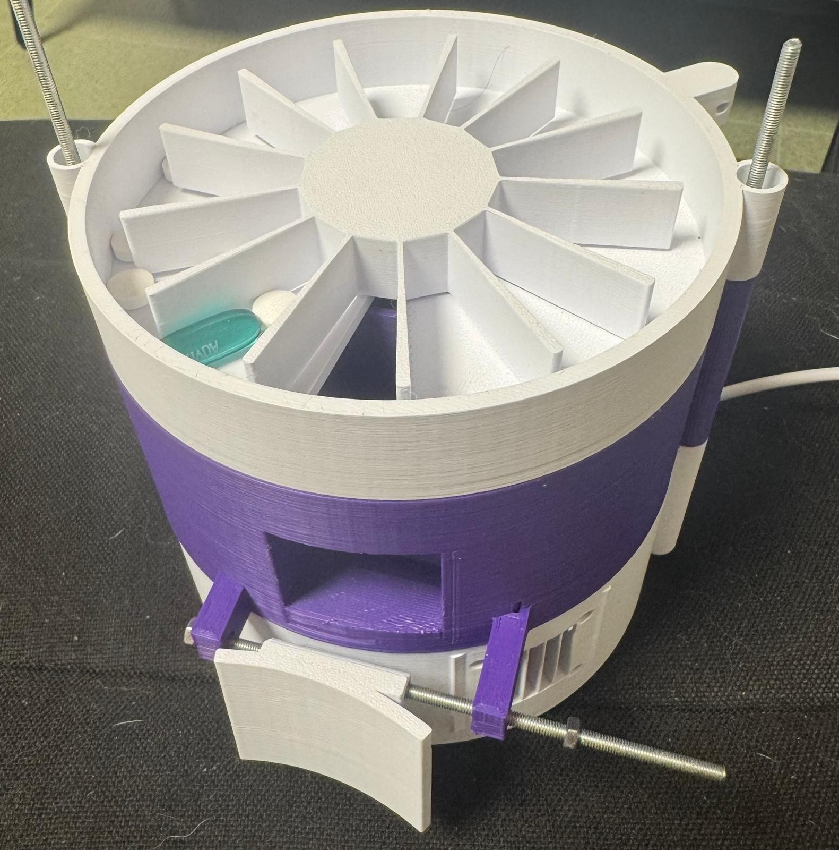
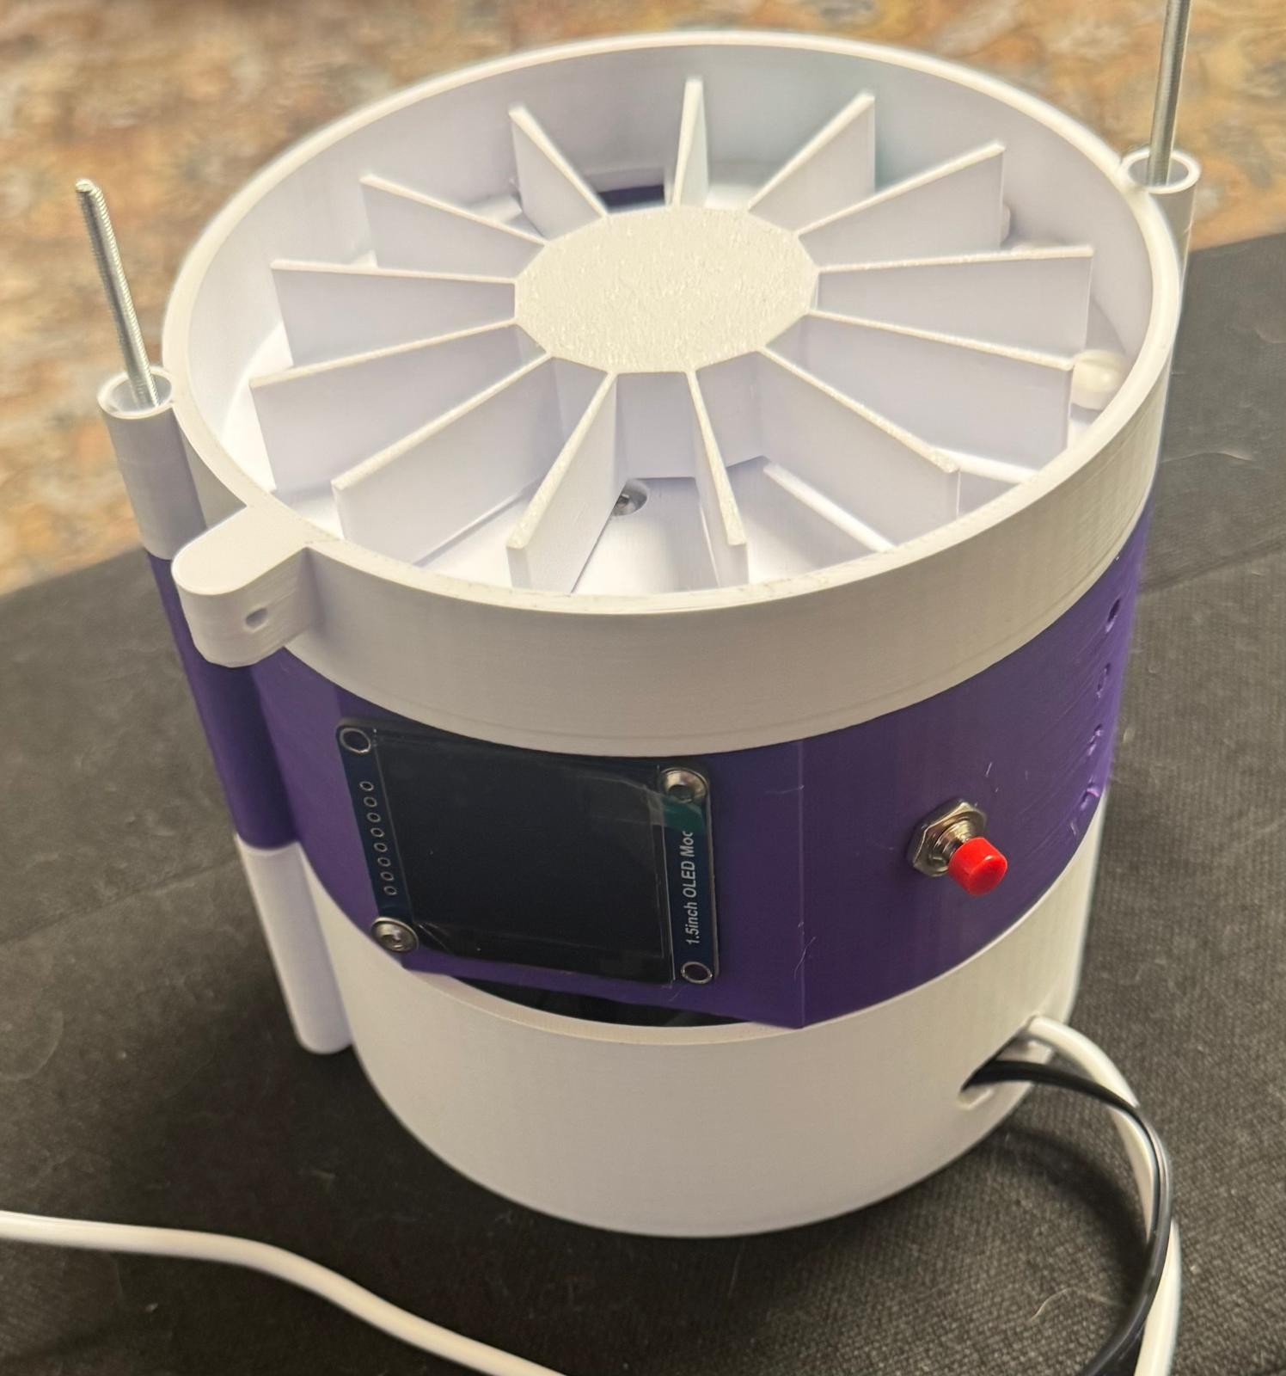
Domain — Smart Pill Box
Arduino / C++
Motor-driven mechanism releases medication into the intake compartment at scheduled times, after user approval
Medication Release
Sensor detects whether the intake compartment was emptied within the allowed time window
Compartment Monitoring
LED indicators assist the user during medication setup by illuminating the correct compartments for each medication.
Medication Loading Guidance
Autonomous Operation
Continues functioning independently even when the patient's phone is not nearby

Slide 8
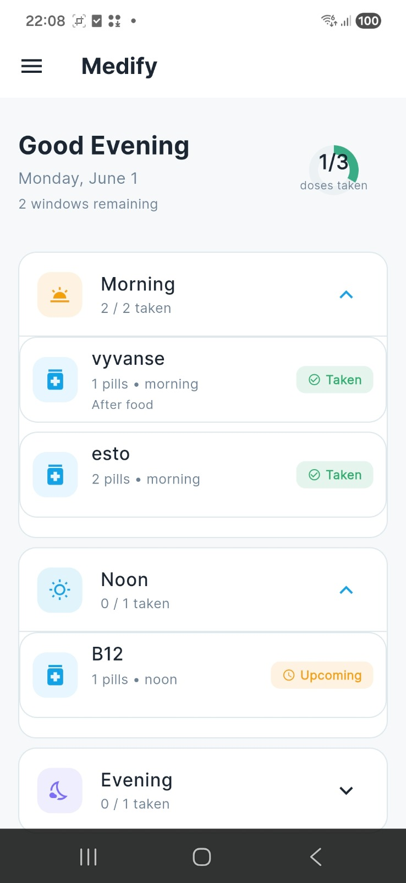
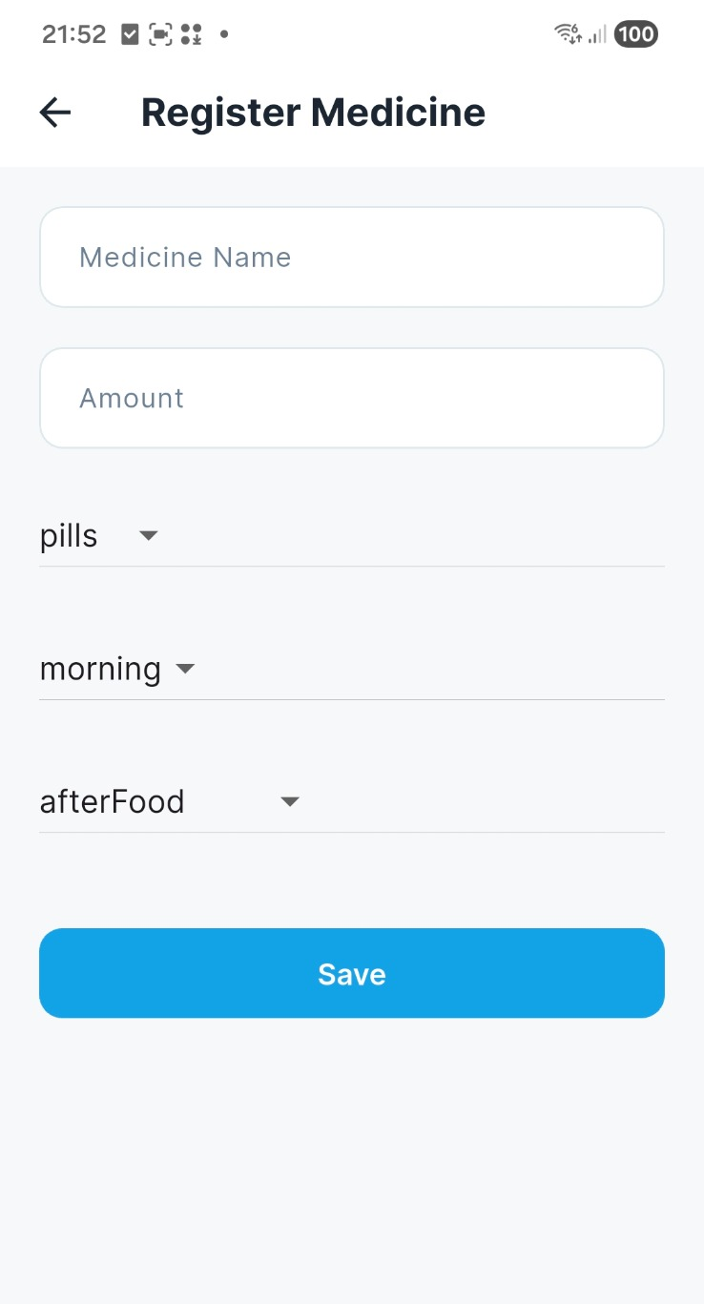
Domain — Mobile Application
Flutter + Dart
Users can manage their medications, define intake windows, and update their treatment routine directly through the app.
Medication Management
Accessible Experience
Simple UI designed to support elderly users.
Guide users through the process of loading medications into the smart pill box.
Medication Setup

Slide 9
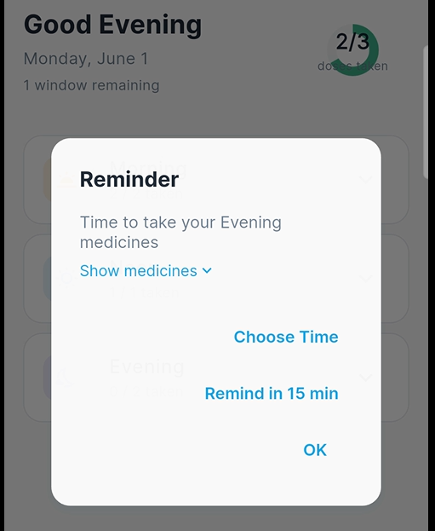
Domain — Mobile Application
Flutter + Dart
Users receive reminders when an intake window opens, with the option to approve medication intake or snooze.
Notifications & Reminders
Caregivers can monitor medication intake status in real time and receive alerts for missed or incomplete intakes.
Caregiver View

Slide 10
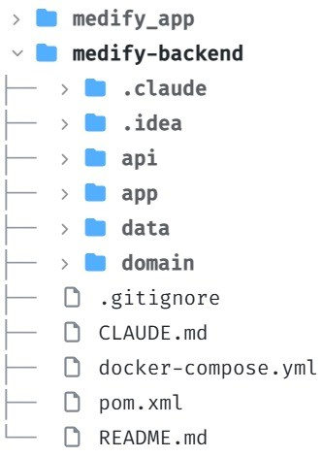
Domain — Backend Server
Java 21 · Spring Boot 3.4
Handles intake-related events based on predefined schedules.
Modules Structure
Scheduling
app - Entry point.
api - REST controllers, services.
Domain - Business logic, schedulers, models.
data - DB communication and access.
Intake Management
Manage the intake status lifecycle:
PENDING → APPROVED → TAKEN.
Data Management
Handles communication with the database.
Missed intake detection
Detects missed medication intake and sends alerts to caregivers.

Slide 11
Domain — Database
PostgreSQL
users
User profiles, roles (PATIENT / CAREGIVER), authentication data
medications
Medication name, timing window, dosage, pre-intake reminder rules
intakes
One record per timing window per day - tracks approval, release, and status
caregiver_links
Patient-caregiver associations and alert preferences
notification_logs
History of all notifications and alerts sent by the system

Slide 12
Current Project Status
Completed
Patient app – register medications, schedule with intake window status, intake notification with approve or snooze options.
Caregiver screen – intake schedule and daily status overview.
Backend core - implement medication management, intake tracking, user and caregiver notifications and persistent DB storage.
Automatic scheduling - Morning 08:00, Noon 13:00, Evening 20:00, and postpone an intake window.
Arduino device - Wi-Fi communication, listen and response to API requests.
Arduino device - app-controlled medication dispensing.
PostgreSQL - database integration and schema management.
Planned
Arduino device - detecting missed medication intake.
Pill insertion flow - developing the process of inserting medications through the mobile application.
Implementation of pre intake notifications.
Multi-user support - extending the system to support multiple users and caregivers simultaneously.

Slide 13
AI Usage in Development
Lovable - used for visual planning and prototyping of the frontend screens before implementing them in Flutter.
Claude Code - used for code generation, architecture discussions, debugging assistance, and project documentation.
ChatGPT - used for document phrasing and assistance with planning the 3D printing components and OpenSCAD logic.

Slide 14
System Demo
See Medify in action
▶
Video coming soon

