Slide 1
Data Science Challenge
PMI – Medina Zaganjori

Slide 2
Dataset
~500 taxi cabs in San Francisco collected over ~30 days.
for each line contains [latitude, longitude, occupancy, time] →[37.75134 -122.39488 0 1213084687], where latitude and longitude are in decimal degrees occupancy shows if a cab has a fare (1 = occupied, 0 = free) time is in UNIX epoch format.

Slide 3
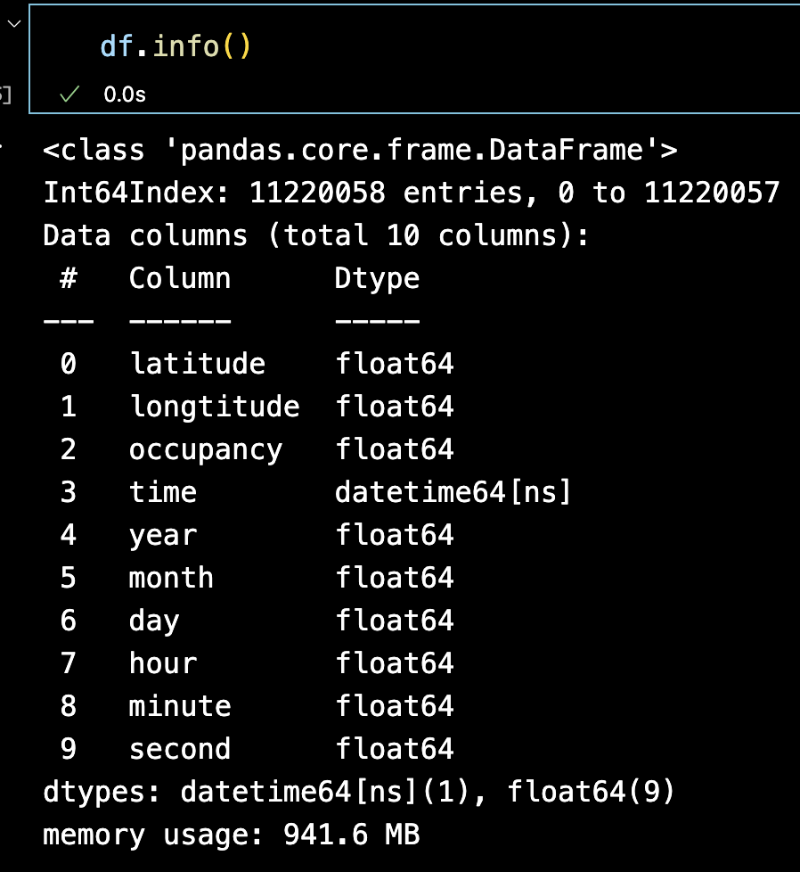
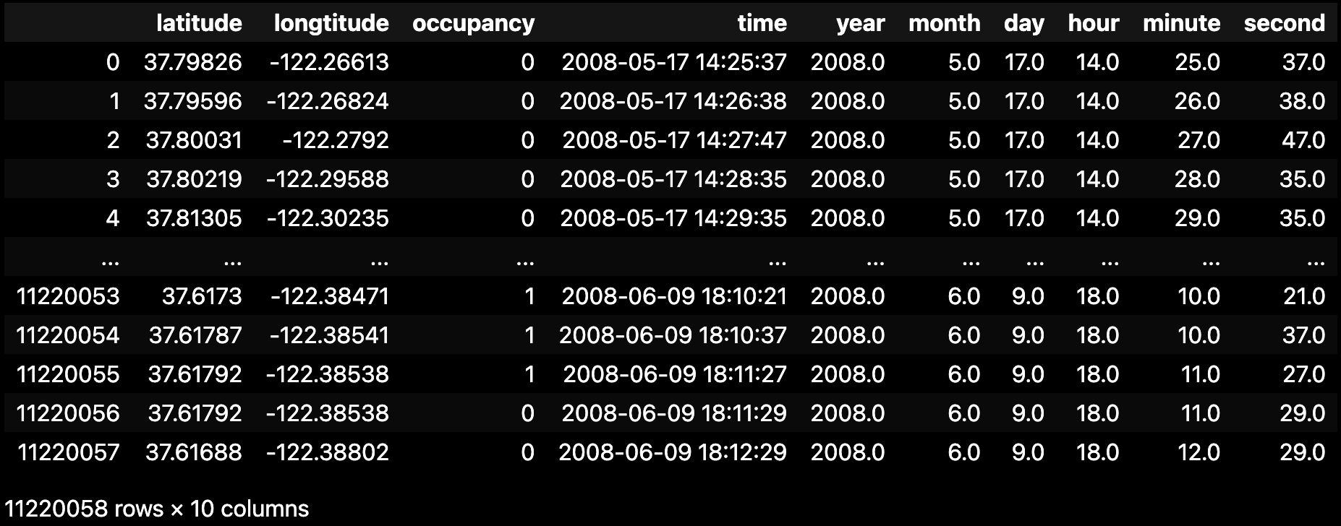
Dataset Manipulation
Dataset Reading: Read over all *.txt files and append them to a list. Convert to list to dataframe by using ’\n’ as a indicator for new row and ’\s’ as indicator for new column.
Convert time from UNIX format to datetime (year, month, day, hour, minute, second):

Slide 4
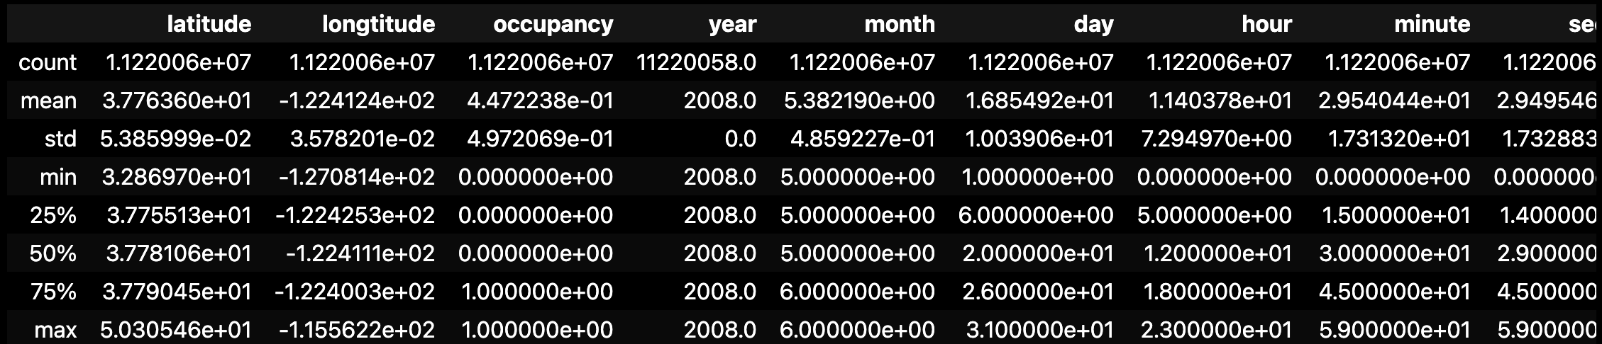
Dataset Manipulation

Slide 5

Potential yearly reduction in CO2
1. To calculate the potential for a yearly reduction in CO2 emissions, caused by the taxi cabs roaming without passengers. In your calculation please assume that the taxicab fleet is changing at the rate of 15% per month (from combustion engine-powered vehicles to electric vehicles). Assume also that the average passenger vehicle emits about 404 grams of CO2 per mile.
function haversine_distance(lat1, lon1, lat2, lon2):
convert degrees to radians for lat1, lon1, lat2, lon2
delta_lat = lat2 - lat1
delta_lon = lon2 - lon1
a = sin^2(delta_lat/2) + cos(lat1) * cos(lat2) *sin^2(delta_lon/2)
c = 2 * atan2(sqrt(a), sqrt(1-a))
radius = Earth's radius in the desired unit (6371km)
distance = radius * c
return distance

Slide 6
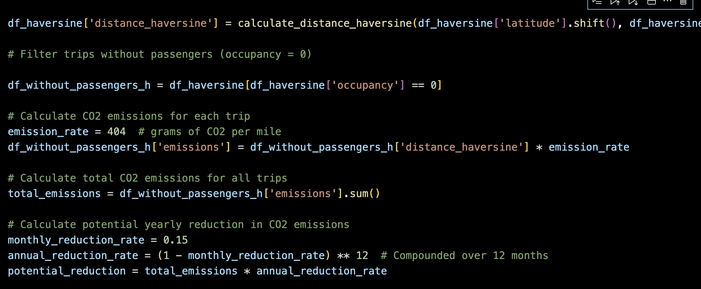
Potential yearly reduction in CO2
emission_rate = 404 gr CO2 per mile
emission_for_each_road_without_passangers: distance_haversine * emission_rate
emission_for_each_road_without_passangers.sum()
Yearly potential reduction: monthly_reduction_rate = 0.15 annual_reduction_rate = (1-monthly_reduction_rate) ** 12 potential_reduction = emission_for_each_road_without_passangers.sum() * annual_reduction_rate

Slide 7

Potential yearly reduction
Potential yearly reduction in CO2 emissions: 10450729260.116621 grams

Slide 8
Further Reading
Vincenty Formula – another solution

Slide 9

Data Science Challenge
For this data science challenge, you are provided with a dataset containing mobility traces of ~500 taxi cabs in San Francisco collected over ~30 days. The format of each mobility trace file is the following - each line contains [latitude, longitude, occupancy, time], e.g.: [37.75134 -122.39488 0 1213084687], where latitude and longitude are in decimal degrees, occupancy shows if a cab has a fare (1 = occupied, 0 = free) and time is in UNIX epoch format.
The goal of this data science challenge is twofold:
1. To calculate the potential for a yearly reduction in CO2 emissions, caused by the taxi cabs roaming without passengers. In your calculation please assume that the taxicab fleet is changing at the rate of 15% per month (from combustion engine-powered vehicles to electric vehicles). Assume also that the average passenger vehicle emits about 404 grams of CO2 per mile.
2. To build a predictor for taxi drivers, predicting the next place a passenger will hail a cab.
3. (Bonus question) Identify clusters of taxi cabs that you find being relevant from the taxi cab company point of view.

Slide 10
Data Analysis § Feature Engineering
head(), info(), describe() → statistics of the dataset
Remove missing values.
Feature Scaling
Create new features.

Slide 11
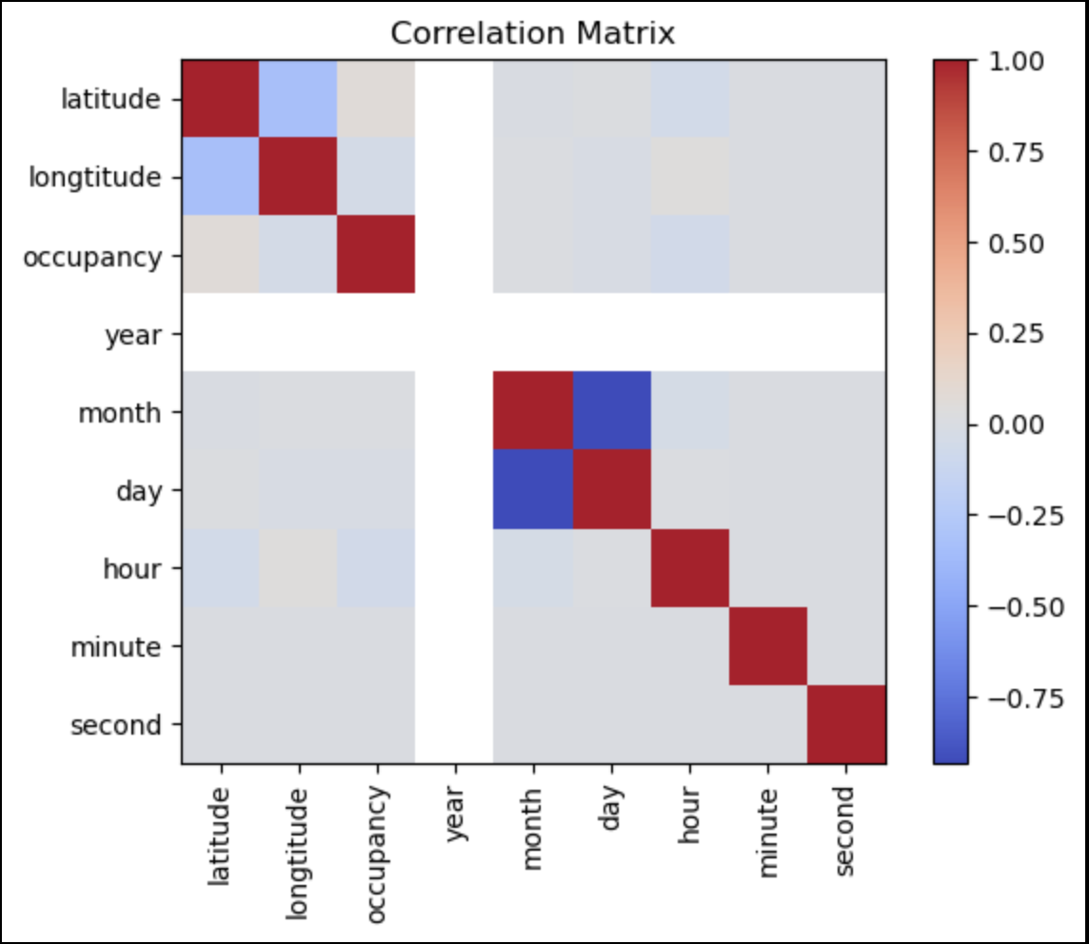
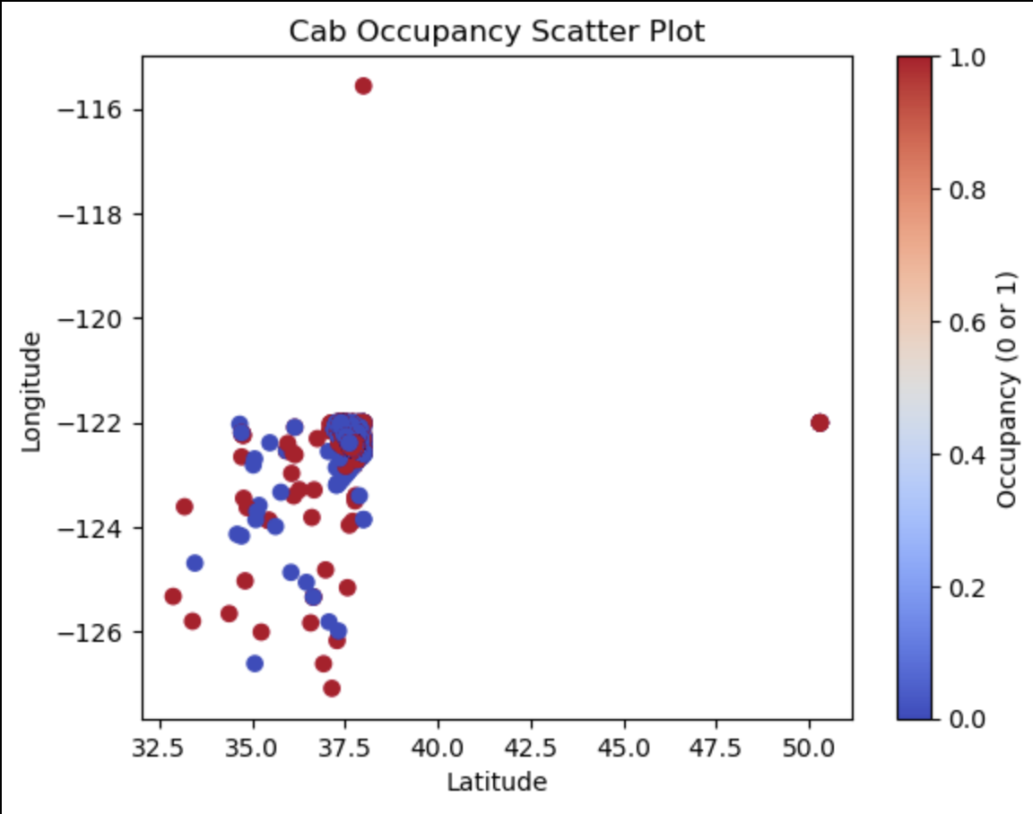
Feature Engineering

Slide 12
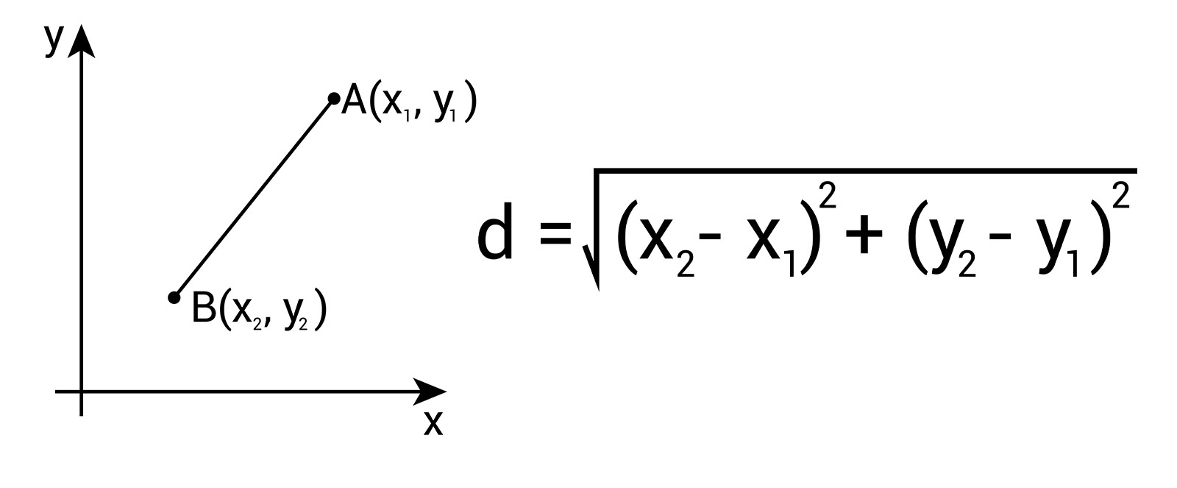
Feature Engineering
data['distance_since_last_pickup'] = ((data['latitude'] - data['previous_pickup_latitude'])**2 + (data['longtitude'] - data['previous_pickup_longitude'])**2)**0.5
data['previous_pickup_latitude'] = data['latitude'].shift()
data['previous_pickup_longitude'] = data['longtitude'].shift()

Slide 13
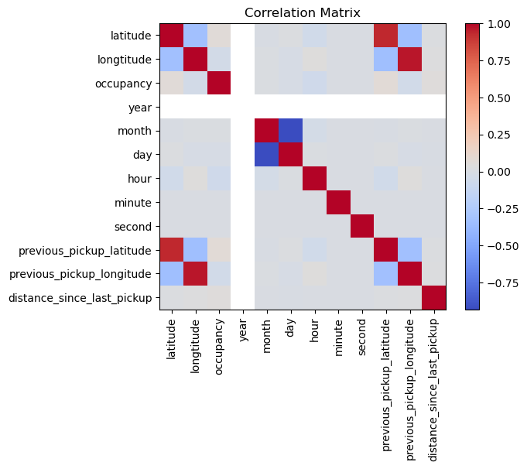
Feature Engineering

Slide 14
Predictor – Linear Regression
X = data[['occupancy', 'year', 'month', 'day', 'hour', 'minute', 'second', 'previous_pickup_latitude', 'previous_pickup_longitude', 'distance_since_last_pickup']]
y = data[['latitude', 'longtitude’]]
from sklearn.model_selection import train_test_split
from sklearn.linear_model import LinearRegression
# Initialize the linear regression model
model = LinearRegression()
X_train, X_test, y_train, y_test = train_test_split(X, y, test_size=0.2, random_state=42)
model.fit(X_train, y_train)
# Make predictions on the testing data
y_pred = model.predict(X_test)

Slide 15
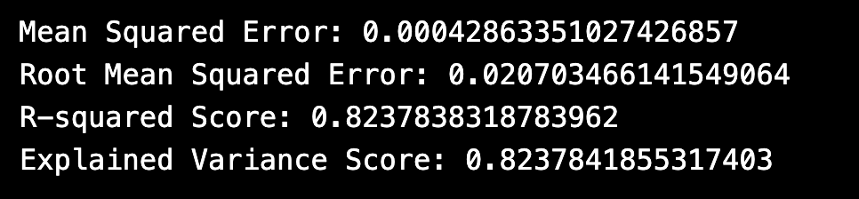
Evaluation Metrics
On average, the squared difference between the predicted values and the actual values is very small.
On average, the difference between the predicted values and the actual values is approximately 0.0207. Similar to the MSE, lower RMSE values indicate better model performance.
R-squared score = 0.8237838318783962. This means that approximately 82.4% of the variance in the dependent variable can be explained by the independent variables in the model.
The explained variance score = 0.8237841855317403, which is similar to the R-squared score. This means that approximately 82.4% of the variance in the dependent variable is explained by the model.

Slide 16
Data Science Challenge
For this data science challenge, you are provided with a dataset containing mobility traces of ~500 taxi cabs in San Francisco collected over ~30 days. The format of each mobility trace file is the following - each line contains [latitude, longitude, occupancy, time], e.g.: [37.75134 -122.39488 0 1213084687], where latitude and longitude are in decimal degrees, occupancy shows if a cab has a fare (1 = occupied, 0 = free) and time is in UNIX epoch format.
The goal of this data science challenge is twofold:
1. To calculate the potential for a yearly reduction in CO2 emissions, caused by the taxi cabs roaming without passengers. In your calculation please assume that the taxicab fleet is changing at the rate of 15% per month (from combustion engine-powered vehicles to electric vehicles). Assume also that the average passenger vehicle emits about 404 grams of CO2 per mile.
2. To build a predictor for taxi drivers, predicting the next place a passenger will hail a cab.
3. (Bonus question) Identify clusters of taxi cabs that you find being relevant from the taxi cab company point of view.

Slide 17
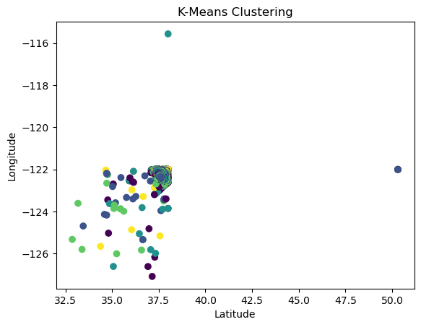
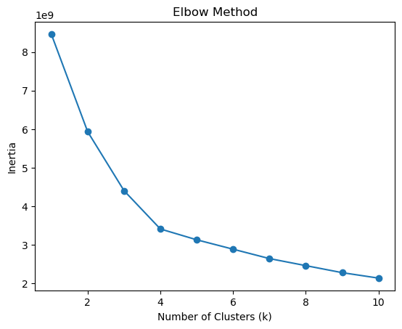
Bonus Question
K-Means Clustering:

Slide 18
Cluster Indentification

