Slide 1
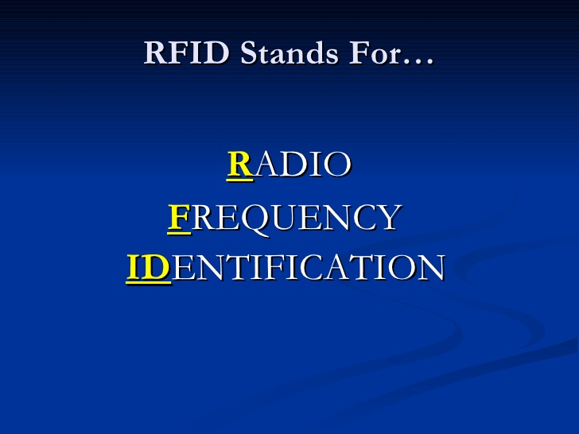

Slide 2
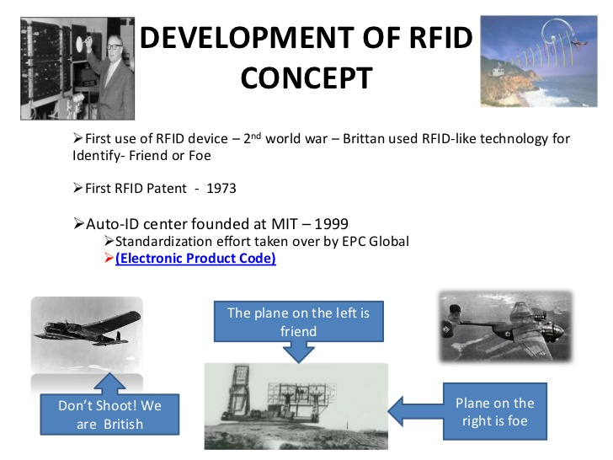

Slide 3
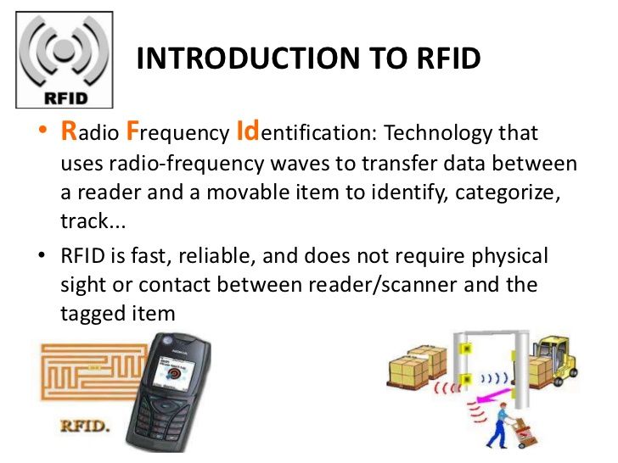

Slide 4
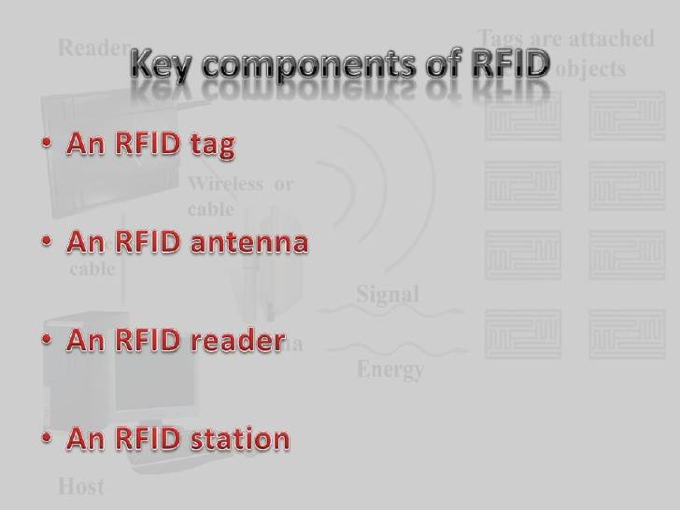

Slide 5
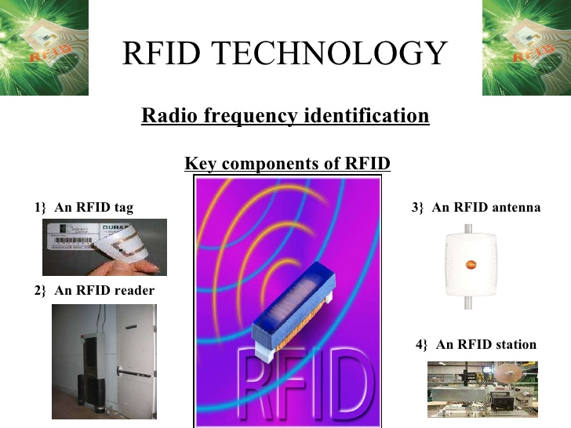

Slide 6
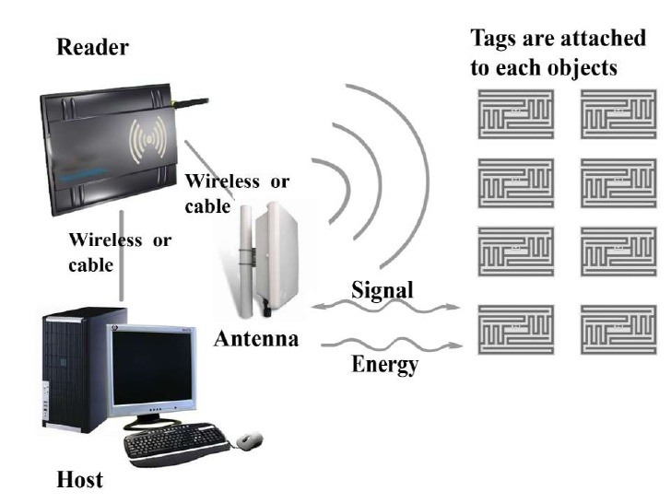

Slide 7
The system offers diverse frequency band ranging from low frequencies to microwave frequencies :
Low Frequency: 125-134 KHz
High Frequency: 13.56 MHz
Ultra High Frequency: 902-928 MHz Microwave Frequency: 2.4 GHz

Slide 8
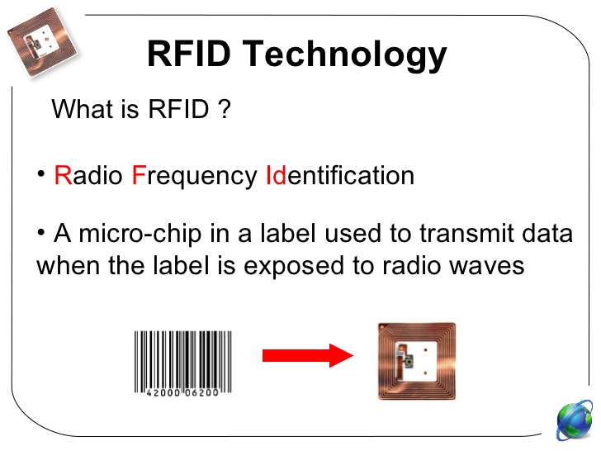

Slide 9
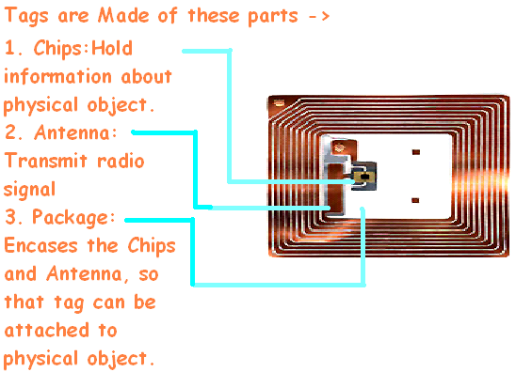
JNIT

Slide 10
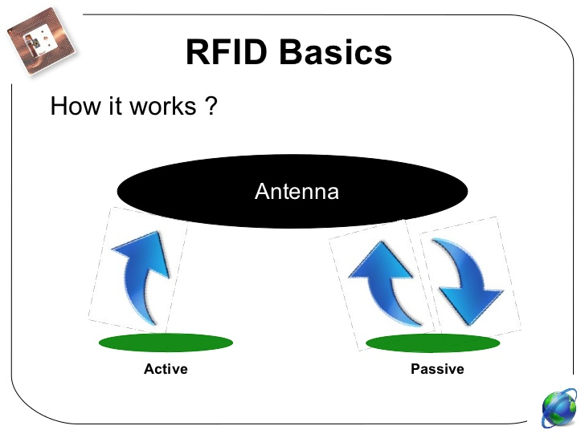

Slide 11
WORKING:
A passive RFID tag transmits information to the reader when it comes in the vicinity of electromagnetic field generated by the reader. The phenomenon is based on Faraday‟s law of electromagnetic induction. The current flowing through the coil of interrogator produces a magnetic field which links to the transponder coil thereby producing a current in the transponder coil.
The transponder coil then varies this current by changing the load on its antenna. This variation is actually the modulated signal (scheme is known as load modulation) which is received by the interrogator coil through mutual induction between the coils. The interrogator coil decodes this signal and passes to the computer for further processing.

Slide 12
Passive tags are comprised of three elements: an integrated circuit or chip, an antenna, and a substrate.
The RFID chip stores data and performs specific tasks. Depending on its design, the chip may be read-only (RO), write-once, read-many (WORM), or read-write (RW). Typically, RFID chips carry 96 bits of memory but can range from 2-1000 bits.
Attached to the chip is the antenna, whose purpose is to absorb radio-frequency (RF) waves from the reader’s signal and to send and receive data. Passive RFID tag performance is strongly dependent on the antenna’s size: the larger the antenna, the more energy it can collect and then send back out. Larger antennas, therefore, have higher read ranges (although not as high as those of active tags).
Antenna shape is also important to the performance of the tag. Low- and high-frequency (LF and HF, respectively) antennas are usually coils because these frequencies are predominantly magnetic in nature.
The third component of a passive RFID tag is called a substrate, which is commonly a Mylar or plastic film. Both the antenna and the chip are attached to the substrate.

Slide 13
Like passive RFID tags, active tags have both a microchip and an antenna. The chips, however, are usually larger in size and have greater capabilities than the RFID chips in passive tags.
Active tags have two additional components that differentiate them from passive tags: an on-board power supply and on-board electronics.
The power supply is usually a battery, although it can also be solar. The built-in power supply allows the tag to transmit data to a reader on its own, without the need to draw power from the reader itself like passive tags do. In addition, active tags can be read from distances of 100 feet or more, whereas passive tags can only be read from up to about 20 feet.
On-board electronics may consist of sensors, microprocessors, and input/output ports, all of which are powered by the tag’s on-board power source. The electronics allow active RFID tags to be used in a wider range of applications than passive tags. For example, perishable food products may be tagged with sensors that collect data that can then be used to determine expiration dates etc.

Slide 14
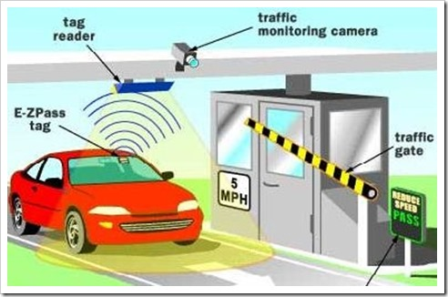

Slide 15
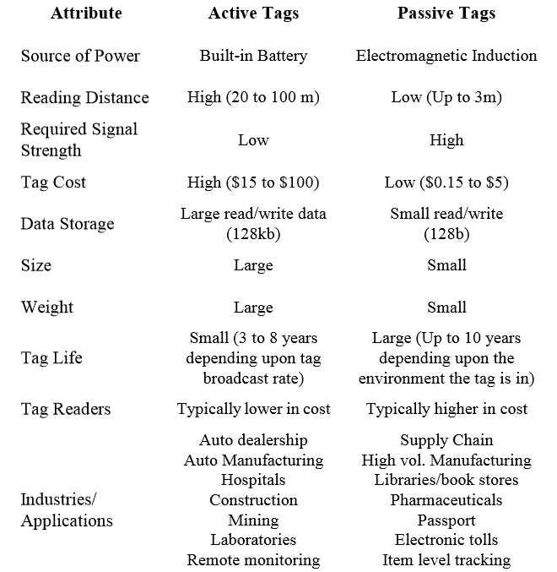

Slide 16
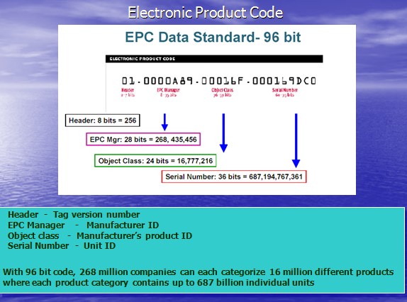

Slide 17
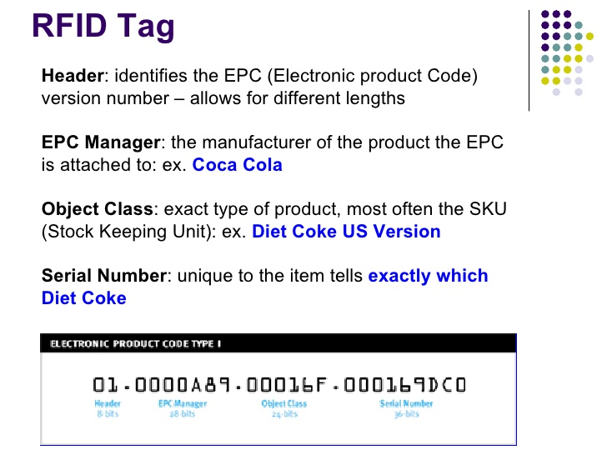

Slide 18
Data Coding and Modulation
Determines bandwidth, integrity, and tag power consumption
Limited by the power modulation / demodulation capabilities of the tag
Readers are generally low bandwidth, due to government regulations
Passive tags can use high bandwidth

Slide 19
Coding
Level Codes
Non-Return-to-Zero
Return-to-Zero
Transition Codes
Manchester
Miller

Slide 20
Coding Considerations
Code must maintain power to tag as much as possible
Code must not consume too much bandwidth
Code must permit the detection of collisions

Slide 21
Coding for Readers and Tags
Reader to Tag uses PPM or PWM (lower bandwidth)
Tag to Reader uses Manchester or NRZ (higher bandwidth)

Slide 22
Modulation
RF communications typically modulate high frequency carrier signal to transmit baseband code
Three classes of digital modulation are ASK, FSK, and PSK.
ASK most common in 13.56 MHz load modulation
PSK most common in 915 MHz backscatter modulation

Slide 23


Slide 24
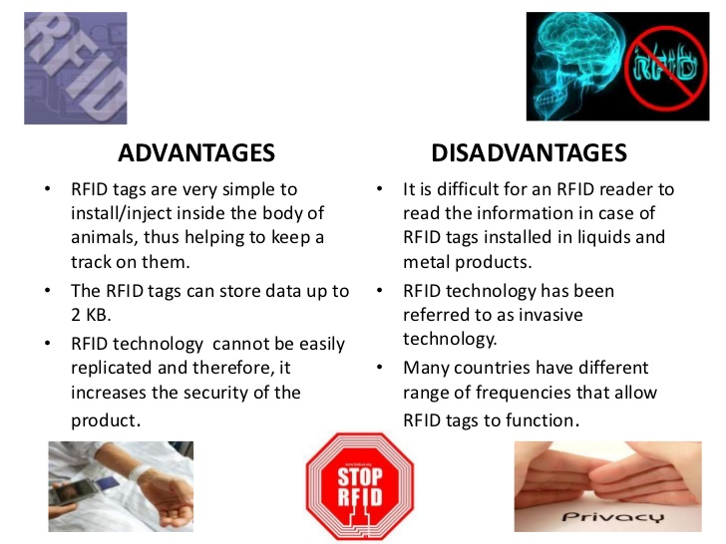

Slide 25
Interference TDMA time slots:tags Different Frequency bands:Readers Beacon frames:Readers

Slide 26
When multiple tags are in range of the reader:
All the tags will be excited at the same time.
Makes it very difficult to distinguish between the tags.
Collision avoidance mechanisms:
Probabilistic:
Tags return at random times.
Deterministic:
Reader searches for specific tags.
Multiple tags simultaneously respond to query ,Results in collision at the reader
Several approaches
Tree algorithm
Memoryless protocol
Contactless protocol
I-code protocol

Slide 27
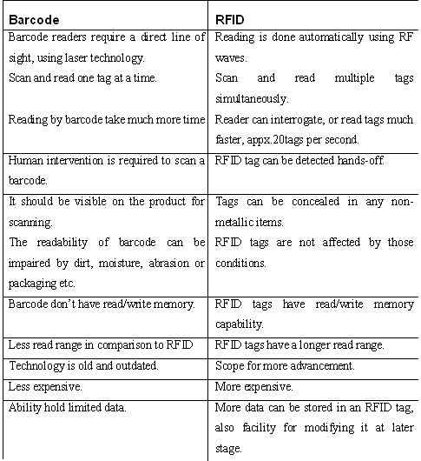

Slide 28
Example: RFID based attendance system?
Radio Frequency Identification based attendance system is an automatic attendance system which consists of a micro controller, RFID reader, RFID tag and a data base as its primary components.
RFID tag serves as a unique identification card for each student.
A student places his identification card in the proximity of RFID reader which detects the unique ID and student details present in the identification card.
Details of the students are stored in a data base.

Slide 29
BLOCK DIAGRAM
MICROCONTROLLER
RFID
READER
RFID
TAG
PC
DATA BASE

Slide 30
Generation of attendance reports daily / monthly / quarterly / annually.
Keeping records of late arrival, early departure and time summary.
Storage of complete attendance data.
Easy transmission of information from the RFID tag to central backend management systems.

Slide 31
Components:
1. MFRC-522 RC522 RFID RF IC card sensor module
2. RFID tags
3. Arduino UNO
4. Micro SD Card module and SD card.

Slide 32
Working principle
RFID – Radio Frequency Identification
The reader coil generates an electromagnetic field, which couples into the coil on the RFID tag (“transponder”).
The field generates a current in the transponder, which powers it, and also contains the transmitted data.

Slide 34
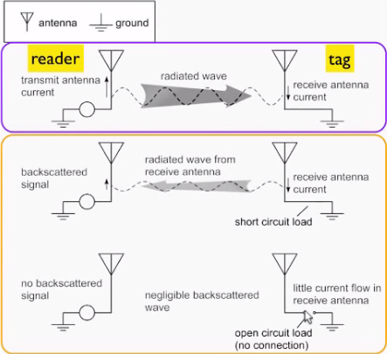
RFID
communication
The ‘reader’ sends a modulated carrier signal to the ‘tag’.

Slide 35
Tag extracts power and the transmitted message.
The induced current in the tag antenna causes a transmission itself.
This re-transmission can be used to send data back to the reader
This is done by modulating the tag antenna load via a switch (transistor). This modulates the current and with that the retransmitted wave.

Slide 36
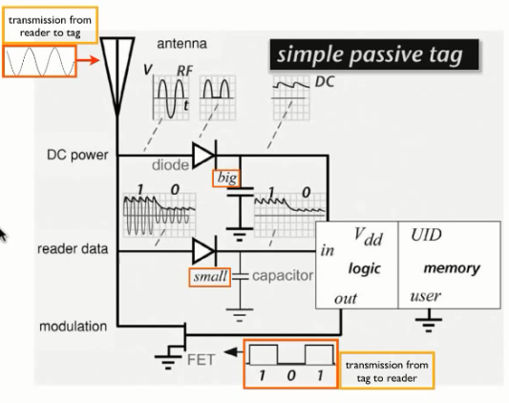
RFID Equivalent circuit model

Slide 37
The reader emits a carrier wave that is (amplitude) modulated with the transmitted data.
The tag has two circuits :
One circuit rectifies and smoothens the incoming stream as “DC power supply”
The other uses a shorter time constant (smaller capacitor) to achieve “envelope detection”- this yields a digital signal that can be interpreted by a processor.

Slide 38
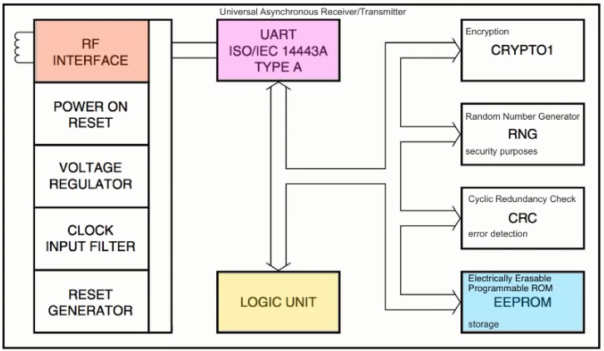
BLOCK DIAGRAM

