Slide 1
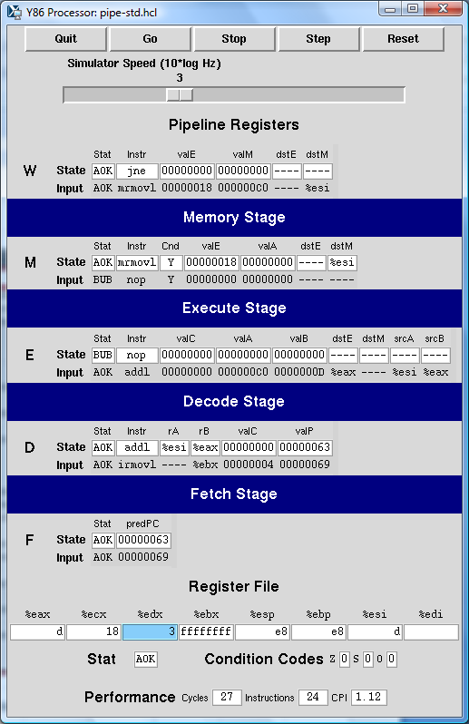
Controls
Pipeline
stages
Register
file
Status &
condition
codes
Performance
monitor

