Slide 1
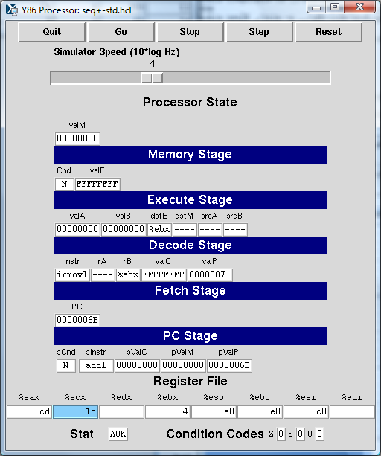
Controls
Stage
signals
Register
file
Condition
codes
Status

