Slide 1
偏振与角向分布

Slide 2
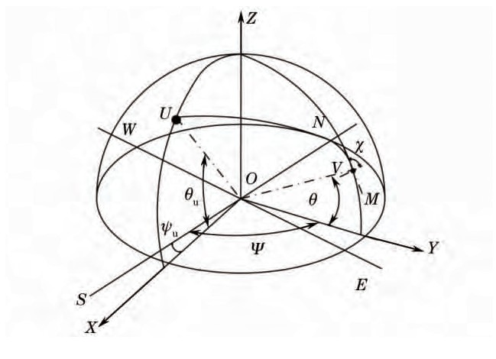
1.月光的偏振——方位建模
Rayleigh散射理论

Slide 3
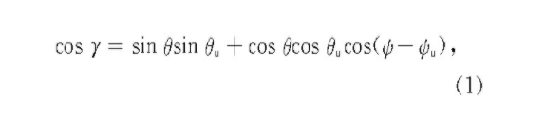



1.月光的偏振——方位建模
角度关系
偏振度
E矢量
偏振方位角

Slide 4
变量注释
O——观测者所在的位置
U——月亮
Z——天顶
OZ轴——观测者和天顶的连线
OV——观测方向
XOY平面——水平面
Θu——月亮的高度角
Ψu——月亮方位角即月亮的午圈与地平经圈之间的夹角
Θ——观测高度角
ψ——观测方位角
S、N、W、E——正南、正北、正西、正东
Χ——偏振方位角

Slide 5
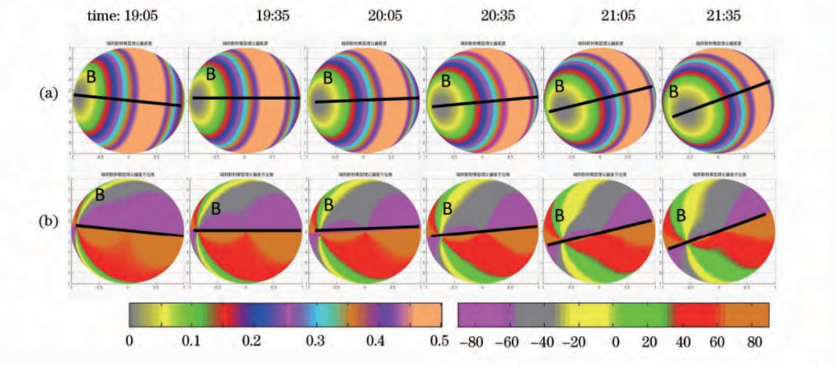
1.月光的偏振——仿真图像
满月月光理论偏振模式的连续变化图
(a) 理论偏振度连续变化图
(b) 理论偏振方位角连续变化图

Slide 6
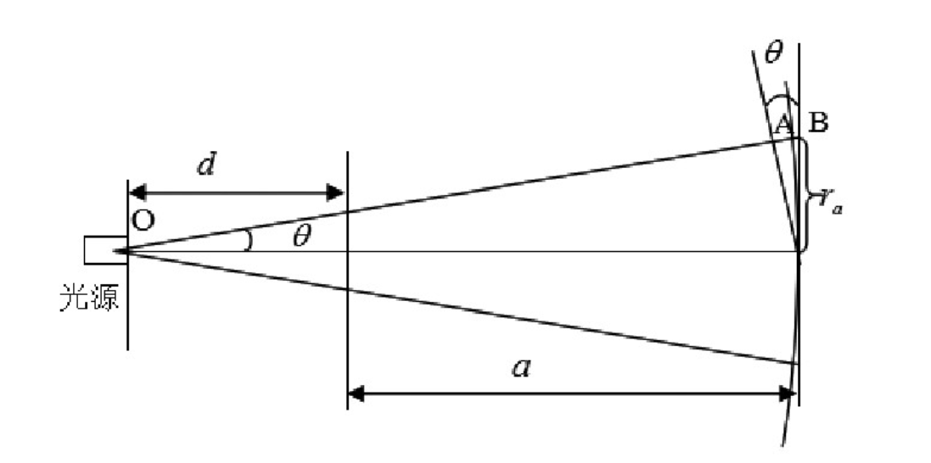
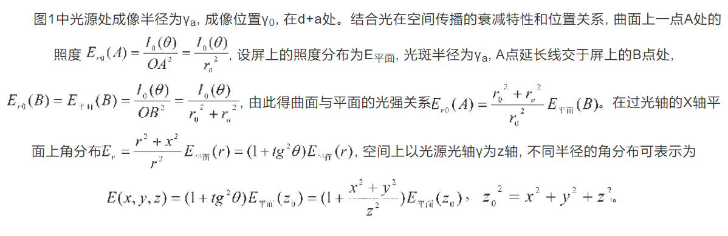
2.光强分布——测量方法

Slide 7
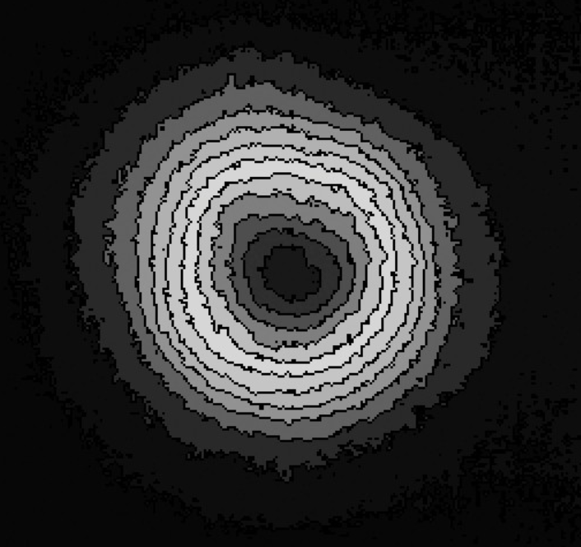
2.光强分布——测量结果

Slide 8
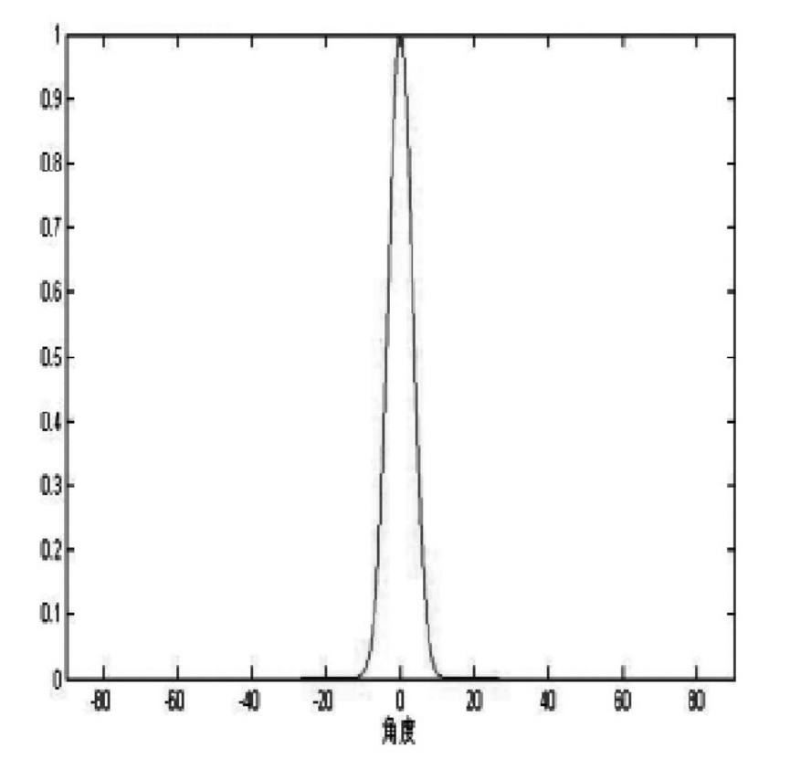
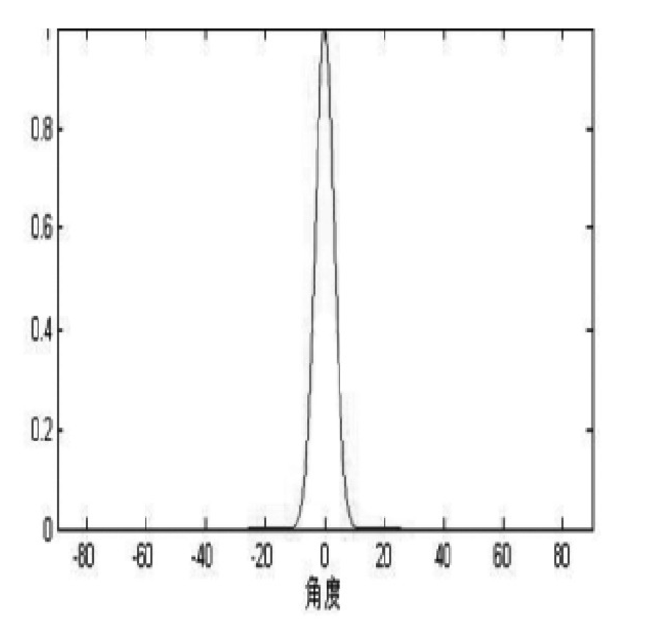
2.光强分布——测量结果
XoZ平面归一化光强分布
YoZ平面归一化光强分布

Slide 9
参考文献
[1]晴朗天气下满月偏振模式的研究https://kns.cnki.net/KXReader/Detail?invoice=On3hL9JYkJA8FlV1CS6A2s3mtpOHeHjDqBgouI65HGzjNIyT%2FzcJAoza1660q4Pr%2FILEMEgpISndNqlGT09J4gaCVCWtxgIzcvITEww6%2FL114QhfrQ25%2BzUww%2BkdJikrG3KxLrk0J%2FQ0E0FbekfcIgYdllSUO6BKcBh5ig2s0ig%3D&DBCODE=CJFD&FileName=GXXB201410022&TABLEName=cjfd2014&nonce=7386B3A3BD9243578C5B8790753B50F4&uid=&TIMESTAMP=1651911191213
[2]一体化LED光源角分布测量平台设计 https://kns.cnki.net/KXReader/Detail?invoice=D%2B3zbonui52EWKezI7%2Ff1umYdxxe8YkLIWpZhHfRfHWAGfHTVZ%2FBfUYLl19nnhYGnK4%2B4t0JXv2N%2FJeR%2FzIPOEpnfsHj1UYhJr9wnL9vQqm11zjQ9yTHhWjfMvwQCmsPMNaEzbMvUcrkwVi%2BnhgvXHaDb%2BGIqsoT55r5DKb4vb4%3D&DBCODE=CJFD&FileName=ZDHJ201702029&TABLEName=cjfdlast2017&nonce=7683CFD39DFF47D4ADC4009270F2010F&uid=&TIMESTAMP=1651913689670

Slide 10
Polarization and intensity distribution

Slide 11
1. Polarization of moonlight——Model
Rayleigh Scattering theory

Slide 12
1. Polarization of moonlight——Model
Angle relationship
The polarization degree
E vector
Azimuth of polarization

Slide 13
Variable annotation
O -- the position of the observer
U - the moon
Z - the zenith
OZ Axis - Line between observer and zenith
OV -- Direction of observation
XOY plane -- horizontal plane
θU -- Altitude Angle of the moon
ψU -- The azimuth of the moon （ Angle between the moon's meridian circle and its meridian circle ）
θ -- Observation altitude Angle
ψ -- Observed azimuth
S, N, W, E -- south, north, west, east
χ -- Polarization azimuth

Slide 14
1. Polarization of moonlight——The simulation image
Continuous variation of the theoretical polarization pattern of a full moon
(a) Diagram of continuous variation of theoretical degree of polarization
(b) Diagram of continuous variation of theoretical polarization azimuth

Slide 15
2. The light intensity distribution——Method of measurement

Slide 16
2. The light intensity distribution——The measured results

Slide 17
2. The light intensity distribution——The measured results
Normalized intensity distribution in XoZ plane
Normalized intensity distribution in YoZ plane

Slide 18
Reference
[1]晴朗天气下满月偏振模式的研究https://kns.cnki.net/KXReader/Detail?invoice=On3hL9JYkJA8FlV1CS6A2s3mtpOHeHjDqBgouI65HGzjNIyT%2FzcJAoza1660q4Pr%2FILEMEgpISndNqlGT09J4gaCVCWtxgIzcvITEww6%2FL114QhfrQ25%2BzUww%2BkdJikrG3KxLrk0J%2FQ0E0FbekfcIgYdllSUO6BKcBh5ig2s0ig%3D&DBCODE=CJFD&FileName=GXXB201410022&TABLEName=cjfd2014&nonce=7386B3A3BD9243578C5B8790753B50F4&uid=&TIMESTAMP=1651911191213
[2]一体化LED光源角分布测量平台设计 https://kns.cnki.net/KXReader/Detail?invoice=D%2B3zbonui52EWKezI7%2Ff1umYdxxe8YkLIWpZhHfRfHWAGfHTVZ%2FBfUYLl19nnhYGnK4%2B4t0JXv2N%2FJeR%2FzIPOEpnfsHj1UYhJr9wnL9vQqm11zjQ9yTHhWjfMvwQCmsPMNaEzbMvUcrkwVi%2BnhgvXHaDb%2BGIqsoT55r5DKb4vb4%3D&DBCODE=CJFD&FileName=ZDHJ201702029&TABLEName=cjfdlast2017&nonce=7683CFD39DFF47D4ADC4009270F2010F&uid=&TIMESTAMP=1651913689670

