Slide 1

Artificial Intelligence – TIN172 Project presentation
Group 20
Pierre BOUTRY, Dan DOLONIUS, Julien MICHELET, Emeric ROVERC'H
21/05/2014

Slide 2
Agenda
►
1. Presentation of the application
2. Grammar
3. Interpreter
4. Planner
5. Ambiguities handling
6. Possible improvements

Slide 3
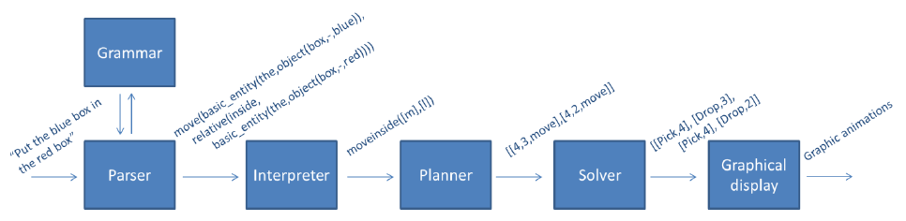
Presentation of the application
Simple client-server architecture
On client side: Collect of the query and graphical display
On server side: Parser, Interpreter, Planner, Solver

Slide 4
Agenda
1. Presentation of the application
►
2. Grammar
3. Interpreter
4. Planner
5. Ambiguities handling
6. Possible improvements

Slide 5
Grammar
One of the major improvements is the possibility for the user to ask 3 new types of questions containing the following keywords: where, what and count.
For example:
“where is the white big ball?”
“what are the objects in the world?”
“how many ball are in the world?”
The user can also perform request to obtain information about an entire stack.
“what are the objects in stack 2?”

Slide 6
Agenda
1. Presentation of the application
2. Grammar
►
3. Interpreter
3. 1 Interpretation rules
3. 2 Quantifiers
4. Planner
5. Ambiguities handling
6. Possible improvements

Slide 7

Interpreter – Interpretation rules (1/2)
We make a set of rules to recursively satisfy every node in the tree, e.g:
We implemented a set of 62 rules to:
Get object satisfying description.
Handle the, any, or all cases for basic entities.
Get object which satisfies relation to "object X".
Get object which satisfies relation to stack.
Process output to goal.

Slide 8

Interpreter – Interpretation rules (2/2)
Further, we have some rules to see if an object is e.g. beside any other object
We also added rules to support the new count, where and what questions.

Slide 9
Agenda
1. Presentation of the application
2. Grammar
►
3. Interpreter
3. 1 Interpretation rules
3. 2 Quantifiers
4. Planner
5. Ambiguities handling
6. Possible improvements

Slide 10



Interpreter - Quantifiers
The quantifiers allow the robot to handle query such has
“put any ball in the red box”.
The quantifier function uses cuts to choose one possible action
A cut (!) in prolog is a way to restrict the search by “fixing” the variables
Here is an example, we define:
and
For bar
For bas
For bac

Slide 11
Agenda
1. Presentation of the application
2. Grammar
3. Interpreter
►
4. Planner
5. Ambiguities handling
6. Possible improvements

Slide 12
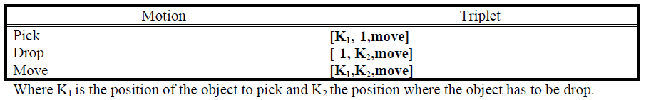
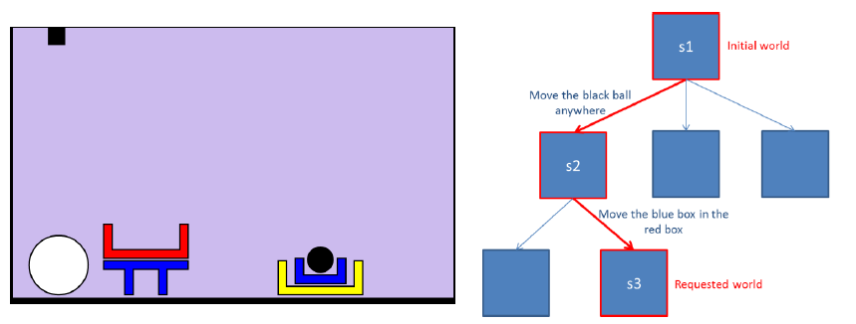
Planner
The planner takes a query as an input and build list of triplets
Here is an example for a complex case:
“Move the black ball in the red box”.
And the output of the planner is:
“Plan: pick,2 drop,1” where 2 is the position of the black ball (Stack 2) and 1 the position of the red box (Stack 1)

Slide 13
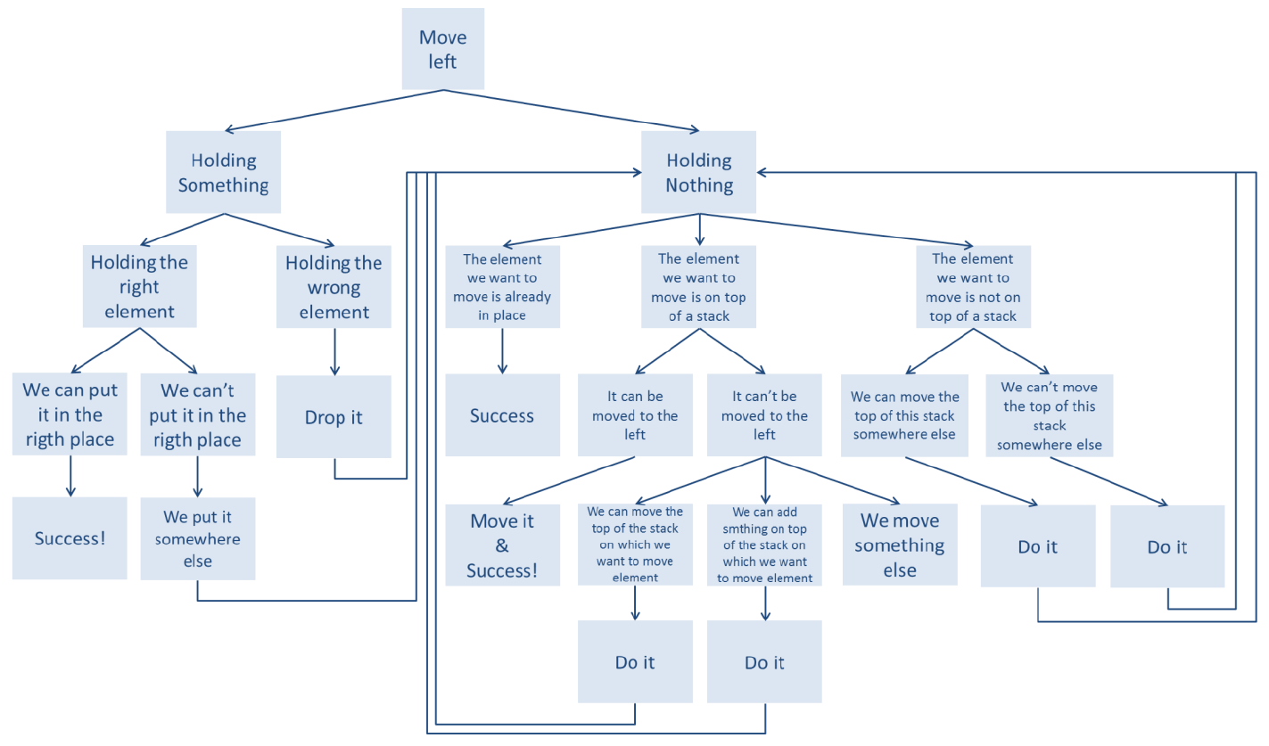
Planner - Heuristic
The heuristic allows the robot to handle complex cases in a smarter way
For example, in case of a move left query:

Slide 14
Agenda
1. Presentation of the application
2. Grammar
3. Interpreter
4. Planner
►
5. Ambiguities handling
6. Possible improvements

Slide 15
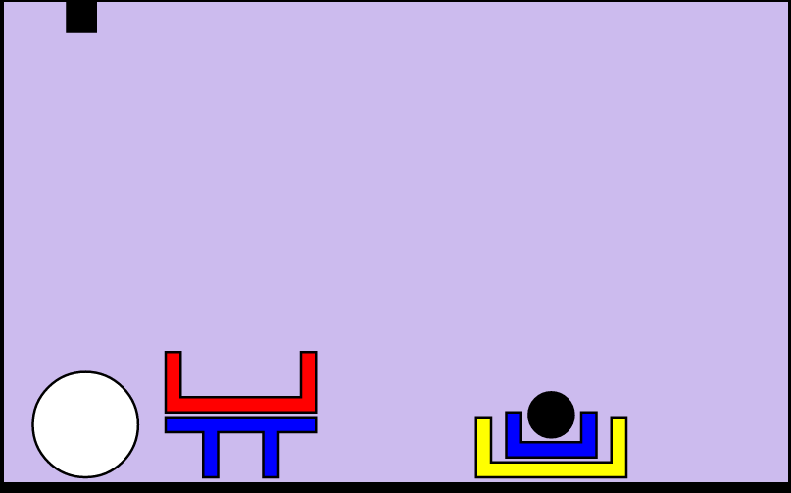
Ambiguities handling
Allows the robot to ask question if a query is not clear enough
For example, in the world below:
“what is under the box?”
The machine would ask for more information
“What object do you mean?”
The user will then have to specify his query
“The big red one”
We had to use a file to store the information needed and reload the prolog part

Slide 16
Agenda
1. Presentation of the application
2. Grammar
3. Interpreter
4. Planner
5. Ambiguities handling
►
6. Possible improvements

Slide 17
Possible improvements
Use machine learning for the heurisitc
Use of probabilistic planning for the heuristic
Use SAT (Boolean Satisfiability problem) to solve our problem

Slide 18

Questions

