Slide 1

Artificial Intelligence – TIN172 Project presentation
Group 20
Pierre BOUTRY, Dan DOLONIUS, Julien MICHELET, Emeric ROVERC'H
21/05/2014

Slide 2
Agenda
►
1. Presentation of the application
2. The world
3. Grammar
4. Interpreter
5. Planner
6. Ambiguities handling
7. Output

Slide 3
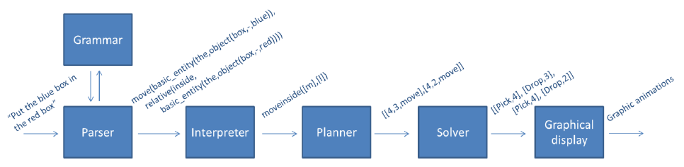
Presentation of the application
Simple client-server architecture
On server side: Parser, Interpreter, Planner, Solver
On client side: Collect of the query and graphical display

Slide 4
Agenda
1. Presentation of the application
►
2. The world
3. Grammar
4. Interpreter
5. Planner
6. Ambiguities handling
7. Output

Slide 5
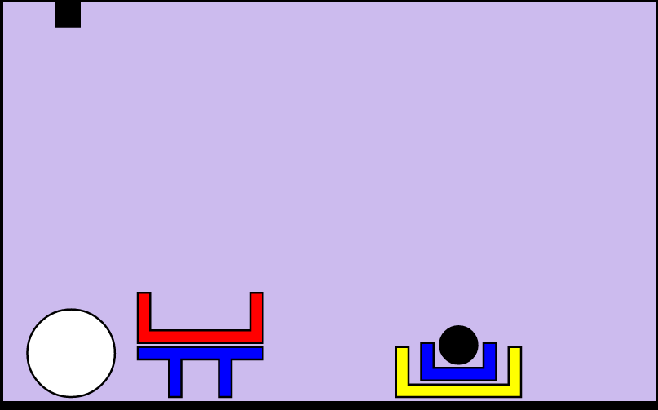
The world
The world can contain objects of different forms, colors and sizes:
Forms: bricks, planks, balls, pyramids, boxes, tables.
Colors: red, black, blue, green, yellow, white.
Sizes: large, medium, small.
The world is ruled by physical rules : e.g. it’s impossible to put an object on top of a ball.
Picture 1. Screenshot of the small world

Slide 6
Agenda
1. Presentation of the application
2. The world
►
3. Grammar
4. Interpreter
5. Planner
6. Ambiguities handling
7. Output

Slide 7
Grammar
One of the major improvements is the possibility for the user to ask 3 new types of questions containing the following keywords: where, what and count.
For example:
“where is the white big ball?”
“what are the object in the world?”
“how many ball are in the world?”
The user can also perform request to obtain information about an entire stack.
“what are the objects in stack 2?”

Slide 8
Agenda
1. Presentation of the application
2. The world
3. Grammar
►
4. Interpreter
4. 1 Interpretation rules
4. 2 Quantifiers
5. Planner
6. Ambiguities handling
7. Output

Slide 9

Interpreter – Interpretation rules (1/2)
We make a set of rules to recursively satisfy every node in the tree, e.g:
We implemented a set of 62 rules to:
Get object satisfying description.
Handle the, any or all cases.
Get object which satisfies relation to "object X".
Get object which satisfies relation to stack.
Process output to goal.

Slide 10

Interpreter – Interpretation rules (2/2)
Further, we have some rules to see if an object is e.g. beside any other object
We also added rules to support the new count, where and what questions.

Slide 11
Agenda
1. Presentation of the application
2. The world
3. Grammar
►
4. Interpreter
4. 1 Interpretation rules
4. 2 Quantifiers
5. Planner
6. Ambiguities handling
7. Output

Slide 12



Interpreter - Quantifiers
The quantifiers allow the robot to handle query such has
“put any ball in the red box”.
The quantifier function uses cuts to choose one possible action
A cut (!) in prolog is a way to restrict the search by “fixing” the variables
Here is an example, we define:
and
For bar
For bas
For bac

Slide 13
Agenda
1. Presentation of the application
2. The world
3. Grammar
4. Interpreter
►
5. Planner
6. Ambiguities handling
7. Output

Slide 14
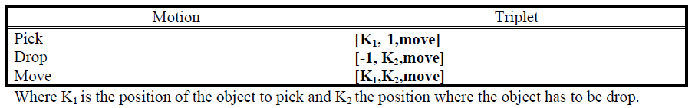
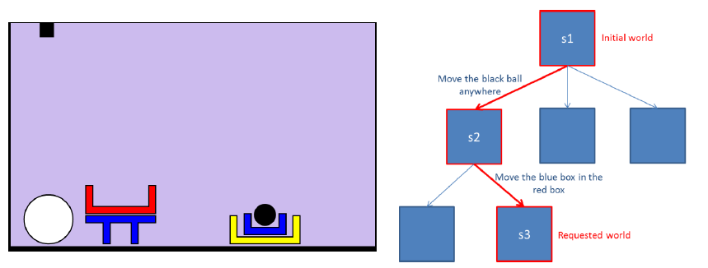
Planner
The planner takes a query as an input and build list of triplets
Here is an example for a complex case:
“Move the black ball in the red box”.
And the output of the planner is:
“Plan: pick,2 drop,1” where 2 is the position of the black ball (Stack 2) and 1 the position of the red box (Stack 1)

Slide 15
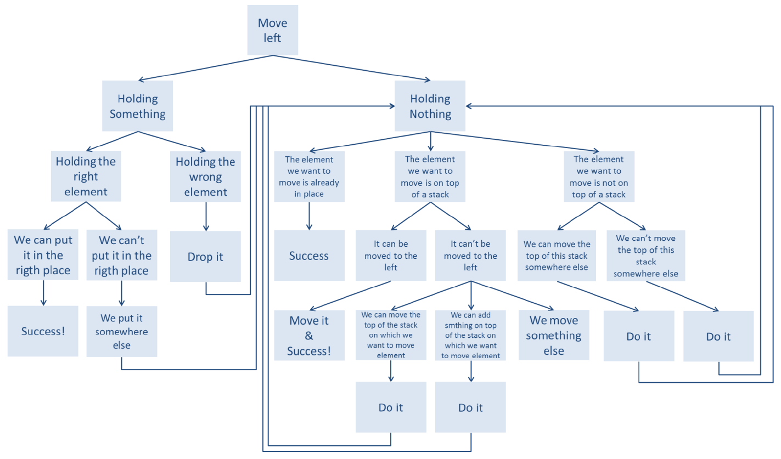
Planner - Heuristic
The heuristic allows the robot to handle complex cases in a smarter way
For example, in case of a move left query:

Slide 16
Agenda
1. Presentation of the application
2. The world
3. Grammar
4. Interpreter
5. Planner
►
6. Ambiguities handling
7. Output

Slide 17
Ambiguities handling
Allows the robot to ask question if a query is not clear enough
For example, in the world below:
“what is under the box?”
The machine would ask for more information
“What box ?”
The user will then have to specify his query
“The big red box”

Slide 18
Agenda
1. Presentation of the application
2. The world
3. Grammar
4. Interpreter
5. Planner
6. Ambiguities handling
►
7. Output

Slide 19
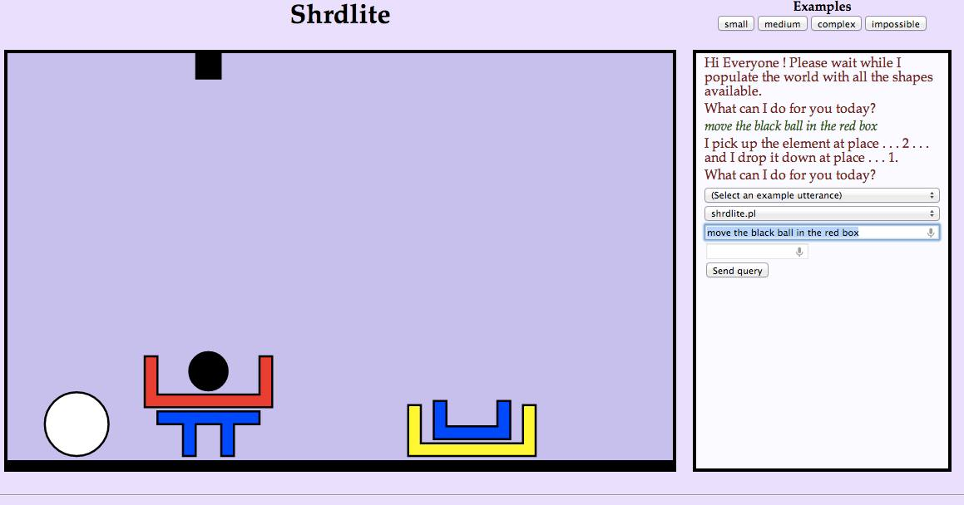
Output
The output is a web interface developed in HTML and Javascript.
All actions are represented with the SVG (Scalable Vector Graphics) library
The web client picks up results by means of an Ajax request

Slide 20

Questions

