Slide 1
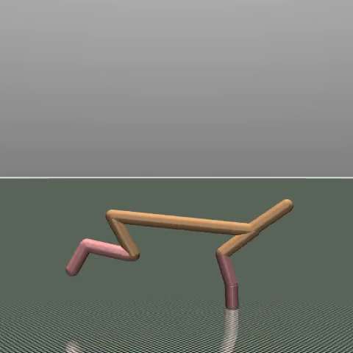
Implicit
Q-Learning
HalfCheetah-v5
Offline reinforcement learning proposal
Aleksandr Medvedev Nikita Shankin Leo Vesin
Ruslan Nasibullin Telman Nuruzov
1 / 8
Notes:
20 seconds. Suggested speaker: Aleksandr Medvedev.
Our project uses Implicit Q-Learning, or IQL, to learn continuous locomotion from recorded data. We will explain how the algorithm works, what HalfCheetah requires, and why this combination is suitable. The final slide shows measured feasibility evidence from our existing project.
Show: Introduce the title and team. Point to the actual HalfCheetah rollout image; hold briefly before advancing.
Sources:
https://github.com/MedvAx-AI/iql-halfcheetah
Image: actual project rollout, seed 1 at 500k, evaluation seed 10000, frame at 20 seconds. https://github.com/MedvAx-AI/iql-halfcheetah/releases/tag/policy-continuation-experiment

Slide 2
Offline data, learned values, continuous control
OFFLINE
Model-free actor-critic
Recorded data
IQL learner
Control policy
(s, a, r, next s)
Values + actor
6 continuous torques
Training: fixed transitions only
Simulator evaluation
Better recorded actions receive more weight
Full policy rollouts
2 / 8
Notes:
50 seconds. Suggested speaker: Leo Vesin.
IQL is offline, model-free actor-critic reinforcement learning. Training starts with a fixed dataset of observations, actions, rewards and next observations. The diagram separates learning from evaluation. IQL estimates values using recorded actions, then trains the actor to imitate stronger actions more heavily. It avoids explicitly maximizing the value backup over unseen actions. The simulator is used to evaluate the policy after training, rather than collect new training data. The policy produces six bounded torque controls at each step.
Show: Follow the upper diagram from recorded transitions to learner to policy. Point to the separate simulator evaluation path. Pause so the audience can follow the distinction.
Sources:
https://arxiv.org/abs/2110.06169
https://github.com/ikostrikov/implicit_q_learning

Slide 3
Three updates inside IQL
01
Value V
0.7
Favors stronger actions
Upper expectile
02
Twin critics
reward + 0.99 × V(next state)
Q1 and Q2
Bootstrap unless truly terminated
03
Actor
min(exp(3 × advantage), 100)
Weighted imitation
Advantage = min(target Q1, Q2) - V
Policy output: tanh-squashed Gaussian
3 / 8
Notes:
50 seconds. Suggested speaker: Leo Vesin.
The learner has three updates. First, the state-value network uses an upper expectile of zero point seven, emphasizing higher-valued recorded actions. Second, the twin Q networks fit reward plus discounted next-state value, with discount zero point nine nine. Third, the actor fits recorded actions using advantage weights: the exponential of three times advantage, capped at one hundred. Advantage is the minimum target-critic estimate minus the state value. Three is inverse temperature. A tanh-squashed Gaussian keeps the actor's outputs within the action bounds. The repeated updates improve the policy without changing the fixed dataset.
Show: Explain each update in order. Point to 0.7, 0.99 and the weight cap of 100. Read the equations in words and allow brief pauses.
Sources:
https://arxiv.org/abs/2110.06169
https://github.com/MedvAx-AI/iql-halfcheetah/blob/c372ec0423b81839956ec00dd7338700db8d3737/src/iql_project/iql.py
https://github.com/MedvAx-AI/iql-halfcheetah/blob/c372ec0423b81839956ec00dd7338700db8d3737/configs/halfcheetah.toml

Slide 4
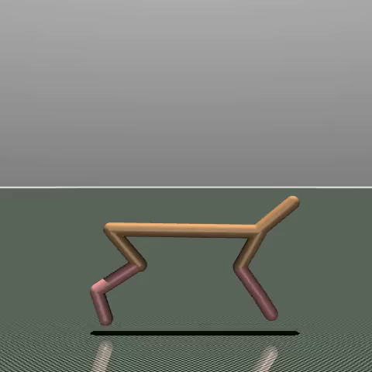
17 observations, 6 joint controls
6
17
joint torques
[-1, 1]
per joint
Absolute x excluded
2 legs × (thigh + shin + foot)
4 / 8
Notes:
65 seconds. Suggested speaker: Nikita Shankin.
HalfCheetah version five is a two-dimensional locomotion task in Gymnasium and MuJoCo. The robot has front and back legs. Its seventeen-value observation combines eight position or angle values with nine velocities. These describe the robot's pose and motion. Absolute horizontal position is excluded from the default observation. The action has six continuous torque components: thigh, shin and foot on each leg. Every component lies between minus one and one. The policy must use the current observation to coordinate these joints into a useful gait. The image comes from a real project rollout, while the color split shows the observation structure.
Show: Point to the actual robot, then trace the 8 plus 9 observation split. Explain the three joints on each of two legs and the action bound. Leave time for the audience to inspect the image.
Sources:
https://gymnasium.farama.org/environments/mujoco/half_cheetah/
Image: actual project rollout, seed 1 at 500k, evaluation seed 10000, frame at 0 seconds. https://github.com/MedvAx-AI/iql-halfcheetah/releases/tag/policy-continuation-experiment

Slide 5
Forward motion earns reward
Reward = forward velocity - 0.1 × sum(action²)
Illustrative step: six action components = 0.5
5.00
0.15
4.85
−
=
forward velocity
control cost
net reward
Goal: sustained, efficient forward motion
0
1,000 steps ≈ 50 seconds
A fall does not end the episode
5 / 8
Notes:
55 seconds. Suggested speaker: Nikita Shankin.
The default reward is forward velocity minus zero point one times squared control effort. The numerical example is illustrative: at five meters per second, six action components of zero point five produce a cost of zero point fifteen, so the reward is four point eight five. This encourages efficient forward motion. The agent should learn a gait that maintains speed throughout the episode. A fall does not terminate HalfCheetah. The time limit is one thousand steps, about fifty simulated seconds. A failed policy can remain on the ground until that limit. Time-limit truncation still preserves next-state value bootstrapping in our learning targets.
Show: Follow the numerical reward example from speed through effort cost to net reward. Trace the 0-to-50-second episode line. Emphasize that a fall does not end the episode.
Sources:
https://gymnasium.farama.org/environments/mujoco/half_cheetah/
https://github.com/MedvAx-AI/iql-halfcheetah/blob/c372ec0423b81839956ec00dd7338700db8d3737/src/iql_project/iql.py

Slide 6
A reproducible training and evaluation plan
1M
3
500k
transitions
training seeds
updates per seed
Minari medium dataset: 1,000 episodes. Batch size: 256.
Train
Select
Final test
Seeds 0, 1, 2
10 episodes / checkpoint
Separate episode seeds
Raw return + random baseline + full videos
Dataset-matched simulator: MuJoCo 3.2.3
6 / 8
Notes:
40 seconds. Suggested speaker: Ruslan Nasibullin.
We use Minari's HalfCheetah medium dataset: one million transitions from one thousand episodes. Our protocol trains three seeds for five hundred thousand offline updates each, with batches of two hundred fifty-six. We evaluate checkpoints over ten episodes, compare raw return with a random baseline, then test the selected checkpoint on separate final episode seeds. We retain full videos and separate episode variation from training-seed variation. MuJoCo three point two point three matches the recorded dataset runtime.
Show: Point to the large dataset and budget numbers, then follow the training-to-selection-to-final-test timeline. Distinguish training seeds from evaluation episode seeds.
Sources:
https://minari.farama.org/datasets/mujoco/halfcheetah/medium-v0/
https://github.com/MedvAx-AI/iql-halfcheetah/blob/c372ec0423b81839956ec00dd7338700db8d3737/docs/POLICY_CONTINUATION.md

Slide 7
Why this algorithm fits this task
Continuous torques
Continuous actor
Recorded locomotion
Offline learning
Returns + visible gait
Measurable evaluation
Challenges: data coverage, seed failures, physics differences
Multiple seeds, full episodes and pinned dependencies
Aleksandr: integration Nikita: data Leo: IQL
Ruslan: evaluation Telman: notebook and presentation
7 / 8
Notes:
60 seconds. Suggested speaker: Telman Nuruzov.
The match has three practical reasons. Continuous joint torques fit a continuous actor directly. Available offline locomotion data makes training feasible without a new data-collection stage. Finally, numerical returns and visible movement make evaluation understandable. IQL's advantage weighting can favor better recorded actions, but improvement is something to test, not assume. The main challenges are limited coverage, policy variation and simulator differences. We address them with multiple training seeds, pinned dependencies and full-episode evaluation. Aleksandr owns integration, Nikita the environment and data, Leo IQL, Ruslan evaluation, and Telman the notebook and presentation. Our shared outputs are a reproducible Colab, checkpoints, plots and complete rollouts.
Show: Follow the three algorithm-to-task matches. Explain the challenges along the bottom. Point to the team ownership line and name each personâ€™s contribution without reading all slide labels aloud.
Sources:
https://arxiv.org/abs/2110.06169
https://minari.farama.org/datasets/mujoco/halfcheetah/medium-v0/
https://gymnasium.farama.org/environments/mujoco/half_cheetah/

Slide 8
Learning progress and final test
15,260
final-test mean, 500k
vs 2,026 at 100k
10/10 → 0/10
episodes with long
stationary tails
Means only: 10 episodes per point. Colab, MuJoCo 3.2.3.
Final test: seed 1, 10 new episodes. Other training seeds still fail.
8 / 8
Notes:
50 seconds. Suggested speaker: Aleksandr Medvedev.
This chart shows recorded Colab validation means for all three training seeds at five measured checkpoints. Each point averages ten episodes. Performance varies across seeds, and the lines do not claim values between measurements. The selected seed-one policy reached a raw return of about fifteen thousand two hundred sixty on ten separate final-test episodes, compared with about two thousand twenty-six at one hundred thousand updates. Long stationary tails decreased from ten out of ten episodes to zero out of ten. Those tails mean at least five seconds of very slow movement at the end. Other training seeds still fail, and these samples do not guarantee success everywhere. The evidence supports feasibility while preserving the limits. Thank you.
Show: Trace all three measured curves. Point to the separate final-test return and stationary-tail counts. Say the other-seed limitation clearly, then pause on the closing slide.
Sources:
https://github.com/MedvAx-AI/iql-halfcheetah
https://github.com/MedvAx-AI/iql-halfcheetah/blob/c372ec0423b81839956ec00dd7338700db8d3737/docs/POLICY_CONTINUATION.md
https://github.com/MedvAx-AI/iql-halfcheetah/blob/aa9ad5baec910730502e1f24459325b5f273b952/docs/evidence/continuation/validation/summary.json
https://github.com/MedvAx-AI/iql-halfcheetah/blob/aa9ad5baec910730502e1f24459325b5f273b952/docs/evidence/continuation/independent-final-test.json
Long stationary tail: at least 5 seconds at the end with absolute forward velocity <= 0.1 m/s. Descriptive diagnostic, not a standard benchmark success score.

