Slide 1

Pyhton Course

Slide 2
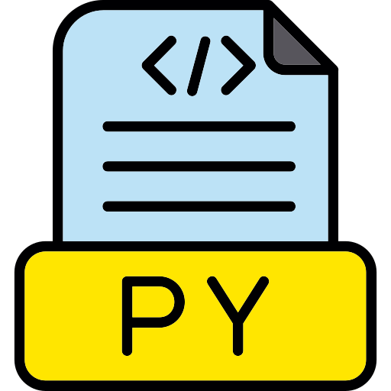
What is Pyhton?
Python is a most popular, high-level (a language that is understandable for humans) language, created by Guido van Rossum and released in 1991. It is interpreted programming language (a language that directly converts human-written code into machine code) that focuses on code readability. It is famous among programmers for its clear and simple syntax, which makes it easy to read and understand.

Slide 3

Python Syntax
Print
(“Hello World”)

Slide 4
Python Variables
Example
Rules
name = “Hala Ahmed"
print(my_box)
Output: Hala Ahmed
Python variable name:
Must start with a letter or the underscore character.
Cannot start with a number.
Can only contain alpha-numeric characters and underscores (A-z, 0-9, and _ ).
They are case-sensitive (name, Name, and NAME are three different variables).
The reserved words (keywords) in Python cannot be used to name the variable in Python.
age = 14
print(age)
Output: 14
my_message = "Hello, " + "World!"
print(my_message)
Output: Hello, world!

Slide 5
Python Keywords
False | await | else | from | with
pass | None | import | nonlocal | async
except | break | True | while | elif
in | raise | class | assert | if
finally | return | and | del | yield
continue | for | lambda | global | Or
try | as | def | not | is

Slide 6





Python Datatypes
name = ‘Salam’
String
names = [“Ali”, “Hana”, “Lama”]
List
age = 12
names = (“Ali”, “Hana”, “Lama”)
Integer
Tuple
hight = 1.4
Float
Dict
person = {"name": "Bob", "age": 12}
Is_it_girl = True
ages = {14, 12, 13, 11}
Boolean
Set

Slide 7
Python Operators
Arithmetic operators
Assignment operators
Comparison operators
y = 12
y += 4
23 > 7
True
10+ 20=30
12 – 4 =8
y *= 11
y /= 5
23 < 7
False
13/4 =3.25
3 * 4 = 12
23 >= 7
True
Identity Operator
13 // 4 = 3
3 ** 2 = 9
23 <= 23
True
a = 5 ls1=[1,2,3]
b = 5 ls2=[1,2,3]
ls3 = ls1
23 == 7
False
age = [12, 13, 14, 15]
Membership operators
23 != 7
True
a is b
True
ls1 is ls2
False
13 in age
True
a is not b
False
True
ls1 is not ls2
True
18 not in age
ls3 is ls1
True

Slide 8
Python Operators
Logical operators
A | B | A and B
True | True | True
True | False | False
False | True | False
False | False | False
A | B | A or B
True | True | True
True | False | False
False | True | False
False | False | False
Logical operators
5<2 and 5>3
False
5<2 or 5>3
True
not 5>3
True

Slide 9

Python Control Flow
Conditional Statements:
age = 12
if age >= 13:
print("You can join the teen club!")
else:
print("Sorry, you need to be older to join.")
age = 12
if age >= 13:
print("You can join the teen club!")
elif age <= 18:
print("Sorry, you need to be younger to join.!")
else:
print("Sorry, you need to be older to join.")

Slide 10

Python Control Flow
Loop
For loop:
for i in range(5):
print("Hello!")
while loop:
count = 0
while count < 5:
print("Hello!")
count += 1

Slide 11
Function
Block of code that performs a specific task.
def sum_values(a,b,c):
sum_vals = a+b+c
return sum_vals
result = sum_values(2,5,3)
print(result)
Function

Slide 12
Modules
Modules are files containing Python code that can be imported into other programs.
\
from math import sqrt
print(sqrt(16))
Output: 4
Modules

Slide 13

Thank You

