Slide 1
Dmitry Pesegov
take-home assignment

Slide 2
Introduction
Objective: help Wolt's marketing team to reactivate different kinds of users using a customer segmentation.
Dataset: User data from September 2020 to October 2021.
For the convenience of the marketing team, it was decided to focus on the RFM approach, since this result will be conveniently interpreted by stakeholders.
Recency (R): when was the last time the customer purchased?
Frequency (F): how often the customer purchases?
Monetary (M): how much the customer spent with us?
Made 3 bins for each of R, F, M. That give us total of 3* 3* 3=27 segments.
Some segments are more critical to focus on than others, especially when the goal is to reactivate customers and maximize value.
Best Customers (R3F3M3)
At Risk (R2F2M3)
Hibernating (R1F3M3)

Slide 3
Anomalies and interesting findings
Strange emptiness in the data
Most of the emptiness is caused by logic behind PURCHASE_COUNT=0. That is all cases when user registered, but didn't make any purchase.
But still with PURCHASE_COUNT>0 we have some NaN's in some fields for users:
FIRST_PURCHASE_DAY - very strange (we didn't write the date of first purchase made)
LAST_PURCHASE_DAY - very strange (we didn't write the date of any of purchase made)
PREFERRED_DEVICE - very strange (do we have purchasing customers without devices?)
PREFERRED_RESTAURANT_TYPES - may be ok if user didn't try delivery from restaurants for example
AVG_DAYS_BETWEEN_PURCHASES - may be ok if no second purchase made
MEDIAN_DAYS_BETWEEN_PURCHASES - may be ok if no second purchase made
 | users | of_all_users_%
FIRST_PURCHASE_DAY | 80 | 0.363918
LAST_PURCHASE_DAY | 19 | 0.08643
PREFERRED_DEVICE | 1 | 0.004549
PREFERRED_RESTAURANT_TYPES | 9362 | 42.587454
AVG_DAYS_BETWEEN_PURCHASES | 4196 | 19.087477
MEDIAN_DAYS_BETWEEN_PURCHASES | 4196 | 19.087477

Slide 4
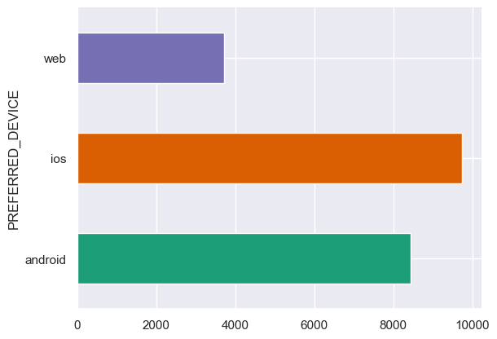
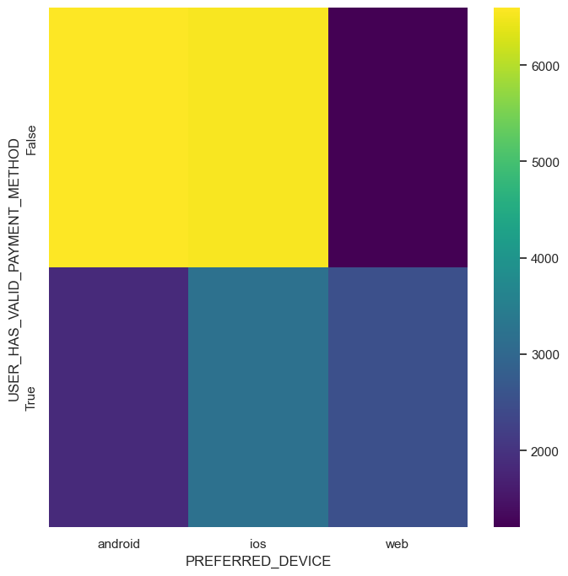
Anomalies and interesting findings
2. Most of possible problems with "no valid payment method" came from Android and IOS
But they are the most popular platforms... would be great to fix it

Slide 5
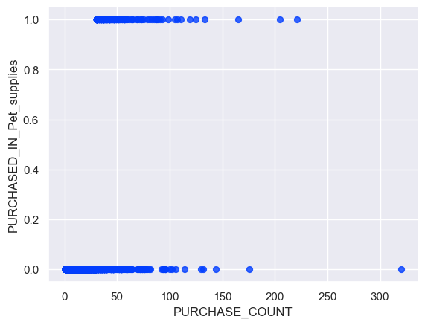
Anomalies and interesting findings
3. Purchases from "pet suppliers" only happens in conjunction with something. Never by itself.

Slide 6
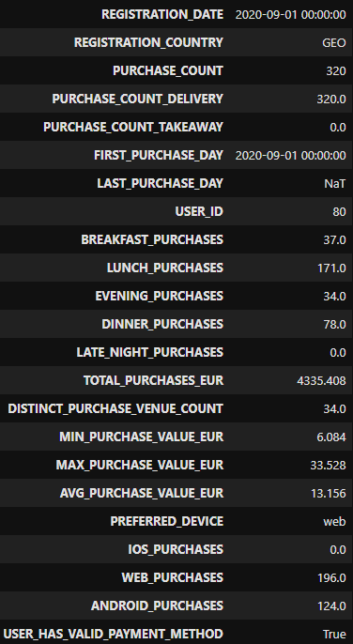
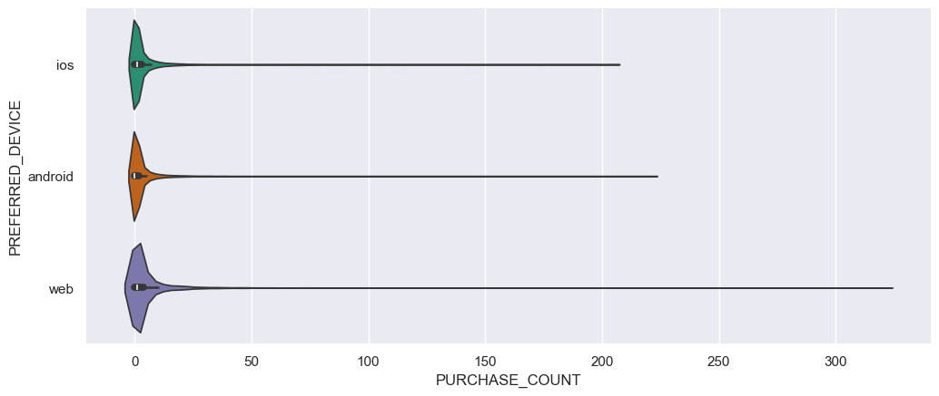
Anomalies and interesting findings
4. Abnormally large orders were placed via WEB. Georgia.

Slide 7
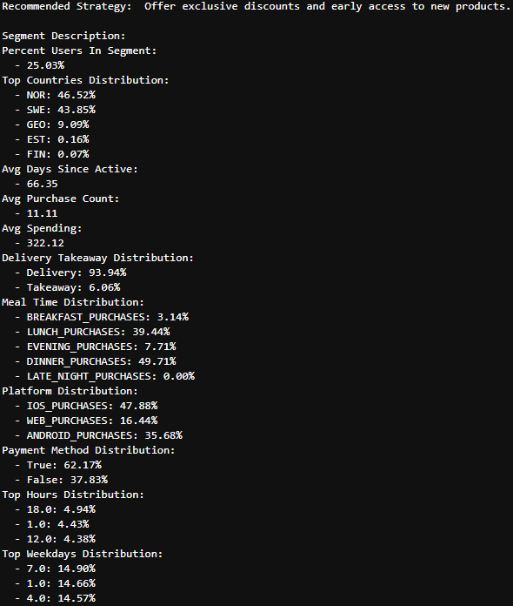
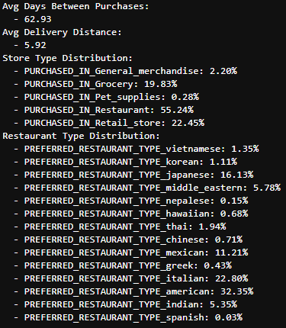
Example of RFM segment: Best Customers (R3F3M3)
For each such a segment with RFM score, easily utilisable by marketing, we have extracted supportive descriptive information and made visualizations.

Slide 8
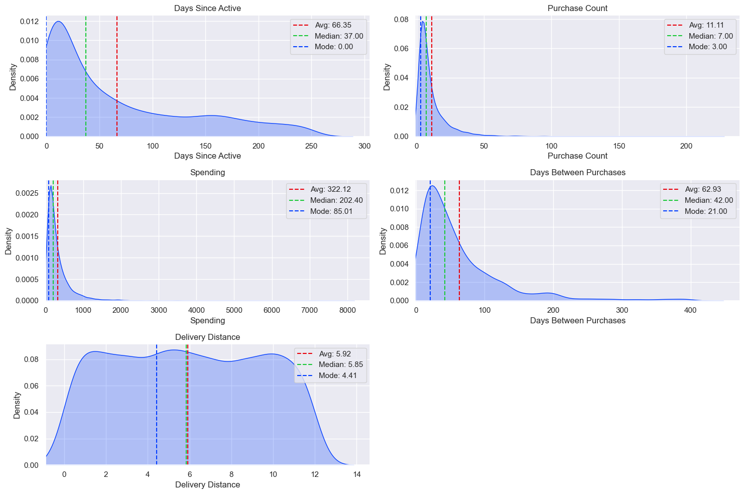
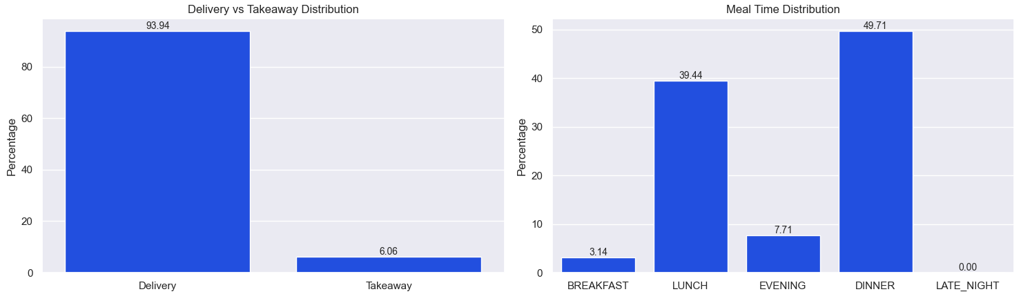
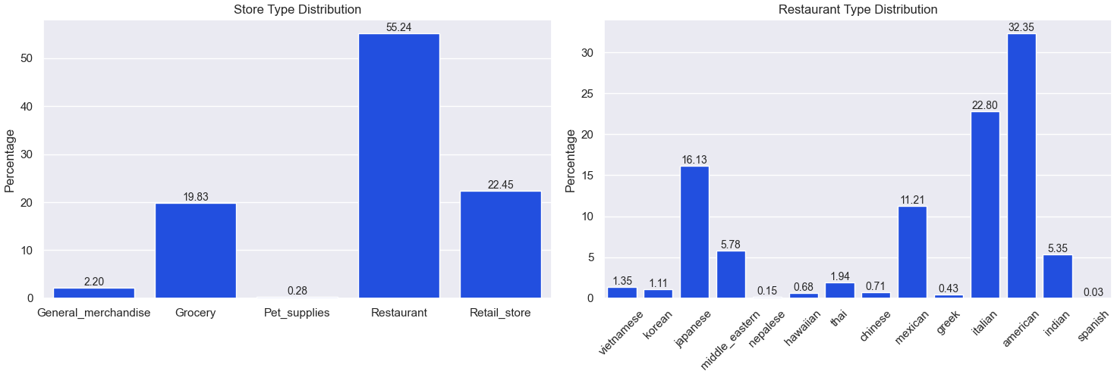
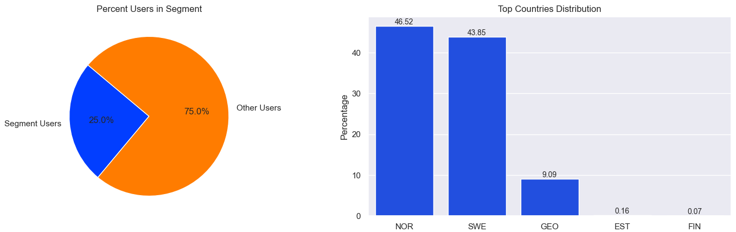
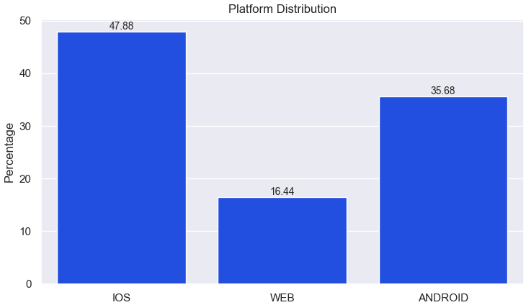
Example of RFM segment: Best Customers (R3F3M3)

Slide 9
Thank you for your attention!

