Slide 1
GOOD GOVERNANCE LEADS TO FLOURISHING OF SOCIETY AND NATION

Slide 2
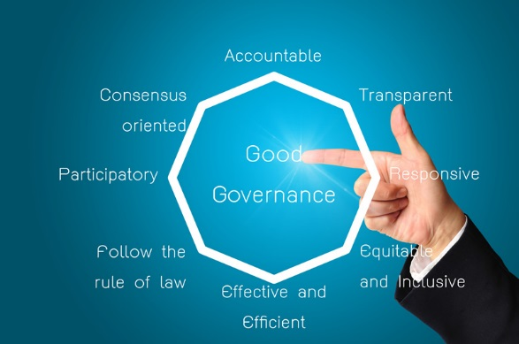

Slide 3
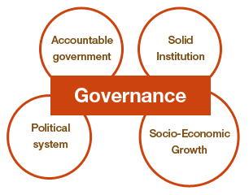

Slide 4
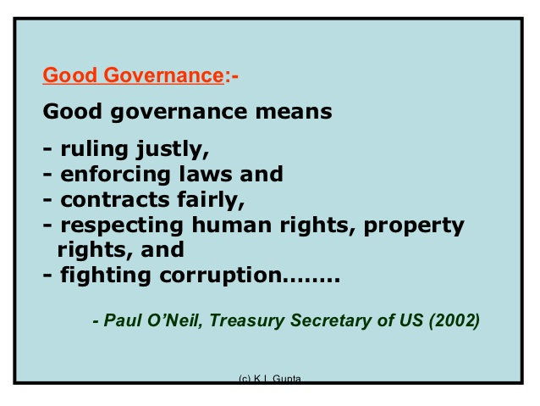

Slide 5

JUSTICE
CORRECTNESS confirming to reality or rules.
The ideal of FAIRNESS, IMPARTIALITY etc., especially with regard to the punishment of wrong doing.

Slide 6
WHY WE DO SO ?
“’We build the toilets when we see our family sitting out in farms !!!!!”, else who cares ? The ones with the technical brains laugh and the ones with same mind envies !!!!
Situation in our country is the same as per human nature and we keep popping up ourselves with our cultures and traditions.

Slide 7
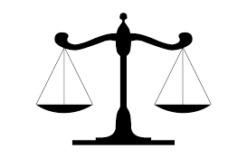
EQUALITY
Equality in plain language is the state or quality of being equal. It includes equality before law, prohibition of discrimination on grounds of religion, race, caste, gender or place of birth, and equality of opportunity in matters of employment, abolition of untouchability and abolition of titles.

Slide 8
Right to equality is the principal foundation of all the other rights and liberties provided in the Indian Constitution.
It guarantees the following:
Equality before law.
Social equality and equal access to public areas.
Equality in matters of public employment.
Abolition of untouchability.
Abolition of titles.

Slide 9
EMPLOYMENT FOR GOOD GOVERNANCE
THE NATION HAS BEEN INDEPENDENT OF THE BRITISH EMPIRE FOR OVER 68 YEARS, YET THERE IS STILL A MAJORITY OF THE POPULATION WHICH IS DYING OF INADEQUATE MEANS OF EMPLOYMENT.
THIS PROBLEM CAN ONLY BE SOLVED IF THE GOVERNMENT STARTS TO WORK AT GRASSROOT LEVEL.

Slide 10
HOW?
THE BASIC PLANNING SHOULD BE REVISED EVERY YEAR TO KEEP UP WITH THE CHANGES IN THE ECONOMIC STATUS ACROSS THE NATION.
EFFICIENCY OF RURAL EMPLOYMENT(NREGA), SHOULD BE IN PROGRESSION.
FLEXIBILITY IN PUBLIC SECTOR EMPLOYMENT CAN PLAY AN IMPORTANT ROLE.

Slide 11
ROLE OF GOOD GOVERNANCE
THE GOVERNMENT CAN BE CONSIDERED EFFICIENT ONLY IF IT IS CAPABLE TO KEEP NATIONAL EMPLOYMENT RATIO STEADY.
EFFICIENCY REFLECTS IN ITS GDP.
SATISFACTION IN EMPLOYED POPULATION RESULTS IN REINSTATEMENT OF GOVERNMENT IN THE FUTURE.

Slide 12
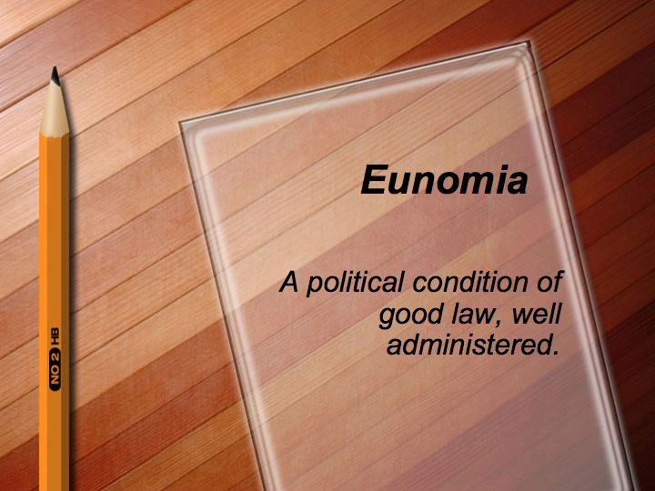

Slide 13
Promoting good governance and fostering an active and independent civil society
Engility defines good governance as the process—inclusive, participatory, transparent, and accountable—in which decisions are made in a democratic society.
Our experts apply good governance practices to all of our technical work, but particularly in clean energy, climate change, food security, and natural resource management programming. Engility brings a politically attentive, conflict-sensitive, and cross-sectoral approach to its democratic governance and civic empowerment programming. Engility fosters local partnerships with national and subnational government bodies, civil society organizations, and the private sector to harness synergies to maximize impact of intended development outcomes.

Slide 14
Democratic Governance
Democratic governance is an inclusive, participatory process that promotes transparent, accountable, equitable, and effective use of power to develop and implement public policies. Our approach is based on good governance principles; it considers both the larger political economy surrounding a particular governance program intervention as well as the nuts and bolts of the governance processes that require reform. Through this in-depth understanding of a society’s political culture and attendant practices, Engility continuously looks for opportunities to support home-grown reform efforts through transparent support for these stakeholders.
Civil Society Development
Societies with organized, active, and open non-governmental organizations (NGOs) and civil society groups (CSGs) contribute greatly to the quality of a nation’s democratic governance. Engility offers expertise in local partner capacity building, organizational development, research, advocacy, and oversight skills training. Engility has worked to empower a range of NGOs/CSGs, media organizations, and community groups in providing services to the public that government is unable or unwilling to provide.
Rule of Law
Adherence to the rule of law is fundamental for good governance to flourish in any society. Respect for a nation’s constitution and its body of laws leads to the effective protection of human rights. We support processes and POLICY AND GOVERNANCE Use of USAID imagery does not imply endorsement by USAID. practices that hold every individual, private enterprise, and the government accountable to publically promulgated laws enforced and independently adjudicated through equitable justice systems.

Slide 15
Why education is extremely important?
. Keeping up with the world
. Education and healthcare
. Respect
. Makes the world a safer and more peaceful place
. Makes you confident
. Society
. For economic growth of the nation
. Saves you from being fooled/cheated
. Makes you self dependent
. Equality

Slide 16
Present scenario of Indian Education
1. The poor kids are been given bags, shoes, dress, shoes, free textbooks.
2. government is providing free education particularly to girls.
3. bright students are been given yearly scholarship.
4. municipal schools are also supporting government by not charging any fees grow and to increase their memory.
5.The curriculum has already included the improvements
like “balanced textbooks” and they try to make it more interactive.
8. Lots of programs is been conducted to help students to grow mentally and specially for girls.

Slide 17
Freedom
What does freedom mean ?
The state of being free or at liberty rather than in confinement or under physical or mental restraint
Or in simple words exemption from external control interference regulation etc.

Slide 18
Freedom of expression
When there is brainstorming on a subject development program country, freedom of speech paves way for many option from which the best can be opted for.
Freedom in action
Implementation of all the welfare scheme requires freedom in action though checklist and standard operating procedures can be defined for.
Freedom of Measurement
During the implementation of the process after partial go through the success or the failure of the scheme is measured

Slide 19
SOLIDARITY
To work in solidarity for the protection of human dignity is the basis of GOOD GOVERNANCE.
Good governance entails the just use o f power to create conditions for unity and trust and to inspire in the governed the desire to contribute to the common good.
Respect for the dignity of the person requires all persons to live in truth and in the exercise of solidarity directly resisting corruption.
SOLIDARITY is the key building block of good governance and is the unified commitment of persons to work in trust towards the common good, fostering a sense of community.
Corruption undermines commitment and solidarity by corroding trust and hope.

Slide 20
TANZANIAN GOVERNMENT
The Government Tanzania officially the United republic of Tanzania is a country in East Africa. Tanzania is the largest country in East Africa, includes the spice islands of Zanzibar, Pemba, and Mafia and contains Africa’s highest point-Kilimanjaro, at 5,895 meters.
It constitutes the Judiciary(decision making body),the Legislature(law making body) and the Executive(the actors of governance).

Slide 21
GOOD GOVERNANCE
Governance is the process of decision making and the procedure by which the decisions are implemented.
Good governance has 8 major characteristics. It is participatory, consensus oriented, accountable, transparent, responsive, effective and efficient, equitable and inclusive and follows the rule of law. It assures that corruption is minimized, the views of minorities are taken into account and that the voices of the most vulnerable in society are heard in decision-making. It is also responsive to the present and future needs of society.

Slide 22

TRANSPARENCY
TRANSPARENCY means making all financial and public information available to the public in an easily accessible manner.
It thus allows us i.e taxpayers to see clearly how public servants are spending tax money, and gives citizens the ability to hold their elected officials accountable.

Slide 23
Transparency adds clarity and accountability to a system, that left unchecked, is prone to corruption.
Thus transparency is also a measure tofight corruption.

Slide 24
CONCLUSION
IS GOOD GOVERNANCE IS NEW TO US?
It is only the ability of a person to differentiate between right and wrong , just and unjust , fair and foul and moral and immoral
It is very difficult to define good governance unless the key components are related between every individual of society ,which includes rule of law, accountability, transparency , equity , respect for human rights and dignity.

