Slide 1
Java Script
Functions

Slide 2
JavaScript - Functions
A function is a group of reusable code which can be called anywhere in your program. This eliminates the need of writing the same code again and again. It helps programmers in writing modular codes. Functions allow a programmer to divide a big program into a number of small and manageable functions.
Function Definition
Before we use a function, we need to define it. The most common way to define a function in JavaScript is by using the function keyword, followed by a unique function name, a list of parameters (that might be empty), and a statement block surrounded by curly braces.

Slide 3
Syntax:
<script type="text/javascript">
function functionname(parameter-list)
{
statements
}
</script>
Example:
<script type="text/javascript">
function sayHello()
{
alert("Hello there");
}
</script>

Slide 4
Calling a Function:
<html>
<head>
<script type="text/javascript">
function sayHello()
{
document.write ("Hello there!");
}
</script>
</head>
<body>
<p>Click the following button to call the function</p>
<form>
<input type="button" onclick="sayHello()" value="Say Hello">
</form>
<p>Use different text in write method and then try...</p>
</body>
</html>

Slide 5
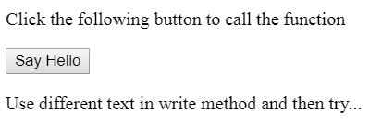

OUTPUT:
Click on Say Hello button

Slide 6
Function Parameters
Till now, we have seen functions without parameters. But there is a facility to pass different parameters while calling a function.
These passed parameters can be captured inside the function and any manipulation can be done over those parameters.
A function can take multiple parameters separated by comma.

Slide 7
Example:
<html>
<head>
<script type="text/javascript">
function sayHello(name, age)
{
document.write (name + " is " + age + " years old.");
}
</script>
</head>
<body>
<p>Click the following button to call the function</p>
<form>
<input type="button" onclick="sayHello('Zara', 7)" value="Say Hello">
</form>
<p>Use different parameters inside the function and then try...</p>
</body>
</html>

Slide 8
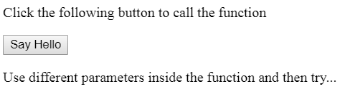
OUTPUT:
Click on Say Hello button
Zara is 7 years old.

Slide 9
The return Statement
A JavaScript function can have an optional return statement. This is required if you want to return a value from a function.
This statement should be the last statement in a function.

Slide 10
<head>
<script type="text/javascript">
function concatenate(first, last)
{
var full;
full = first + last;
return full;
}
function secondFunction()
{
var result;
result = concatenate('Zara', 'Ali');
document.write (result );
}
</script>
</head>
<body>
<p>Click the following button to call the function</p>
<form>
<input type="button" onclick="secondFunction()" value="Call Function">
</form>
<p>Use different parameters inside the function and then try...</p>
</body>

Slide 11
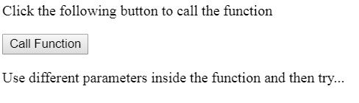
OUTPUT:
Click on Say Hello button
ZaraAli
1) Write a program to add two numbers using function.

Slide 12
Dialog Box
JavaScript supports three important types of dialog boxes. These dialog boxes can be used to raise and alert, or to get confirmation on any input or to have a kind of input from the users.
Alert Dialog Box
An alert dialog box is mostly used to give a warning message to the users. For example, if one input field requires to enter some text but the user does not provide any input, then as a part of validation, you can use an alert box to give a warning message.
A confirmation dialog box
is mostly used to take user's consent on any option. It displays a dialog box with two buttons: Cancel and Ok
If the user clicks on the OK button, the window method confirm() will return true. If the user clicks on the Cancel button, then confirm() returns false. You can use a confirmation dialog box as follows.

Slide 13
The prompt dialog box
is very useful when you want to pop-up a text box to get user input. Thus, it enables you to interact with the user. The user needs to fill in the field and then click OK.
This dialog box is displayed using a method called prompt() which takes two parameters: (i) a label which you want to display in the text box and (ii) a default string to display in the text box.
This dialog box has two buttons: OK and Cancel. If the user clicks the OK button, the window method prompt() will return the entered value from the text box. If the user clicks the Cancel button, the window method prompt()returns null.

Slide 14
Alert Dialog Box
<html>
<head>
<script type="text/javascript">
function Warn() {
alert ("This is a warning message!");
document.write ("This is a warning message!");
}
</script>
</head>
<body>
<p>Click the following button to see the result: </p>
<form>
<input type="button" value="Click Me" onclick="Warn();" />
</form>
</body>
</html>

Slide 15
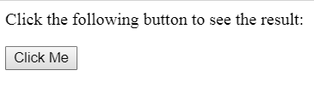
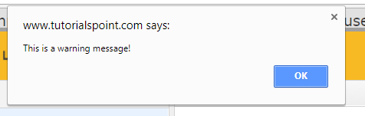
OUTPUT:
This is a warning message!

Slide 16
A confirmation dialog box
<html>
<head>
<script type="text/javascript">
function getConfirmation(){
var retVal = confirm("Do you want to continue ?");
if( retVal == true ){
document.write ("User wants to continue!");
return true;
}
else{
document.write ("User does not want to continue!");
return false;
}
}
</script>
</head>
<body>
<p>Click the following button to see the result: </p>
<form>
<input type="button" value="Click Me" onclick="getConfirmation();" />
</form>
</body></html>

Slide 17
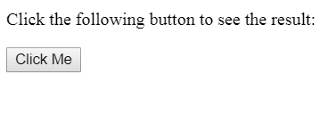
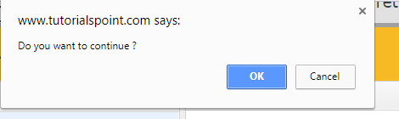

Slide 18
Prompt Dialog Box
<html>
<head>
<script type="text/javascript">
function getValue(){
var retVal = prompt("Enter your name : ", "your name here");
document.write("You have entered : " + retVal);
}
</script>
</head>
<body>
<p>Click the following button to see the result: </p>
<form>
<input type="button" value="Click Me" onclick="getValue();" />
</form>
</body>
</html>

Slide 19
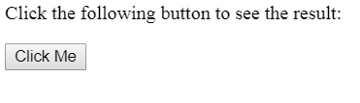
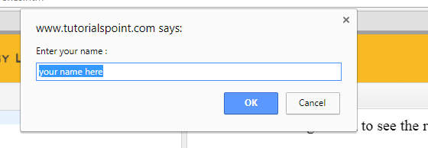

Slide 20
Example of ALERT BOX:
<html>
<head>
<script type="text/javascript">
function add()
{
a=10;
b=20;
c=a+b;
alert(c);
}
</script>
</head>
<body>
<form>
<input type="button" value="click me" onclick="add();">
</form>
</body>
</html>

Slide 21
GetElementById()
The getElementById() method returns the element that has the ID attribute with the specified value.
This method is one of the most common methods in the HTML DOM, and is used almost every time you want to manipulate, or get info from, an element on your document.
Returns null if no elements with the specified ID exists.
An ID should be unique within a page.

Slide 22
To find cube of given number from text box
<html>
<body>
<script type="text/javascript">
function getcube(){
var number1=document.getElementById("number").value;
alert(number1*number1*number1);
}
</script>
<form>
Enter No:<input type="text" id="number" name="number1"/><br/>
<input type="button" value="cube" onclick="getcube()"/>
</form>
</body>
</html>

Slide 23
To display text box values:
<html>
<body>
<form>
Name: <input type="text" id="Text1">
Surname: <input type="text" id="Text2">
full name:<input type="text" id="Text3">
<p>click on button to check name and surname </p>
<button onclick="myFunction();">Try it</button>
</form>
<script>
function myFunction() {
a=document.getElementById("Text1").value;
b=document.getElementById("Text2").value;
c=a+b;
//alert("full name is : " +a+ " " +b);
document.getElementById("Text3").value=c;
}
</script>
</body>
</html>

Slide 24
ADDITION OF TWO NUMBERS:
<html>
<body>
<form>
Num1: <input type="text" id="Text1">
Num2: <input type="text" id="Text2">
<p>Click the button for addition.</p>
<button onclick="myFunction()">Try it</button>
</form>
<script>
function myFunction() {
a = parseInt(document.getElementById("Text1").value);
b = parseInt(document.getElementById("Text2").value);
c = a+b;
document.write("addition of num1 and num is : " +c);
}
</script>
</body>
</html>

Slide 25
Write a program to print addition and subtraction using text boxes:
<html>
<head>
<body>
<script>
function add()
{
a = parseInt(document.getElementById("Text1").value);
b = parseInt(document.getElementById("Text2").value);
c = a+b;
document.getElementById("Text3").value = c;
}
function sub() {
a = parseInt(document.getElementById("Text1").value);
b = parseInt(document.getElementById("Text2").value);
c = a-b;
document.getElementById("Text4").value = c;
}
</script>
continue..

Slide 26
<form>
Num1: <input type="text" id="Text1">
Num2: <input type="text" id="Text2">
add: <input type="text" id="Text3">
sub :<input type="text" id="Text4">
<p>Click the button for addition.</p>
<button type="button" onclick="add();">addition</button>
<button type="button" onclick="sub();">sub</button>
</form>
</head>
</body>
</html>

Slide 27
<html>
<script>
function chgclr(color)
{
document.body.bgColor=color;
// in bgcolor C is capital
}
</script>
<body>
<h3> program to change background color using button </h3>
<input type="button" value="red" onclick="chgclr('red');">
<input type="button" value="green" onclick="chgclr('green');">
<input type="button" value="blue" onclick="chgclr('blue');">
</body>
</html>

Slide 28
Increment number by 1 using onclick event:
<script type="text/javascript">
var index = 0;
function increment(var1)
{
document.getElementById("t1").value=index;
index++;
}
</script>
<input type="button" id="button1" onclick="increment(1)" value="increment me!"/>
<input type="text" id="t1">

Slide 29
innerHTML:
The innerHTML property can be used to write the dynamic html on the html document.
It is used mostly in the web pages to generate the dynamic html such as registration form, comment form, links etc.
Example1:
<html>
<body>
<script>
function myFunction()
{
document.getElementById("demo").innerHTML = "Paragraph changed!";
}
</script>
<p id="demo" onclick="myFunction()">Click me to change my HTML content (innerHTML).</p>
</body>
</html>

Slide 30
Example2:
<html>
<script>
function abc()
{
document.getElementById("p1").innerHTML = "CSE/IT departments";
}
</script>
<body>
<h3 id="p1"> welcome to SBMP </h3>
<input type="button" value="click" onclick="abc();">
</body>
</html>

Slide 31
String - length Property:
The length property returns the length of a string (number of characters).
The length of an empty string is 0.
It will count the whitespaces.
<html>
<body>
<script>
var str = "this is text";
var n = str.length;
document.write("length is :" +n);
</script>
</body>
</html>

Slide 32
Style Object:
Syntax:element.style.property
Example1:
<html>
<body>
<h1 id="myH1">How to change the style of a header</h1>
<p>Click the button to change the style of the H1 element.</p>
<button onclick="myFunction()">Try it</button>
<script>
function myFunction() {
document.getElementById("myH1").style.color = "red";
}
</script>
</body>
</html>

Slide 33
Style background:
Example 3
<html>
<body>
<h1>Hello World!</h1>
<button type="button" onclick="myFunction();">Set background color</button>
<script>
function myFunction() {
document.body.style.backgroundColor = "red";
}
</script>
</body>
</html>

Slide 34
Mouseover and mouseout event(In HTML):
<html>
<head>
<script type="text/javascript">
function over()
{
document.getElementById("t").style.visibility="hidden";
}
function out()
{
document.getElementById("t").style.visibility="visible";
}
</script>
</head>
<body>
<pre id="t" onmouseover="over()" onmouseout="out()"> hiiiiiiiiiiiii</pre>
</body>
</html>

Slide 35
Mouseover and mouseout event(In Javascript):
<html>
<body>
<p>This example uses the HTML DOM to assign an "onmouseover" and "onmouseout" event to a h1 element.</p>
<h1 id="demo">Mouse over me</h1>
<script>
document.getElementById("demo").onmouseover = function() {mouseOver()};
document.getElementById("demo").onmouseout = function() {mouseOut()};
function mouseOver() {
document.getElementById("demo").style.color = "red";
}
function mouseOut() {
document.getElementById("demo").style.color = "black";
}
</script>
</body>
</html>

Slide 36
Onblur event:
The onblur event occurs when an object loses focus.
The onblur event is most often used with form validation code (e.g. when the user leaves a form field).
Example:
<html>
<body>
Enter your name: <input type="text" id="fname" onblur="myFunction()">
<p>When you leave the input field, a function is triggered which transforms the input text to upper case.</p>
<script>
function myFunction() {
var x = document.getElementById("fname").value;
y = x.toUpperCase();
document.getElementById("fname").value=y;
}
</script>
</body>
</html>

Slide 37
Onfocus:
The onfocus event occurs when an element gets focus
The onfocus event is the opposite of the onblur event.
<html>
<body>
Enter your name: <input type="text" id="myInput" onfocus="focusFunction()">
<script>
function focusFunction()
{
// Focus = Changes the background color of input to yellow
document.getElementById("myInput").style.background = "yellow";
}
</script>
</body>
</html>

Slide 38
Onfocus - onblurr event
<html>
<body>
Enter your name: <input type="text" id="myInput" onfocus="focusFunction()" onblur="blurFunction()">
<script>
function focusFunction() {
// Focus = Changes the background color of input to yellow
document.getElementById("myInput").style.background = "yellow";
}
function blurFunction() {
// No focus = Changes the background color of input to red
document.getElementById("myInput").style.background = "red";
}
</script>
</body>
</html>

Slide 39
onsubmit event
The onsubmit event occurs when a form is submitted.
<html>
<body>
<p>When you submit the form, a function is triggered which alerts some text.</p>
<form onsubmit="myFunction()">
Enter name: <input type="text" name="fname">
<input type="submit" value="Submit">
</form>
<script>
function myFunction() {
alert("The form was submitted");
}
</script>
</body>
</html>

Slide 40
onreset event
The onreset event occurs when a form is reset.
<html>
<body>
<p>When you reset the form, a function is triggered which alerts some text.</p>
<form onreset="myFunction()">
Enter name: <input type="text">
<input type="reset">
</form>
<script>
function myFunction() {
alert("The form was reset");
}
</script>
</body>
</html>

Slide 41
onselect Event
The onselect event occurs after some text has been selected in an element.
The onselect event is mostly used on <input type="text"> or <textarea> elements.
<html>
<body>
Select some of the text: <input type="text" value="Hello world!" onselect="myFunction()">
<script>
function myFunction()
{
alert("You selected some text!");
}
</script>
</body>
</html>

Slide 42
FORM VALIDATION USING FORM NAME.
<script>
function validateform(){
var name=document.myform.name.value;
var password=document.myform.password.value;
if (name=="")
{ alert("Name can't be blank");
return false; }
else if(password.length<6)
{ alert("Password must be at least 6 characters long.");
return false;
}
}
</script>
<body>
<form name="myform" method="get" action="hi.html" onsubmit="return validateform()">
Name: <input type="text" name="name"><br/>
Password: <input type="password" name="password"><br/>
<input type="submit" value="register">
</form>
</body>

Slide 43
FORM VALIDATION USING getElementById() method
<script>
function validateform(){
var name1=document.getElementById("t1").value;
if (name1=="")
{
alert("enter valid");
}
else
{
alert("successfull");
}}
</script>
<body>
<form name="myform" method="post" >
Name: <input type="text" id="t1"><br/>
<input type="submit" value="register" onclick="validateform()">
</form>
</body>

