Slide 1
Unit1
Introduction to Web programming

Slide 2
The uses of the Internet
Send e-mail messages.
Send (upload) or receive (down load) files between computers.
Participate in discussion groups, such as mailing lists and newsgroups.
Surfing the web.

Slide 3
What is Web?
The Web (World Wide Web) consists of information organized into Web pages containing text and graphic images.
It contains hypertext links, or highlighted keywords and images that lead to related information.
A collection of linked Web pages that has a common theme or focus is called a Web site.
The main page that all of the pages on a particular Web site are organized around and link back to is called the site’s home page.

Slide 4
How to access the Internet?
Many schools and businesses have direct access to the Internet using special high-speed communication lines and equipment.
Students and employees can access through the organization’s local area networks (LAN) or through their own personal computers.
Another way to access the Internet is through Internet Service Provider (ISP).

Slide 5
ISP
Stands for "Internet Service Provider."
An ISP provides access to the Internet.
Whether you're at home or work, each time you connect to the Internet, your connection is routed through an ISP.

Slide 6
How ISP works??
Early ISPs provided Internet access through dial-up modems.
This type of connection took place over regular phone lines and was limited to 56 Kbps.
In the late 1990s, ISPs began offering faster broadband Internet access via DSL and cable modems.
Some ISPs now offer high-speed fibre connections, which provide Internet access through fibre optic cables.
Companies like Comcast and Time Warner provide cable connections while companies like AT&T and Verizon provide DSL Internet access.

Slide 7
To connect to an ISP, you need a modem and an active account.
When you connect a modem to the telephone or cable outlet in your house, it communicates with your ISP.
The ISP verifies your account and assigns your modem an IP address. Once you have an IP address, you are connected to the Internet.

Slide 8
You can use a router (which may a separate device or built into the modem) to connect multiple devices to the Internet.
Since each device is routed through the same modem, they will all share the same public IP address assigned by the ISP.

Slide 9
ISPs act as hubs on the Internet since they are often connected directly to the Internet backbone.
Because of the large amount of traffic ISPs handle, they require high bandwidth connections to the Internet.
In order to offer faster speeds to customers, ISPs must add more bandwidth to their backbone connection in order to prevent bottlenecks.
This can be done by upgrading existing lines or adding new ones.

Slide 10
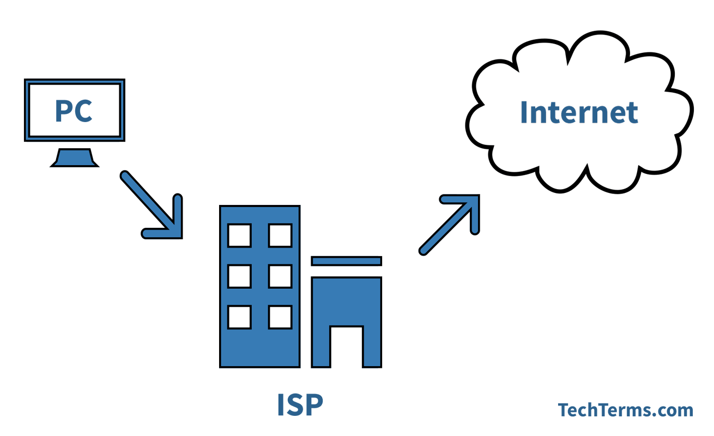

Slide 11
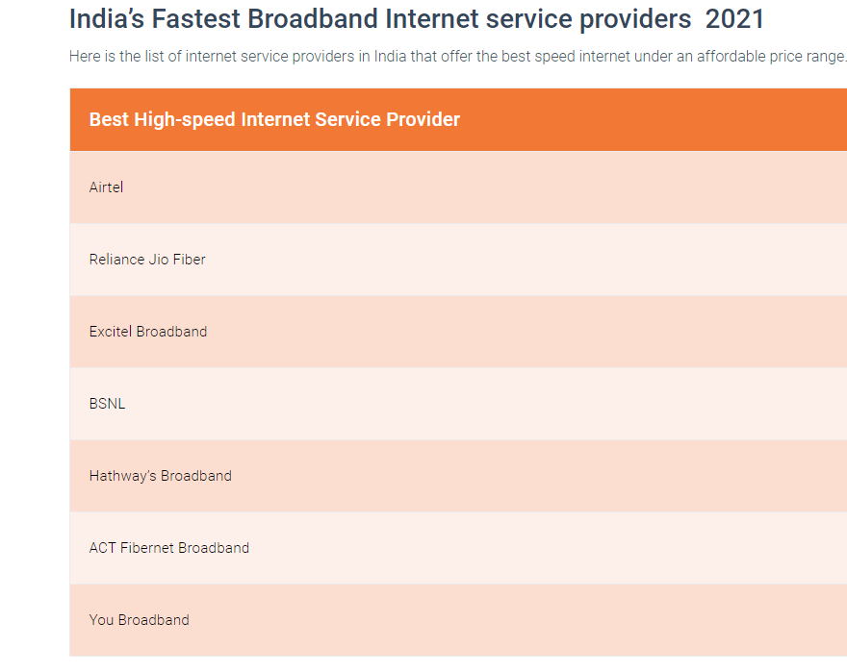

Slide 12
Web server
It is a software that delivers Web pages and other documents to browsers using the HTTP protocol from the computer on which such software runs.
For Example : you are sitting at your computer, surfing the Web using a browser, Typing this URL and check it out. It's at http://www.abcxyz.com/def.htm."
So you type that URL into your browser and press Enter, no matter where in the world that URL lives, the page pops up on your screen.

Slide 13
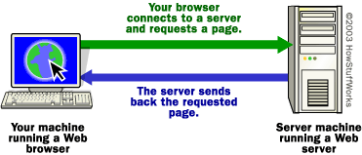

Slide 14
The basic steps that occurred behind the scenes:
The browser broke the URL into three parts:
The protocol ("http")
The server name ("www.abcxyz.com”)
The file name ("def.htm")

Slide 15
The browser communicated with a name server(Domain Name Server) to translate the server name "www.abcxyz.com" into an IP Address, which it uses to connect to the server machine.
The browser then formed a connection to the server at that IP address on port 80.

Slide 16
Continue..

Slide 17
Following the HTTP protocol, the browser sent a GET request to the server, asking for the file "http://www.abcxyz.com/def.htm."

Slide 18
The server then sent the HTML text for the Web page to the browser.
The browser read the HTML tags and formatted the page onto your screen.

Slide 19
our home computers CAN act like web servers.
Things we need:
A static I.P. (Internet protocol) address
(so that the location of the hosted web site/s does not change).
24/7 Internet connectivity Web server software
A stable and reliable operating system

Slide 20
Why static I.P. address?
Now, most of us use net connections on our home/office computers from the local Internet Service Provider. These ISPs assigned our computers with a dynamic I.P. address each time we connect. Thus, each time we disconnect and start the connection again, our computers are given a different I.P. address.

Slide 21
Issues for getting static IP address
The problem is that ISPs generally do not allow you to host a web site on your computer.
And they do this by allocating a new I.P. address each time you connect and also blocking required ports.
You can get a static I.P. addresses by either upgrading your package (to something like a "business package") or shift to an ISP that does provides one.
The cost of a static I.P. can be expensive. $30 to $50 or more per month extra (maybe even more). Check with your Internet Service Provider.
There are web hosting companies offer feature-rich packages.

Slide 22
Client/Server Structure of the Web
Web is a collection of files that reside on computers, called Web servers, that are located all over the world and are connected to each other through the Internet.
When you use your Internet connection to become part of the Web, your computer becomes a Web client in a worldwide client/server network.
A Web browser is the software that you run on your computer to make it work as a web client.

Slide 23
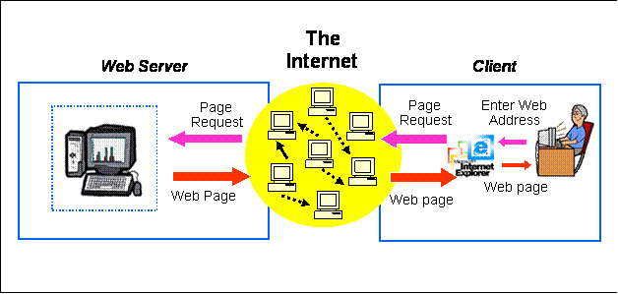

Slide 24
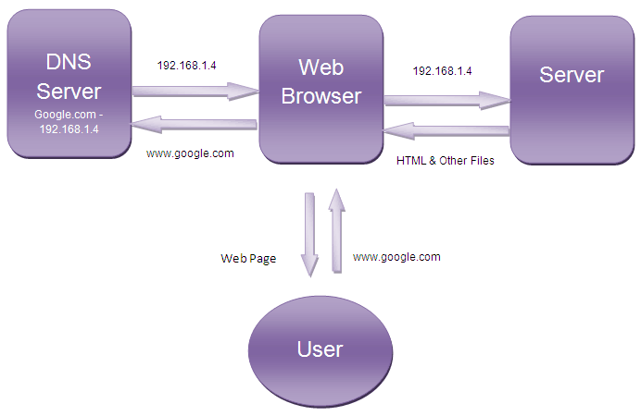
Working of web browser

Slide 25
Contact to DNS Server –
When a user enters a URL into the address bar and hits ‘enter’, at first browser contacts the DNS server.
A DNS server stores the IP addresses of the server associated with the corresponding domain names.
The DNS server takes the domain name from the browser and returns the corresponding IP address to the browser.

Slide 26
Contact to Server – After getting the IP address of the server for the requested webpage, browser sends a request to that server for the desired files. For example consider the following URL :
http://www.google.com
This URL is divided into parts. First one is HTTP – it is a protocol named Hyper Text Transfer Protocol which defines the way browser communicates with the server.
The second part is www.google.com which is translated by the DNS server with the IP address.
It is the address of a computer (Web Server) where the requested web page is stored.

Slide 27
Web server
A Web server is a program that uses HTTP (Hypertext Transfer Protocol)
to serve the files that form Web pages to users, in response to their requests, which are forwarded by their computers' HTTP clients.
Dedicated computers and appliances may be referred to as Web servers as well.

Slide 28
The process is an example of the client/server model.
All computers that host Web sites must have Web server programs.

Slide 29
Various types of web servers Software
Apache (the most widely-installed Web server)
Microsoft's Internet Information Server (IIS)
nginx (pronounced engine X) from NGNIX.
Novell's NetWare server
Google Web Server (GWS)
IBM's family of Domino servers.

Slide 30
Types of Servers
From A to Z
Application Servers
Audio/Video Servers
Chat Servers
Fax Servers
FTP Servers
Groupware Servers
IRC Servers
List Servers
Mail Servers
News Servers
Proxy Servers
Telnet Servers
Web Servers
Z39.50 Servers

Slide 31
Application Servers: Connects database with web servers.
Audio/Video Servers: They bring multimedia capabilities to Web sites by enabling them to broadcast streaming multimedia content.
Chat Servers: They enable users to exchange information in an environment that offer real-time discussion capabilities.
Fax Servers:organizations can fax large amount of documents.
FTP Servers: File Transfer Protocol makes it possible to move one or more files securely between computers.

Slide 32
What is client-side scripting?
Client-side scripting simply means running scripts, such as JavaScript, on the client device, usually within a browser.
All kinds of scripts can run on the client side if they are written in JavaScript, because JavaScript is universally supported.

Slide 33
What is server-side scripting?
Server-side scripts run on the server instead of the client, often in order to deliver dynamic content to webpages in response to user actions.
Server-side scripts don't have to be written in JavaScript, since the server may support a variety of languages.

Slide 34
A markup language is a language which is used to represent structured data.
For example, HTML enables to specify that some part of the document is a title or some other part is a list.
A scripting language is a programming language which is interpreted, rather than compiled, which means that scripting languages represent a subset of all programming languages.
Example of scripting languages are javascript, VB script, Perl, python, php etc

Slide 35
Search Engine
A search engine is a web-based tool that enables users to locate information on the World Wide Web.
Popular examples of search engines are Google, Yahoo!, and MSN Search.

Slide 36
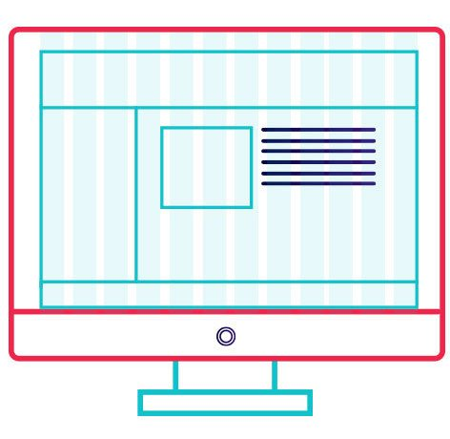
Principles of web designing
WEBSITE PURPOSE
SIMPLICITY
NAVIGATION
F-SHAPED PATTERN READING
VISUAL HIERARCHY :Visual hierarchy is the arrangement of elements is order of importance
CONTENT
GRID BASED LAYOUT: Grids help to structure web design and keep web content organised.
LOADTIME
MOBILE FRIENDLY

Slide 37
Planning process of web page designing
Research and goal setting
Planning
Designing the layout
Writing the content
Coding
Testing and launching
Maintaining

Slide 38
10 rules for web design
Simple is beautiful.
Design is paramount.
Navigation should be easy.
Consistency is key.
Colors are crucial.
Make website responsive.
Develop for multiple browsers.
Check website for errors.
Write own code.
Quality content.

Slide 39
Web Hosting
What is Web Hosting?
Web hosting is a service that allows organizations and individuals to post a website or web page onto the Internet.
A web host, or web hosting service provider, is a business that provides the technologies and services needed for the website or webpage to be viewed in the Internet.

Slide 40
