Slide 1
Unit 1
Introduction to Web Programming

Slide 2


Some Common Terms
The Internet is a network of computers spanning the globe. It is also called the World Wide Web.
An Internet Browser is a software program that enables you to view Web pages on your computer. Browsers connect computers to the Internet, and allow people to “surf the Web.”
Internet Explorer is one of the browsers most commonly used. There are other browsers available as well, including Netscape.

Slide 3
A site or area on the World Wide Web that is accessed by its own Internet address is called a Web site.
A Web Page is like a page in a book. Websites often have several pages that you can access by clicking on links. A Web site can be a collection of related Web pages.
Each Web site contains a home page (this is the original starting page) and may also contain additional pages.
Different computers will have different home pages. You can set your own webpage.

Slide 4
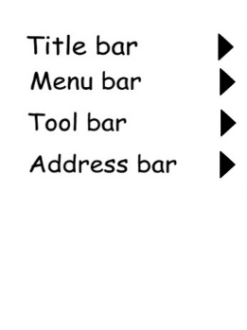
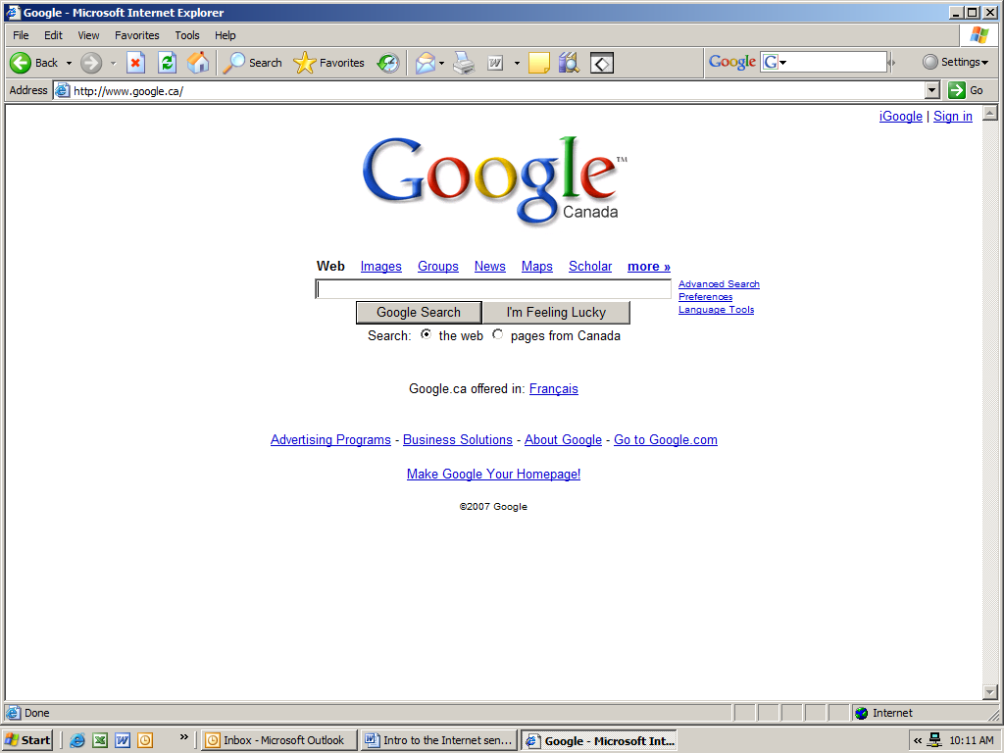
Layout of a Web Page
Title bar – tells you the name of the web page
Menu bar – has commands for moving around the webpage, printing, etc
Tool bar – short cuts to commands. Each picture represents a command
Address bar – webpage address. If you want to go directly to a web page, you will need to know the address.

Slide 5
Parts of a Web Address
A web address is typically composed of four parts:
For example, the address http://www.google.ca is made up of the following areas:
http:// This Web server uses Hypertext Transfer Protocol (HTTP). This is the most common protocol on the Internet.
www This site is on the World Wide Web.
google The Web server and site maintainer.
ca This tells us it is a site in Canada.

Slide 6
Endings of web pages tells us a bit about the page. Some common endings to web addresses are:
com (commercial)
edu (educational institution)
gov (government)
net (network)
org (organization)
You might also see addresses that add a country code as the last part of the address such as:
ca (Canada)
uk (United Kingdom)
fr (France)
us (United States of America)
au (Australia)

Slide 7
How to Search the Internet
Two basic ways
if you know the address of the web page (example: www.cbc.ca)
2. Using a search engine like Google to find the address. This is called a keyword search

Slide 8
Typing in the Web Site Address
Go to the address bar. Click once to highlight the address. (It should turn blue).
Hit the Delete key on your keyboard.
Enter the following address: www.theweathernetwork.com
Then press Enter on the keyboard or click on the word Go on the right side of the Address Bar.

Slide 9
Search the Internet
If you don’t know the address of the webpage, but want to learn more about a topic or find a particular website, you will need to do a search.
There are several handy search engines out there that will locate information for you. Two of the mostly commonly used are:
www.google.com
www.yahoo.com

Slide 10
Practice Exercise
Type www.google.ca into the address bar. (www.google.ca is a Canadian version of the search engine. www.google.com will search US sites first)
Hit the Enter key or Go on the toolbar. You should see the Google web page.

Slide 11
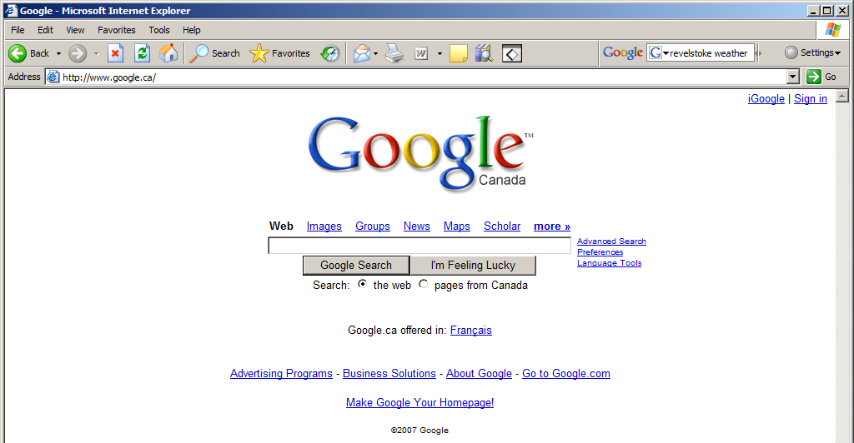
3. Now click on the Google box. You should see a flashing cursor. Type in the topic. Hit enter.

