Slide 1
Event handlers

Slide 2
What is an Event ?
JavaScript's interaction with HTML is handled through events that occur when the user or the browser manipulates a page.
When the page loads, it is called an event. When the user clicks a button, that click too is an event.
Other examples include events like pressing any key, closing a window, resizing a window, etc.

Slide 3
onclick Event Type
This is the most frequently used event type which occurs when a user clicks the left button of his mouse.
We can put your validation, warning etc., against this event type.

Slide 4
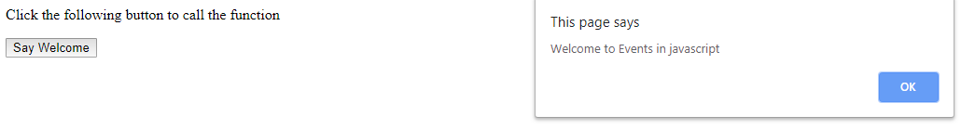
<html>
<head>
<script>
function welcome()
{
alert ("Welcome to Events in javascript");
}
</script>
</head>
<body>
<p>Click the following button to call the function</p>
<form>
<input type="button" onclick="welcome()" value="Say Welcome">
</form>
</body></html>

Slide 5
JavaScript - Functions
A function is a group of reusable code which can be called anywhere in your program. This eliminates the need of writing the same code again and again. It helps programmers in writing modular codes. Functions allow a programmer to divide a big program into a number of small and manageable functions.
Function Definition
Before we use a function, we need to define it. The most common way to define a function in JavaScript is by using the function keyword, followed by a unique function name, a list of parameters (that might be empty), and a statement block surrounded by curly braces.

Slide 6
Syntax:
<script type="text/javascript">
function functionname(parameter-list)
{
statements
}
</script>
Example:
<script type="text/javascript">
function sayHello()
{
alert("Hello there");
}
</script>

Slide 7
Calling a Function:
<html>
<head>
<script>
function sayHello()
{
document.write ("Hello there!");
}
</script>
</head>
<body>
<p>Click the following button to call the function</p>
<form>
<input type="button" onclick="sayHello()" value="Say Hello">
</form>
</body>
</html>

Slide 8
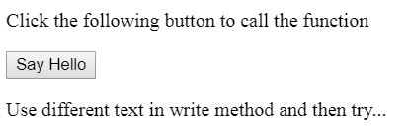

OUTPUT:
Click on Say Hello button

Slide 9
Function Parameters
Till now, we have seen functions without parameters. But there is a facility to pass different parameters while calling a function.
These passed parameters can be captured inside the function and any manipulation can be done over those parameters.
A function can take multiple parameters separated by comma.

Slide 10
Example:
<html>
<head>
<script type="text/javascript">
function sayHello(name, age)
{
document.write (name + " is " + age + " years old.");
}
</script>
</head>
<body>
<p>Click the following button to call the function</p>
<form>
<input type="button" onclick="sayHello('Zara', 7)" value="Say Hello">
</form>
<p>Use different parameters inside the function and then try...</p>
</body>
</html>

Slide 11
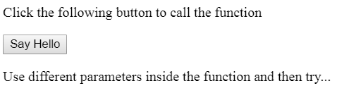
OUTPUT:
Click on Say Hello button
Zara is 7 years old.

Slide 12
The return Statement
A JavaScript function can have an optional return statement. This is required if you want to return a value from a function.
This statement should be the last statement in a function.

Slide 13
<head>
<script type="text/javascript">
function concatenate(first, last)
{
var full;
full = first + last;
return full;
}
function secondFunction()
{
var result;
result = concatenate('Zara', 'Ali');
document.write (result );
}
</script>
</head>
<body>
<p>Click the following button to call the function</p>
<form>
<input type="button" onclick="secondFunction()" value="Call Function">
</form>
<p>Use different parameters inside the function and then try...</p>
</body>

Slide 14
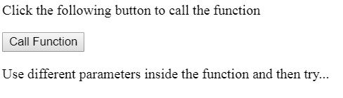
OUTPUT:
Click on Say Hello button
ZaraAli
1) Write a program to add two numbers using function.

Slide 15
onmouseover Event
The onmouseover event occurs when the mouse pointer is moved onto an element, or onto one of its children.
Syntax
In JavaScript:
object.onmouseover = function(){myScript};

Slide 16
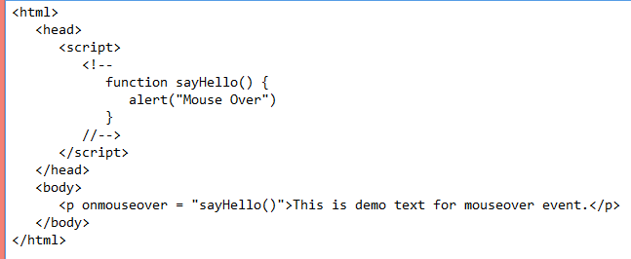
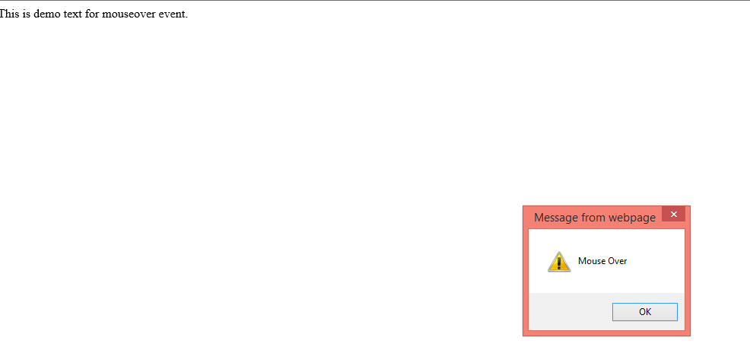

Slide 17
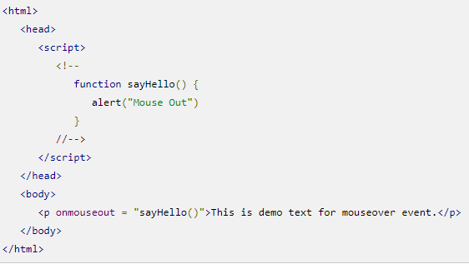
It is an event that triggers when the mouse pointer moves out of an element.

Slide 18
onsubmit event
The onsubmit event occurs when a form is submitted.
<html>
<body>
<p>When you submit the form, a function is triggered which alerts some text.</p>
<form onsubmit="myFunction()">
Enter name: <input type="text" name="fname">
<input type="submit" value="Submit">
</form>
<script>
function myFunction() {
alert("The form was submitted");
}
</script>
</body>
</html>

Slide 19
onreset event
The onreset event occurs when a form is reset.
<html>
<body>
<p>When you reset the form, a function is triggered which alerts some text.</p>
<form onreset="myFunction()">
Enter name: <input type="text">
<input type="reset">
</form>
<script>
function myFunction() {
alert("The form was reset");
}
</script>
</body>
</html>

Slide 20
onselect Event
The onselect event occurs after some text has been selected in an element.
The onselect event is mostly used on
<input type="text"> or <textarea> elements.
<html>
<body>
Select some of the text: <input type="text" value="Hello world!" onselect="myFunction()">
<script>
function myFunction()
{
alert("You selected some text!");
}
</script>
</body>
</html>

Slide 21
GetElementById()
The getElementById() method returns the element that has the ID attribute with the specified value.
This method is one of the most common methods in the HTML DOM, and is used almost every time you want to manipulate, or get info from, an element on your document.
Returns null if no elements with the specified ID exists.
An ID should be unique within a page.

Slide 22
To find cube of given number from text box
<html>
<body>
<script type="text/javascript">
function getcube(){
var number1=document.getElementById("number").value;
alert(number1*number1*number1);
}
</script>
<form>
Enter No:<input type="text" id="number" name="number1"/><br/>
<input type="button" value="cube" onclick="getcube()"/>
</form>
</body>
</html>

Slide 23
To display text box values:
<html>
<body>
<form>
Name: <input type="text" id="Text1">
Surname: <input type="text" id="Text2">
full name:<input type="text" id="Text3">
<p>click on button to check name and surname </p>
<button onclick="myFunction();">Try it</button>
</form>
<script>
function myFunction() {
a=document.getElementById("Text1").value;
b=document.getElementById("Text2").value;
c=a+b;
//alert("full name is : " +a+ " " +b);
document.getElementById("Text3").value=c;
}
</script>
</body>
</html>

Slide 24
Onfocus:
The onfocus event occurs when an element gets focus
The onfocus event is the opposite of the onblur event.
<html>
<body>
Enter your name: <input type="text" id="myInput" onfocus="focusFunction()">
<script>
function focusFunction()
{
// Focus = Changes the background color of input to yellow
document.getElementById("myInput").style.background = "yellow";
}
</script>
</body>
</html>

Slide 25
Onfocus - onblurr event
<html>
<body>
Enter your name: <input type="text" id="myInput" onfocus="focusFunction()" onblur="blurFunction()">
<script>
function focusFunction() {
// Focus = Changes the background color of input to yellow
document.getElementById("myInput").style.background = "yellow";
}
function blurFunction() {
// No focus = Changes the background color of input to red
document.getElementById("myInput").style.background = "red";
}
</script>
</body>
</html>

