Slide 1
JAVASCRIPT

Slide 2
JavaScript is a dynamic computer programming language.
It is lightweight and most commonly used as a part of web pages, whose implementations allow client-side script to interact with the user and make dynamic pages.

Slide 3
JavaScript can be implemented using JavaScript statements that are placed within the <script>... </script> HTML tags in a web page.
The <script> tag alerts the browser program to start interpreting all the text between these tags as a script. A simple syntax of your JavaScript will appear as follows.
<script>
javascript code
</script>
The script tag takes two important attributes −
Language − This attribute specifies what scripting language you are using. Typically, its value will be javascript.
Type − This attribute is what is now recommended to indicate the scripting language in use and its value should be set to "text/javascript".
<script language="javascript" type="text/javascript">
JavaScript code
</script>

Slide 4
Example of Javascript:
<html>
<body>
<script language="javascript“ type="text/javascript">
document.write("welcome to javascript");
</script>
</body>
</html>

Slide 5
VARIABLES:
Variables are the containers for storing information.
For example, assume you want to store two values 10 and 20 in your program and at a later stage, you want to use these two values. Let's see how you will do it. Here are the following three simple steps −
Create variables with appropriate names.
Store your values in those two variables.
Retrieve and use the stored values from the variables.
2. Javascript variables should be declare with the var statement
3. JavaScript variables are used to hold values or expressions.
4. Javascript variables are case sensitive.
5. Variable must begin with the letter.
eg: stu_name
stu_rollno
rollno

Slide 6
JavaScript DATATYPES
One of the most fundamental characteristics of a programming language is the set of data types it supports.
These are the type of values that can be represented and manipulated in a programming language.
data types:
Numbers: eg. 123, 120.50 etc.
Strings: of text e.g. "This text string" etc.
Boolean: e.g. true or false
Before you use a variable in a JavaScript program, you must declare it. Variables are declared with the var keyword as follows.
Example:
var money;
var name;
var money,name;
Storing a value in a variable is called variable initialization. You can do variable initialization at the time of variable creation or at a later point in time when you need that variable.
Example: name=“john”;
money=12;
or
var name=“john”;

Slide 7
What is an operator?
Let us take a simple expression 4 + 5 is equal to 9. Here 4 and 5 are called operands and ‘+’ is called the operator.
JavaScript supports the following types of operators.
Arithmetic Operators:
Operator | Description
+ | Addition
- | Subtraction
* | Multiplication
/ | Division
% | Modulus
++ | Increment
-- | Decrement

Slide 8
Example:
var x = 5; var y = 2; var z = x + y;
Output:z=7
Example:
txt1 = "John"; txt2 = "Doe"; txt3 = txt1 + " " + txt2;
Output: John Doe

Slide 9
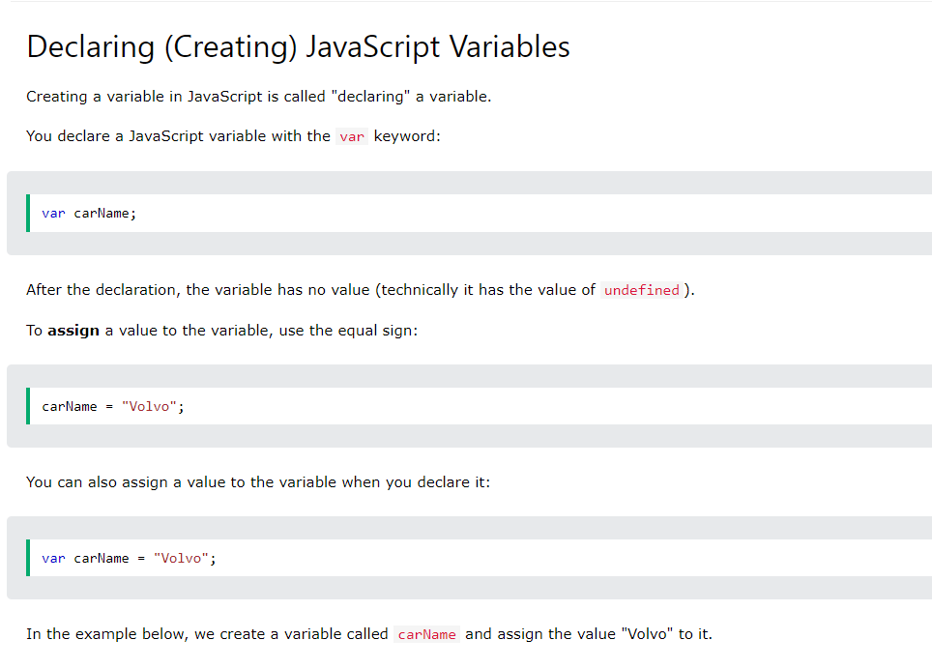

Slide 10
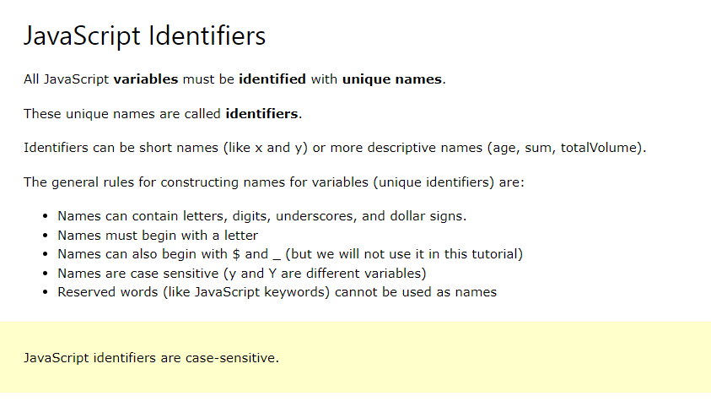

Slide 11
JavaScript Assignment operators
The Assignment operator is equal (=) which assigns the value of right-hand operand to its left-hand operand. That is if a = b assigns the value of b to a.
The simple assignment operator is used to assigning a value to a variable. The assignment operation evaluates to the assigned value.
Syntax:
data=value

Slide 12
// Lets take some variables
x=10
y=20
x=y // Here, x is equal to 20
y=x // Here, y is equal to 10

Slide 13
Chaining the assignment operator is possible in order to assign a single value to multiple variables.
See the example.
var x=y=z=30;

Slide 14
JavaScript Comparison Operators:
== | equal to
=== | equal value and equal type
!= | not equal
!== | not equal value or not equal type
> | greater than
< | less than
>= | greater than or equal to
<= | less than or equal to

Slide 15
JavaScript Logical Operators
Operator | Description
&& | logical and
|| | logical or
! | logical not

Slide 16
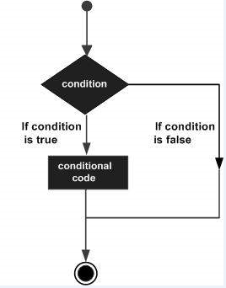
Control structures and looping:
While writing a program, there may be a situation when you need to adopt one out of a given set of paths.
In such cases, you need to use conditional statements that allow your program to make correct decisions
and perform right actions.
JavaScript supports conditional statements which are used to perform different actions based on different conditions.
1) if..else statement.

Slide 17
Example
Try the following example to understand how the if statement works.
<html>
<body>
<script type="text/javascript">
var age = 20;
if( age > 18 )
{
document.write("<b>Qualifies for driving</b>");
}
</script>
<p>Set the variable to different value and then try...</p>
</body>
</html>

Slide 18
Example
Try the following code to learn how to implement an if-else statement in JavaScript.
<html>
<body>
<script type="text/javascript">
var age = 20;
if( age > 18 ){
document.write("<b>Qualifies for driving</b>");
}
else{
document.write("<b>Does not qualify for driving</b>");
}
</script>
<p>Set the variable to different value and then try...</p>
</body>
</html>

Slide 19
Example
Try the following code to learn how to implement an if-else-if statement in JavaScript.
<script type="text/javascript">
var book = "maths";
if( book == "history" ){
document.write("<b>History Book</b>");
}
else if( book == "maths" ){
document.write("<b>Maths Book</b>");
}
else if( book == "economics" ){
document.write("<b>Economics Book</b>");
}
else{
document.write("<b>Unknown Book</b>");
}
</script>

Slide 20
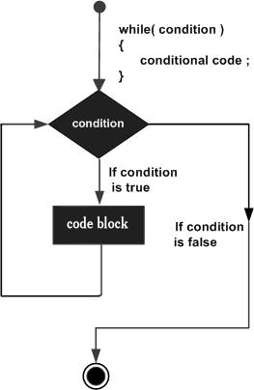
The while Loop:
The purpose of a while loop is to execute a statement or code block repeatedly as long as an expression is true. Once the expression becomes false, the loop terminates.
while (expression){
Statement(s) to be executed if expression is true
}

Slide 21
Example:
<html>
<body>
<script type="text/javascript">
var count = 0;
document.write("Starting Loop ");
while (count < 10)
{
document.write("Current Count : " + count + "<br />");
count++;
}
document.write("Loop stopped!");
</script>
<p>Set the variable to different value and then try...</p>
</body>
</html>

Slide 22
OUTPUT:
Starting Loop Current Count : 0 Current Count : 1 Current Count : 2 Current Count : 3 Current Count : 4 Current Count : 5 Current Count : 6 Current Count : 7 Current Count : 8 Current Count : 9 Loop stopped!Set the variable to different value and then try...

Slide 23
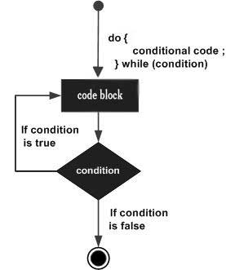
The do...while Loop:
The do...while loop is similar to the while loop except that the condition check happens at the end of the loop.
This means that the loop will always be executed at least once, even if the condition is false.
do{
Statement(s) to be executed;
}
while (expression);

Slide 24
<html>
<body>
<script type="text/javascript">
var count = 0;
document.write("Starting Loop" + "<br />");
do{
document.write("Current Count : " + count + "<br />");
count++;
}
while (count < 5);
document.write ("Loop stopped!");
</script>
<p>Set the variable to different value and then try...</p>
</body>
</html>

Slide 25
Starting Loop
Current Count : 0
Current Count : 1
Current Count : 2
Current Count : 3
Current Count : 4
Loop Stopped!
Set the variable to different value and then try...

Slide 26
FOR LOOP:
The 'for' loop is the most compact form of looping. It includes the following three important parts −
The loop initialization where we initialize our counter to a starting value. The initialization statement is executed before the loop begins.
The test statement which will test if a given condition is true or not. If the condition is true, then the code given inside the loop will be executed, otherwise the control will come out of the loop.
The iteration statement where you can increase or decrease your counter.

Slide 27
<html>
<body>
<script type="text/javascript">
var count;
document.write("Starting Loop" + "<br />");
for(count = 0; count < 10; count++)
{
document.write("Current Count : " + count );
document.write("<br />");
}
document.write("Loop stopped!");
</script>
<p>Set the variable to different value and then try...</p>
</body>
</html>

Slide 28
OUTPUT:
Starting Loop
Current Count : 0
Current Count : 1
Current Count : 2
Current Count : 3
Current Count : 4
Current Count : 5
Current Count : 6
Current Count : 7
Current Count : 8
Current Count : 9
Loop stopped!
Set the variable to different value and then try...

Slide 29
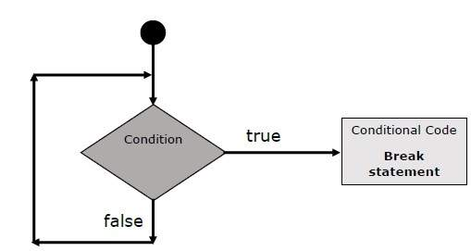
The break Statement:
JavaScript provides full control to handle loops. There may be a situation when you need to come out of a loop without reaching its bottom. There may also be a situation when you want to skip a part of your code block and start the next iteration of the loop.
To handle all such situations, JavaScript provides break and continuestatements. These statements are used to immediately come out of any loop or to start the next iteration of any loop respectively.
The break Statement

Slide 30
Example:
<html>
<body>
<script type="text/javascript">
var x = 1;
document.write("Entering the loop<br /> ");
while (x < 20)
{
if (x == 5){
break; // breaks out of loop completely
}
x = x + 1;
document.write( x + "<br />");
}
document.write("Exiting the loop!<br /> ");
</script>
<p>Set the variable to different value and then try...</p>
</body>
</html>

Slide 31
OUTPUT:
Entering the loop 2 3 4 5 Exiting the loop! Set the variable to different value and then try...

Slide 32
The continue Statement
The continue statement tells the interpreter to immediately start the next iteration of the loop and skip the remaining code block. When a continuestatement is encountered, the program flow moves to the loop check expression immediately and if the condition remains true, then it starts the next iteration, otherwise the control comes out of the loop.

Slide 33
<html>
<body>
<script type="text/javascript">
var x = 1;
document.write("Entering the loop<br /> ");
while (x < 10)
{
x = x + 1;
if (x == 5){
continue; // skip rest of the loop body
}
document.write( x + "<br />");
}
document.write("Exiting the loop!<br /> ");
</script>
<p>Set the variable to different value and then try...</p>
</body>
</html>

Slide 34
OUTPUT:
Entering the loop 2 3 4 6 7 8 9 10 Exiting the loop! Set the variable to different value and then try...

