Slide 1
Event handlers

Slide 2
What is an Event ?
JavaScript's interaction with HTML is handled through events that occur when the user or the browser manipulates a page.
When the page loads, it is called an event. When the user clicks a button, that click too is an event.
Other examples include events like pressing any key, closing a window, resizing a window, etc.

Slide 3
onclick Event Type
This is the most frequently used event type which occurs when a user clicks the left button of his mouse.
We can put your validation, warning etc., against this event type.

Slide 4
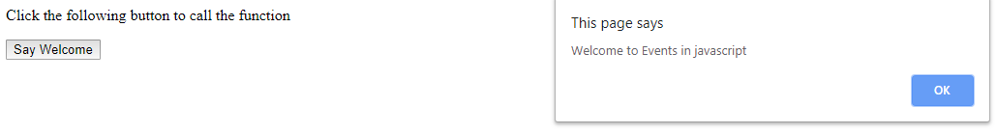
<html>
<head>
<script>
function welcome()
{
alert ("Welcome to Events in javascript");
}
</script>
</head>
<body>
<p>Click the following button to call the function</p>
<form>
<input type="button" onclick="welcome()" value="Say Welcome">
</form>
</body></html>

Slide 5
JavaScript - Functions
A function is a group of reusable code which can be called anywhere in your program. This eliminates the need of writing the same code again and again. It helps programmers in writing modular codes. Functions allow a programmer to divide a big program into a number of small and manageable functions.
Function Definition
Before we use a function, we need to define it. The most common way to define a function in JavaScript is by using the function keyword, followed by a unique function name, a list of parameters (that might be empty), and a statement block surrounded by curly braces.

Slide 6
Syntax:
<script type="text/javascript">
function functionname(parameter-list)
{
statements
}
</script>
Example:
<script type="text/javascript">
function sayHello()
{
alert("Hello there");
}
</script>

Slide 7
Calling a Function:
<html>
<head>
<script>
function sayHello()
{
document.write ("Hello there!");
}
</script>
</head>
<body>
<p>Click the following button to call the function</p>
<form>
<input type="button" onclick="sayHello()" value="Say Hello">
</form>
</body>
</html>

Slide 8
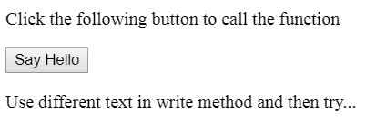

OUTPUT:
Click on Say Hello button

Slide 9
onmouseover Event
The onmouseover event occurs when the mouse pointer is moved onto an element, or onto one of its children.
Syntax In JavaScript:
onmouseover = function();

Slide 10
<html><head> <script>
function sayHello()
{
alert("Mouse Over")
}
</script>
</head>
<body>
<p onmouseover = "sayHello()">This is demo text for mouseover event.</p>
</body>
</html>

Slide 11
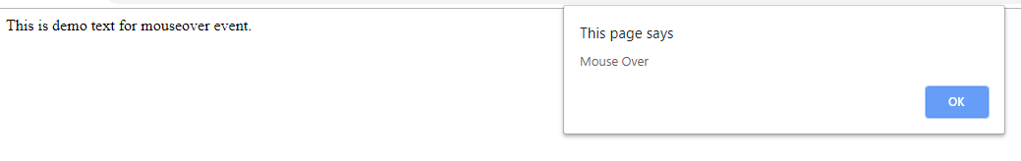

Slide 12
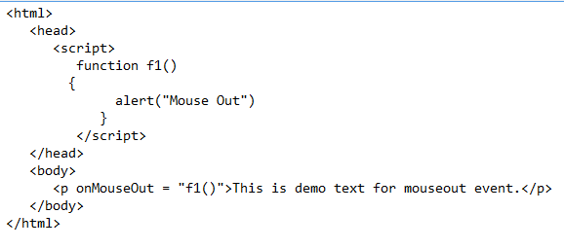
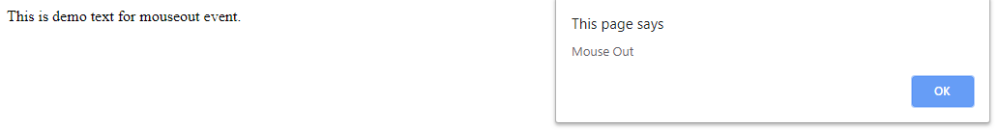
onMouseOut
It is an event that triggers when the mouse pointer moves out of an element.

Slide 13
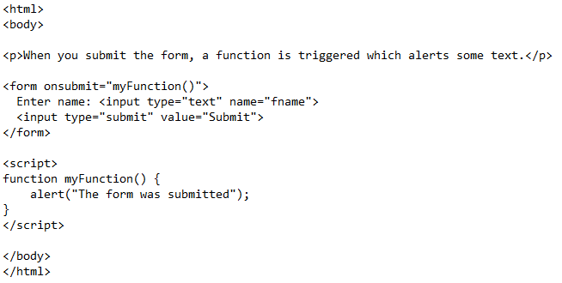
onsubmit event
The onsubmit event occurs when a form is submitted.

Slide 14
onsubmit event

Slide 15
onreset event
The onreset event occurs when a form is reset.
<html>
<body>
<p>When you reset the form, a function is triggered which alerts some text.</p>
<form onreset="myFunction()">
Enter name: <input type="text">
<input type="reset">
</form>
<script>
function myFunction() {
alert("The form was reset");
}
</script>
</body>
</html>

Slide 16
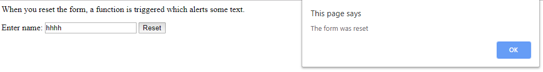

Slide 17
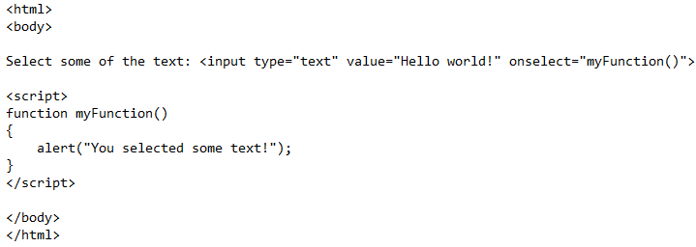
onselect Event
The onselect event occurs after some text has been selected in an element.

Slide 18
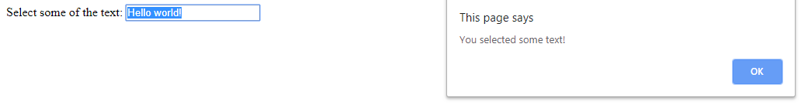

Slide 19
onfocus Event
<input type="text" onfocus="myFunction()">
The onfocus event occurs when an element gets focus.
The onfocus event is most often used with <input>, <select>, and <a>.
The onfocus event is the opposite of the onblur event.

Slide 20
<html>
<body>
Enter your name: <input type="text" onfocus="myFunction(this)">
<p>When the input field gets focus a function is triggered which changes the background-color.</p>
<script>
function myFunction(x)
{
x.style.background = "yellow";
}
</script>
</body>
</html>

Slide 22
onblur Event
The onblur event occurs when an object loses focus.
The onblur event is most often used with form validation code
(e.g. when the user leaves a form field).
The onblur event is the opposite of the onfocus event.

Slide 23
<html>
<body>
<p>When you leave the input field, a function is triggered which sets the background color to red.</p>
Enter your name:
<input type="text" id="myInput" onfocus="focusFunction()" onblur="blurFunction()">
<script>
function blurFunction() {
document.getElementById("myInput").style.background = "red";
}
</script>
</body>
</html>

Slide 24
getElementById() Method
document.getElementById(“name of element");
The getElementById() method returns the element that has the ID attribute with the specified value.
This method is one of the most common methods in the HTML DOM, and is used almost every time you want to manipulate, or get info from, an element on your document.
Returns null if no elements with the specified ID exists.
An ID should be unique within a page.

