Slide 1
CSS properties

Slide 2
Style sheet Properties
Font
Text
Box
Color
Background

Slide 3
The CSS Box Model
The CSS box model is essentially a box that wraps around every HTML element. It consists of: margins, borders, padding, and the actual content.

Slide 4

box model
Content - The content of the box, where text and images appear
Padding - Clears an area around the content. The padding is transparent
Border - A border that goes around the padding and content
Margin - Clears an area outside the border. The margin is transparent

Slide 5
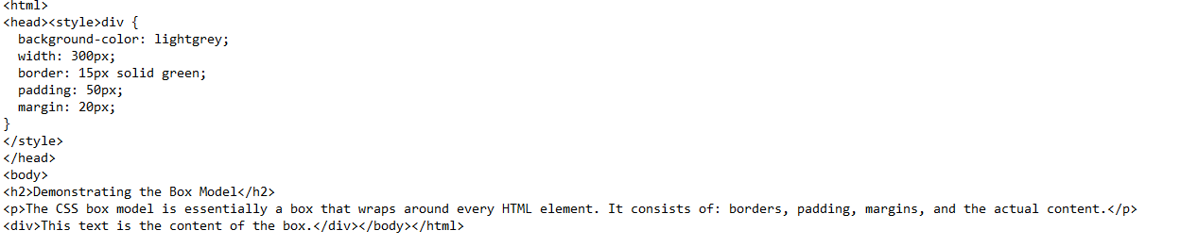

Slide 7
CSS: color property
The CSS color property defines the foreground color of the text content for an element.
The syntax for the color CSS property is:
color: value;

Slide 8
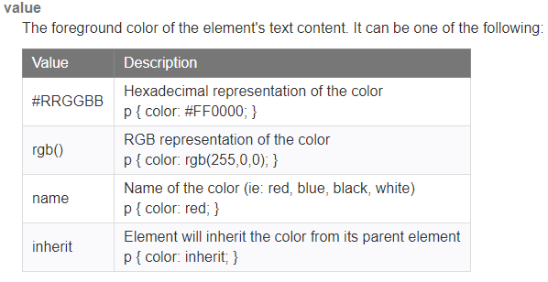

Slide 9
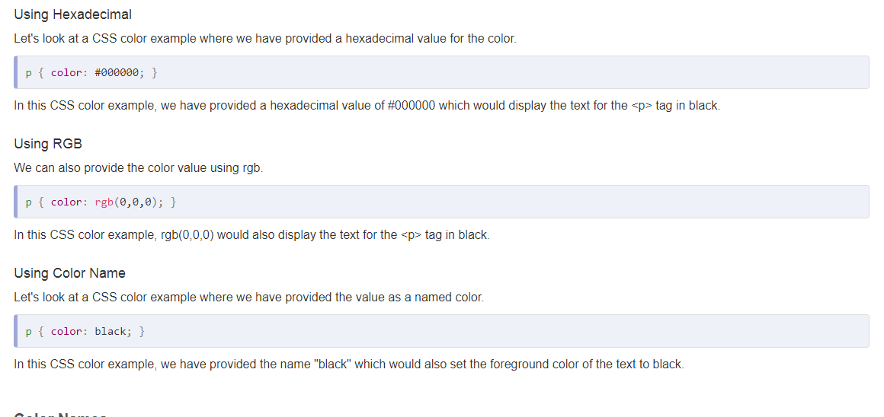

Slide 10
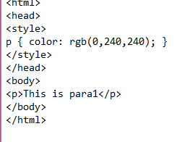
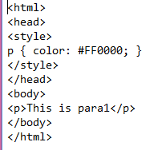
3 Examples

Slide 11
CSS Background
CSS background property is used to define the background effects on element.

Slide 12
There are 5 CSS background properties that affects the HTML elements:
background-color
background-image
background-repeat
background-attachment
background-position

Slide 13
background-repeat
By default, the background-image property repeats the background image horizontally and vertically.
background-repeat: repeat-x;
background-repeat: repeat-y;

Slide 14
CSS background-attachment
The background-attachment property is used to specify if the background image is fixed or scroll with the rest of the page in browser window. If you set fixed the background image then the image will not move during scrolling in the browser.

Slide 15
CSS background-position
The background-position property is used to define the initial position of the background image. By default, the background image is placed on the top-left of the webpage.
We can set the following positions:
center
top
bottom
left
right

