Slide 1
Unit3
Chipset Hub architecture

Slide 2
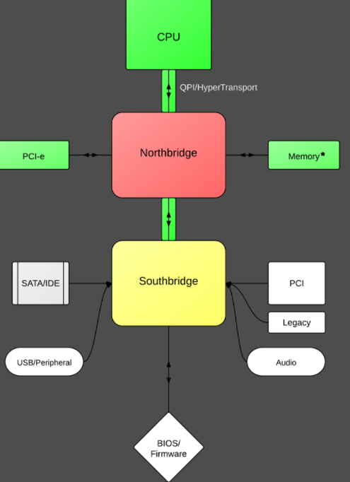
Basic Chipset Workflow

Slide 3
Intel Hub Architecture (IHA)
Intel Hub Architecture (IHA) is a chipset architecture consisting of a Memory Controller Hub or MCH and Input Output Controller Hub (ICH) which are connected together via bus.
Intel Hub Architecture was developed as a part of Intel Architecture in the year 1999.
It was high in usage and demand as well until it was being replaced by PCH or Platform Controller Hub in the year 2008.
It is no longer in use.

Slide 4
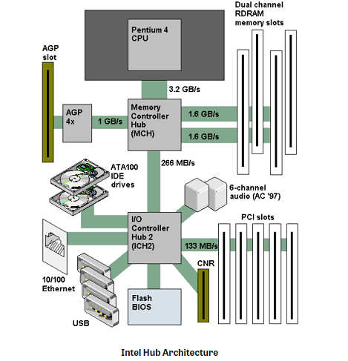

Slide 5
It uses a memory controller hub (MCH) that is connected to an I/O controller hub (ICH) via a 266 MB/sec bus.
The MCH chip supports memory and AGP, while the ICH chip provides connectivity for PCI, USB, sound, IDE hard disks and LAN.
Because of the high-speed channel between the sections, the Intel Hub Architecture (IHA) is much faster than the earlier Northbridge/Southbridge design, which hooked all low-speed ports to the PCI bus. The IHA also optimizes data transfer based on data type. See Northbridge and Intel chipsets.

Slide 6
Features of Hub Architecture
The Intel Hub Architecture contains of chips that are similar to the North and South Bridge.
The chips work faster than North and South bridge.
The data transfer is faster.
The data transfer is done according to the datatype that is being assigned to it.
The second version of IHA called the IHA 2.0 was introduced by Intel.
Separate data paths were assigned for faster data transfer.
IO transfers were made faster and were made access to high speed networks.

Slide 7
Advantages of IHA
IHA is a combination of North and South bridge thereby working faster.
It is cost effective.
The data transfer was much easier.
The data was transferred according to the user requests only making it another advantage.

Slide 8
Disadvantages of IHA
As the hardware technology advanced, so did the parts of the motherboard thus replacing Intel Hub Architecture with North and South bridge.

