Slide 1
Unit 1
On the Motherboard

Slide 2
PC Architecture –Basic Block Diagram
A block diagram of a computer gives you the pictorial representation of a computer that how it works inside.
In the computer’s block diagram, we will see how the computer works from feeding the data to getting the result.

Slide 3
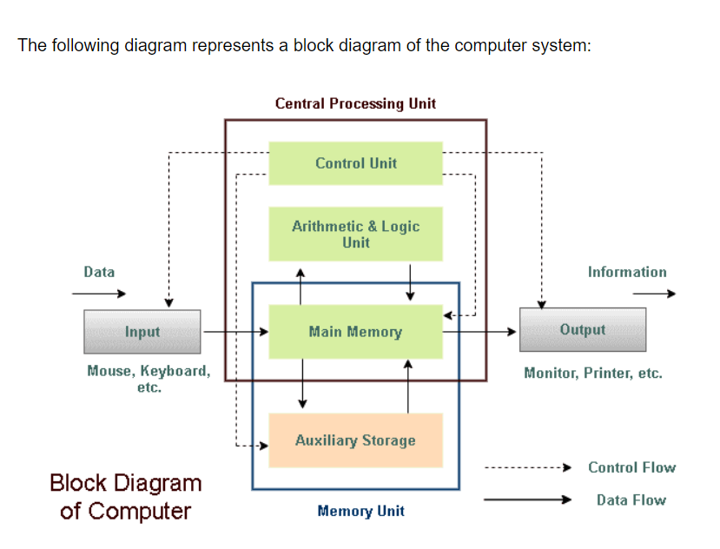

Slide 4
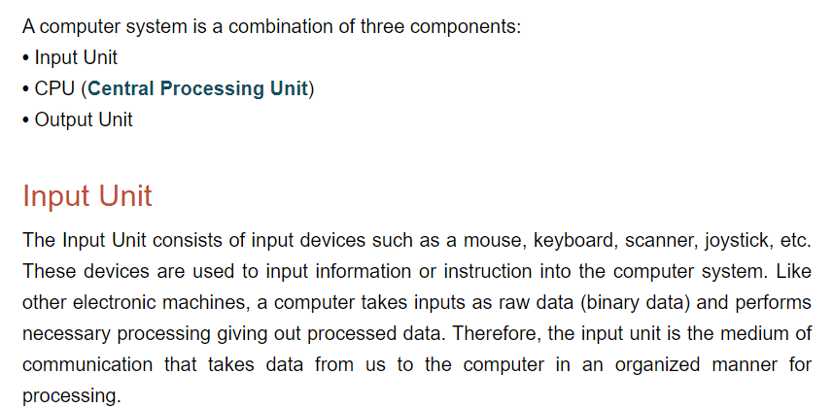

Slide 5
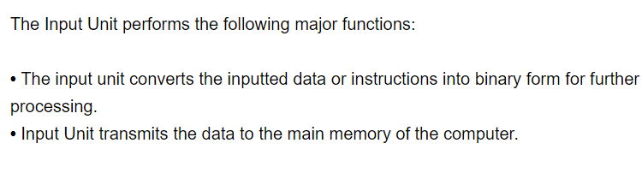

Slide 6
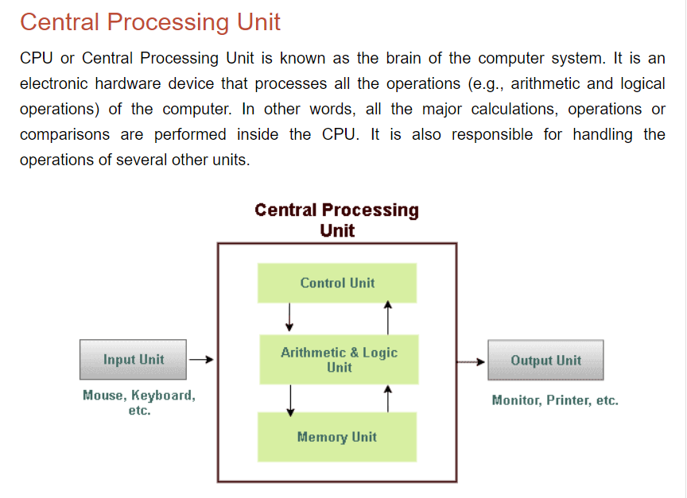

Slide 7
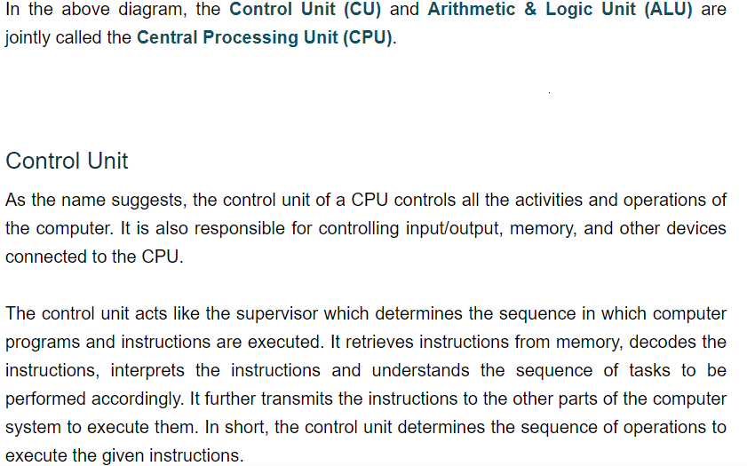

Slide 8
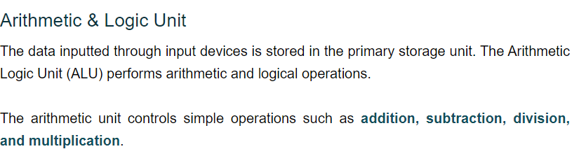

Slide 9
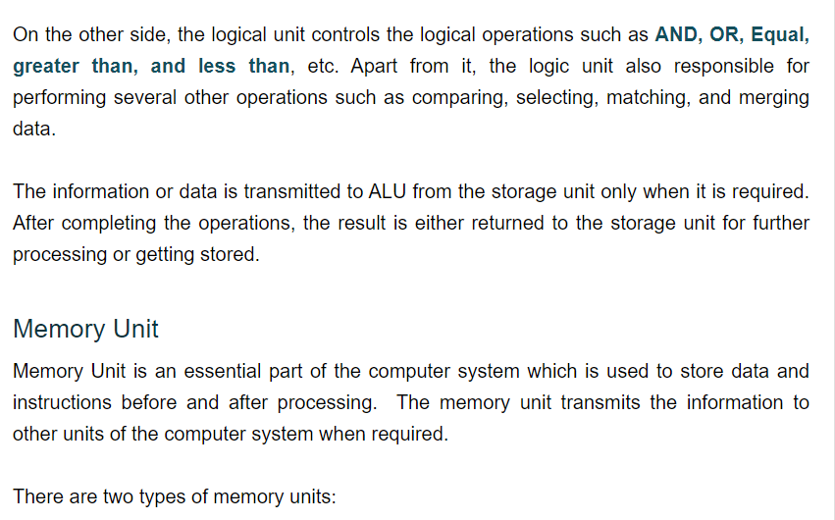

Slide 10
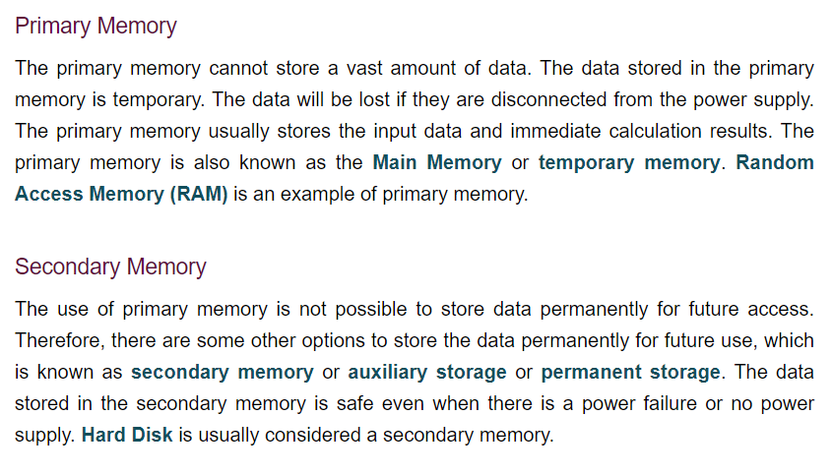

Slide 11
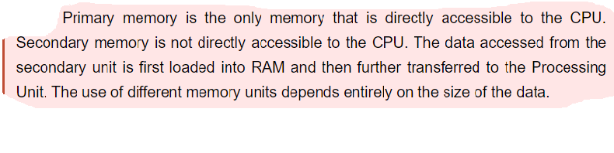

Slide 12
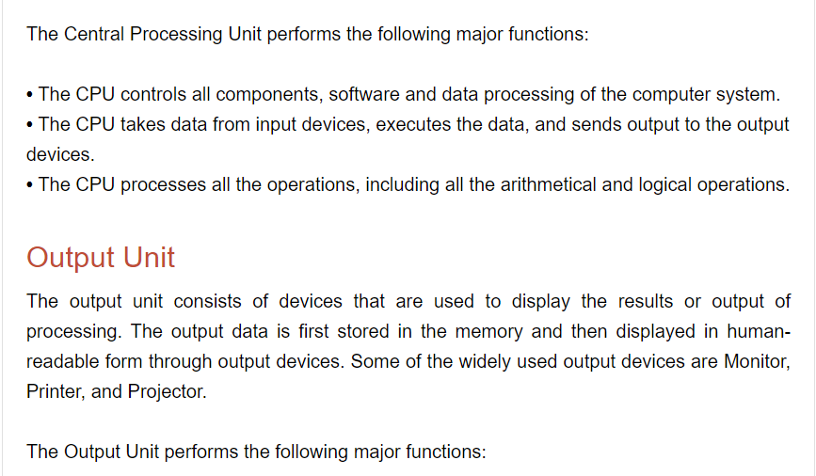

Slide 13
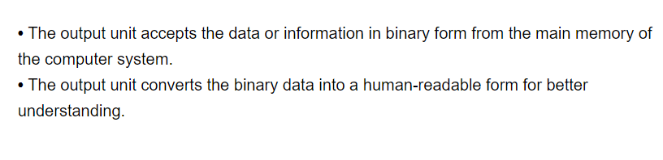

Slide 14
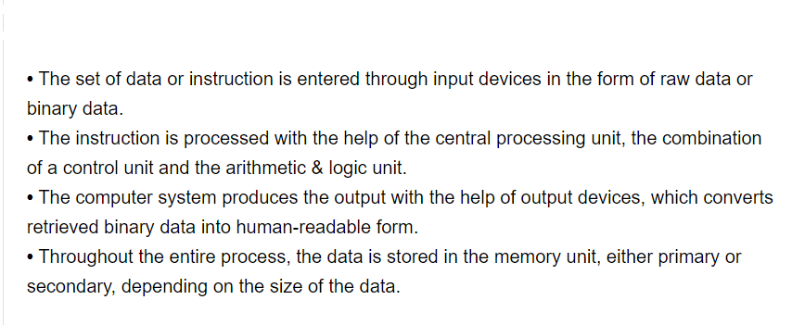
SUMMARY

