Slide 1
MBR

Slide 2
MBR (Master Boot Record)
MBR is Short for Master Boot Record, a small program that is executed when a computer boots up.
Typically, the MBR resides on the first sector of the hard disk or diskette that identifies how and where an operating system is located so that it can be boot (loaded) into the computer's main storage or random access memory.

Slide 3
The MBR contains two elements;
1. Executable code and
2. A partition table,

Slide 4
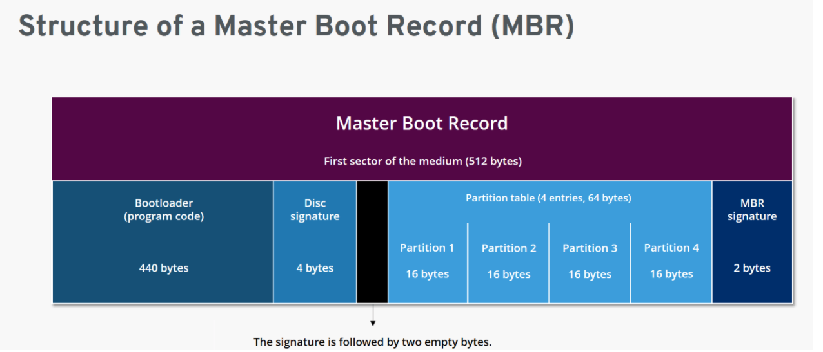

Slide 5
Master Boot Record is the first sector of a hard disk and the place where all the information about the disk and booting can be found.
It is the most essential part of the booting process.
Along with the bootloader program, MBR also contains details regarding the partitions of the hard disk.
The size of MBR is commonly less than or equal to 512 bytes.

Slide 6
Which identifies each partition residing on the hard drive.
The MBR executable code or program begins the boot process by looking up the partition table to determine what partition holds the operating system.

Slide 7
As the name suggests, Master Boot Record, commonly known as MBR, is the first (main) sector of a hard disk and determines the location of the operating system (OS) to complete the execution of the booting process.
MBR is often called the partition sector or master partition table because of its components.
It consists of a table that holds details of the partitions of the hard disk and their locations.
MBR also contains a record that helps in booting up the entire Operating System.

Slide 8
When a computer is first turned on, it runs a special program called Basic Input Output System (BIOS) that is stored in the Read-Only Memory (ROM).
BIOS contains the code that locates and executes MBR.
MBR contains a partition table holding locations of various hard disk partitions which further helps in loading the operating system.

Slide 9
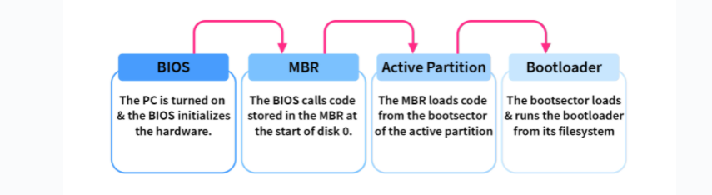
Flow from BIOS to Boot

Slide 10
The program begins the boot process by looking up the partition table to determine which partition to use for booting.
It then transfers program control to the boot sector of that partition, which continues the boot process.
In DOS and Windows systems, you can create the MBR with the FDISK/MBR command

Slide 11
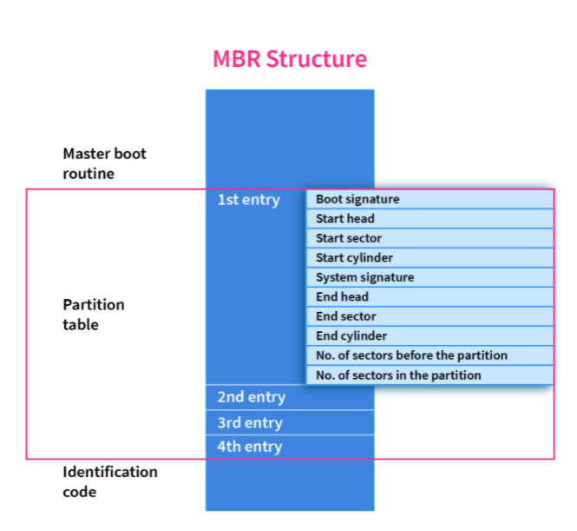

Slide 12
Functions of the MBR
The Master Boot Record will examine the hard disk partition table to verify if it is in excellent working condition and will look for a bootable partition active in the partition table.
MBR also aids in the memory storage of the contents of the active partition's initial logical sector.

Slide 13
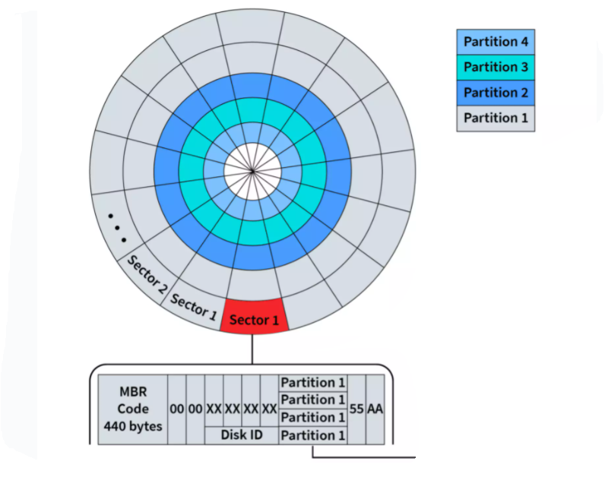
MBR in HDD

Slide 14
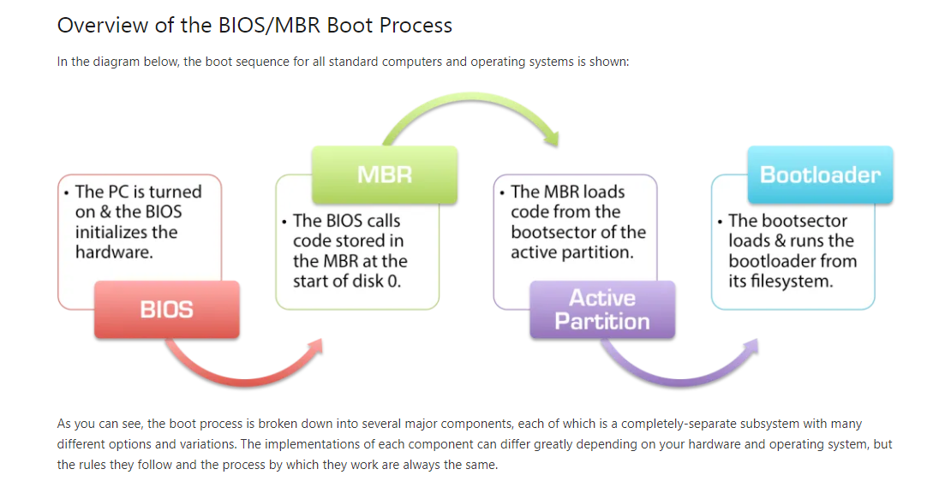

Slide 15
Hard Disk Partitioning

Slide 16
When considering the speed in reading a file from hard drive following are two important points related to partitioning.
Files in outer tracks are readable much faster
It is a well known theory in hard disk read/writes that performance is much higher in outer tracks compared to inner tracks.
When partitioning a hard disk, the first partition is created in the outer tracks
In creating partitions, the first partition is created in the outer most tracks while each new partition is created in inner tracks than the previous.
So the partitions in a hard disk would look as the below diagram.

Slide 17
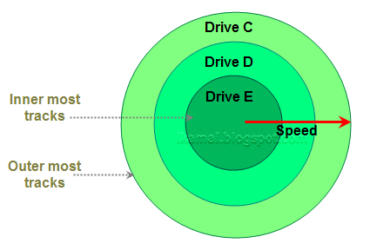

Slide 18
