Slide 1
Introduction to Motherboard

Slide 2
The motherboard is also known as logic board, baseboard, system board, mainboard, main circuit board, planar board, and mobo in a short way.
It is a nonconductive plastic sheet that has the necessary circuit and place holders like sockets/slots to connect components and provide logistics for all the components to work in a coordinated manner.

Slide 3
Thin narrow layers of Aluminum or Copper printed on the plastic sheet of the board acts like a circuit that connects various components.
It is a chassis(framework) in which all the components are fitted in the designated place and they are all powered and well interfaced with each other.

Slide 4
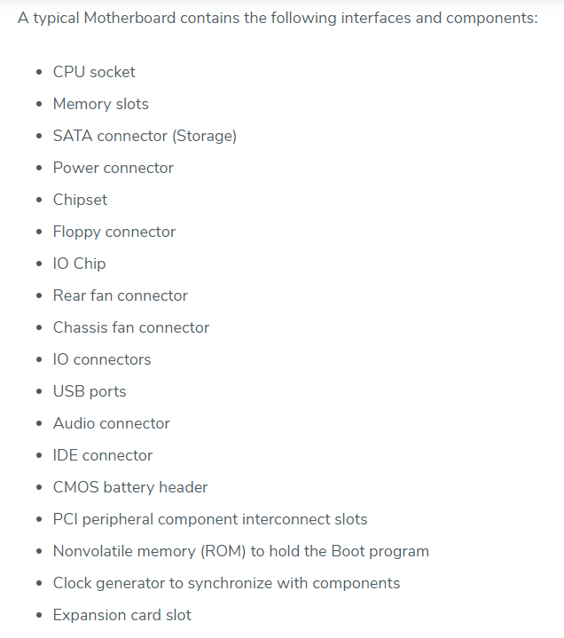

Slide 5
The motherboard is comprehensive in all aspects and it contains provisions to connect any kind of components to meet application requirements.
The motherboard is self-sufficient to meet all requirements and it is a single board to manage all the functions.
The name mother in the motherboard is attributed to its character as it takes a leadership role to manage all the components connected to it.

Slide 6
Mouse, keypads are connected to USB ports on the motherboard.
Apple computers motherboard has minimum provisions to connect to peripheral devices.
Many boards have a provision of expansion to connect to additional devices.
Heat sinks and fan points are available in the modern motherboard to transfer excess heat.

Slide 7
Types of Motherboard

Slide 8
Motherboards are present in Desktop, Laptop, Tablet, and Smartphone and the components and functionalities are the same.
But the size of the components and the way they are accommodated on the board varies due to space availability.
In desktops, most of the components are fitted inside the sockets provided on the board and it is easy to replace each of them separately, whereas in Laptops/Smartphones some components are soldered on the board, hence it is difficult to replace/upgrade.

Slide 9
Though different motherboards have varying capabilities, limitations, features, Physical size/shapes (form factor), they are identified/grouped/categorized mostly by their form factors.
Each manufacturer has come out with its form factor to suit the design of computers.
Motherboard manufactured to suit IBM and its compatible computers fit into other case sizes as well.
Motherboards built using ATX form factors were used in most of the computers manufactured in 2005 including IBM and Apple.

Slide 10
different types of Motherboards

Slide 11
AT Motherboard
ATX Motherboard
Pentium

Slide 12
AT Motherboard
These motherboards have bigger physical dimensions of hundreds of millimeters and hence they are not the right fit for the mini desktop category of computers.
Bigger physical size also inhibits installing new drivers.

Slide 13
Sockets and six-pin plugs are used as power connectors in these motherboards.
These power connectors are not that easily identifiable and hence users face difficulties in connecting and using it.
This type of motherboard was in vogue in the 1980s and it enjoyed a substantial self-life.

Slide 14
ATX Motherboard
ATX denotes Advanced technology extended, it was developed by Intel during the 1990s and it was an improved version over an earlier version of AT motherboard.
It is smaller in size when compared to AT and it provides interchangeability of the connected components.
There is a marked improvement in the connector aspects.

Slide 15
Pentium
What is an Intel motherboard and how does it work?
Modern Intel motherboards connect CPUs directly to RAM, from which it fetches instructions from different programs, as well as to some expansion slots that can hold performance-critical components such as GPUs and storage drives.

Slide 16
GPU (graphics processing unit) GPUs came about as a way to offload some tasks from CPUs, freeing up their processing power.
A GPU may be found integrated with a CPU on the same circuit, on a graphics card or in the motherboard of a personal computer or server.

Slide 17
Form factor plays an important role as the computer takes many shapes due to digital application needs where computers need to be inbuilt in the machines, moving vehicles, and in any equipment on the earth.
The nature and size of the motherboard will undergo continuous changes in the days to come.

Slide 18
MotherBoard Components

Slide 19
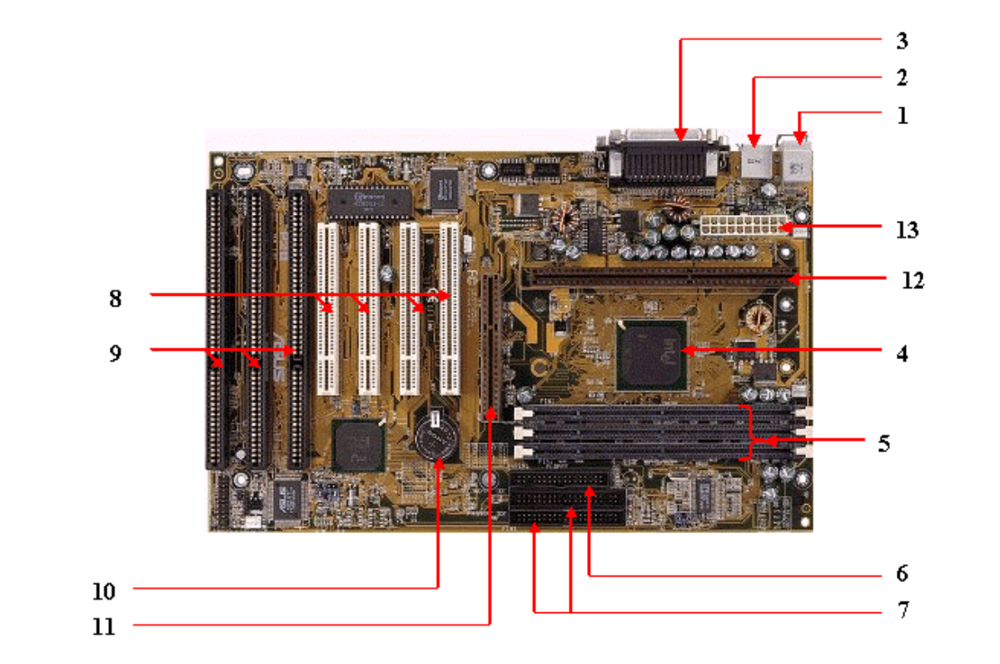

Slide 20
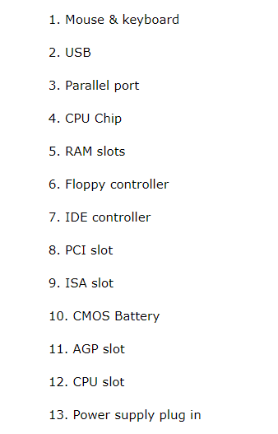

Slide 21
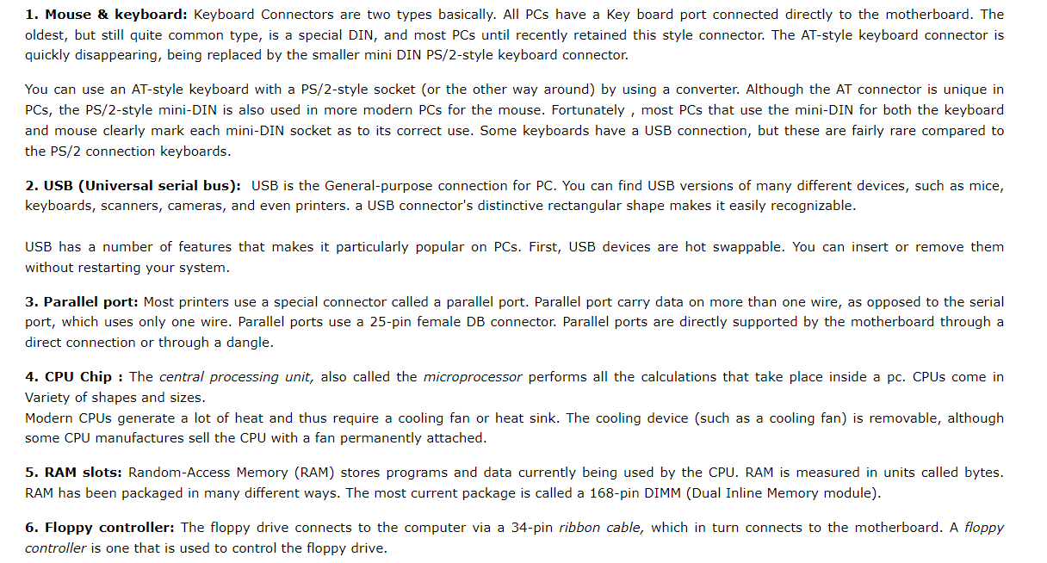

Slide 22
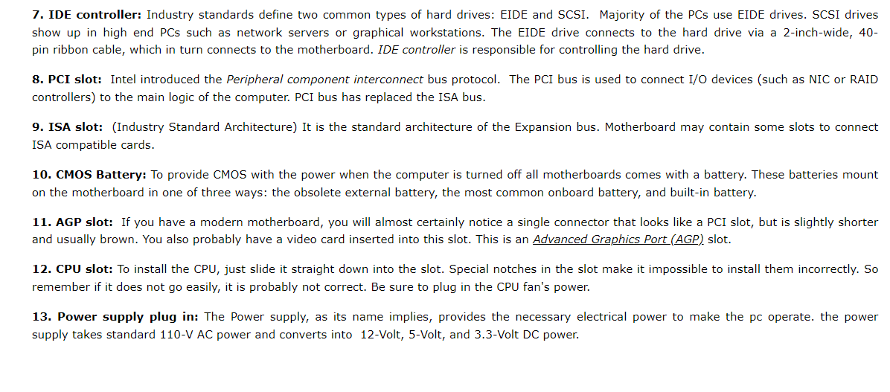

Slide 23
Reputed Computer Manufacturers
Manufacturers offering PCs with branded motherboards include Acer, Dell, HP, Lenovo, and others.
Dell Make: The range of computers offered include All-in-one models, high performance business grade computers, notebooks, mini notebooks, high performance gaming computers, and hardware/software accessories. Dell makes use of custom made motherboards. Please visit Dell site at www.dell.com for more information.
Lenovo make: The computer products offered by Lenovo include Laptops & netbooks, Desktops & all-in-ones, Workstations, and Servers. The company offers solutions for Home or home office, small/large businesses, educational institutes, healthcare, etc.
Acer Make: Acer brand is well known for its notebook and desktop computers. The company, like Dell, offers All-in-one series up to more powerful gaming computers. Acer too, provides motherboards that are custom made. Please visit Acer website www.acer.com for more information.

