Slide 1
Speeding up processor operations

Slide 2
Cache Memory
A faster and smaller segment of memory whose access time is as close as registers are known as Cache memory.
In a hierarchy of memory, cache memory has access time lesser than primary memory.
Generally, cache memory is very smaller and hence is used as a buffer.

Slide 3
Need of cache memory
Data in primary memory can be accessed faster than secondary memory but still, access times of primary memory are generally in few microseconds, whereas CPU is capable of performing operations in nanoseconds.
Due to the time lag between accessing data and acting of data performance of the system decreases as the CPU is not utilized properly, it may remain idle for some time.
In order to minimize this time gap new segment of memory is Introduced known as Cache Memory.

Slide 4
How does cache work?
Cache memory is faster, they can be accessed very fast
Cache memory is smaller, a large amount of data cannot be stored
Whenever CPU needs any data it searches for corresponding data in the cache (fast process) if data is found, it processes the data according to instructions,
however, if data is not found in the cache CPU search for that data in primary memory(slower process) and loads it into the cache.
This ensures frequently accessed data are always found in the cache and hence minimizes the time required to access the data.

Slide 5
Cache performance
On searching in the cache if data is found, a cache hit has occurred.
On searching in the cache if data is not found, a cache miss has occurred.

Slide 6
Performance of cache is measured by the number of cache hits to the number of searches. This parameter of measuring performance is known as the Hit Ratio.
Hit ratio=(Number of cache hits)/(Number of searches)

Slide 7
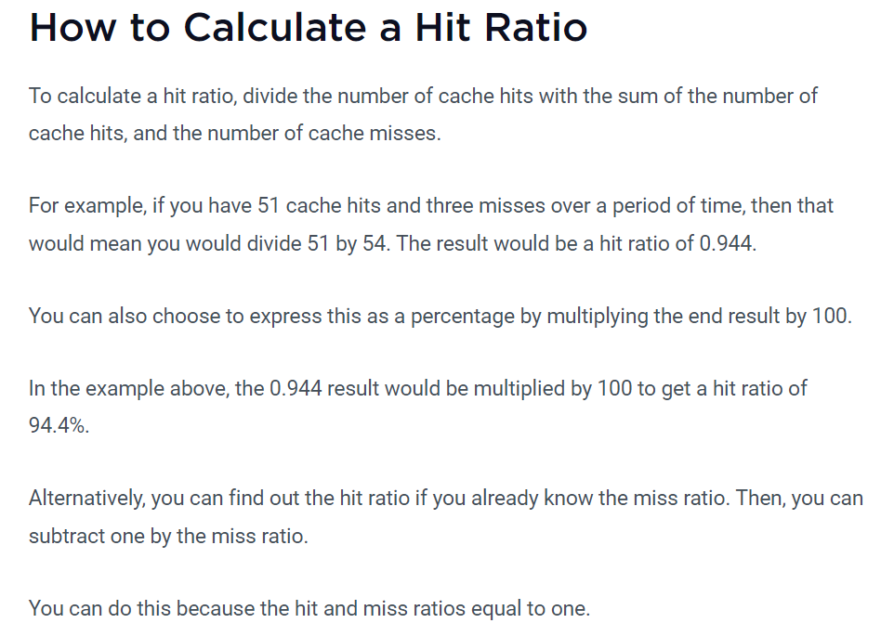

Slide 8
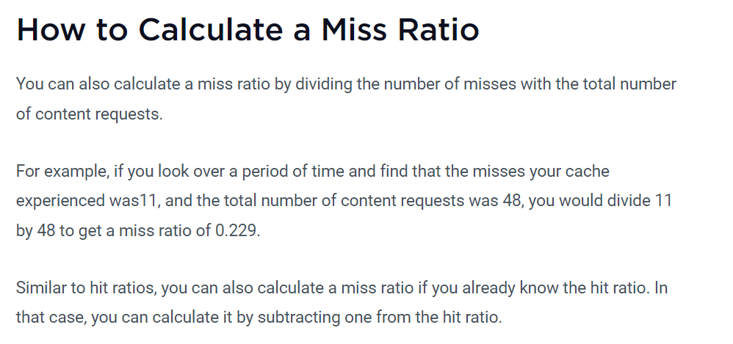

Slide 9
Clock Speed
A CPU can not operate alone when we give huge amount of data and instructions to it simultaneously.
It needs other components to work for it and for this it requires a clock which synchronizes all the components of the system.
Rate at which a processor completes its total processing cycle in one second is called as its ‘clock speed’.

Slide 10
It is also known as clock rate.
The performance of CPU has a major impact on the speed at which a program is loaded and then executed.
It is usually measured in Megahertz or Gigahertz .
In modern CPU, we measure clock speed in Gigahertz.

Slide 11
1 Megahertz = 1, 000, 000 cycles / sec
1 Gigahertz = 1, 000, 000, 000 cycles / sec

Slide 12
Examples :
A CPU with a clock speed of 4.2 MHz executes 4.2 Million cycles per second.
A CPU with a clock speed of 4.2 GHz executes 4.2 Billion cycles per second.

Slide 13
Generally, it is said that higher the clock speed, faster the CPU.
But this may not be the only reason for a faster CPU.
There are many factors behind it like number of processors, speed of RAM, bus speed, size of cache etc.
Some instructions require more cycles from CPU to be completed .

Slide 14
Depending upon the architecture of CPU the clock speed can be more or less important.
Some CPU can actually perform faster at slower clock speed while some processor’s architecture focuses more on high clock speed with few instructions per cycle.

Slide 15
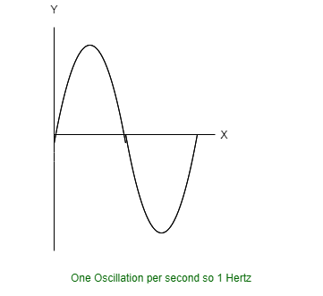

Slide 16
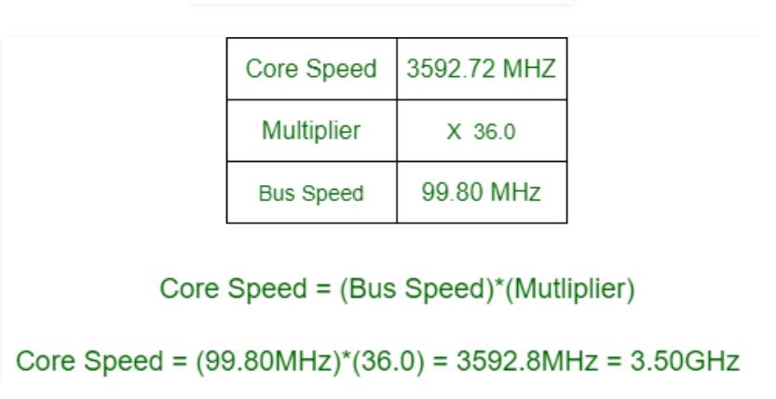

Slide 17
Speed of CPU determines number of calculations it can perform in one second of time.
However, the speed of the CPU clock for processing power can be increased by ‘overclocking’.
But as we raise the clock speed there can be stability issues and our system might get crashed.

Slide 18
Higher clock speeds can generate more heat so, to keep themselves away from dangerous overheating, processors will strangle down to a lower frequency when they get overheated.
Overclocking may also lead to over volting.

Slide 19
Overvolting is when you raise the voltage given to the chip in order to increase the clock speed.
Altair 8800, the first commercial PC used an Intel 8080 CPU with clock rate of 2 MHz (2 Million cycles / sec) and Intel P5 Pentium has clock rate of 100 MHz (100 Million cycles / sec) .
In 2000, AMD was the first processor that reached 1 GHz (1 Billion cycles / sec).
In 2002, an Intel Premium 4 was the first CPU with clock rate of 3GHz (3 Billion cycles / sec).

Slide 20
Overclocking
In the computer world overclocking is referred to as the act of increasing the clock rate of a computer component like processor, RAM, etc.
For example, if we have a processor which has a base clock of 2.91 GHz, So, making it run at higher clock rate than 2.91 GHz will be termed as overclocking.

Slide 21
Nowadays, it is very easy to overclock any given components due to sophisticated engineering that goes into designing that component.
The graphics cards, processors, RAM modules, monitors, PCI express slots, motherboards, etc.
All of these components now come with overclocking capabilities.

Slide 22
What Is Overclocking?
our computer’s CPU comes from the factory set to run at a certain maximum speed. If we run our CPU at that speed with proper cooling, it should perform fine without giving we any problems.

Slide 23
However, we’re often not limited to that CPU speed. we can increase the CPU’s speed by setting a higher clock rate or multiplier in the computer’s BIOS, forcing it to perform more operations per second.
This can speed up our CPU — and therefore speed up our computer if our computer is limited by its CPU — but the CPU will produce additional heat.
It may become physically damaged if we don’t provide additional cooling, or it may be unstable and cause our computer to blue-screen or restart.

Slide 24
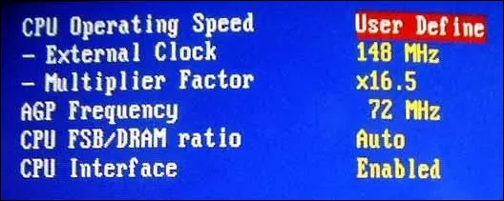

Slide 25
Gamers or enthusiasts that want their hardware to run as fast as possible may still want to overclock.
However, even gamers will find that modern CPUs are so fast and games are so limited by graphics cards that overclocking doesn’t work the magic it used to.
Overclocking a GPU may get you a small increase in performance, though, depending on our system and the games we are playing.

Slide 26
PROS and CONS of overclocking

Slide 27
Pros –
We get higher clock rates and hence processing speeds.
Faster computer performance.
We will be able to squeeze more performance out of our existing PC, without spending even a single penny.

Slide 28
Cons –
The warranty of the product is void if overclocked.
The overall life of the product will be decreased.
The product may get damaged or may become unfunctional if overclocked beyond some specified limits.

