Slide 1
Upgrading and replacing motherboard

Slide 2
Before replacing a motherboard, it is important to do all the following
Remove the CPU and CPU fan.
Remove adapters from expansion slots.
Remove memory chips from expansion slots.
Disconnect power connectors.
Disconnect ribbon cables.
Disconnect external devices such as mouse, keyboard, and monitor.

Slide 3
Replacement motherboards do not normally come with RAM, so the old modules are removed from the bad/older motherboard.
A motherboard usually does not come with a CPU.
Make note of the CPU orientation before removing it from the bad/older motherboard.
Some retailers sell kits that include the computer case, power supply, motherboard, and CPU so that the components match, function together correctly, and are physically compatible.

Slide 4
upgrading a motherboard
Clarify the reasons for upgrade
Why is the computer being upgraded?
For example,
does the computer need more memory?
Are more expansion slots needed?
Does the computer need a bigger/faster CPU to run certain operating systems or applications?

Slide 5
Is more space wanted in the computer area?
Sometimes upgrading the motherboard does not help unless the other computer components are upgraded.
The most expensive and fastest motherboard/CPU will not run applications well unless it has the proper amount of memory.
Hard drives are another issue.
If software access is slow, the solution might not be a new motherboard but a faster and larger hard drive or more RAM.

Slide 6
Which type of expansion slot (PCI, AGP, or PCIe) and how many adapters of each type are needed from the old motherboard?
Does the new motherboard have the required expansion slots?

Slide 7
What type of chipsets does the new motherboard support? What features, if any, would this bring to the new motherboard?
(Each motherboard has chipset, which is the collection of controllers and chips. Every new motherboard uses a new chipset at the time they are developed. Although these motherboards are usually faster and more efficient as compared to their predecessors, the older components often do not work with new chipsets.)

Slide 8
Will the new motherboard fit in the current computer case, or is a new one required?
If upgrading the CPU, will the motherboard support the new type of CPU?
Does the motherboard allow for future CPU upgrades?
How much memory (RAM) does the motherboard allow?
What memory chips are required on the new motherboard?
Will the old memory chips work in the new motherboard or with the new CPU?

Slide 9
Processor Cooling

Slide 10
Keeping the CPU cool is critical.
Both Intel and AMD have technologies that reduce processor energy consumption (and heat) by turning off unused parts of the processor or slowing down the processor when it starts to overheat.
But these measures alone are not enough.
Today’s systems use one or more of the methods listed in table

Slide 11
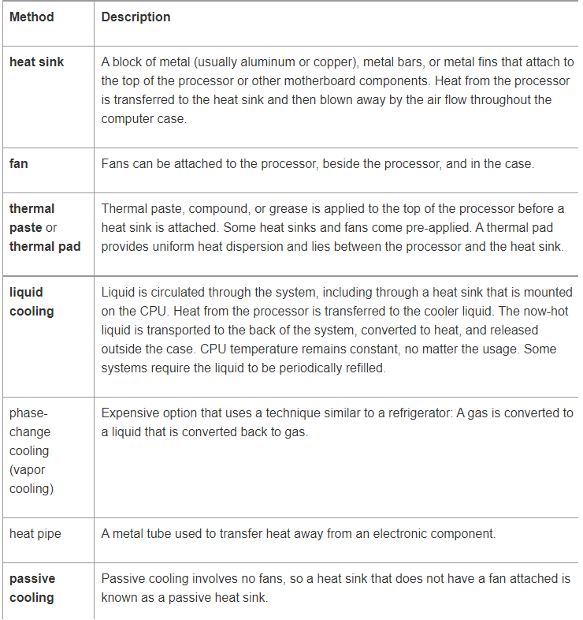

Slide 12
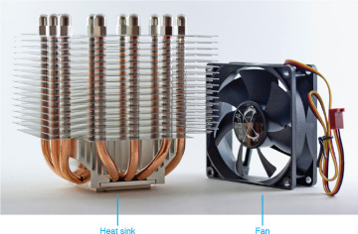

Slide 13
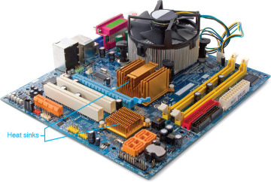
Motherboard heat sinks

Slide 14
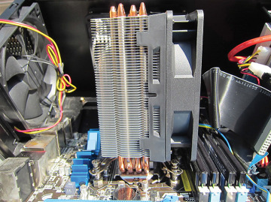
CPU with heat sink and fan attached
The largest chip on the motherboard with a fan or a heat sink attached is easily recognized as the processor.
Figure shows an Intel Core i7 that has a fan and a heat sink installed.
Notice the heat pipes that are used as part of the heat sink.

Slide 15
CMOS setup

Slide 16
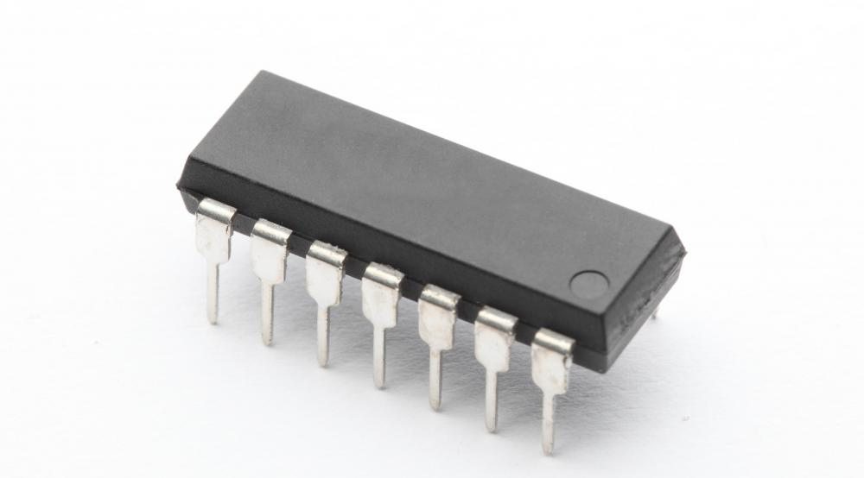
What Is CMOS?
CMOS stands for complementary metal oxide semiconductor (CMOS)
It is a type of integrated circuit technology.
The term is often used to refer to a battery-powered chip found in many personal computers that holds some basic information, including the date and time and system configuration settings, needed by the basic input/output system (BIOS) to start the computer.

Slide 17
most modern computers no longer use these chips for this function,
but instead depend on other forms of non-volatile memory.
CMOS chips are still found in many other electronic devices, including digital cameras.

Slide 18
The CMOS is a little bit of RAM that stores all the BIOS information so that each time the computer restarts or powers on, the computer can remember this information.
To provide CMOS with the power when the computer is turned off all motherboards comes with a battery.
These batteries mount on the motherboard in one of three ways: the obsolete external battery, the most common onboard battery, and built-in battery.

Slide 19
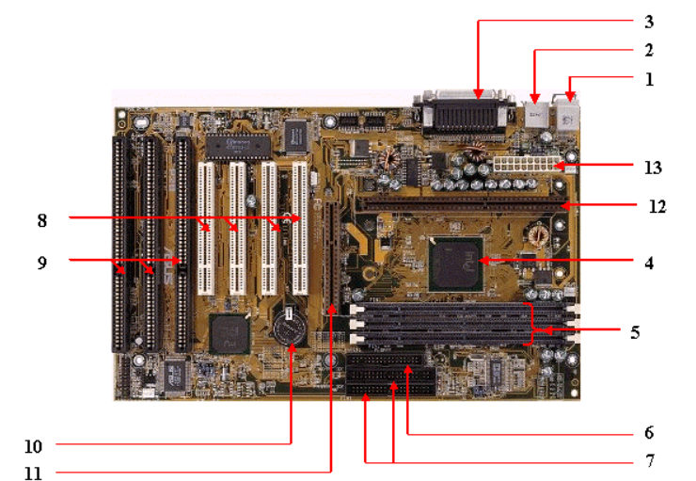
10. CMOS BATTERY

Slide 20
CMOS (short for complementary metal-oxide-semiconductor) is the term usually used to describe the small amount of memory on a computer motherboard that stores the BIOS settings.
Some of these BIOS settings include the system time and date, as well as hardware settings.

Slide 21
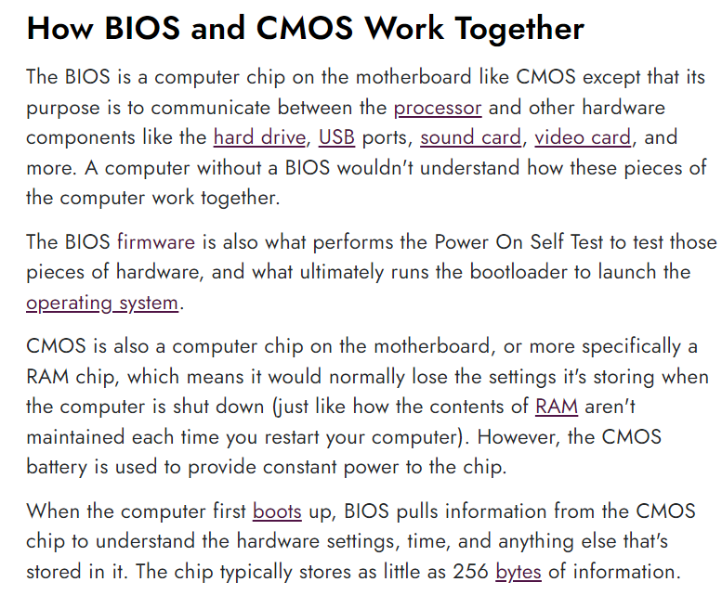

Slide 22
