Slide 1
Unit 3

Slide 2
CHIPSET BASICS
What is a Chipset???????????
A motherboard is a PCB that connects all components of the computer.
In older computers, all the chips were spread across the motherboard.
In modern computers, the number of chips is reduced and centralized into particular locations.

Slide 3
Therefore, multiple chips are combined together to form one single chip. This chip that can replace a large number of chips is called a chipset. There is a chipset in the motherboard. Chipset handles the communication between various components such as CPU, peripherals, and buses. Northbridge and southbridge are two chips in the chipset.

Slide 4
In PC, the chipset represents the connection between the processor and everything else. The processor can’t talk to the memory, adapter boards, devices without going through the chipset
If processor is the brain, the chipset is spine and central nervous system of computer.
The chipset manufacturers are Intel, Acer Labs, Silicon Integrated System (SIS) and AMD etc.

Slide 5
The chipset is the "glue" that connects the microprocessor to the rest of the motherboard and therefore to the rest of the computer.
On a PC, it consists of two basic parts -- the northbridge and the southbridge.
All of the various components of the computer communicate with the CPU through the chipset.

Slide 6
Chipset Architecture
Intel has used two different chipset architectures:
North/South bridge architecture
Hub architecture.
All the chipsets introduced from the 800 series onwards, use the hub architecture.

Slide 7
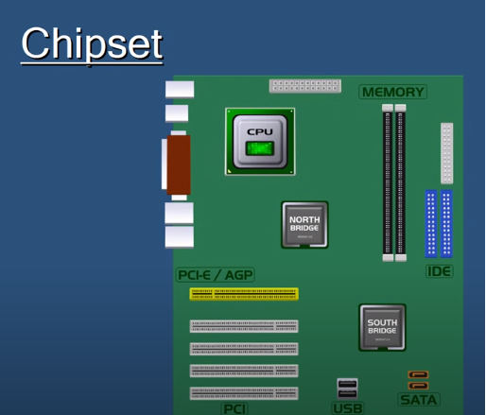

Slide 8
The northbridge connects directly to the processor via the front side bus (FSB).
A memory controller is located on the northbridge, which gives the CPU fast access to the memory.
The northbridge also connects to the AGP or PCI Express bus and to the memory itself.

Slide 9
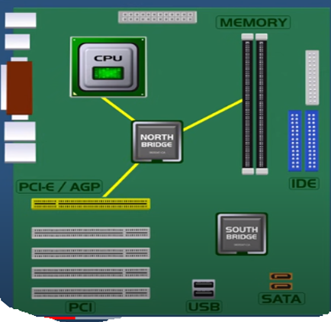

Slide 10
The southbridge is slower than the northbridge, and information from the CPU has to go through the northbridge before reaching the southbridge.
Other buses connect the southbridge to the PCI bus, the USB ports and the IDE or SATA hard disk connections.

Slide 11
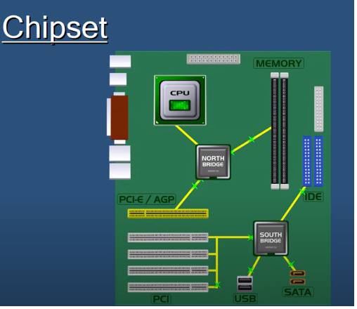

Slide 12
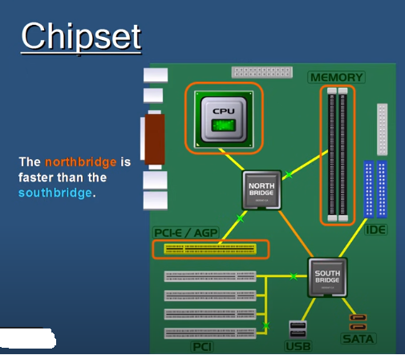

Slide 13
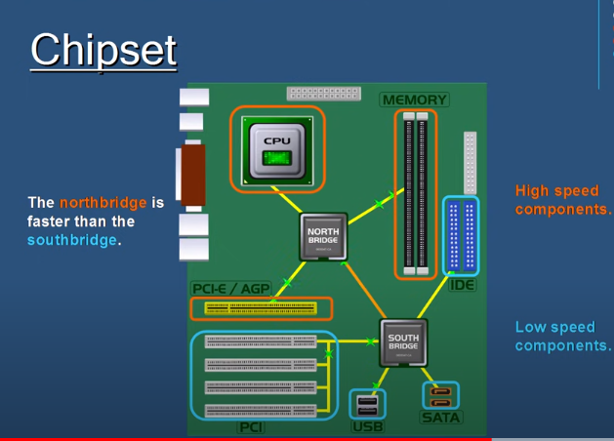

Slide 14
Bus

Slide 15
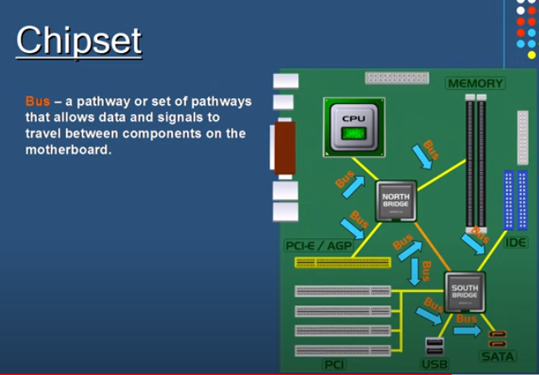

Slide 16
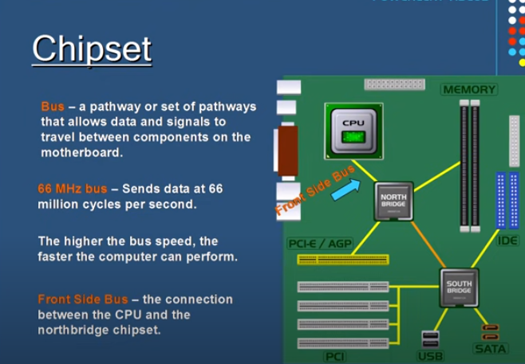

Slide 17
A bus is simply a circuit that connects one part of the motherboard to another.
The more data a bus can handle at one time, the faster it allows information to travel.
The speed of the bus, measured in megahertz (MHz), refers to how much data can move across the bus simultaneously.

Slide 18
Bus speed usually refers to the speed of the front side bus (FSB), which connects the CPU to the northbridge.
FSB speeds can range from 66 MHz to over 800 MHz.
Since the CPU reaches the memory controller though the northbridge, FSB speed can dramatically affect a computer's performance.

Slide 19
Bus
The motherboard's bus transfers data between parts. The term "bus speed" refers to how quickly the system bus can move data from one computer component to the other.
The faster the bus, the more data it can move within a given amount of time.

Slide 20
The system's "Front Side Bus" connects the CPU to the computer's "Northbridge," which handles communication between the computer's RAM and the processor.
This is the fastest part of the bus and handles the computer's most vital workload.

Slide 21
Bus Feeds the CPU
The CPU itself needs data to process; the bus' job is to get that data to the CPU. The bus does not increase or decrease the CPU's speed, but handles that data that flows in and out of the device, which plays a key role in how well the CPU performs.

Slide 22
This is the point where the Bus can affect the CPU's performance output – the CPU works in a cyclical process, with data going in and out of the device on a timed interval.
If the CPU doesn't have any data to work with in a cycle, it wastes a cycle and doesn't process any data.

Slide 23
Chipset selection and CPU selection go hand in hand, because manufacturers optimize chipsets to work with specific CPUs.
The chipset is an integrated part of the motherboard, so it cannot be removed or upgraded.
This means that not only must the motherboard's socket fit the CPU, the motherboard's chipset must work optimally with the CPU.

