Slide 1
Unit 3

Slide 2
Difference Between Northbridge and Southbridge
The main difference between northbridge and southbridge is that the northbridge is a chip in the chipset of a motherboard that directly connects to the CPU while the southbridge is a chip in the chipset of a motherboard that does not directly connects to the CPU.

Slide 3
Modern computers are electronic devices that are designed to perform multiple tasks.
There are various components in a computer. The CPU or the processor manages the functionalities of the other components.
A motherboard is a Printed Circuit Board (PCB) that allows communication between various components of the system.
A motherboard consists of a chipset.
Northbridge and southbridge are two chips in that chipset.
High-speed components are connected to the northbridge while lower speed components are connected to the southbridge.

Slide 4
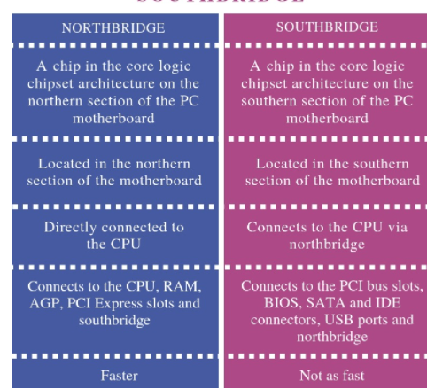

Slide 5
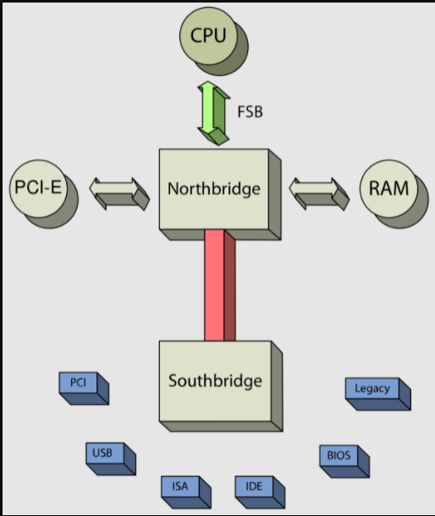
Location of Northbridge and southbridge

Slide 6
Connecting Components
Northbridge connects to the CPU, RAM, AGP, PCI Express slots and southbridge.
On the other hand, southbridge connects to the PCI bus slots, BIOS, SATA and IDE connectors, USB ports and northbridge.
Operating Speed
northbridge operates faster than southbridge.

Slide 7
