Slide 1
Unit3

Slide 2
Intel Chipset 915 G Features
dual-channel DDR main memory
PCI-Express interface
It provides revolutionary graphics experience with Intel® Media Accelerator 900 Technology
Serial-ATA interface for improving storage performance.

Slide 3
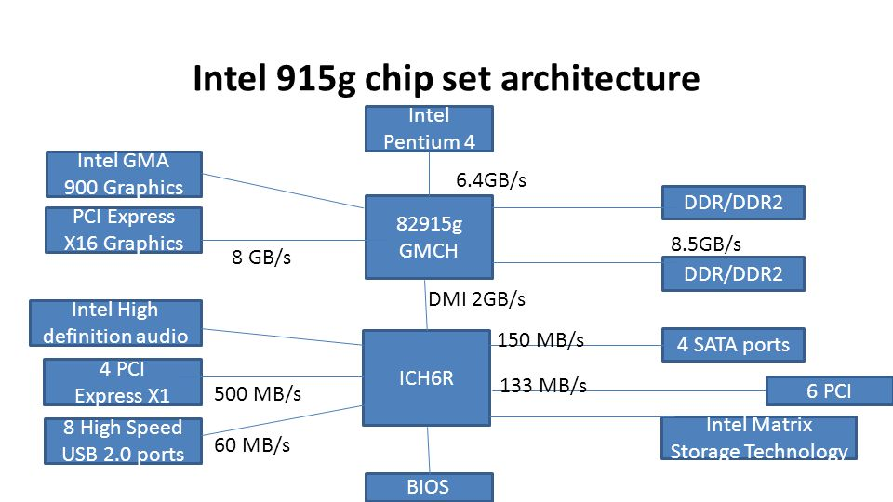

Slide 4
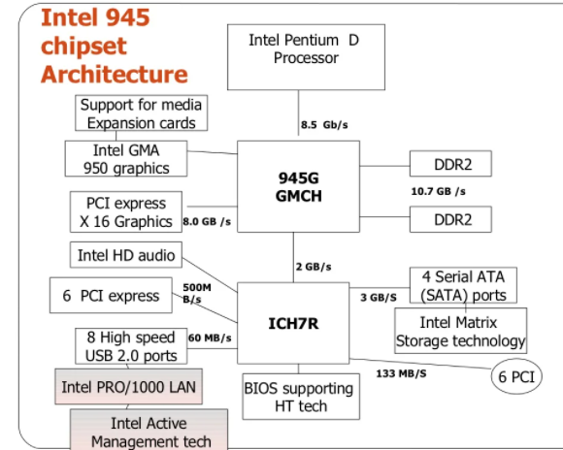
Intel Chipset 945 G architecture

