Slide 1
Types of Storage Devices
6A-<number>

Slide 2
Describing Storage Devices
Store data when computer is off
Two processes
  Writing data
  Reading data
6A-<number>

Slide 3
Describing Storage Devices
Storage terms
  Media is the material storing data
  Storage devices manage the media
  Magnetic devices use a magnet
  Optical devices use lasers
  Solid-state devices have physical switches
6A-<number>

Slide 4
Magnetic Storage Devices
Most common form of storage
Hard drives, floppy drives, tape
All magnetic drives work the same
6A-<number>
Notes:
Teaching tip
Figure 6A.2 and 6A.3 on page 227 provide illustrations of devices and the read/write process.

Slide 5
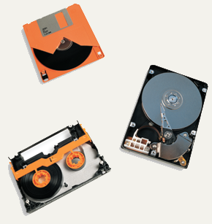
Magnetic Storage Devices
Floppy Disk
Hard Disk
Tape
6A-<number>

Slide 6
Magnetic Storage Devices
Data storage and retrieval
  Media is covered with iron oxide
  Read/write head is a magnet
  Magnet writes charges on the media
    Positive charge is a 1
    Negative charge is a 0
  Magnet reads charges
  Drive converts charges into binary
6A-<number>
Notes:
Teaching tip
This process is difficult for students to see. Draw a diagram on the board that illustrates the process.

Slide 7
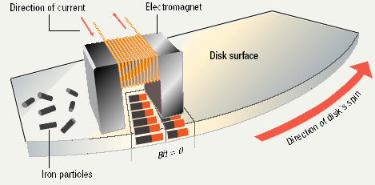
Data Retrieval
6A-<number>

Slide 8
Magnetic Storage Devices
Data organization
  Disks must be formatted before use
  Format draws tracks on the disk
  Tracks is divided into sectors
    Amount of data a drive can read
6A-<number>
Notes:
Discussion point
Discuss the sector size limitation. Discuss what can happen when writing a 1-byte file or a 513-byte file. After the waste issue is brought up, then discuss the problem from the hardware issue. How can a manufacturer make a 1-byte head?

Slide 9
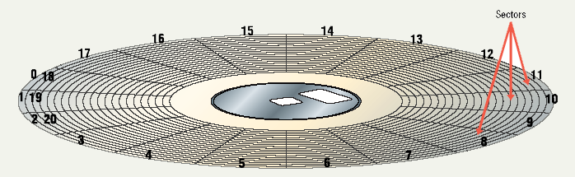
Tracks and Sectors
6A-<number>

Slide 10
Magnetic Storage Devices
Finding data on disk
  Each track and sector is labeled
    Some are reserved
  Listing of where files are stored
    File Allocation Table (FAT)
    FAT32
    NTFS
  Data is organized in clusters
    Size of data the OS handles
6A-<number>
Notes:
Teaching tip
Draw clustering on the board. Discuss why it can improve the performance of a system.

Slide 11
Magnetic Storage Devices
Diskettes
  Also known as floppy disks
  Read with a disk drive
  Mylar disk
  Spin at 300 RPM
  Takes .2 second to find data
  3 ½ floppy disk holds 1.44 MB
6A-<number>
Notes:
Teaching tip
The formula for the disk capacity is listed on page 232 of the text.

Slide 12
Magnetic Storage Devices
Hard disks
  Primary storage device in a computer
  2 or more aluminum platters
  Each platter has 2 sides
  Spin between 5,400 to 15,000 RPM
  Data found in 9.5 ms or less
  Drive capacity greater than 40 GB
6A-<number>
Notes:
Teaching tip
Students often have a hard time grasping the speed of a hard drive. Use an analogy: The circumference of a hard drive platter is nearly 1 foot. A drive spinning 5,400 RPM can travel 5,400 feet in one minute, or a little over 1 mile in a minute!

Slide 13
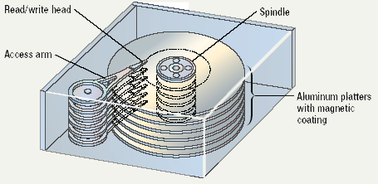
Illustrated Hard Disk
6A-<number>

Slide 14
Magnetic Storage Devices
Removable high capacity disks
  Speed of hard disk
  Portability of floppy disk
  Several variants have emerged
  High capacity floppy disk
    Stores up to 750 MB of data
  Hot swappable hard disks
    Provide GB of data
    Connect via USB
6A-<number>

Slide 15
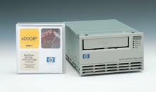
Magnetic Storage Devices
Tape drives
  Best used for
    Infrequently accessed data
    Back-up solutions
  Slow sequential access
  Capacity exceeds 200 GB
6A-<number>
Notes:
Teaching tip
Students often do not understand why random access hard drives and floppy drives are faster than sequential drives. To illustrate, compare the modern audio CD to the antiquated 8-track. On a CD if you wish to hear song 1 over and over, you simply press repeat. In an 8-track, you often must play the entire tape before the song can be repeated.

Slide 16
Optical Storage Devices
CD-ROM
  Most software ships on a CD
  Read using a laser
    Lands, binary 1, reflect data
    Pits scatter data
  Written from the inside out
  CD speed is based on the original
    Original CD read 150 Kbps
    A 10 X will read 1,500 Kbps
  Standard CD holds 650 MB
6A-<number>

Slide 17
Optical Storage Devices
DVD-ROM
  Digital Video Disk
  Use both sides of the disk
  Capacities can reach 18 GB
  DVD players can read CDs
6A-<number>

Slide 18
Recordable Optical Technologies
CD Recordable (CD-R)
  Create a data or audio CD
  Data cannot be changed
  Can continue adding until full
6A-<number>

Slide 19
Recordable Optical Technologies
CD Rewritable (CD-RW)
  Create a reusable CD
  Cannot be read in all CD players
  Can reuse about 100 times
6A-<number>
Notes:
Insider Information
When a CD-R or RW is ‘burned’, the laser modifies the reflectivity of a dye that is sandwiched between the bottom clear layer and a top reflective layer. The lands are transparent sections while the pits are non-reflective.

Slide 20
Recordable Optical Technologies
Photo CD
  Developed by Kodak
  Provides for photo storage
  Photos added to CD until full
  Original pictures cannot be changed
6A-<number>

Slide 21
Recordable Optical Technologies
DVD Recordable
  Several different formats exist
  None are standardized
  Allows home users to create DVDs
  Cannot be read in all players
6A-<number>
Notes:
Teaching tip
There are several formats of DVD recordable. Current research indicates that DVD+R is more compatible with devices than the other formats. Spend time researching the different standards.

Slide 22
Recordable Optical Technologies
DVD-RAM
  Allow reusing of DVD media
  Not standardized
  Cannot be read in all players
6A-<number>

Slide 23
Solid State Devices
Data is stored physically
No magnets or laser
Very fast
6A-<number>

Slide 24
Solid State Devices
Flash memory
  Found in cameras and USB drives
  Combination of RAM and ROM
  Long term updateable storage
6A-<number>

Slide 25
Solid State Devices
Smart cards
  Credit cards with a chip
  Chip stores data
  Eventually may be used for cash
  Hotels use for electronic keys
6A-<number>

Slide 26
Solid State Devices
Solid-state disks
  Large amount of SDRAM
  Extremely fast
  Volatile storage
  Require battery backups
  Most have hard disks copying data
6A-<number>

Slide 27
Continue………………..
6A-<number>

Slide 28
Storage solutions that are currently available in computer world, are of different types and these vary from Direct Attached Storage (DAS) solutions to Network Attached Storage (NAS) solutions.
Use of disaster recovery methods and business continuity planning has boosted the demand for better and reliable storage solutions.
Storage used with the computer systems can be either internal storage or external storage type.

Slide 29
The most common internal storage used in the computer systems is the hard disk which is also known as fixed disk.
Hard disks store data on magnet-coated surfaces in the form of magnetic patterns.
Commonly used external storage devices include hard disks, DVD, magnetic tape, flash drive, etc.
External storage devices are connected to the computers through USB, FireWire or other interfaces.

Slide 30
Data transfer to external hard disks is faster than data transfer to the optical devices.
External hard disks are reliable and cheaper.
Optical storage has become a common storage technology in the recent years.
This technology makes use of laser beams for storing data and files in the medium.

Slide 31
CD, DVD, Blu-ray are the examples of storage devices that are using optical storage technology.
Storage devices are available with different storage capacities.
A large storage means more applications and files can be stored in it. Capacity of the modern hard disks is measured in higher units such as gigabytes (GB), terabytes (TB), etc.

Slide 32
. The total capacity of disk can be calculated when the details of tracks and sectors are known. The storage capacity is calculated using the following equation:
Storage capacity = Number of sides * Heads * Surface * Number of tracks * Number of sectors * 512 bytes.

Slide 33
Example
Consider a disk pack with the following specifications-
16 surfaces,
128 tracks per surface,
256 sectors per track and 512 bytes per sector.
What is the capacity of disk pack?

Slide 34
Solution-
Number of surfaces = 16
Number of tracks per surface = 128
Number of sectors per track = 256
Number of bytes per sector = 512 bytes
Capacity of disk pack
= Total number of surfaces x Number of tracks per surface x Number of sectors per track x Number of bytes per sector
= 16 x 128 x 256 x 512 bytes = 228 bytes
= 256 MB

Slide 35
Flash memory devices
A flash memory device contains trillions of interconnected flash memory cells that store data.
These cells hold millions of transistors that when switched on or off represent 1s and 0s in binary code, allowing a computer to read and write information.

Slide 36
One of the most recognizable type of flash memory device is the USB flash drive.
These days, a USB flash drive can hold up to 2 TB of storage.
They’re more expensive per gigabyte than an external hard drive, but they have prevailed as a simple, convenient solution for storing and transferring smaller files.
Aside from USB drives, flash memory devices also include SD and memory cards, which is a storage medium used in digital cameras.

Slide 37
Optical Storage Devices
CDs, DVDs, and Blu-Ray discs are Collectively known as optical storage devices or optical media.
Binary code is stored on these disks in the form of minuscule bumps along a track that spirals outwards from the center of the disk.
When the disk is in operation it spins at a constant speed, while a laser contained within the disk drive scans the bumps on the disk.

Slide 38
The way the laser reflects or bounces off a bump determines whether it represents a 0 or 1 in binary.
A DVD has a tighter spiral track than a CD, allowing it to store more data despite being the same size, and a finer red laser is used in DVD drives than CD drives.
DVDs also allow dual layering to increase their capacity further.
Blu-Ray store data on multiple layers with even smaller bumps that require an even finer blue laser to read them.

Slide 39
CD-ROM, DVD-ROM, and BD-ROM refer to read-only optical storage disks.
The data written on them is permanent and cannot be removed or overwritten.
This is why they can't be used as a personal storage. Instead, they are typically used for software installation programs.

Slide 40
CD-R, DVD-R, and BD-R format disks are recordable, but cannot be overwritten.
Whatever data you save on a blank recordable disk will then be permanently stored on that disk.
So, they can store data, but they’re not quite as flexible as other storage devices.

Slide 41
CD-RW, DVD-RW, and BD-RE are re-writable. This allows you can to write new data on them and erase unwanted data from them as much as you want.
They’ve been overtaken by newer technology like flash memory, but CD-RWs were once the top choice for external storage.
Most desktop computers and many laptops have a CD or DVD drive.
CD can store up to 700 MB of data, DVD-DL can store up to 8.5 GB, and Blu-Ray can store between 25 and 128 GB of data.

Slide 42
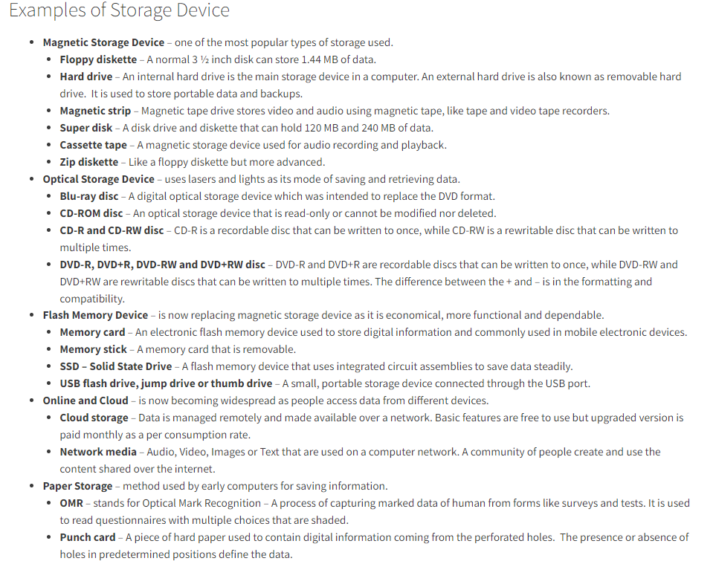

Slide 43
