Slide 1
Unit 4

Slide 2
Hard Drive’s Landing Zone
Also known as the LZone or LZ, the landing zone is a setting that identifies where the actuator heads will “park” when not in use.
Landing zones were once defined in BIOS (Basic Input-Output System, software that allowed computers to initialize their hardware)

Slide 3
For some drives, the landing zone is located at the inner edge of the platter(s) near the spindle.
Other drives, including most modern drives, have a landing zone of plastic “head ramps” just outside the edge of the platter.

Slide 4
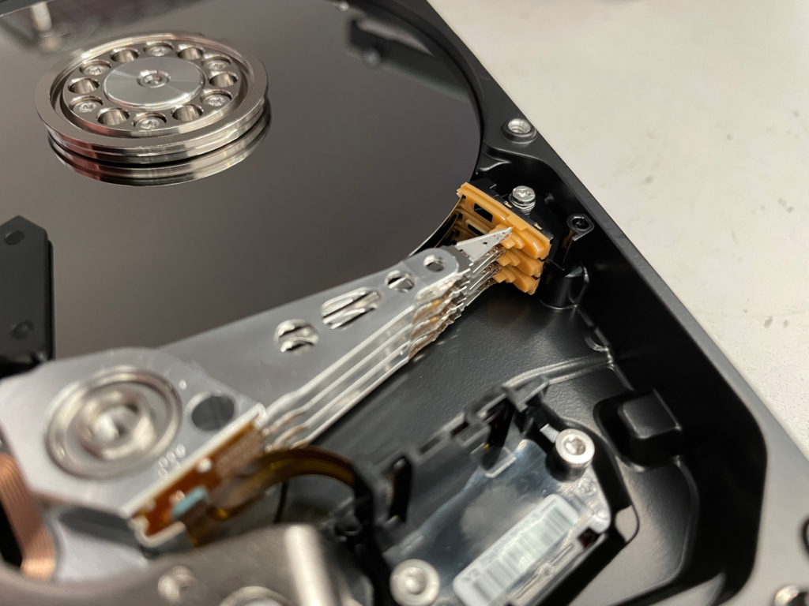
Here is a hard drive that has its heads resting on a landing zone consisting of head ramps located just outside the platters-

Slide 5
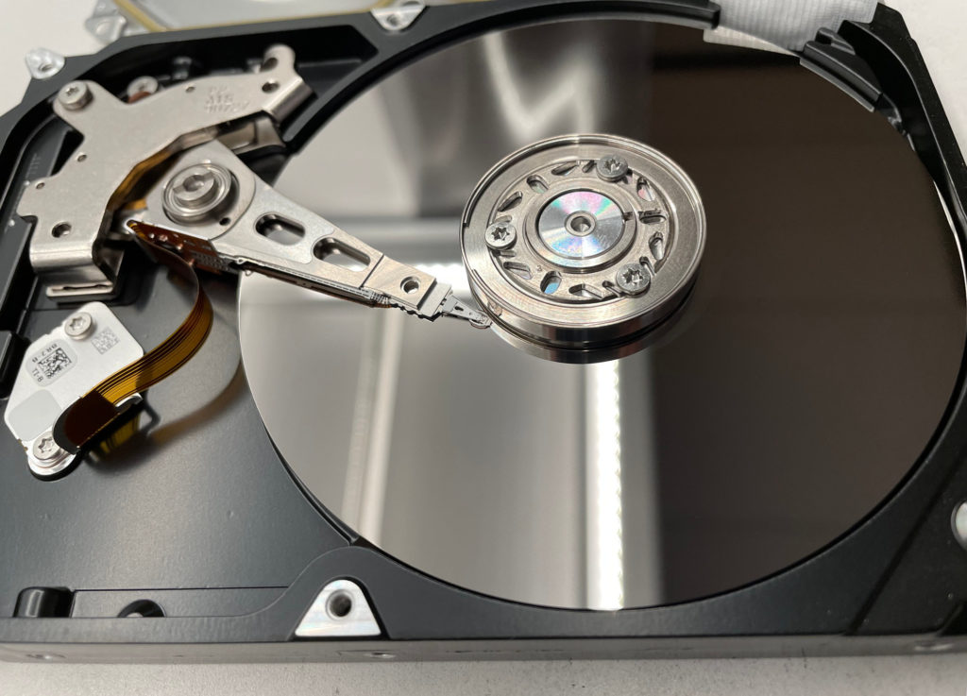
And here is an older drive with its heads resting on a landing zone located on the inner side of the platters-

Slide 6
why is the hard drive’s landing zone important?
The actuator heads are the components that read and write data; they float above a series of spinning discs called platters.
The heads float on a cushion of air generated by the spinning platters.
The platters are coated with magnetic material, which stores your data — and if the actuator heads touch down in the wrong area, they can physically remove this magnetic material. When that occurs, data is unrecoverable.

Slide 7
When a hard drive powers down, the landing zone allows the heads to park in a safe area, preventing this type of data loss.
The LZ indicates non-data areas on the platters, so under most circumstances, the user’s files should be safe when the drive is powered off.

Slide 8
Like all failsafe mechanisms, the landing zone specification isn’t perfect.
If heads are misaligned or if the drive fails catastrophically due to mechanical or electronic damage, data loss can still occur.

Slide 9
Modern computers usually specify the landing zone automatically. This setting can be changed, but there are very few reasons to do so — computers can easily determine non-data areas of storage media, so if you see a landing zone setting in your computer’s CMOS, you should leave it alone.

Slide 10
On older computers, the landing zone was typically defined as the number of cylinders plus one.
A cylinder is defined as two corresponding tracks on the platters. If a hard drive has 1,024 cylinders, the landing zone would be 1,025. Users could set this manually in the computer’s BIOS.
But modern drives no longer use the cylinder-head-sector (or CHS) method for assigning addresses to physical blocks of data. Embedded disk controllers have made this approach largely obsolete.

Slide 11
Does a Hard Drive’s Landing Zone Affect Data Recovery?
some older computers still have landing zones that can be defined by a human, but newer hard drives are much more complex and much more capable of responding to unexpected events without losing data.

Slide 12
While landing zones serve an important role in preventing hard drive failures, no landing zone setting can restore a failed drive to healthy operation.

Slide 13
Recording techniques
Techniques used to write /store data on hard disk is known as Recording technique.
Types Of Recording techniques
Frequency Modulation technique
Modified Frequency Modulation Technique
Run Length Limited Method

Slide 14
Recording Techniques :
1. FM encoding method
2. MFM encoding method
3. RLL encoding method

Slide 15
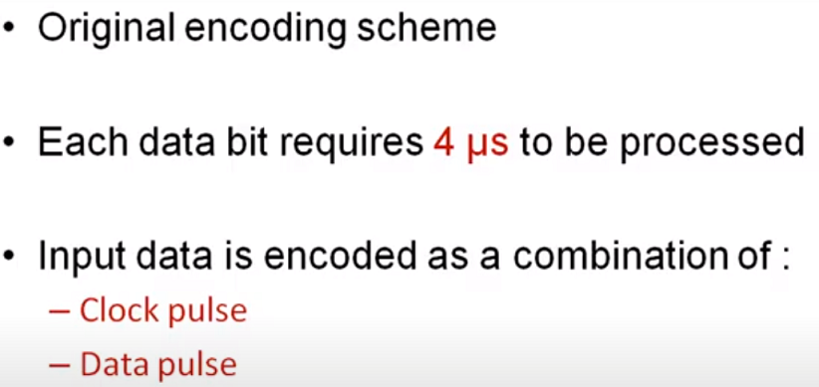
Rules of FM technique

Slide 16
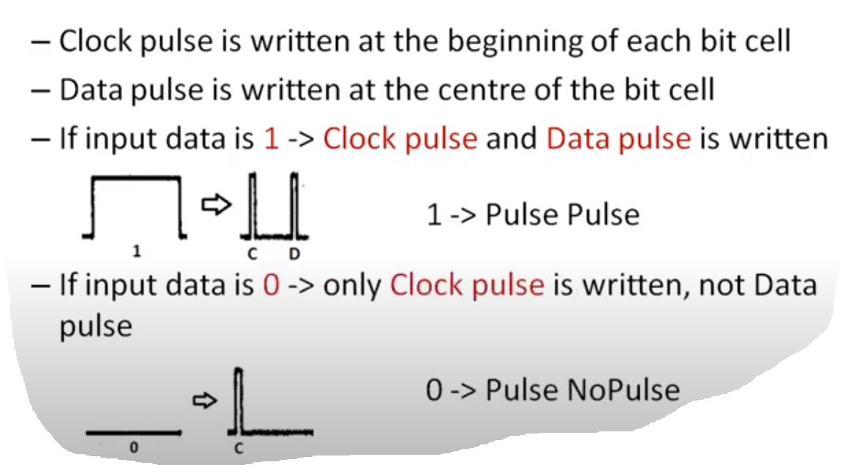

Slide 17
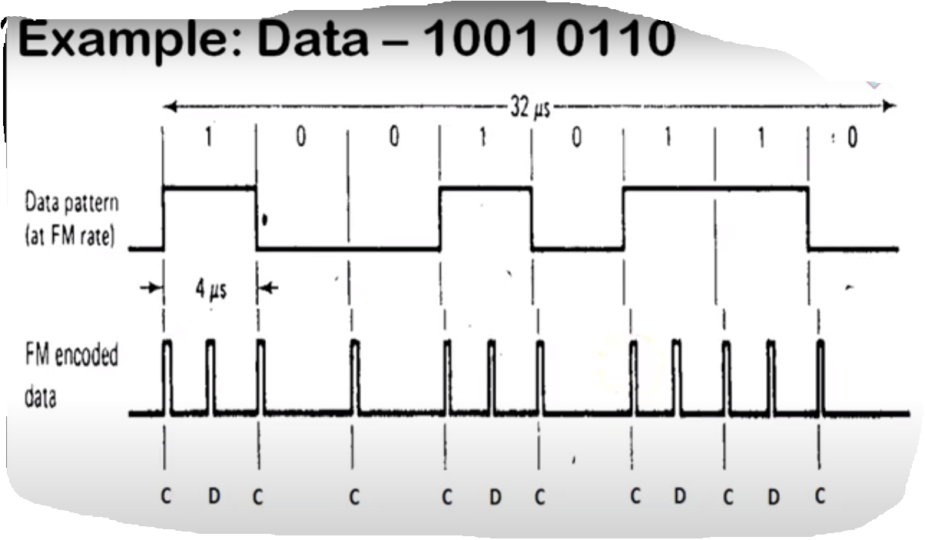

Slide 18
Total number of pulses required to process this 8 bits are:
1001 0110 =12 Pulses

Slide 19
????????
Find the number of pulses required for 4bit data
1011
with data pattern and FM recorded data

Slide 20
For example, a binary number 1011
will be stored as PP PN PP PP

Slide 21
FM Encoding Scheme:
This method of data encoding is also known as the “Single density recording”.
In this FM method of data recording a 1 bit is stored as two pulses(one clock pulse and one data pulse), and a 0 bit is stored as a one pulse and one gap or no pulse.

Slide 22
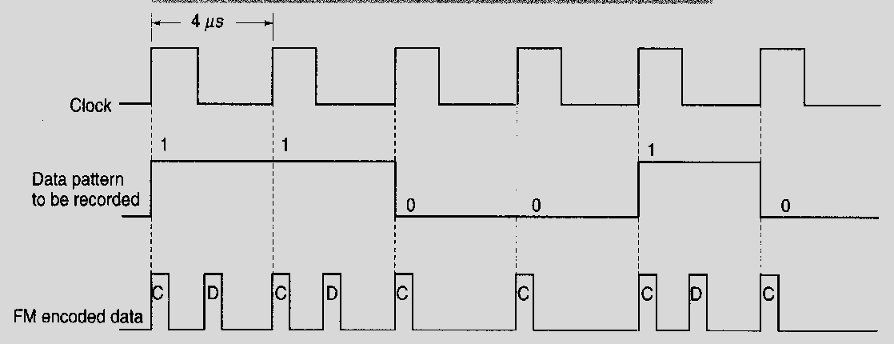
Find the data bit for the following recording??

Slide 23
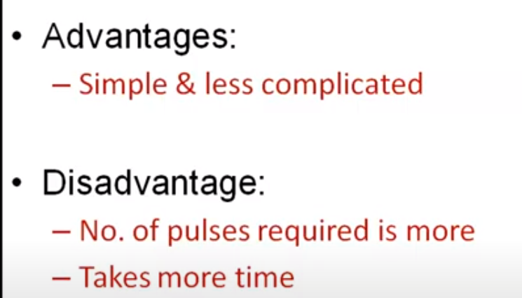

Slide 24
MFM Encoding Scheme:

Slide 25
To overcome these disadvantages MFM Encoding technique was proposed.
MFM stands for modified frequency modulation

Slide 26
The MFM (modified frequency modulation) method of data storage, by reducing the number of pulses
able to store more data without any data and synchronization number of pulses
able to store more data without any data and synchronization loss.

Slide 27
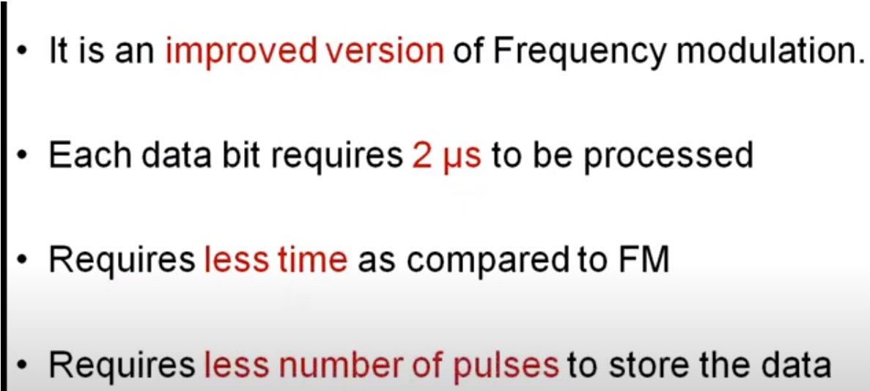

Slide 28
In MFM recording the 0s and 1s are encoded as given below
1 is always stored as no pulse, and a pulse(NP)
0, when preceded by another 0, is stored as a pulse, and no pulse(PN)
0, when preceded by a 1, is stored as two no pulses(NN)

Slide 29
If you store 1001 on the disk surface using the MFM storage method, it would be stored
as NP NN PN NP.

Slide 30
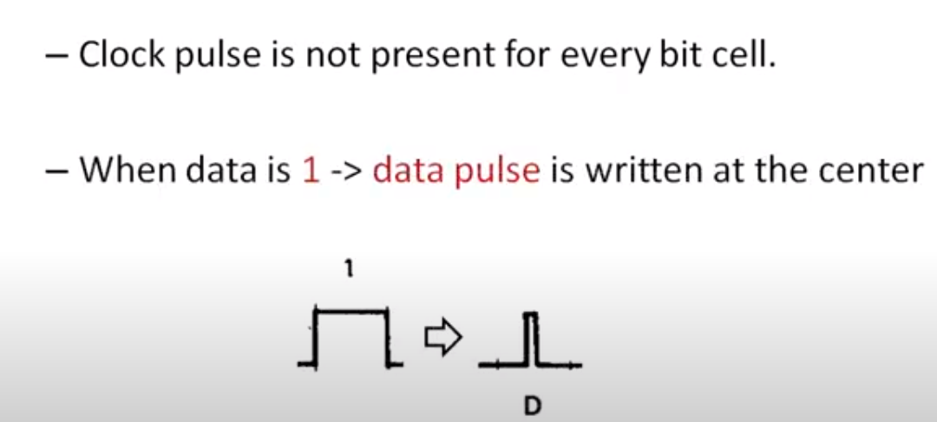

Slide 31
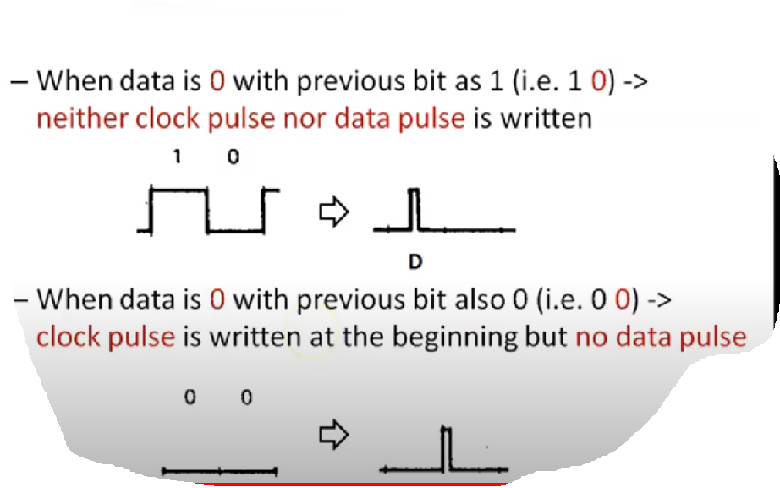

Slide 32
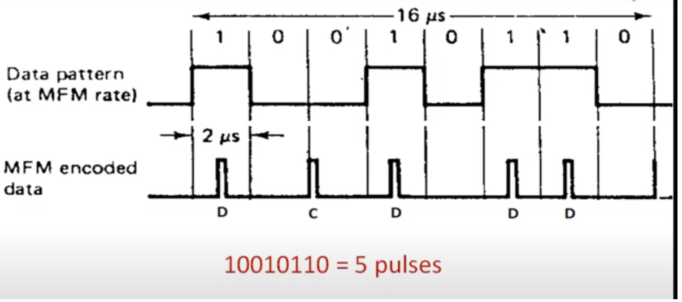
10010110 recoding example

Slide 33
The Logic behind is :
More data can be stored on the same surface or the data storage density can be increased, if the number of pulses required to store the data can be minimized.
When minimizing the pulses, one should be careful that the number of no pulses together should not be very long; otherwise the disk controller may go out of synchronization with the data.

Slide 34
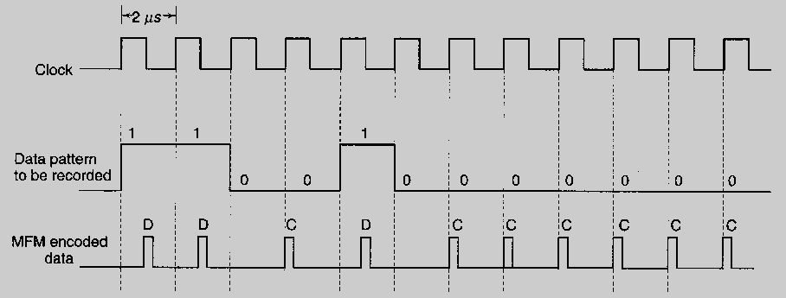
Find the data bit for the below encoding???

Slide 35
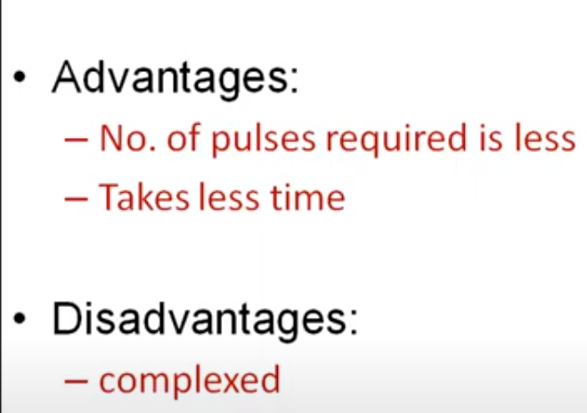

Slide 36
RLL Encoding scheme

Slide 37
3. RLL Encoding Scheme
The RLL is encoding or the run length limited encoding is the most common encoding scheme used in the hard disk storage.

Slide 38
The RLL encoding scheme can store 50 percent more information than MFM encoding scheme on a given surface and it can store three times as much information as the FM encoding scheme.
The Run length Limited name comes from the minimum number (run Length) and maximum number (run Limit) of “no pulse” values allowed between two pulses.

Slide 39
For the RLL encoding, an encoder/decoder (Endec) table is used to find the pulse signal to be used for different data bit groups.
Endec table used by the IBM to convert bit information to the pulse signal is shown below

Slide 40
Data Bit Pulse Encoding
10 NPNN
11 PNNN
000 NNNPNN
010 PNNPNN
011 NNPNNN
0010 NNPNNPNN
0011 NNNNPNNN
For example, if you want to encode a byte 100011 to proper RLL pulse signal then the
Bit 10 can be encoded as NPNN
Bit 0011can be encoded as NNNNPNNN

Slide 41
Instead of encoding a single bit, RLL typically encodes a group of data bits at a time.
The term Run Length Limited is derived from the two primary specifications of these codes, which are the minimum number (the run length) and maximum number (the run limit) of transition cells allowed between two actual flux transitions.
Several variations of the scheme are achieved by changing the length and limit parameters, but only two have achieved real popularity: RLL 2,7 and RLL 1,7.

Slide 42
Perpendicular Encoding :
Virtually all hard drives record data using longitudinal recording which stores magnetic bits horizontally across the surface of the media.
However perpendicular recording which aligns magnetic signals vertically on the media surface has the potential to achieve higher data intensities because vertically oriented magnetic bits use less space than longitudinally stored bits.
Notes:
42

Slide 43
MBR

Slide 44
MBR (Master Boot Record)
MBR is Short for Master Boot Record, a small program that is executed when a computer boots up.
Typically, the MBR resides on the first sector of the hard disk or diskette that identifies how and where an operating system is located so that it can be boot (loaded) into the computer's main storage or random access memory.

Slide 45
The MBR contains two elements;
1. Executable code and
2. A partition table,

Slide 46
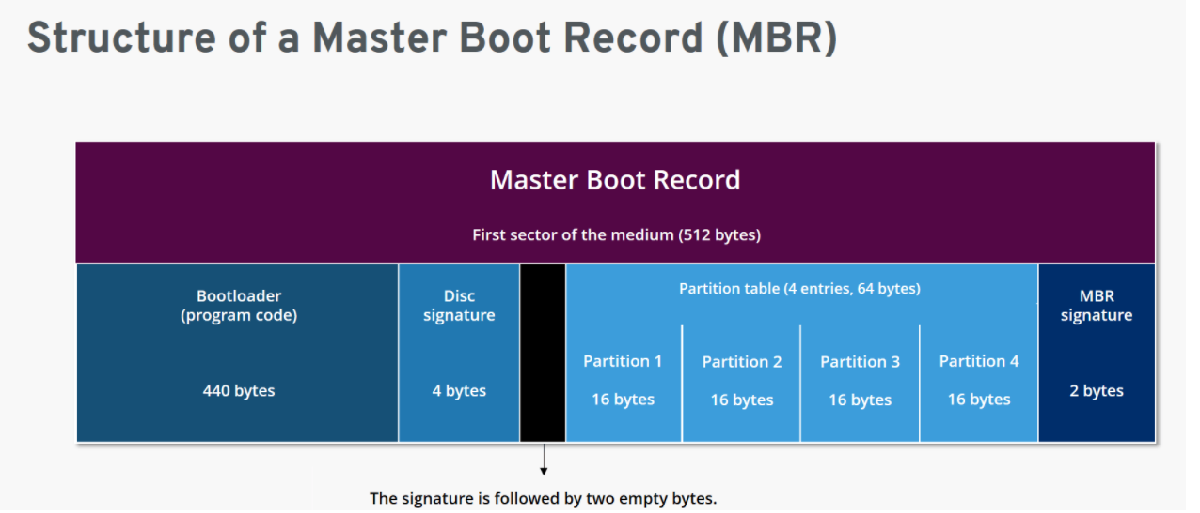

Slide 47
Master Boot Record is the first sector of a hard disk and the place where all the information about the disk and booting can be found.
It is the most essential part of the booting process.
Along with the bootloader program, MBR also contains details regarding the partitions of the hard disk.
The size of MBR is commonly less than or equal to 512 bytes.

Slide 48
Which identifies each partition residing on the hard drive.
The MBR executable code or program begins the boot process by looking up the partition table to determine what partition holds the operating system.

Slide 49
As the name suggests, Master Boot Record, commonly known as MBR, is the first (main) sector of a hard disk and determines the location of the operating system (OS) to complete the execution of the booting process.
MBR is often called the partition sector or master partition table because of its components.
It consists of a table that holds details of the partitions of the hard disk and their locations.
MBR also contains a record that helps in booting up the entire Operating System.

Slide 50
When a computer is first turned on, it runs a special program called Basic Input Output System (BIOS) that is stored in the Read-Only Memory (ROM).
BIOS contains the code that locates and executes MBR.
MBR contains a partition table holding locations of various hard disk partitions which further helps in loading the operating system.

Slide 51
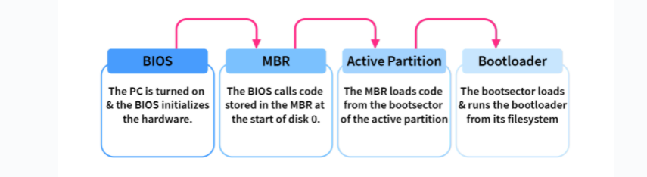
Flow from BIOS to Boot

Slide 52
The program begins the boot process by looking up the partition table to determine which partition to use for booting.
It then transfers program control to the boot sector of that partition, which continues the boot process.
In DOS and Windows systems, you can create the MBR with the FDISK/MBR command

Slide 53
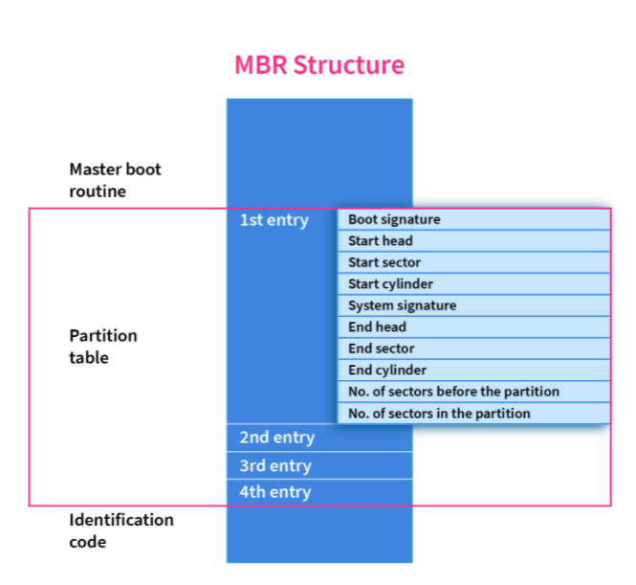

Slide 54
Functions of the MBR
The Master Boot Record will examine the hard disk partition table to verify if it is in excellent working condition and will look for a bootable partition active in the partition table.
MBR also aids in the memory storage of the contents of the active partition's initial logical sector.

Slide 55
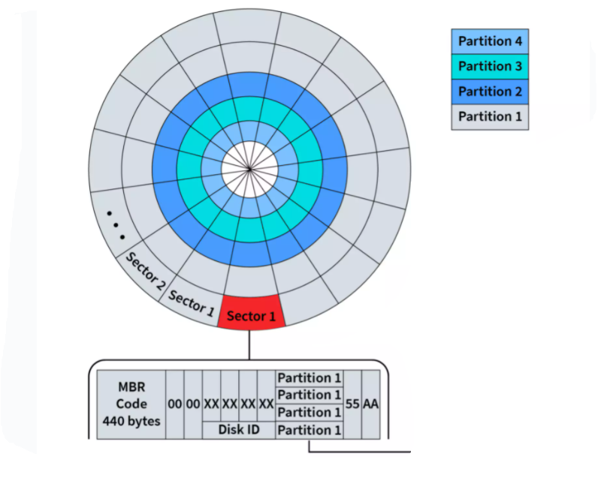
MBR in HDD

Slide 56
