Slide 1
power supply

Slide 2
Topics
8)Comparison of Linear PS and SMPS
9)Explain the need of earthing?
10)What are the considerations of Power line in power supply?
11) What are factors affecting PC operations?

Slide 3
The power supply unit is the part of the hardware that is used to convert the power provided from the outlet into usable power to many parts inside an electrical device.
There are two types of power supplies existed, AC and DC power supply.
Based on the electrical device’s electric specifications it may use AC power or DC power.
What is a Power Supply?
The power supply can be defined as it is an electrical device used to give electrical supply to electrical loads.
The main function of this device is to change the electrical current from a source to the accurate voltage, frequency and current to supply the load.

Slide 4
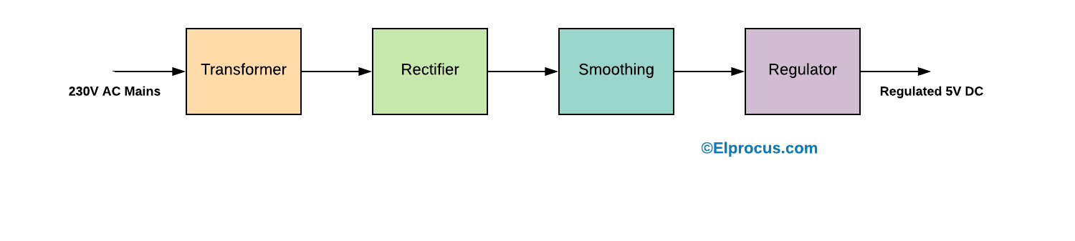
Power Supply Block Diagram:
The Power supply circuit is used in various electrical & electronic devices. The power supply circuits are classified into different types based on the power they utilize for providing for circuits or devices.
For instance, the microcontroller based circuits are generally the 5V DC regulated power supply (RPS) circuits, which can be designed with the help of different method for changing the power from 230V AC to 5V DC.
The power supply block diagram, and the step by step conversion of 230V AC to 12V DC is discussed below.
A step-down transformer converts the 230V AC into12v.
The bridge rectifier is used to change AC to DC
A capacitor is used to filter the AC ripples and gives to the voltage regulator.
Finally voltage regulator regulates the voltage to 5V and finally, a blocking diode is used for taking the pulsating waveform.

Slide 5
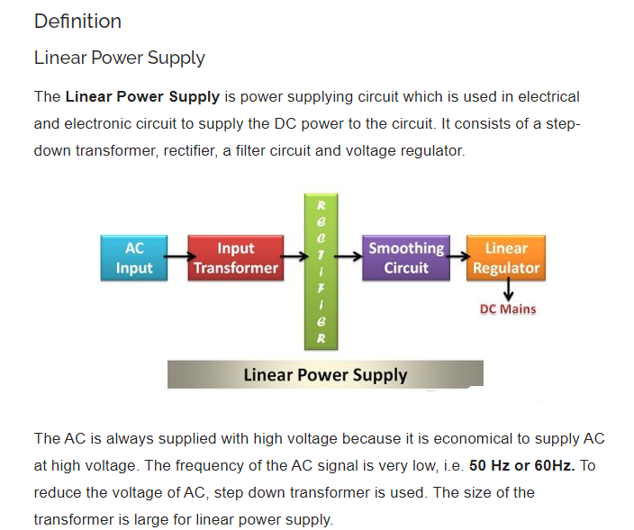

Slide 6
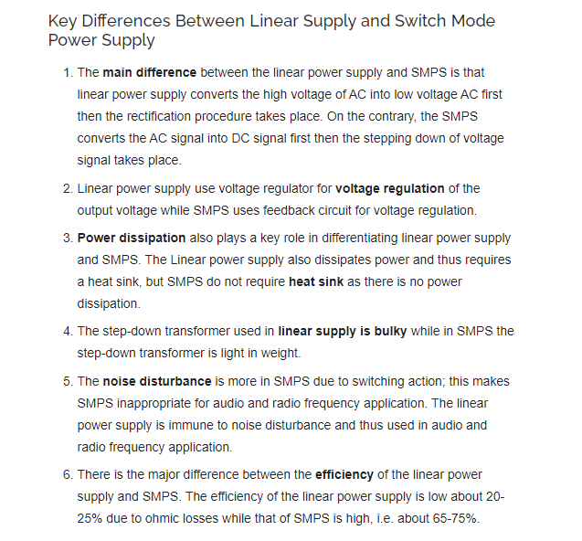

Slide 7
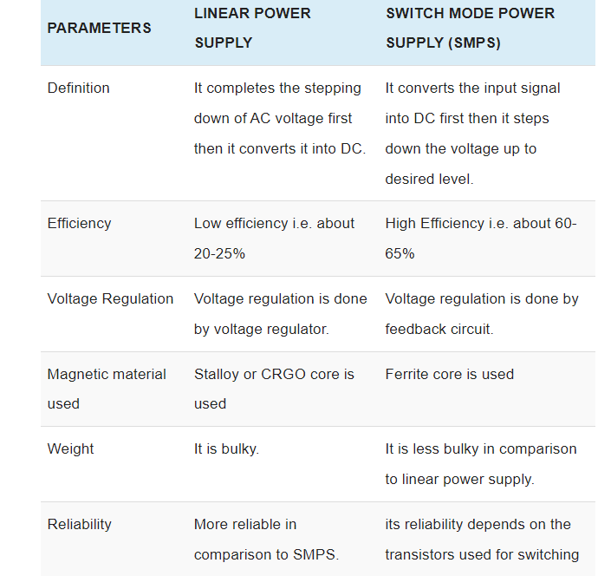
Comparison of Linear PS and SMPS

Slide 8
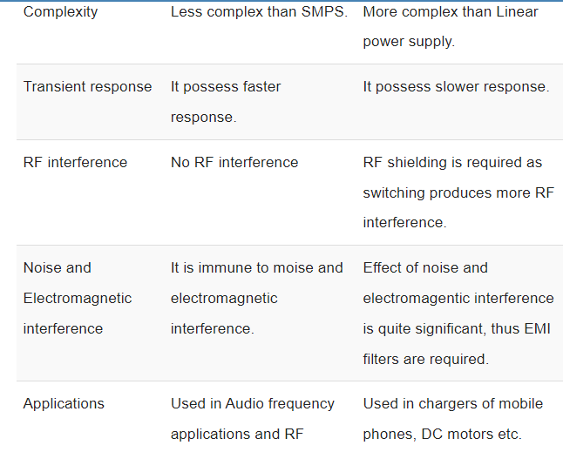

Slide 9
Alternating Current | Direct Current
AC is safe to transfer longer distance even between two cities, and maintain the electric power. | DC cannot travel for a very long distance. It loses electric power.
The rotating magnets cause the change in direction of electric flow. | The steady magnetism makes DC flow in a single direction.
The frequency of AC is dependent upon the country. But, generally, the frequency is 50 Hz or 60 Hz. | DC has no frequency of zero frequency.
In AC the flow of current changes its direction backwards periodically. | It flows in a single direction steadily.
Electrons in AC keep changing its directions – backward and forward | Electrons only move in one direction – that is forward.

Slide 10
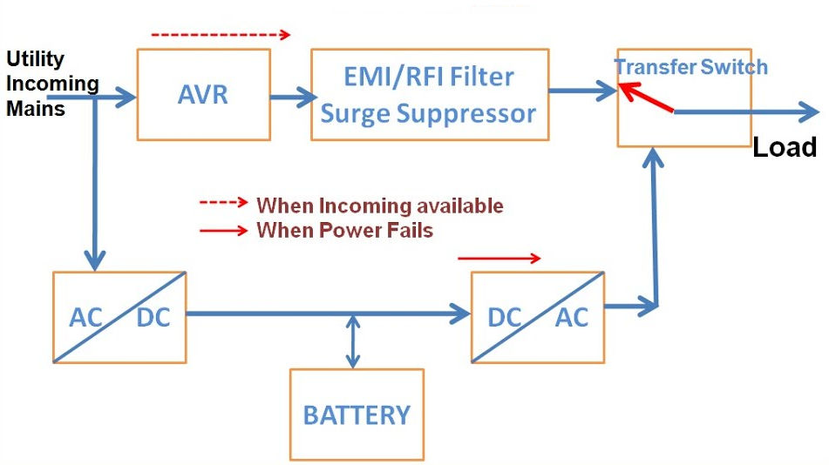
Line Interactive UPS
For small business and departmental servers and webs, line interactive UPS is used.
This is more or less same as that of off-line UPS.
The difference is the addition of tap changing transformer.
Voltage regulation is done by this tap-changing transformer by changing the tap depending on input voltage.
Additional filtering is provided in this UPS result in lower transient loss.
The block diagram is shown below.

Slide 11
What is earthing?
Earthing is defined as “the process in which the instantaneous discharge of the electrical energy takes place by transferring charges directly to the earth through low resistance wire.”

Slide 12
Need of earthing
Why is an Earthing Necessary?
Earthing is an important component of electrical systems because of the following reasons:
It keeps people safe by preventing electric shocks
It prevents damage to electrical appliances and devices by preventing excessive current from running through the circuit
It prevents the risk of fire that could otherwise be caused by current leakage

Slide 13
Advantages of earthing
From a technical perspective, earthing has some excellent advantages, resulting it in becoming a mainstream practice in the electrical industry.
Overload Protection – In scenarios where excessive power surge occurs, a grounded system helps immensely. This simple form of surge protection can instantly save your electrical appliances and devices from getting fried by excessive electrical power, saving your data as well as equipment.
Voltage Stabilization – When it comes to calculating the right amount of power to be distributed between voltage sources, the earth provides that universal standard point of reference. Earthing takes the guesswork out of voltage stabilization, helping to ensure that no circuits overload or blow up.
Damage, Injury & Death Prevention – Blown fuses or a tripped circuit breaker are far more welcome than electrical fires or shocks, which can pose serious safety hazards to people and property. Essentially, grounding protects against equipment, property and data loss, as well as injuries and fatalities!

Slide 14
Power line consideration
Plan the location of your Powerline devices:
Connect Powerline devices to electrical outlets that are not controlled by a wall switch to avoid accidentally turning off power to the device.
2. Do not connect the Powerline devices to an extension cord, surge protec-tor, or power strip as this might prevent it from working correctly, or nega-tively impact network performance.
3. Avoid using the Powerline devices in an electrical outlet that is located near to an appliance that uses a lot of power such as, a washing machine or tumble-dryer, or a refrigerator. This may prevent the adapter from working correctly, or negatively impact network performance.
4. Verify that your Powerline devices are electrically rated to operate within the power available within your location.
5. To help prevent against electrical shock, be sure to plug the power cables into properly grounded electrical outlets.

Slide 15
Factors Affecting PC-Operation
PC is a machine with electrical and electronic circuits as well as electromechanical assemblies. For reliable operation and long life of PC, must consider various environmental factors.
The following factors affect the normal working of PC. These factors should be kept within the specified limits or tey to avoid these factor near PC for trouble-free operation.
1> Temprature [10° C - 45° C]
Affects :
Life of IC's and other components.
Encounter excessive chip creep.
Signal traces on circuit board can crack and separate.
Solder joints can break.
Contacts in the system can undergo accelerated corrosion.
Solid-state components such as chips can be damaged.
Temperature generates intermittent problems in electronic circuits
Early failure of electronic components.
Avoiding Temperature :
Install an adequate fan in the power supply or system.
Add an auxiliary fan.
Run PC's only in safe temperature range.
Install Air Conditioner in computer room.
Avoid direct sunbeam in computer room.
Use adequate space for computers.

Slide 16
2> Humidity [60° Relative humidity]
Affects :
Causes corrosion in the contact region, which in turn causes contact problems in the different components.
High humidity in low temperature will cause the surface oxidation effect on metal parts, such as electrical contacts & breakdown of insulation material in a power supplies & monitor.
Low humidity, high temperature and dry weather may create problems with static electricity.
May also generate sticky layer of dust on ICs and components, avoid heat dissipation.
May fails ICs and component.
Avoiding Humidity Problems :
Use dehumidifier.
Install Air Conditioner in computer room.

Slide 17
3> Dust :
Affects :
As dust buids up, entire board can become coated with fine insulating shealth. This avoids heat dissipation and damages ICs.
Reduces life of chips and various components.
It damages Magnetic tape storage of a computer. And causes head crash in Hard Disk.
Dust on read/write head crashes disk surface.
Keyboard may get affected with dust and dirt. It jams the keys and may cause improper functioning of keyboard.
Avoiding Dust :
The computer room must be cleaned regularly.
Clean the computer with dust free cloth.
Use vacuum to remove dust from the keyboard and system board.
Wndows in the computer room must be enclosed with curtains to prevent entry of dust.
Smoking in the computer room must be prohibited.
Use covers on different parts of computer such as monitor, system unit, keyboards.
Use Air Conditioner for computer room.

Slide 18
Magnetic Field Effect :
Affects :
Data storage on magnetic storage devices may get affected or corrupted.
May disturb electron beams of CRT monitor, causinf improper deflection.
Can cause permanent loss of data on hard disk.
Avoiding Magnetic Field :
Keep PC away from the Television.
Keep PC away from the Speaker.
Do not keep any permanent magnet or electromagnet near PC.
Do not keep any recording machine near to PC

Slide 19
Factors affecting computer performance
1) The speed of the CPU The speed of the CPU is also known as the clock speed of the CPU. The clock speed of the CPU is the frequency of which the processor executes instructions or the frequency by which data is processed by the CPU. It is measured in millions of cycles per second or megahertz (MHz). If the Clock speed of the CPU is fast then definitely the performance of the computer will be affected positively, in other words the computer will carry out processing functions at a faster pace. 2) The size of the RAM (Random Access Memory) The RAM is referred to as the active part of the computer. This is because the RAM has the capability of storing data that the computer is currently using, because of the fact that it is fast to retrieve data stored in the RAM. With the definition above, a large RAM size will mean a faster computer performance and a smaller RAM size will result to slower computer performance.
3) The speed of the hard disk The hard disk speed is defined as the rate at which material and content can be read and written on it. The hard disk speed of different hard disks is not consistent because they vary by manufacturer, drive type and the use of the hard disk. It therefore means that the higher the speed of the hard disk the
faster the performance of the computer and vice versa.

Slide 20
4) Hard disk space The bigger the space on the hard disk will result to faster performance of the computer. The smaller the space on the hard disk will result in a slower performance of the computer. The hard disk is filled with data this will use most of the memory leaving less memory for the operations of the processor. 5) Multiple applications running on the computer Multi-tasking tends to slow down the performance of the computer because memory is used to support more than one applications compared to when one application has all the memory to itself. This means that the more applications that are running the slower the computer will perform. Likewise if less or one application is running the performance of the computer will be faster. 6) Type of graphic card When it comes to quality of pictures and animations graphic cards are the main factors. So if a machine processes many graphics and it has a weak graphic card it will perform slower. This means that the more powerful the graphic card is the faster the performance of the computer. 7) Defragmenting files Files that are broken or it takes long to read them will mean that the computer will have to defragment them first. This will slow down the performance of the computer.

