Slide 1

Chapter 3
Data and Signals
3.<number>
Copyright © The McGraw-Hill Companies, Inc. Permission required for reproduction or display.

Slide 2

Note
To be transmitted, data must be transformed to electromagnetic signals.
3.<number>

Slide 3
3-1 ANALOG AND DIGITAL
Data can be analog or digital. The term analog data refers to information that is continuous; digital data refers to information that has discrete states. Analog data take on continuous values. Digital data take on discrete values.
Topics discussed in this section:
Analog and Digital Data
Analog and Digital Signals
Periodic and Nonperiodic Signals
3.<number>

Slide 4
Note
Data can be analog or digital.
Analog data are continuous and take continuous values.
Digital data have discrete states and take discrete values.
3.<number>

Slide 5
Note
Signals can be analog or digital.
Analog signals can have an infinite number of values in a range; digital signals can have only a limited
number of values.
3.<number>

Slide 6
Note
In data communications, we commonly use periodic analog signals and nonperiodic digital signals.
3.<number>

Slide 7
3-2 PERIODIC ANALOG SIGNALS
Periodic analog signals can be classified as simple or composite. A simple periodic analog signal, a sine wave, cannot be decomposed into simpler signals. A composite
periodic analog signal is composed of multiple sine waves.
Topics discussed in this section:
Sine Wave
Wavelength
Time and Frequency Domain
Composite Signals
Bandwidth
3.<number>

Slide 8

Figure 3.2 A sine wave
3.<number>

Slide 9
Note
If a signal does not change at all, its frequency is zero.
If a signal changes instantaneously, its frequency is infinite.
3.<number>

Slide 10

Figure 3.7 The time-domain and frequency-domain plots of a sine wave
3.<number>

Slide 11
Note
The bandwidth of a composite signal is the difference between the
highest and the lowest frequencies contained in that signal.
3.<number>

Slide 12
3-3 DIGITAL SIGNALS
In addition to being represented by an analog signal, information can also be represented by a digital signal. For example, a 1 can be encoded as a positive voltage and a 0 as zero voltage. A digital signal can have more than two levels. In this case, we can send more than 1 bit for each level.
Topics discussed in this section:
Bit Rate
Bit Length
Digital Signal as a Composite Analog Signal
Application Layer
3.<number>

Slide 13
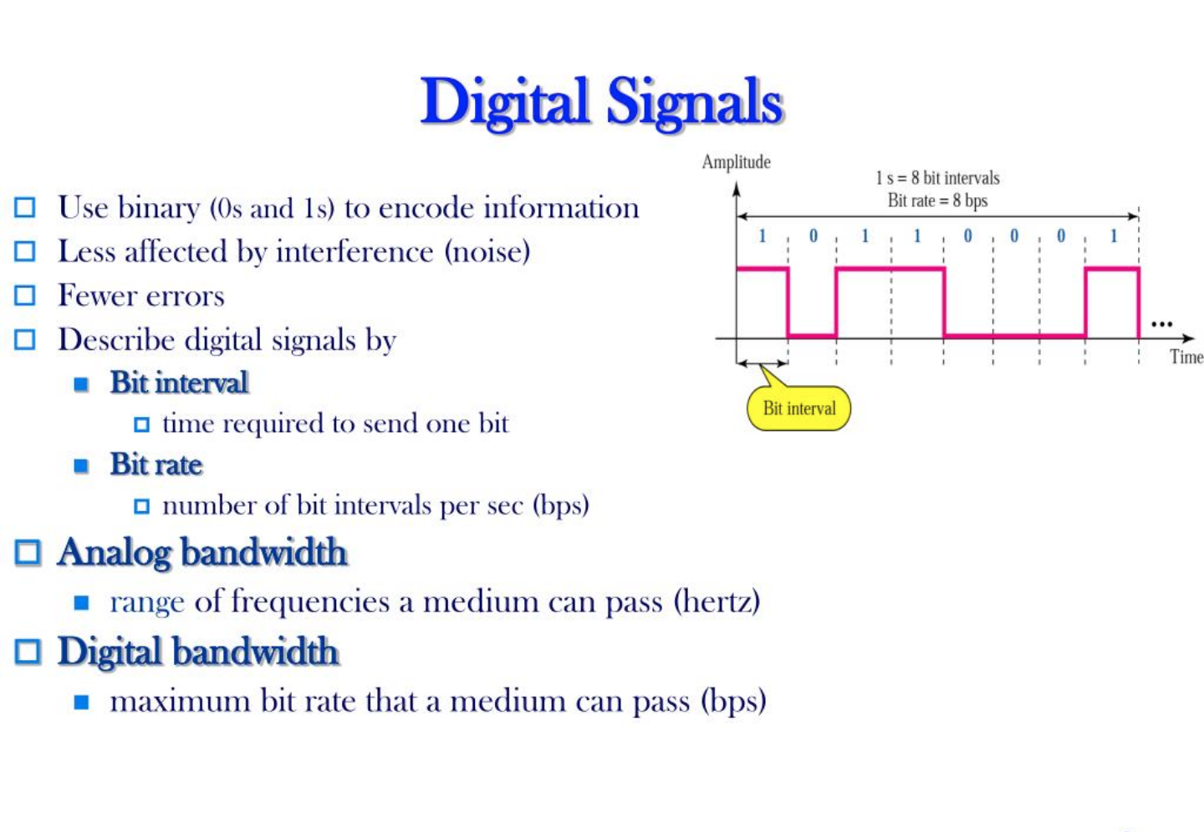
3.<number>

Slide 14

Figure 3.16 Two digital signals: one with two signal levels and the other
with four signal levels
3.<number>

Slide 15
Example 3.18
Assume we need to download text documents at the rate of 100 pages per minute. What is the required bit rate of the channel?
Solution
A page is an average of 24 lines with 80 characters in each line. If we assume that one character requires 8 bits, the bit rate is
3.<number>

Slide 16
3-4 TRANSMISSION IMPAIRMENT
Signals travel through transmission media, which are not perfect. The imperfection causes signal impairment. This means that the signal at the beginning of the medium is not the same as the signal at the end of the medium. What is sent is not what is received. Three causes of impairment are attenuation, distortion, and noise.
Topics discussed in this section:
Attenuation
Distortion
Noise
3.<number>

Slide 17

Figure 3.25 Causes of impairment
3.<number>

Slide 18

Figure 3.26 Attenuation
3.<number>

Slide 19
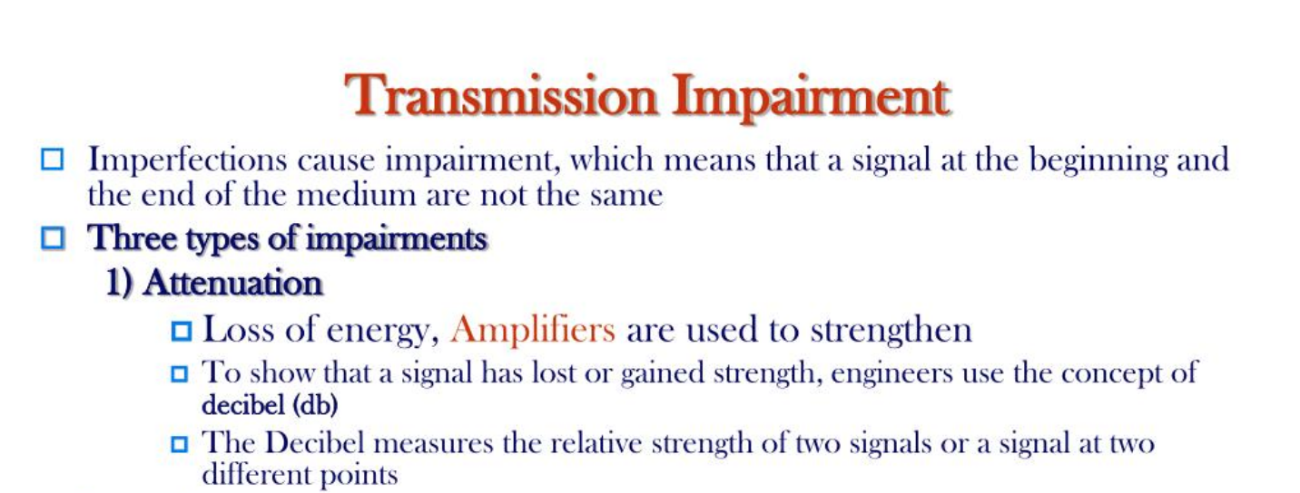
3.<number>

Slide 20

Figure 3.28 Distortion
3.<number>

Slide 21
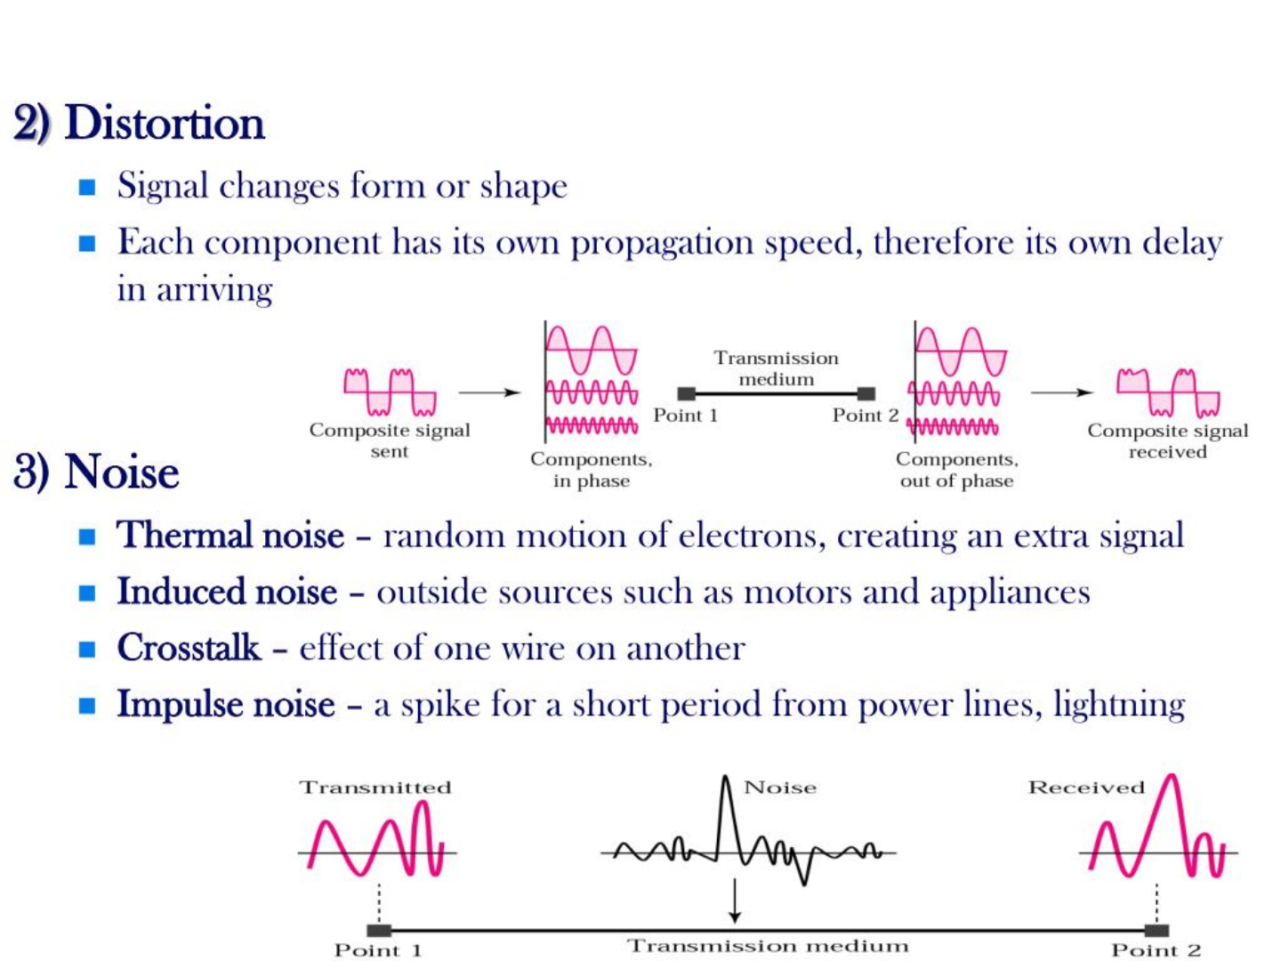
3.<number>

Slide 22

Figure 3.29 Noise
3.<number>

Slide 23
Note
In networking, we use the term bandwidth in two contexts.
❏ The first, bandwidth in hertz, refers to
the range of frequencies in a
composite signal or the range of
frequencies that a channel can pass.
❏ The second, bandwidth in bits per
second, refers to the speed of bit
transmission in a channel or link.
3.<number>

