Slide 1

Chapter 5
Analog Transmission
5.<number>
Copyright © The McGraw-Hill Companies, Inc. Permission required for reproduction or display.

Slide 2
5-1 DIGITAL-TO-ANALOG CONVERSION
Digital-to-analog conversion is the process of changing one of the characteristics of an analog signal based on the information in digital data.
Topics discussed in this section:
Aspects of Digital-to-Analog Conversion
Amplitude Shift Keying
Frequency Shift Keying
Phase Shift Keying
Quadrature Amplitude Modulation
5.<number>

Slide 3

Figure 5.1 Digital-to-analog conversion
5.<number>

Slide 4

Figure 5.2 Types of digital-to-analog conversion
5.<number>

Slide 5

Note
Bit rate is the number of bits per second. Baud rate is the number of signal
elements per second.
In the analog transmission of digital data, the baud rate is less than
or equal to the bit rate.
5.<number>

Slide 6

Figure 5.3 Binary amplitude shift keying
5.<number>

Slide 7

Figure 5.4 Implementation of binary ASK
5.<number>

Slide 8

Figure 5.6 Binary frequency shift keying
5.<number>

Slide 9

Figure 5.7 Bandwidth of MFSK used in Example 5.6
5.<number>

Slide 10

Figure 5.9 Binary phase shift keying
5.<number>

Slide 11

Figure 5.10 Implementation of BASK
5.<number>

Slide 12
5-2 ANALOG AND DIGITAL
Analog-to-analog conversion is the representation of analog information by an analog signal. One may ask why we need to modulate an analog signal; it is already analog. Modulation is needed if the medium is bandpass in nature or if only a bandpass channel is available to us.
Topics discussed in this section:
Amplitude Modulation
Frequency Modulation
Phase Modulation
5.<number>

Slide 13

Figure 5.15 Types of analog-to-analog modulation
5.<number>

Slide 14

Figure 5.16 Amplitude modulation
5.<number>

Slide 15

Figure 5.18 Frequency modulation
5.<number>

Slide 16

Figure 5.20 Phase modulation
5.<number>

Slide 17
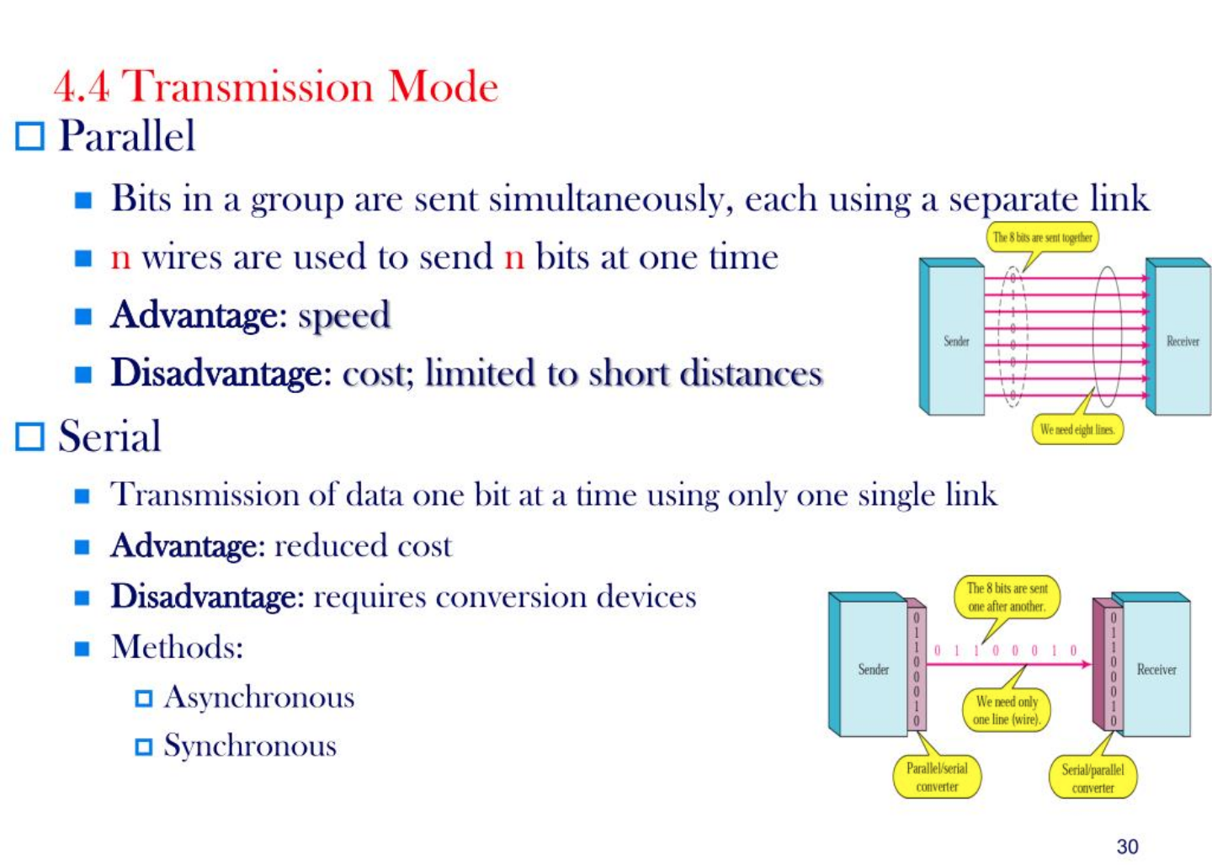
5.<number>

Slide 18
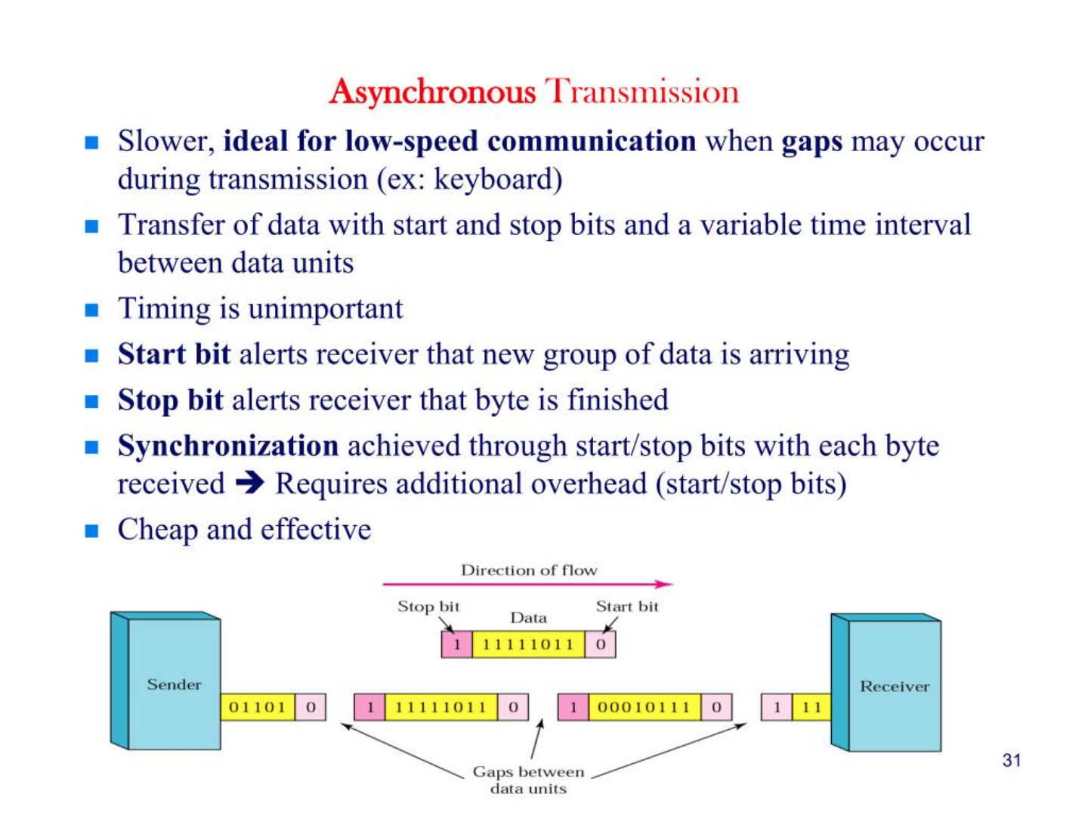
5.<number>

Slide 19
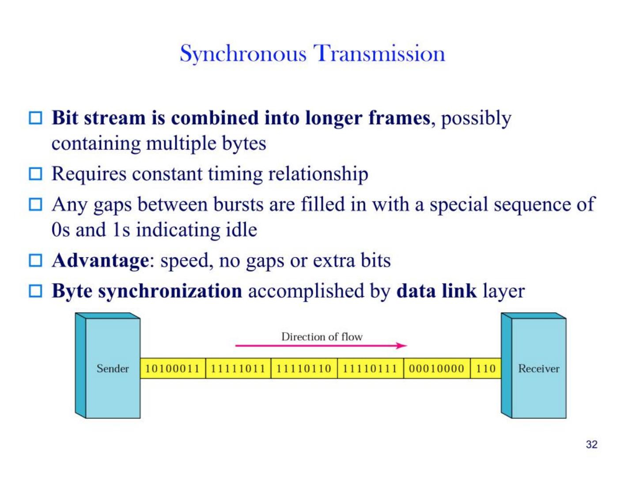
5.<number>

