Slide 1

Chapter 11
Data Link Control
11.<number>
Copyright © The McGraw-Hill Companies, Inc. Permission required for reproduction or display.

Slide 2
11-1 FRAMING
The data link layer needs to pack bits into frames, so that each frame is distinguishable from another. Our postal system practices a type of framing. The simple act of inserting a letter into an envelope separates one piece of information from another; the envelope serves as the delimiter.
Topics discussed in this section:
Fixed-Size Framing
Variable-Size Framing
11.<number>

Slide 3

Figure 11.1 A frame in a character-oriented protocol
11.<number>

Slide 4

Figure 11.2 Byte stuffing and unstuffing
11.<number>

Slide 5

Note
Byte stuffing is the process of adding 1 extra byte whenever there is a flag or escape character in the text.
11.<number>

Slide 6

Figure 11.3 A frame in a bit-oriented protocol
11.<number>

Slide 7
Note
Bit stuffing is the process of adding one extra 0 whenever five consecutive 1s follow a 0 in the data, so that the receiver does not mistake
the pattern 0111110 for a flag.
11.<number>

Slide 8

Figure 11.4 Bit stuffing and unstuffing
11.<number>

Slide 9
11-2 FLOW AND ERROR CONTROL
The most important responsibilities of the data link layer are flow control and error control. Collectively, these functions are known as data link control.
Topics discussed in this section:
Flow Control
Error Control
11.<number>

Slide 10
Note
Flow control refers to a set of procedures used to restrict the amount of data
that the sender can send before
waiting for acknowledgment.
11.<number>

Slide 11
Note
Error control in the data link layer is based on automatic repeat request, which is the retransmission of data.
11.<number>

Slide 12
11-3 PROTOCOLS
Now let us see how the data link layer can combine framing, flow control, and error control to achieve the delivery of data from one node to another. The protocols are normally implemented in software by using one of the common programming languages. To make our discussions language-free, we have written in pseudocode a version of each protocol that concentrates mostly on the procedure instead of delving into the details of language rules.
11.<number>

Slide 13

Figure 11.5 Taxonomy of protocols discussed in this chapter
11.<number>

Slide 14
11-4 NOISELESS CHANNELS
Let us first assume we have an ideal channel in which no frames are lost, duplicated, or corrupted. We introduce two protocols for this type of channel.
Topics discussed in this section:
Simplest Protocol
Stop-and-Wait Protocol
11.<number>

Slide 15

Figure 11.6 The design of the simplest protocol with no flow or error control
11.<number>

Slide 16

Figure 11.7 Flow diagram for Example 11.1
11.<number>

Slide 17

Figure 11.8 Design of Stop-and-Wait Protocol
11.<number>

Slide 18

Figure 11.9 Flow diagram for Example 11.2
11.<number>

Slide 19
11-5 NOISY CHANNELS
Although the Stop-and-Wait Protocol gives us an idea of how to add flow control to its predecessor, noiseless channels are nonexistent. We discuss three protocols in this section that use error control.
Topics discussed in this section:
Stop-and-Wait Automatic Repeat Request
Go-Back-N Automatic Repeat Request
Selective Repeat Automatic Repeat Request
11.<number>

Slide 20
Note
Error correction in Stop-and-Wait ARQ is done by keeping a copy of the sent frame and retransmitting of the frame when the timer expires.
11.<number>

Slide 21
Note
In Stop-and-Wait ARQ, we use sequence numbers to number the frames.
The sequence numbers are based on modulo-2 arithmetic.
11.<number>

Slide 22
Note
In Stop-and-Wait ARQ, the acknowledgment number always announces in modulo-2 arithmetic the sequence number of the next frame expected.
11.<number>

Slide 23

Figure 11.10 Design of the Stop-and-Wait ARQ Protocol
11.<number>

Slide 24

Figure 11.11 Flow diagram for Example 11.3
11.<number>

Slide 25
Note
In the Go-Back-N Protocol, the sequence numbers are modulo 2^{m},
where m is the size of the sequence number field in bits.
11.<number>

Slide 26

Figure 11.12 Send window for Go-Back-N ARQ
11.<number>

Slide 27
Note
The send window is an abstract concept defining an imaginary box of size 2^{m} − 1 with three variables: Sf, Sn, and S_{size}.
11.<number>

Slide 28
Note
The send window can slide one
or more slots when a valid acknowledgment arrives.
11.<number>

Slide 29

Figure 11.13 Receive window for Go-Back-N ARQ
11.<number>

Slide 30
Note
The receive window is an abstract concept defining an imaginary box
of size 1 with one single variable R_{n}.
The window slides
when a correct frame has arrived; sliding occurs one slot at a time.
11.<number>

Slide 31
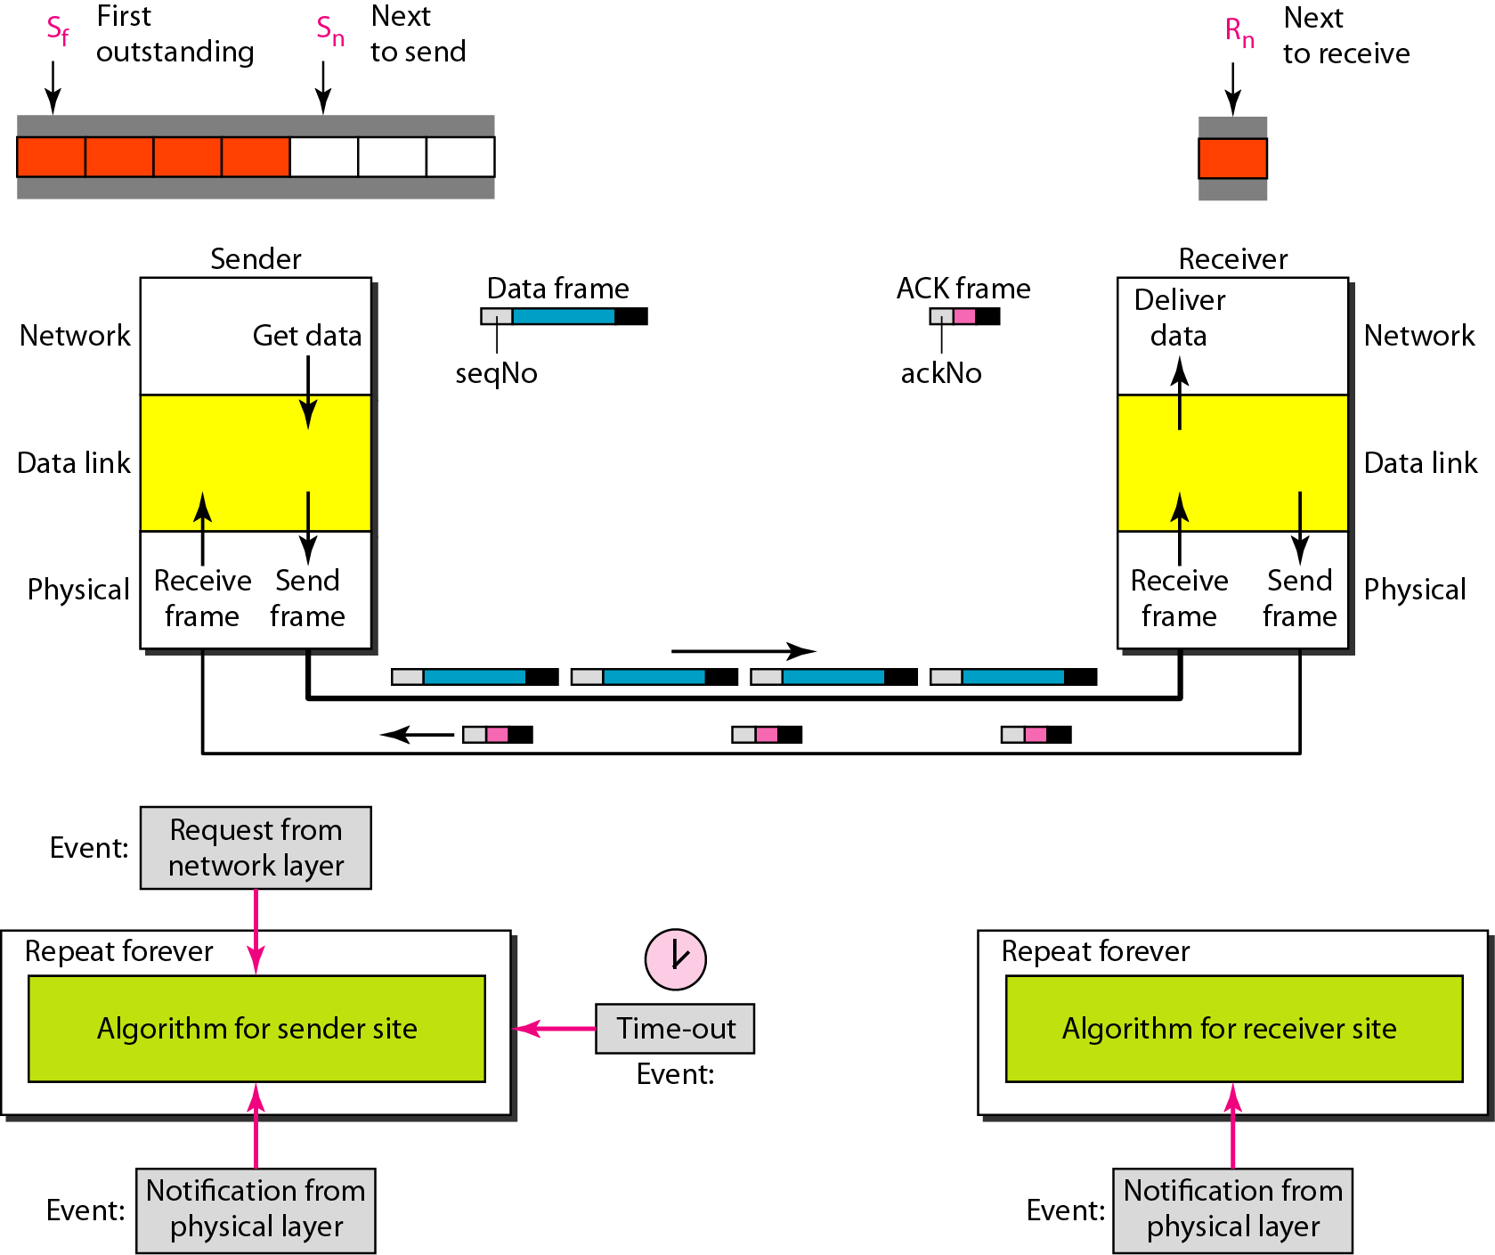
Figure 11.14 Design of Go-Back-N ARQ
11.<number>

Slide 32

Figure 11.15 Window size for Go-Back-N ARQ
11.<number>

Slide 33
Note
In Go-Back-N ARQ, the size of the send window must be less than 2^{m};
the size of the receiver window
is always 1.
11.<number>

Slide 34

Figure 11.16 Flow diagram for Example 11.6
11.<number>

Slide 35

Figure 11.17 Flow diagram for Example 11.7
11.<number>

Slide 36
Note
Stop-and-Wait ARQ is a special case of Go-Back-N ARQ in which the size of the send window is 1.
11.<number>

Slide 37

Figure 11.18 Send window for Selective Repeat ARQ
11.<number>

Slide 38

Figure 11.19 Receive window for Selective Repeat ARQ
11.<number>

Slide 39
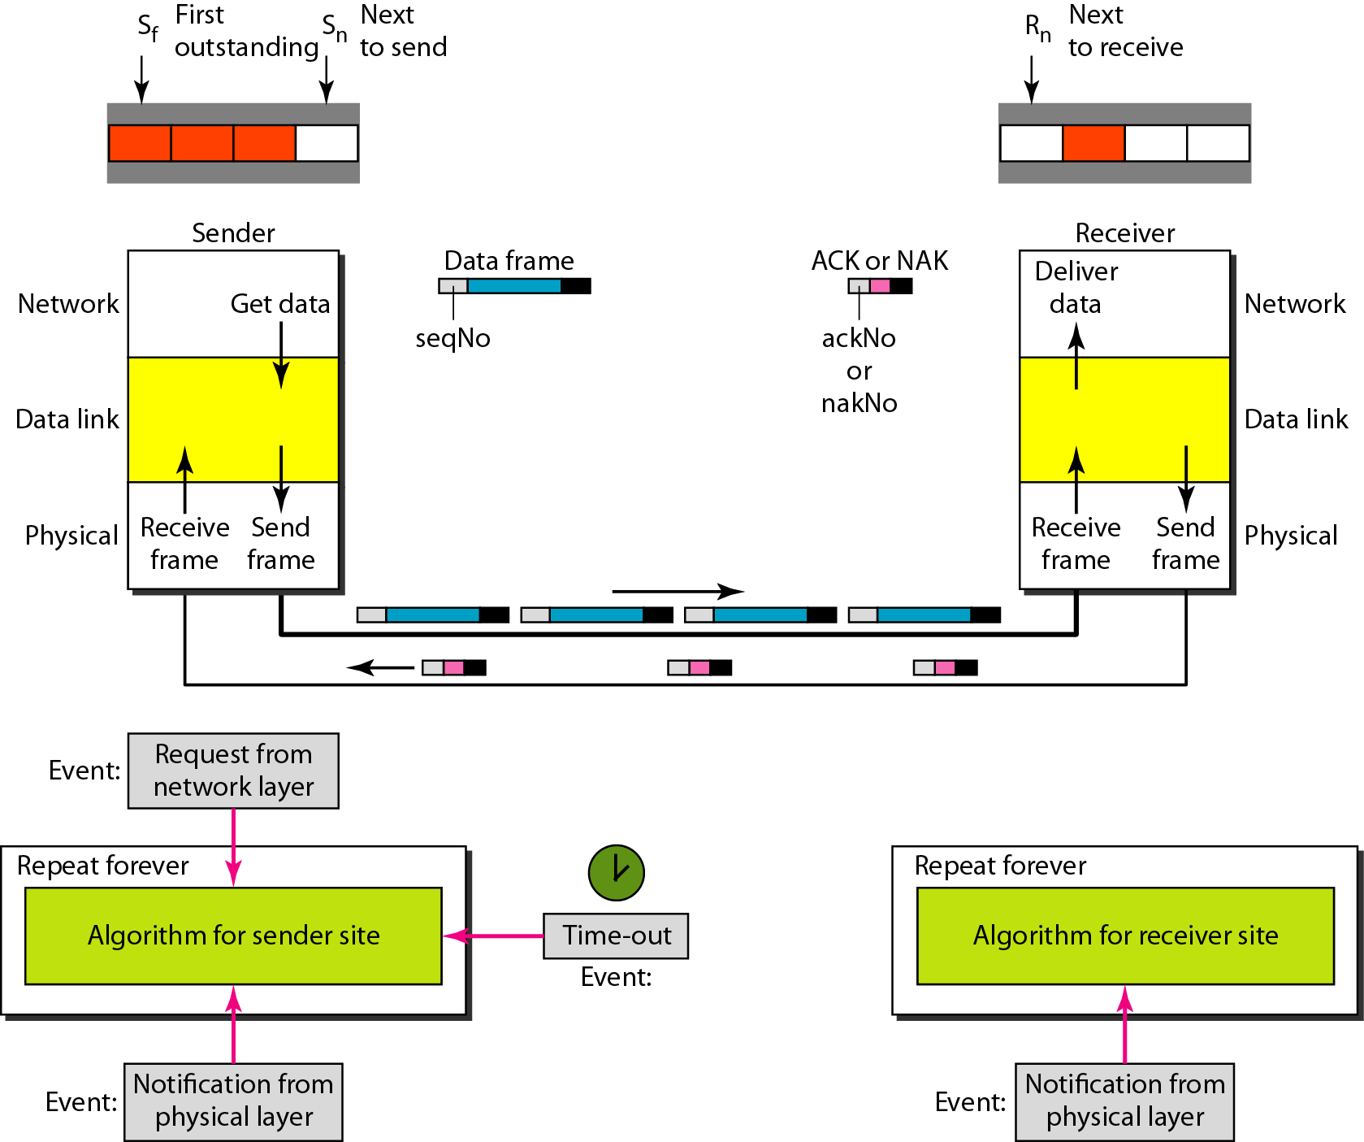
Figure 11.20 Design of Selective Repeat ARQ
11.<number>

Slide 40

Figure 11.21 Selective Repeat ARQ, window size
11.<number>

Slide 41
Note
In Selective Repeat ARQ, the size of the sender and receiver window
must be at most one-half of 2^{m}.
11.<number>

Slide 42

Figure 11.22 Delivery of data in Selective Repeat ARQ
11.<number>

Slide 43

Figure 11.23 Flow diagram for Example 11.8
11.<number>

Slide 44
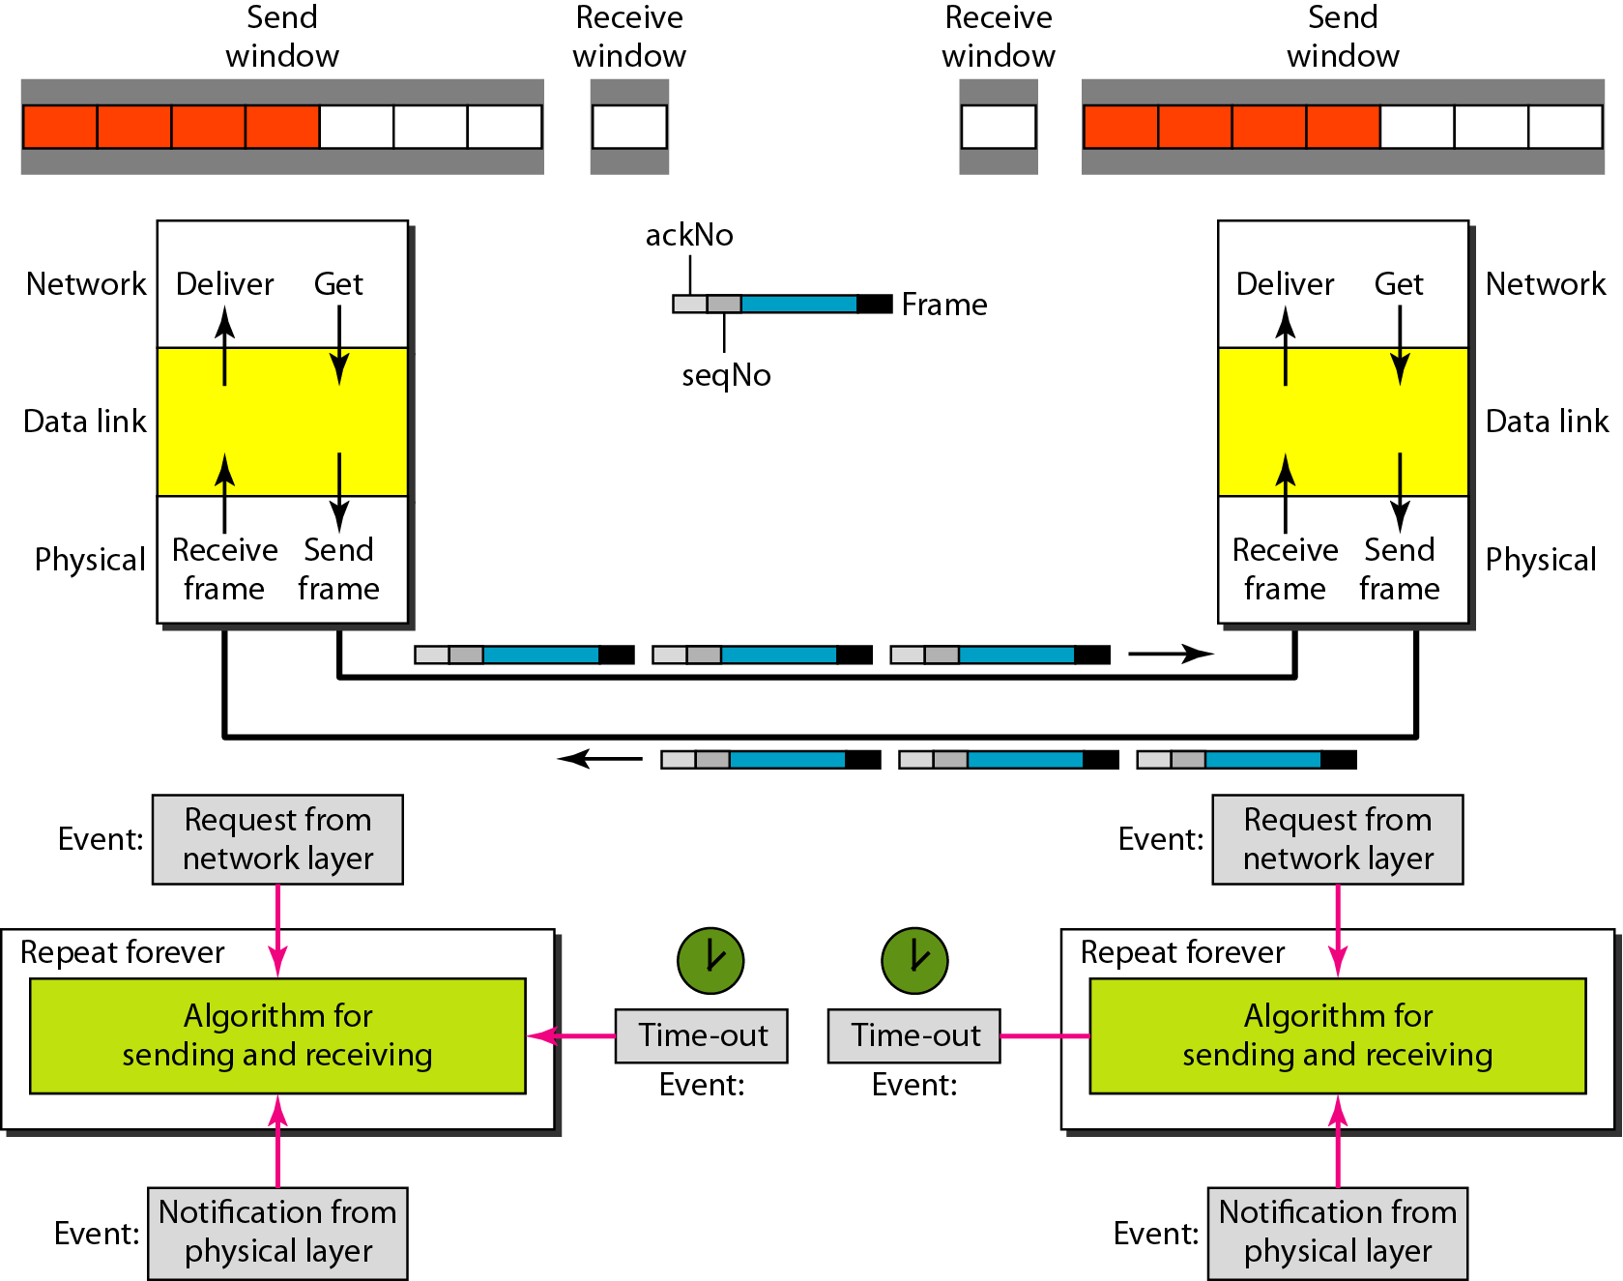
Figure 11.24 Design of piggybacking in Go-Back-N ARQ
11.<number>

Slide 45
11-6 HDLC
High-level Data Link Control (HDLC) is a bit-oriented protocol for communication over point-to-point and multipoint links. It implements the ARQ mechanisms we discussed in this chapter.
Topics discussed in this section:
Configurations and Transfer Modes
Frames
Control Field
11.<number>

Slide 46
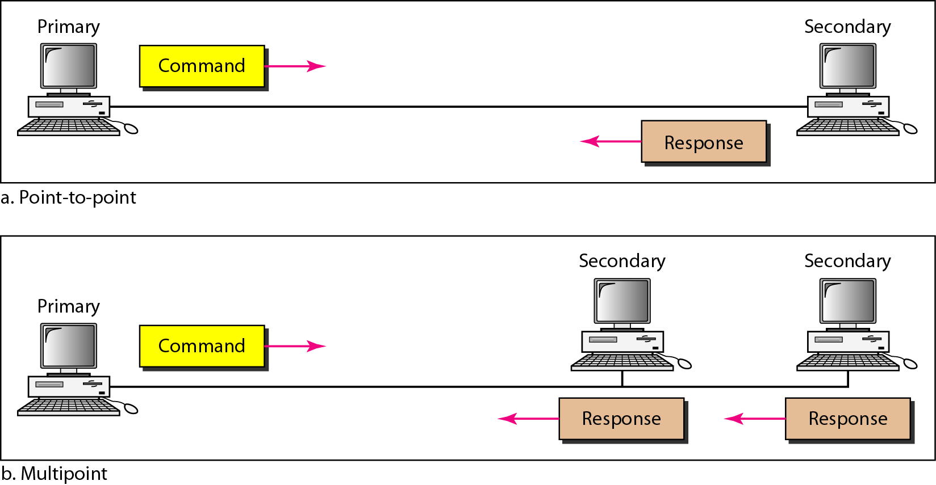
Figure 11.25 Normal response mode
11.<number>

Slide 47
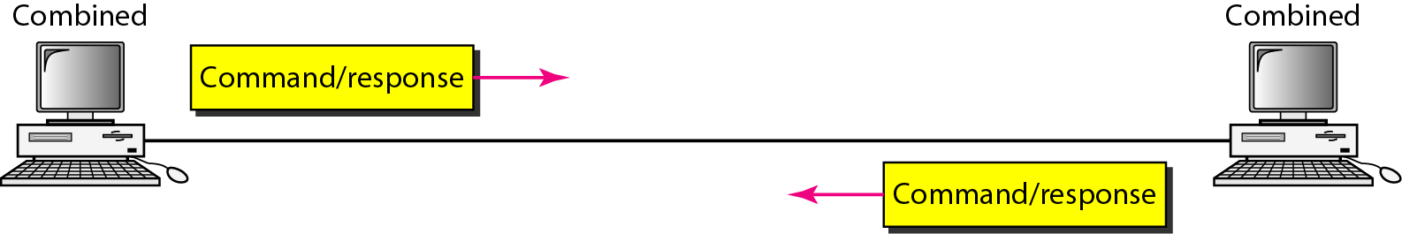
Figure 11.26 Asynchronous balanced mode
11.<number>

Slide 48
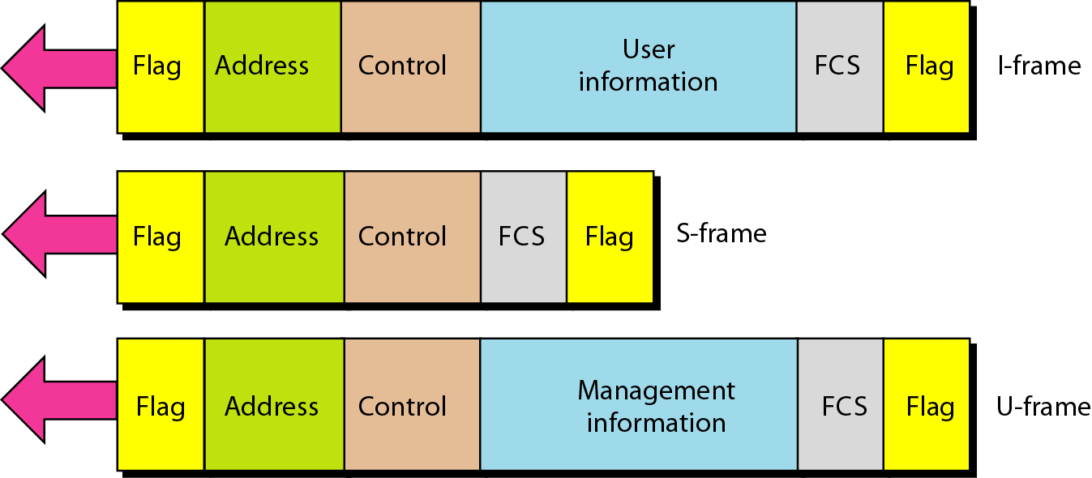
Figure 11.27 HDLC frames
11.<number>

Slide 49
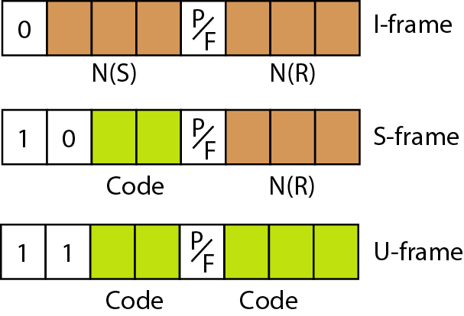
Figure 11.28 Control field format for the different frame types
11.<number>

Slide 50
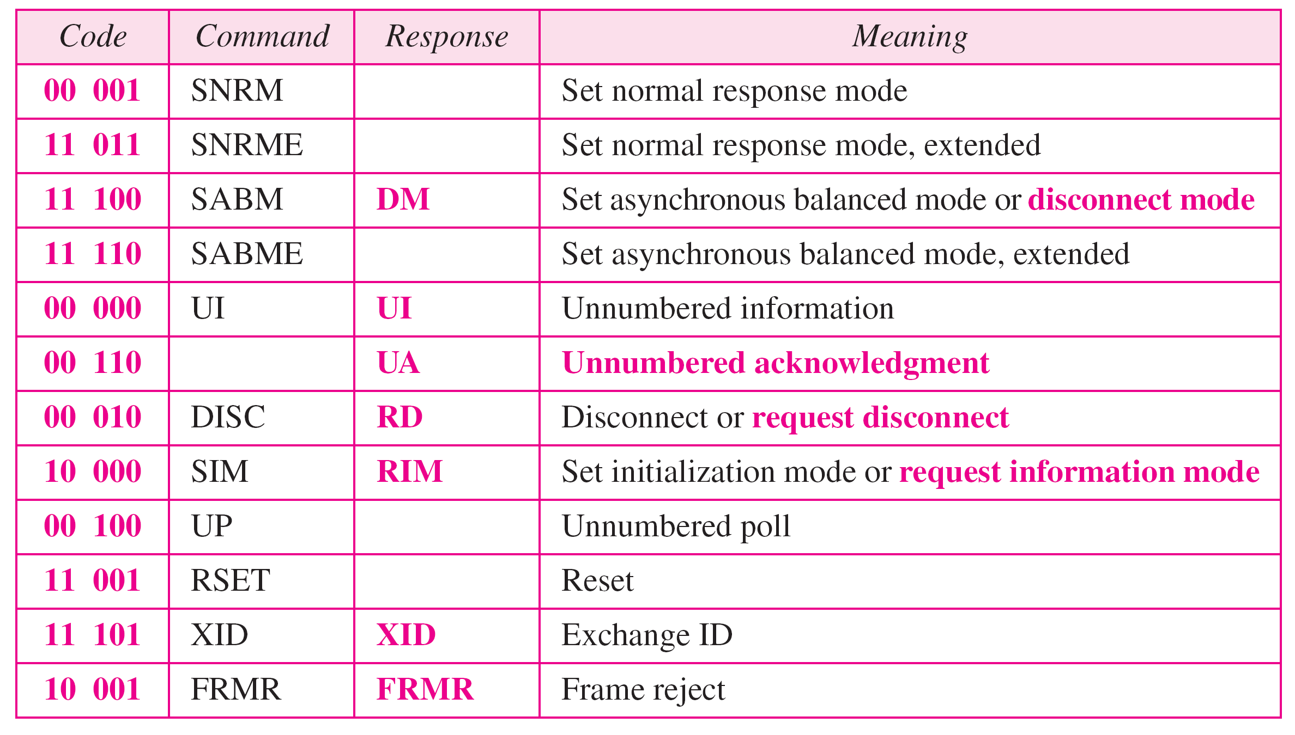
Table 11.1 U-frame control command and response
11.<number>

Slide 51
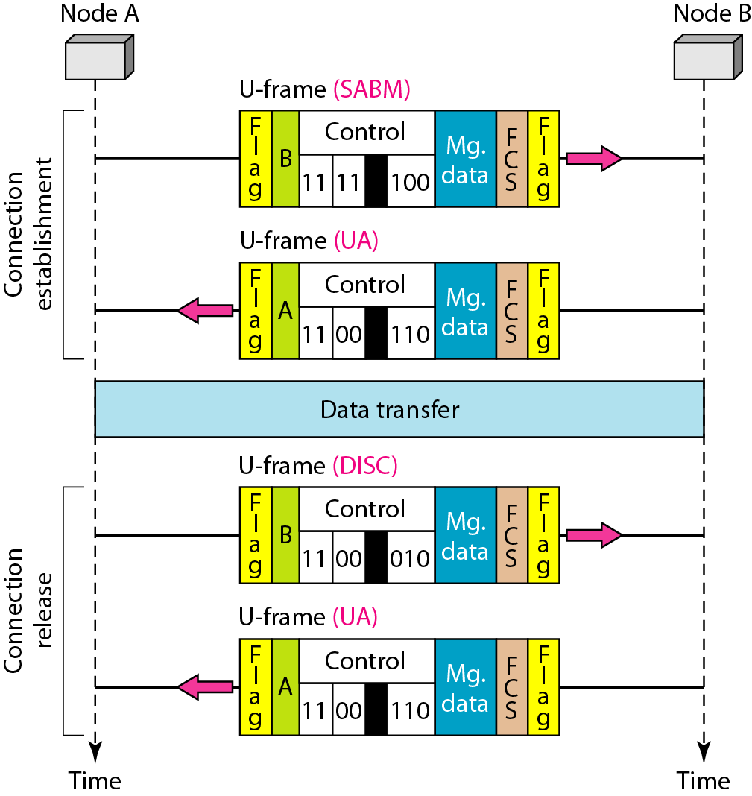
Figure 11.29 Example of connection and disconnection
11.<number>

Slide 52
11-7 POINT-TO-POINT PROTOCOL
Although HDLC is a general protocol that can be used for both point-to-point and multipoint configurations, one of the most common protocols for point-to-point access is the Point-to-Point Protocol (PPP). PPP is a byte-oriented protocol.
Topics discussed in this section:
Framing
Transition Phases
Multiplexing
Multilink PPP
11.<number>

Slide 53
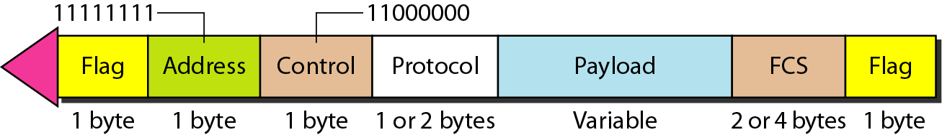
Figure 11.32 PPP frame format
11.<number>

Slide 54
Note
PPP is a byte-oriented protocol using byte stuffing with the escape byte 01111101.
11.<number>

Slide 55
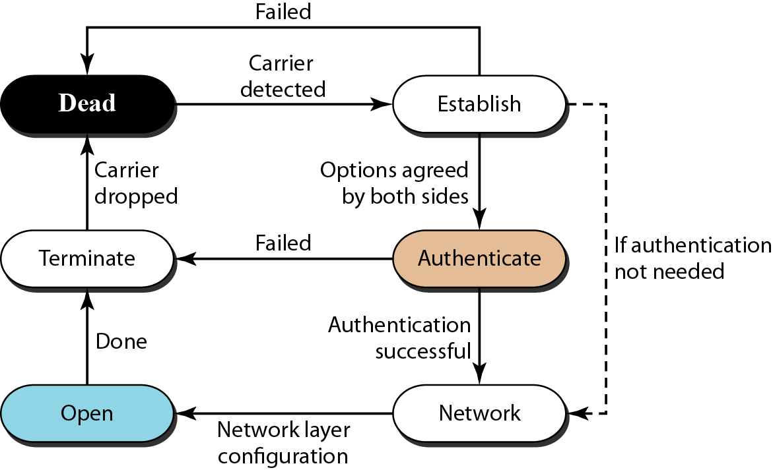
Figure 11.33 Transition phases
11.<number>

Slide 56
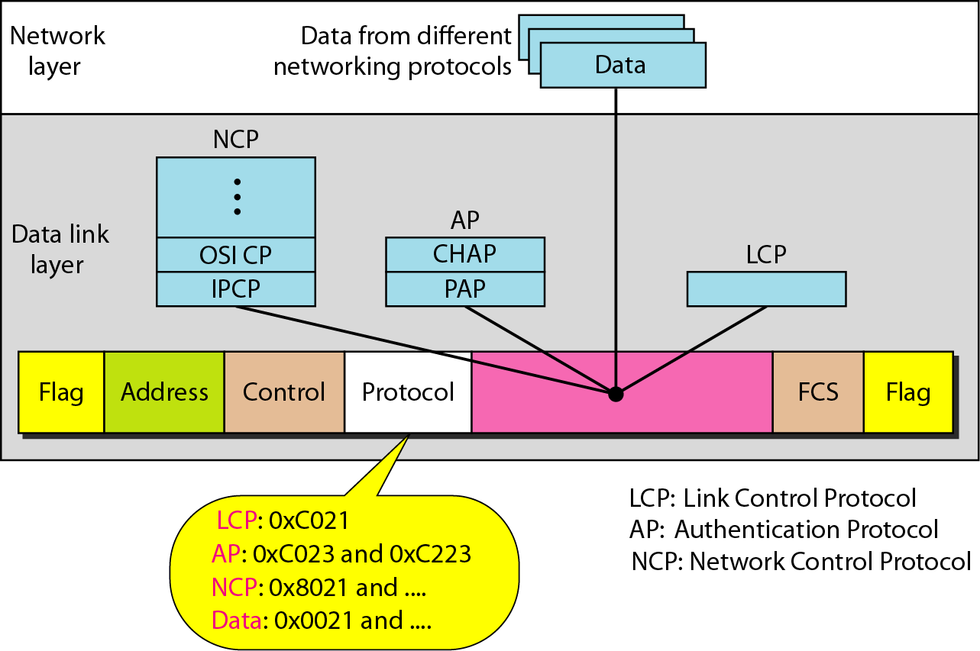
Figure 11.34 Multiplexing in PPP
11.<number>

Slide 57
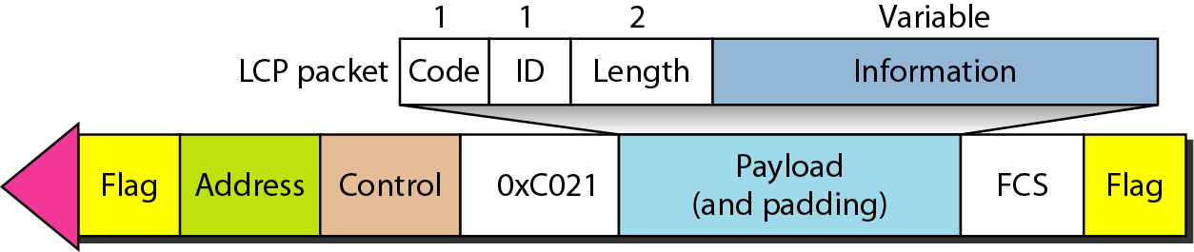
Figure 11.35 LCP packet encapsulated in a frame
11.<number>

Slide 58
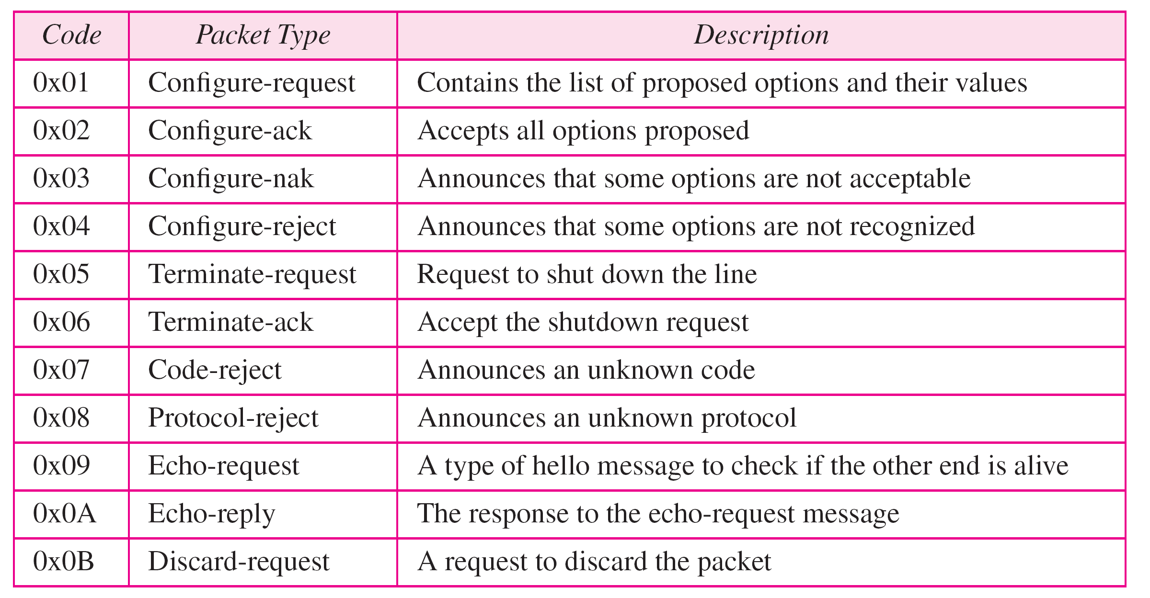
Table 11.2 LCP packets
11.<number>

Slide 59
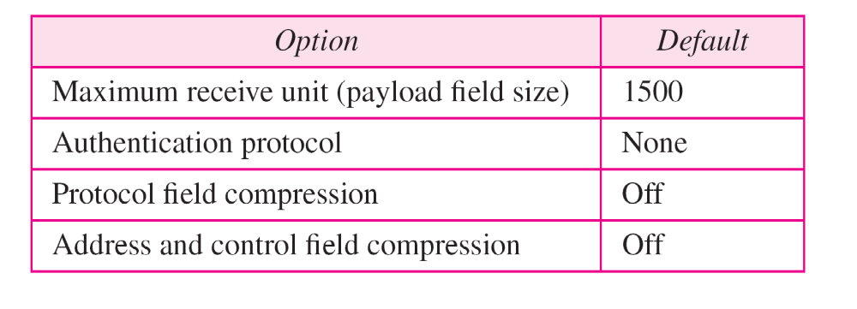
Table 11.3 Common options
11.<number>

Slide 60
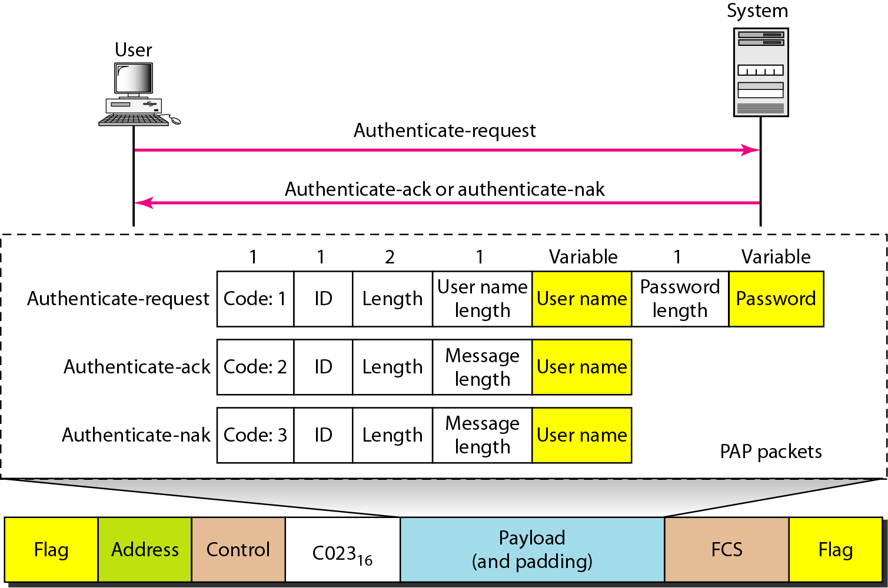
Figure 11.36 PAP packets encapsulated in a PPP frame
11.<number>

Slide 61
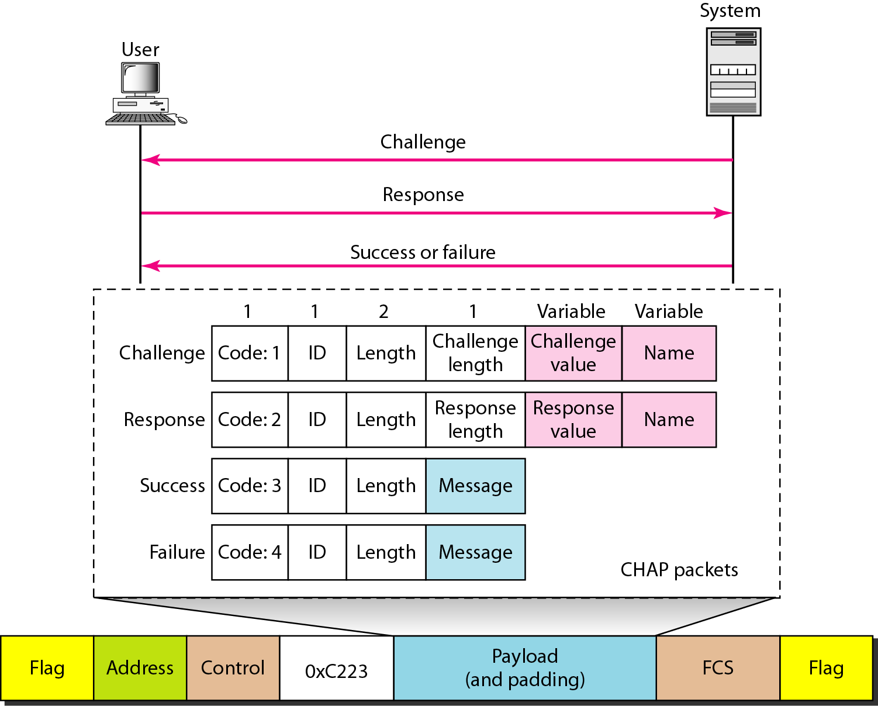
Figure 11.37 CHAP packets encapsulated in a PPP frame
11.<number>

Slide 62
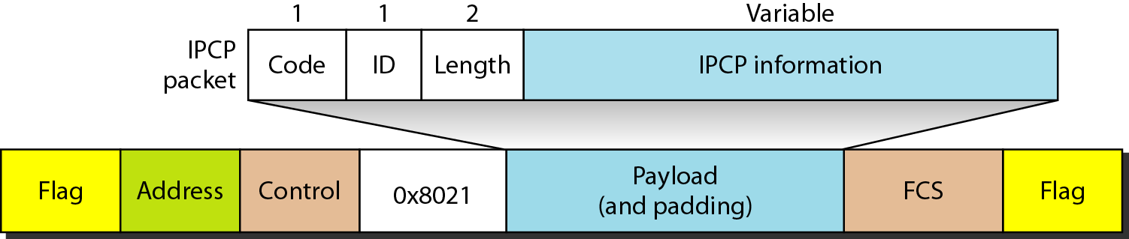
Figure 11.38 IPCP packet encapsulated in PPP frame
11.<number>

Slide 63
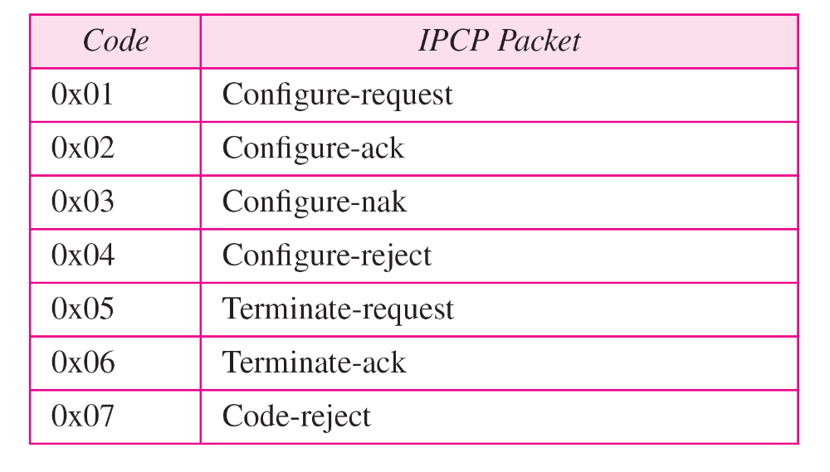
Table 11.4 Code value for IPCP packets
11.<number>

Slide 64
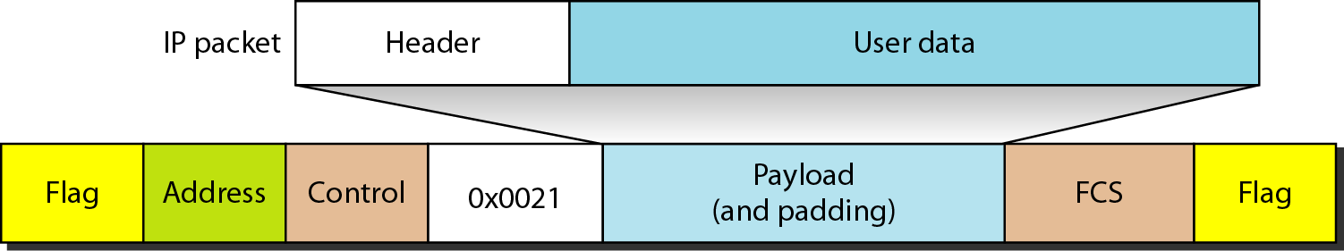
Figure 11.39 IP datagram encapsulated in a PPP frame
11.<number>

