Slide 1

Chapter 21
Network Layer:
Address Mapping,
Error Reporting,
and Multicasting
21.<number>
Copyright © The McGraw-Hill Companies, Inc. Permission required for reproduction or display.

Slide 2
21-1 ADDRESS MAPPING
The delivery of a packet to a host or a router requires two levels of addressing: logical and physical. We need to be able to map a logical address to its corresponding
physical address and vice versa. This can be done by using either static or dynamic mapping.
Topics discussed in this section:
Mapping Logical to Physical Address
Mapping Physical to Logical Address
21.<number>

Slide 3

Figure 21.1 ARP operation
21.<number>

Slide 4

Figure 21.2 ARP packet
21.<number>

Slide 5
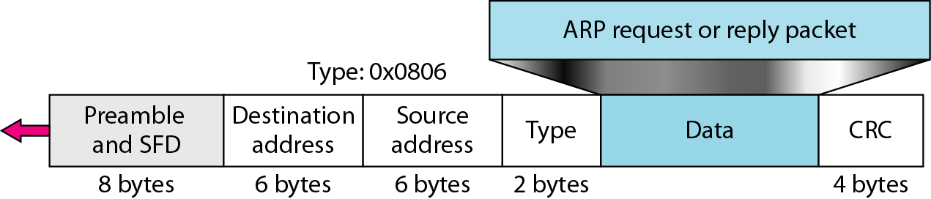
Figure 21.3 Encapsulation of ARP packet
21.<number>

Slide 6

Figure 21.4 Four cases using ARP
21.<number>

Slide 7

Note
An ARP request is broadcast;
an ARP reply is unicast.
21.<number>

Slide 8
Example 21.1
A host with IP address 130.23.43.20 and physical address B2:34:55:10:22:10 has a packet to send to another host with IP address 130.23.43.25 and physical address A4:6E:F4:59:83:AB. The two hosts are on the same Ethernet network. Show the ARP request and reply packets encapsulated in Ethernet frames.
Solution
Figure 21.5 shows the ARP request and reply packets. Note that the ARP data field in this case is 28 bytes, and that the individual addresses do not fit in the 4-byte boundary. That is why we do not show the regular 4-byte boundaries for these addresses.
21.<number>

Slide 9

Figure 21.5 Example 21.1, an ARP request and reply
21.<number>

Slide 10

Figure 21.6 Proxy ARP
21.<number>

Slide 11
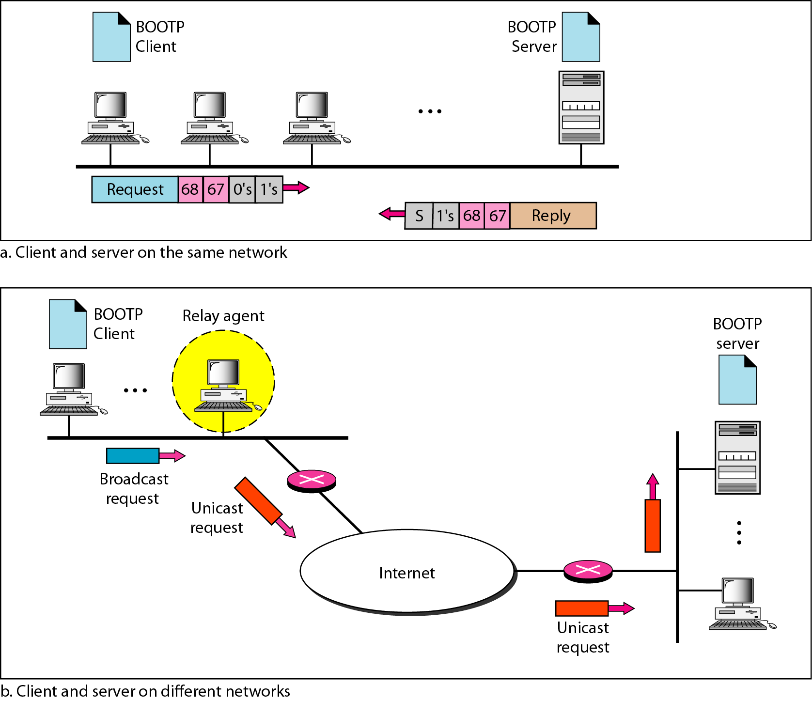
Figure 21.7 BOOTP client and server on the same and different networks
21.<number>

Slide 12
Note
DHCP provides static and dynamic address allocation that can be
manual or automatic.
21.<number>

Slide 13
21-2 ICMP
The IP protocol has no error-reporting or error-correcting mechanism. The IP protocol also lacks a mechanism for host and management queries. The Internet Control Message Protocol (ICMP) has been designed to compensate for the above two deficiencies. It is a companion to the IP protocol.
Topics discussed in this section:
Types of Messages
Message Format
Error Reporting and Query
Debugging Tools
21.<number>

Slide 14

Figure 21.8 General format of ICMP messages
21.<number>

Slide 15
Note
ICMP always reports error messages to the original source.
21.<number>

Slide 16
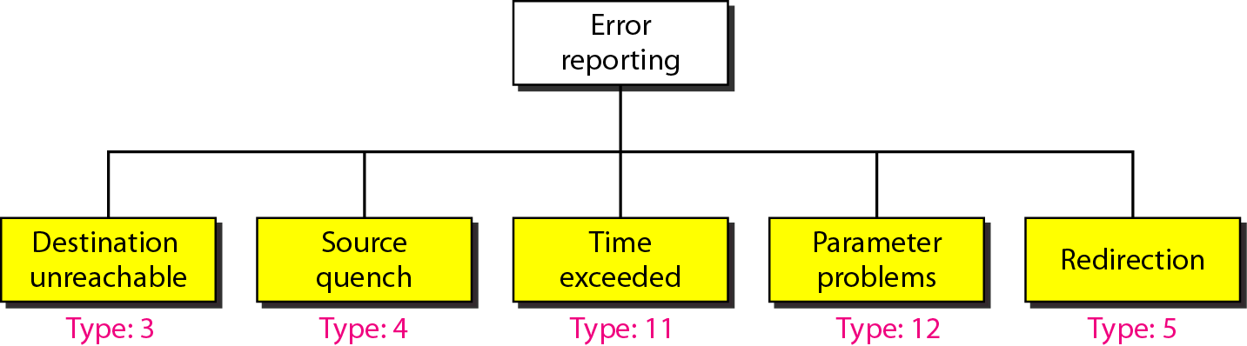
Figure 21.9 Error-reporting messages
21.<number>

Slide 17
Note
Important points about ICMP error messages:
❏ No ICMP error message will be generated in
response to a datagram carrying an ICMP error
message.
❏ No ICMP error message will be generated for a
fragmented datagram that is not the first fragment.
❏ No ICMP error message will be generated for a
datagram having a multicast address.
❏ No ICMP error message will be generated for a
datagram having a special address such as
127.0.0.0 or 0.0.0.0.
21.<number>

Slide 18
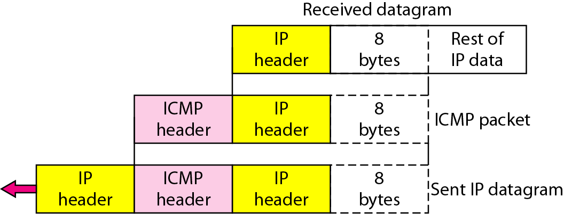
Figure 21.10 Contents of data field for the error messages
21.<number>

Slide 19
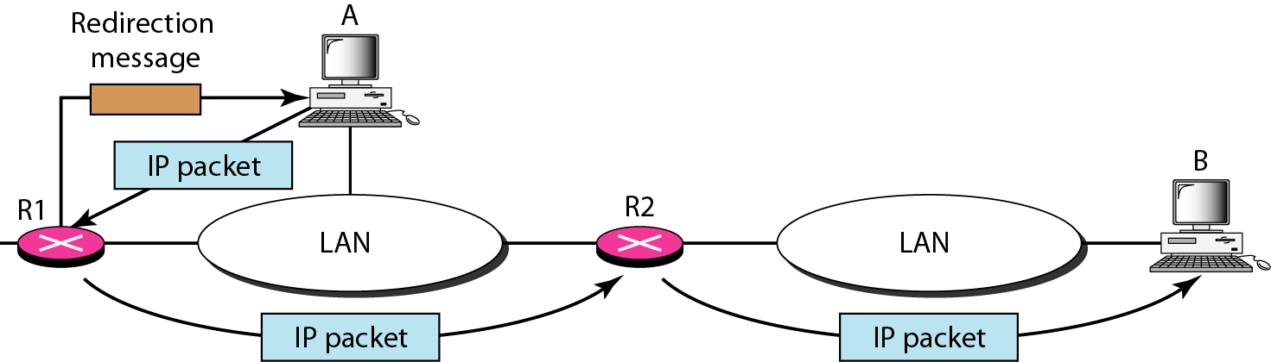
Figure 21.11 Redirection concept
21.<number>

Slide 20

Figure 21.12 Query messages
21.<number>

Slide 21
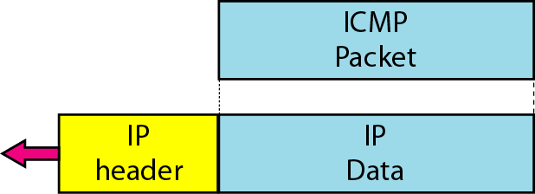
Figure 21.13 Encapsulation of ICMP query messages
21.<number>

Slide 22
21-3 IGMP
The IP protocol can be involved in two types of communication: unicasting and multicasting. The Internet Group Management Protocol (IGMP) is one of the necessary, but not sufficient, protocols that is involved in multicasting. IGMP is a companion to the IP protocol.
Topics discussed in this section:
Group Management
IGMP Messages and IGMP Operation
Encapsulation
Netstat Utility
21.<number>

Slide 23
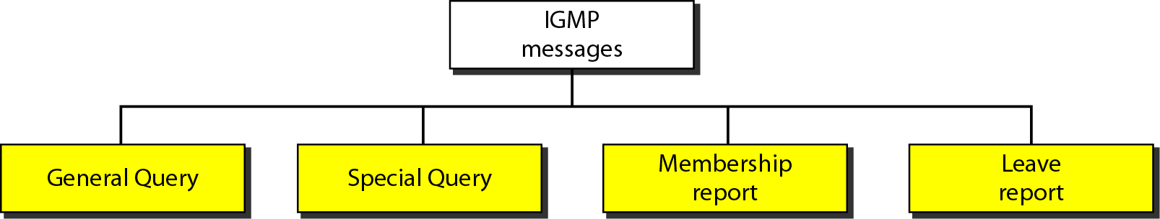
Figure 21.16 IGMP message types
21.<number>

Slide 24
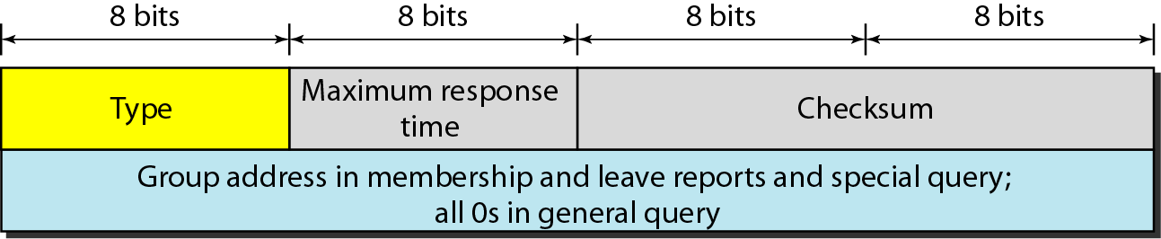
Figure 21.17 IGMP message format
21.<number>

Slide 25
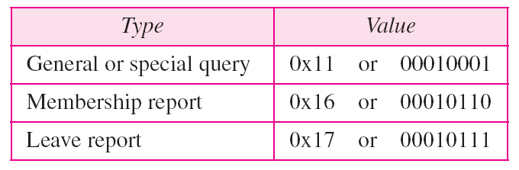
Table 21.1 IGMP type field
21.<number>

Slide 26
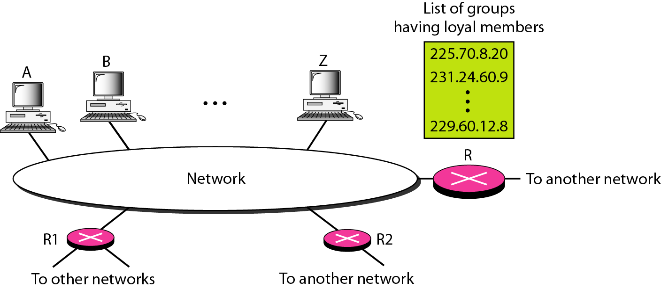
Figure 21.18 IGMP operation
21.<number>

Slide 27
Note
In IGMP, a membership report is sent twice, one after the other.
21.<number>

Slide 28
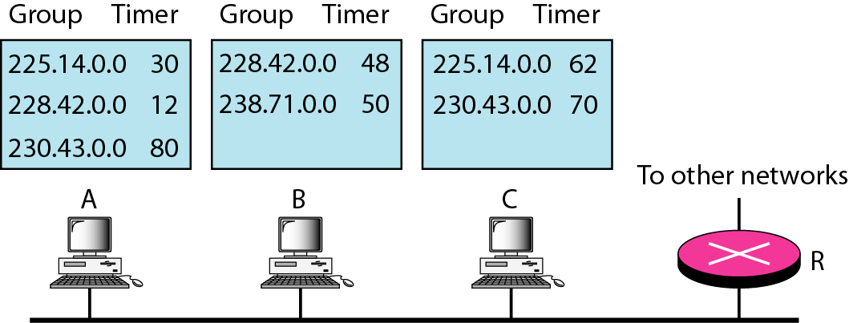
Figure 21.19 Example 21.6
21.<number>

Slide 29
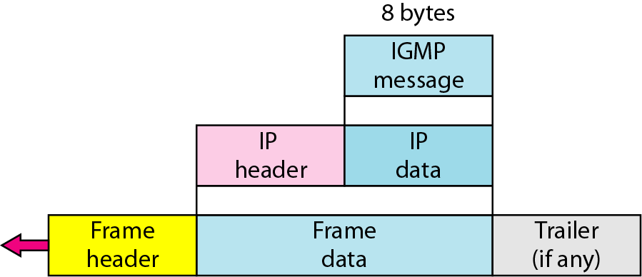
Figure 21.20 Encapsulation of IGMP packet
21.<number>

Slide 30
Note
The IP packet that carries an IGMP packet has a value of 1 in its TTL field.
21.<number>

Slide 31
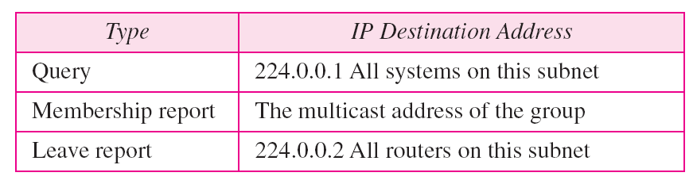
Table 21.2 Destination IP addresses
21.<number>

Slide 32
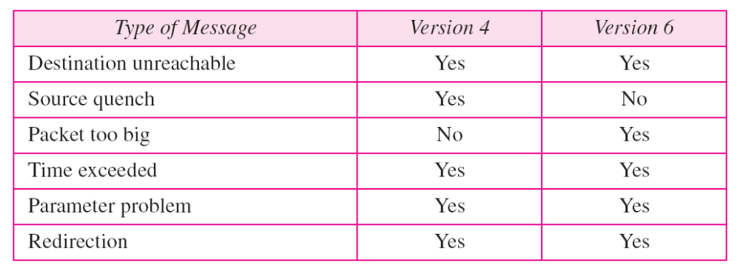
Table 21.3 Comparison of error-reporting messages in ICMPv4 and ICMPv6
21.<number>

