Slide 1

Chapter 26
Remote Logging,
Electronic Mail,
and File Transfer
26.<number>
Copyright © The McGraw-Hill Companies, Inc. Permission required for reproduction or display.

Slide 2
26-2 ELECTRONIC MAIL
One of the most popular Internet services is electronic mail (e-mail). The designers of the Internet probably never imagined the popularity of this application program. Its architecture consists of several components that we discuss in this chapter.
Topics discussed in this section:
Architecture
User Agent
Message Transfer Agent: SMTP
Message Access Agent: POP and IMAP
Web-Based Mail
26.<number>

Slide 3

Figure 26.6 First scenario in electronic mail
26.<number>

Slide 4

Note
When the sender and the receiver of an e-mail are on the same system,
we need only two user agents.
26.<number>

Slide 5

Figure 26.7 Second scenario in electronic mail
26.<number>

Slide 6
Note
When the sender and the receiver of an e-mail are on different systems, we
need two UAs and a pair of
MTAs (client and server).
26.<number>

Slide 7

Figure 26.8 Third scenario in electronic mail
26.<number>

Slide 8
Note
When the sender is connected to the mail server via a LAN or a WAN,
we need two UAs and two pairs
of MTAs (client and server).
26.<number>

Slide 9

Figure 26.9 Fourth scenario in electronic mail
26.<number>

Slide 10

Figure 26.10 Push versus pull in electronic email
26.<number>

Slide 11
Note
When both sender and receiver are connected to the mail server via
a LAN or a WAN, we need two
UAs, two pairs of MTAs
and a pair of MAAs.
This is the most common situation today.
26.<number>

Slide 12

Figure 26.11 Services of user agent
26.<number>

Slide 13
Note
Some examples of command-driven user agents are mail, pine,
and elm.
26.<number>

Slide 14
Note
Some examples of GUI-based user agents are Eudora, Outlook, and Netscape.
26.<number>

Slide 15

Figure 26.12 Format of an e-mail
26.<number>

Slide 16

Figure 26.13 E-mail address
26.<number>

Slide 17
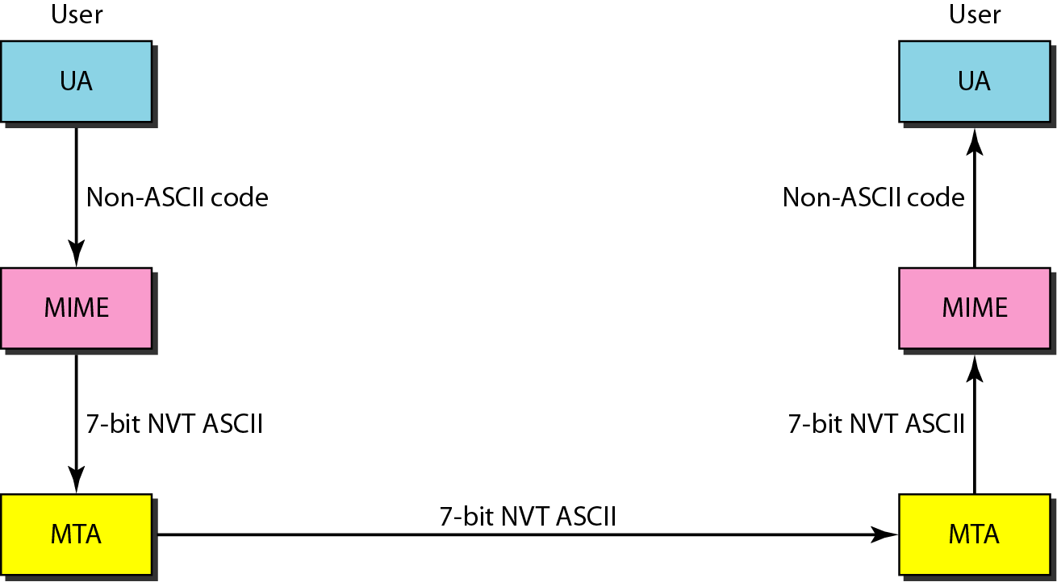
Figure 26.14 MIME
26.<number>

Slide 18
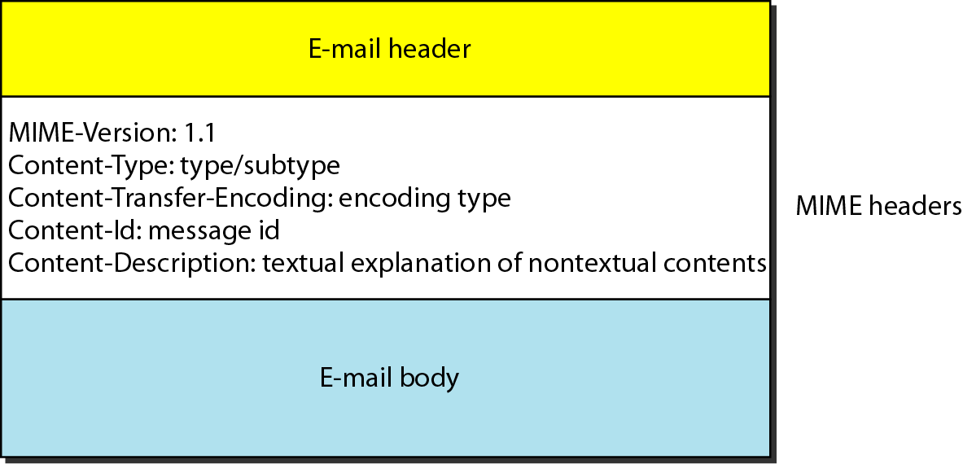
Figure 26.15 MIME header
26.<number>

Slide 19
Table 26.5 Data types and subtypes in MIME
26.<number>

Slide 20
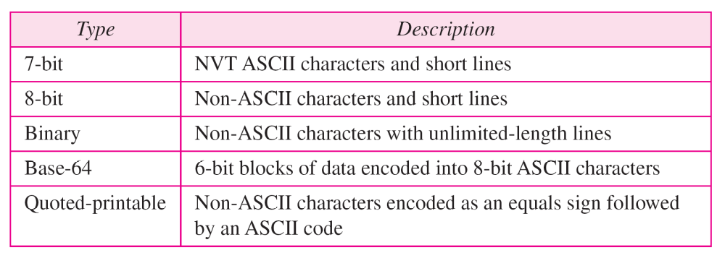
Table 26.6 Content-transfer-encoding
26.<number>

Slide 21
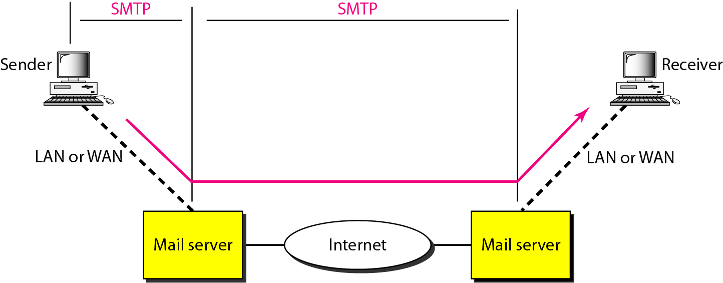
Figure 26.16 SMTP range
26.<number>

Slide 22

Figure 26.17 Commands and responses
26.<number>

Slide 23

Figure 26.18 Command format
26.<number>

