Slide 1
1: Processes CO1: To implement process scheduling algorithms.
-PN

Slide 2
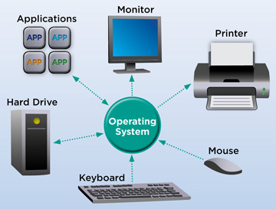
What is an Operating System?
An operating system is the most important software that runs on a computer. It manages the computer's memory and processes, as well as all of its software and hardware. It also allows you to communicate with the computer without knowing how to speak the computer's language. Without an operating system, a computer is useless.

Slide 3
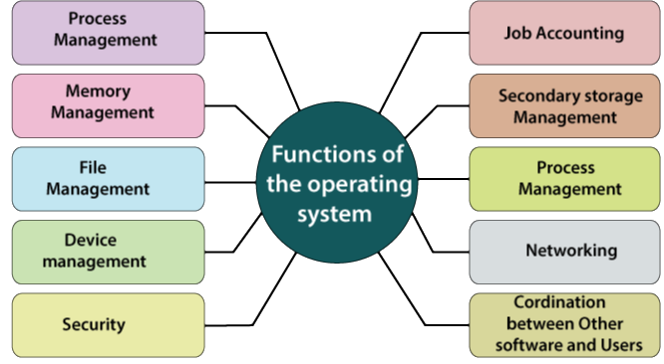
Functions of Operating System

Slide 4
The Process Concept
A process is a program in execution which then forms the basis of all computation. The process is not as same as program code but a lot more than it. A process is an 'active' entity as opposed to the program which is considered to be a 'passive' entity. Attributes held by the process include hardware state, memory, CPU, etc.
Once created, a process becomes active and eligible to compete for system resources such as processor and I/O devices.
Each active process is an individually schedulable entity.
Process is a dynamic concept that refers to a program in execution, undergoing frequent state and attribute changes.
An executable program on the other hand, is a static process template that may give rise to one or more processes.

Slide 5

Example
Consider execution of the text editor program in a multi programmed, multi user system.
File……
Editor Program
Template for editor process
Loads the editor program into memory
Creates an editor process
Invokes the editor
Operating System
Schedules it for execution
User

Slide 6
Contd…
Editor Process
The editor process begins executing the editing commands issued by the user from the terminal.
Performs housekeeping
Exit Command
Terminates itself by calling OS
OS closes the data files and erases the record

Slide 7
Process Management Functions
Creating and Removing (destroying) processes.
Controlling the progress of processes, that is, ensuring that each logically enabled process makes progress towards its completion at a positive rate.
Acting on exceptional conditions arising during the execution of a process, including interrupts and arithmetic errors.
Allocating hardware resources among processes.
Providing a means of communicating messages or signals among processes.

Slide 8
Implicit and Explicit Tasking
Implicit tasking means that processes are defined by the system
In this approach, each program submitted for execution is treated by the operating system as an independent process
Processes created in this manner are usually transient in the sense that they are destroyed and disposed of by the system after each run
Explicit tasking means that programs explicitly define each process and some of its attributes.
Explicit tasking is used in situations where high performance in desired system programs such as parts of the operating system and real time applications are common examples of programs defined processes.
After dividing process into several independent processes, a system programs defines the confines of each individual process. A parent process is then commonly added to create the environment for and to control execution of individual processes.

Slide 9
Uses of explicit tasking
Speedup: Explicit tasking can result in faster execution of applications.
Driving I/O devices that have latency: While one task is waiting for I/O to complete, another portion of the application can make progress towards completion if it contains other tasks that can do useful work in the interim.
User convenience: By creating tasks to handle individual actions, a graphical interface can allow users to launch several operations concurrently by clicking on action icons before completion of previous commands.
Multiprocessing and multi computing: A program coded as a collection of tasks can be relatively easily posted to a multiprocessor system, where individual tasks may be executed on different processors in parallel.

Slide 10
Process Relationship
Independent process:
These type of processes have following features:
Their state is not shared in any way by any other process.
Their execution is deterministic, i.e., the results of execution depend only on the input values.
Their execution is reproducible, i.e., the results of execution will always be the same for the same input.
Their execution can be stopped and restarted without any negative effect.

Slide 11
Cooperating process:
In contrast to independent processes, cooperating processes can
affect or be affected by other processes executing the system. They are characterized
by:
Their states are shared by other processes.
Their execution is not deterministic, i.e., the results of execution depend on relative execution sequence and cannot be predicted in advance.
Their execution is irreproducible, i.e., the results of execution are not always the same
for the same input.

Slide 12
Process Relationship (Contd…)
In the concurrent environment basically processes have two relationships, competition and cooperation
In the concurrent environment, processes compete with each other for allocation of system resources to execute their instructions
In the competition, there should be proper resource allocation and protection in address generation.

Slide 13

Operating System view of processes
Running
Terminates
Awaits Event (I/O Synchronization)
Dormant
Scheduled
Suspended
Pre-empted
Created
Event Occurs
Ready

Slide 14
A process state may be in one of the following:
Dormant : The process is being created.
Ready : The process is waiting to be assigned to a processor.
Running : Instructions are being executed.
Waiting/Suspended/Blocked : The process is waiting for some event to occur.
Halted/Terminated : The process has finished execution.

Slide 15
Process Control Block (PCB)
To implement the process model, the operating system maintains a table, an array of structures, called the process table or process control block (PCB)
Each entry identifies a process with information such as process state, its program counter, stack pointer, memory allocation, the status of its open files, its accounting and scheduling information

Slide 16
The following is the information stored in a PCB.
Process name (ID)
Priority
State (ready, running, suspended)
Hardware State (processor registers and flags)
Scheduling information and usage statistics
Memory management information (registers, tables)
I/O Status (allocated devices, pending operations)
File management information (open files, access rights)
Accounting information

Slide 17
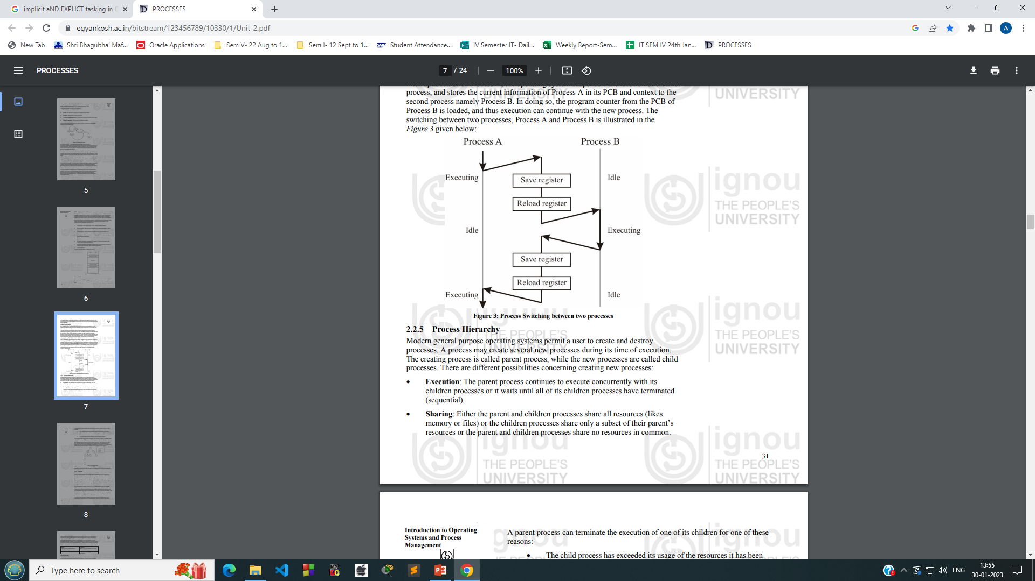
Process Transition

Slide 18
Operating system services for process management
CREATE (processID, attributes);
DELETE (processID);
ABORT (processID);
FORK/JOIN;
SUSPEND (processID);
RESUME (processID);
DELAY (processID, time);
GET_ATTRIBUTES (processID, attribute_set);
CHANGE_PRIORITY (processID, new_priority);

Slide 19
Scheduling
Scheduling refers to a set of policies and mechanisms built into the operating system that govern the order in which the work to be done by computer system is completed.​
A Scheduler is an OS module that selects the next job to be admitted into the system and the next process to run.​
The primary objective of scheduling is to optimize system performance in accordance with the criteria deemed most important by the system designers.

Slide 20
Scheduling Criteria
CPU Utilization:
The key idea is that if the CPU is busy all the time, the utilization factor of all the components of the system will be also high. CPU utilization is the ratio of busy time of the processor to the total time passes for processes to finish.
Processor Utilization = (Processor busy time) / (Processor busy time + Processor idle time)
Throughput:
It refers to the amount of work completed in a unit of time. One way to measure throughput is by means of the number of processes that are completed in a unit of time
Throughput = (No. of processes completed) / (Time unit)

Slide 21
Turnaround Time :
It may be defined as interval from the time of submission of a process to the time of its completion. It is the sum of the periods spent waiting to get into memory, waiting in the ready queue, CPU time and I/O operations.
Turnaround Time = t(Process completed) – t(Process submitted)
Waiting Time:
This is the time spent in the ready queue.
Waiting time = Turnaround Time - Processing Time
Response time:
Response time = t(first response) – t(submission of request)

Slide 22
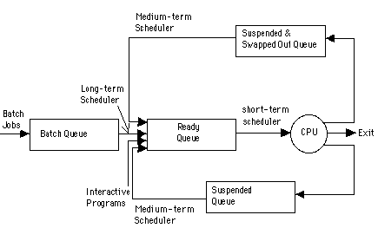
Types of schedulers

