Slide 1
Paging
Paging is a memory management scheme that eliminates the need for contiguous allocation of physical memory. This scheme permits the physical address space of a process to be non – contiguous.

Slide 2
The mapping from virtual to physical address is done by the memory management unit (MMU) which is a hardware device and this mapping is known as paging technique.
The Physical Address Space is conceptually divided into a number of fixed-size blocks, called frames.
The Logical address Space is also split into fixed-size blocks, called pages.
Page Size = Frame Size

Slide 3
Address generated by CPU is divided into
Page number(p): Number of bits required to represent the pages in Logical Address Space or Page number
Page offset(d): Number of bits required to represent particular word in a page or page size of Logical Address Space or word number of a page or page offset.

Slide 4
Physical Address is divided into
Frame number(f): Number of bits required to represent the frame of Physical Address Space or Frame number.
Frame offset(d): Number of bits required to represent particular word in a frame or frame size of Physical Address Space or word number of a frame or frame offset.

Slide 5
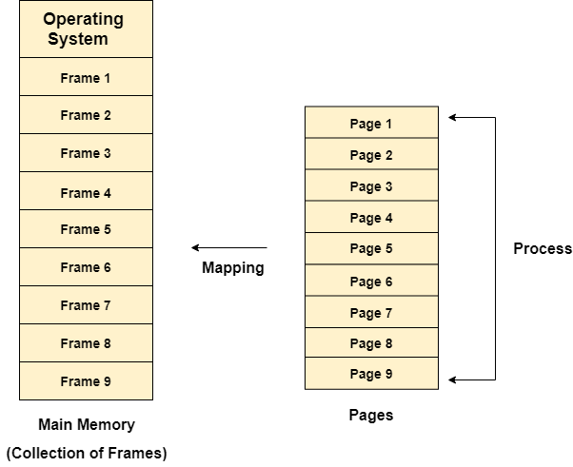
Different operating system defines different frame sizes. The sizes of each frame must be equal. Considering the fact that the pages are mapped to the frames in Paging, page size needs to be as same as frame size.

Slide 6
Example
Let us consider the main memory size 16 Kb and Frame size is 1 KB therefore the main memory will be divided into the collection of 16 frames of 1 KB each.
There are 4 processes in the system that is P1, P2, P3 and P4 of 4 KB each. Each process is divided into pages of 1 KB each so that one page can be stored in one frame.
Initially, all the frames are empty therefore pages of the processes will get stored in the contiguous way.

Slide 7
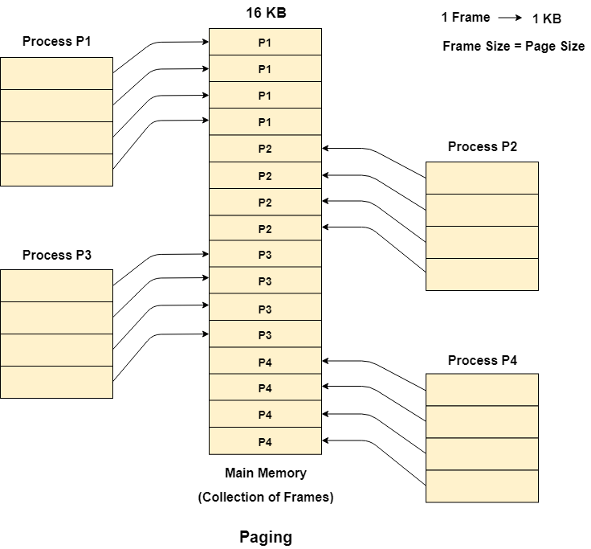
Frames, pages and the mapping between the two is shown in the image below.

Slide 8
Let us consider that, P2 and P4 are moved to waiting state after some time. Now, 8 frames become empty and therefore other pages can be loaded in that empty place. The process P5 of size 8 KB (8 pages) is waiting inside the ready queue.
Given the fact that, we have 8 non contiguous frames available in the memory and paging provides the flexibility of storing the process at the different places. Therefore, we can load the pages of process P5 in the place of P2 and P4.

Slide 9
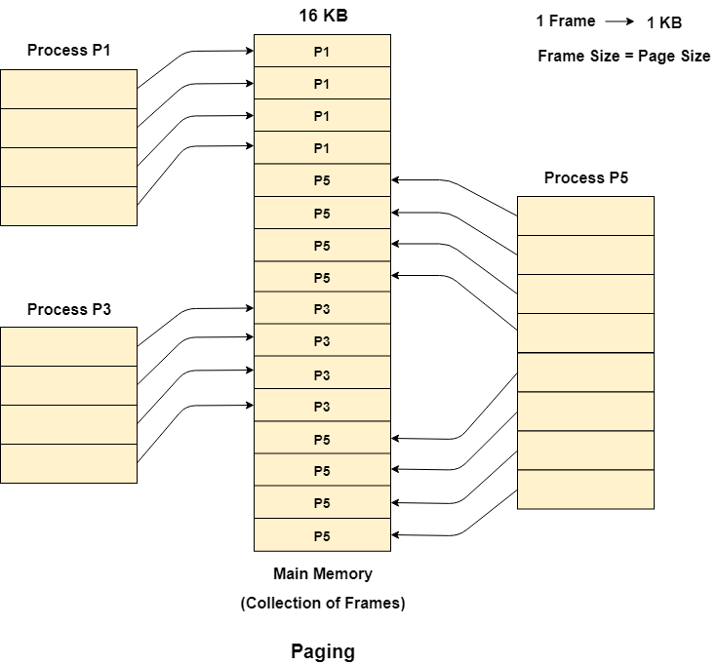

Slide 10
Memory Management Unit
The purpose of Memory Management Unit (MMU) is to convert the logical address into the physical address. The logical address is the address generated by the CPU for every page while the physical address is the actual address of the frame where each page will be stored.

Slide 11
When a page is to be accessed by the CPU by using the logical address, the operating system needs to obtain the physical address to access that page physically.
The logical address has two parts.
Page Number
Offset
Memory management unit of OS needs to convert the page number to the frame number.

Slide 12
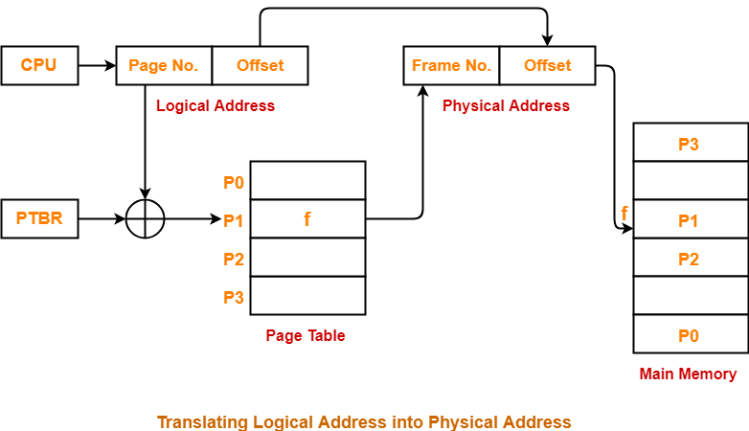

Slide 13
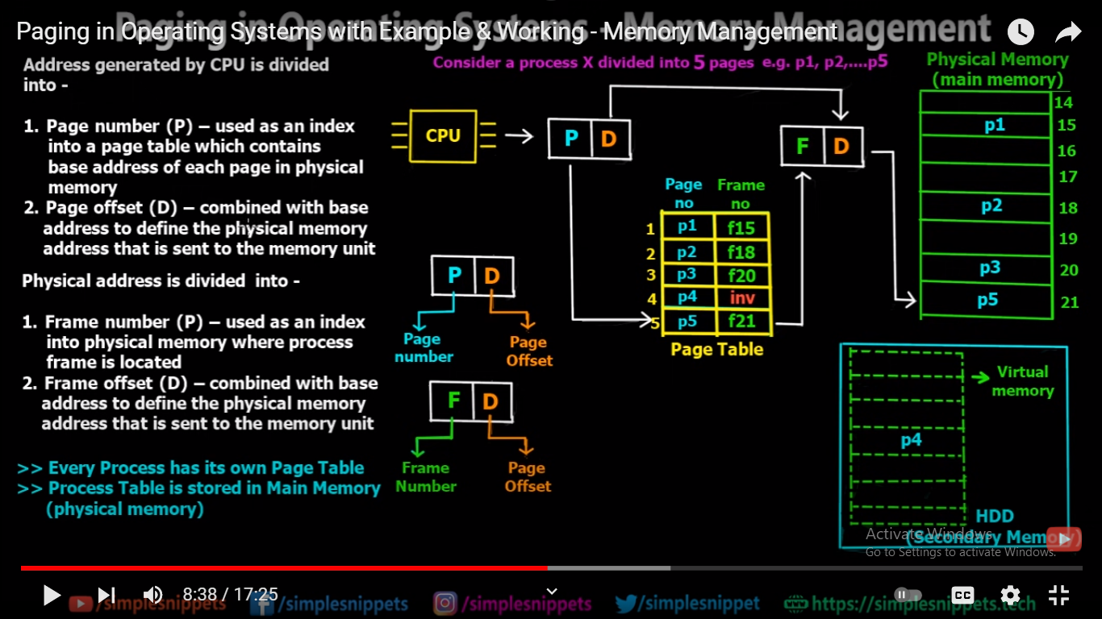

Slide 14
Virtual Memory
Virtual Memory is a storage allocation scheme in which secondary memory can be addressed as though it were part of the main memory.
The size of virtual storage is limited by the addressing scheme of the computer system and the amount of secondary memory is available not by the actual number of the main storage locations.

Slide 15
Contd..
It is a technique that is implemented using both hardware and software. It maps memory addresses used by a program, called virtual addresses, into physical addresses in computer memory.

Slide 16
All memory references within a process are logical addresses that are dynamically translated into physical addresses at run time. This means that a process can be swapped in and out of the main memory such that it occupies different places in the main memory at different times during the course of execution.
A process may be broken into a number of pieces and these pieces need not be continuously located in the main memory during execution. The combination of dynamic run-time address translation and use of page or segment table permits this.

Slide 17
Contd..
If these characteristics are present then, it is not necessary that all the pages or segments are present in the main memory during execution.
This means that the required pages need to be loaded into memory whenever required.
Virtual memory is implemented using Demand Paging or Demand Segmentation.

Slide 18
Demand Paging
If the CPU tries to refer to a page that is currently not available in the main memory, it generates an interrupt indicating a memory access fault.
The OS puts the interrupted process in a blocking state. For the execution to proceed the OS must bring the required page into the memory.
The OS will search for the required page in the logical address space.
The required page will be brought from logical address space to physical address space. The page replacement algorithms are used for the decision-making of replacing the page in physical address space.
The page table will be updated accordingly.
The signal will be sent to the CPU to continue the program execution and it will place the process back into the ready state.

Slide 19
Demand Paging

Slide 20
S.NO | Paging | Segmentation
1. | In paging, program is divided into fixed or mounted size pages. | In segmentation, program is divided into variable size sections.
2. | For paging operating system is accountable. | For segmentation compiler is accountable.
3. | Page size is determined by hardware. | Here, the section size is given by the user.
4. | It is faster in the comparison of segmentation. | Segmentation is slow.
5. | Paging could result in internal fragmentation. | Segmentation could result in external fragmentation.
6. | In paging, logical address is split into page number and page offset. | Here, logical address is split into section number and section offset.
7. | Paging comprises a page table which encloses the base address of every page. | While segmentation also comprises the segment table which encloses segment number and segment offset.
8. | Page table is employed to keep up the page data. | Section Table maintains the section data.
9. | In paging, operating system must maintain a free frame list. | In segmentation, operating system maintain a list of holes in main memory.
10. | Paging is invisible to the user. | Segmentation is visible to the user.
11. | In paging, processor needs page number, offset to calculate absolute address. | In segmentation, processor uses segment number, offset to calculate full address.
12. | It is hard to allow sharing of procedures between processes. | Facilitates sharing of procedures between the processes.
13 | In paging, a programmer cannot efficiently handle data structure. | It can efficiently handle data structures.
14. | In this protection is hard to apply. | Easy to apply protection in segmentation.

