Slide 1
Producer-Consumer problem
The Producer-Consumer problem is a classical multi-process synchronization problem, that is we are trying to achieve synchronization between more than one process.
There is one Producer in the producer-consumer problem, Producer is producing some items, whereas there is one Consumer that is consuming the items produced by the Producer.
The same memory buffer is shared by both producers and consumers which is of fixed-size.
The task of the Producer is to produce the item, put it into the memory buffer, and again start producing items. Whereas the task of the Consumer is to consume the item from the memory buffer.
The producer should produce data only when the buffer is not full. In case it is found that the buffer is full, the producer is not allowed to store any data into the memory buffer.
Data can only be consumed by the consumer if and only if the memory buffer is not empty. In case it is found that the buffer is empty, the consumer is not allowed to use any data from the memory buffer.
Accessing memory buffer should not be allowed to producer and consumer at the same time.

Slide 2
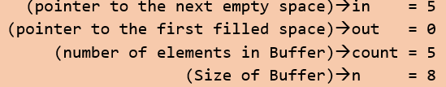
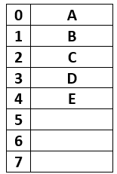
Let's start with the producer who wanted to produce an element " F ", according to code it will enter into the producer() function, while(1) will always be true, itemP = F will be tried to insert into the buffer, before that while(count == n); will evaluate to be False.

Slide 3
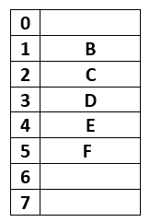
Consumer Code:
Now starting consumer who wanted to consume the first element " A ", according to code it will enter into the consumer() function, while(1) will always be true, while(count == 0); will evaluate to be False( since the count is still 5, which is not equal to 0.

Slide 4
The producer consumer problem can be resolved using semaphores. The codes for the producer and consumer process are given as follows −
Producer Process
The code that defines the producer process is given below
do {
. .
PRODUCE ITEM
.
wait(empty);
wait(mutex);
.
. PUT ITEM IN BUFFER
.
signal(mutex);
signal(full);
}
while(1);

Slide 5
mutex is initialized to 1, empty is initialized to n (maximum size of the buffer) and full is initialized to 0.
The mutex semaphore ensures mutual exclusion.
The empty and full semaphores count the number of empty and full spaces in the buffer.
After the item is produced, wait operation is carried out on empty.
This indicates that the empty space in the buffer has decreased by 1.
Then wait operation is carried out on mutex so that consumer process cannot interfere.
After the item is put in the buffer, signal operation is carried out on mutex and full.
The former indicates that consumer process can now act and the latter shows that the buffer is full by 1.

Slide 6
Do
{
wait(full);
wait(mutex);
REMOVE ITEM FROM BUFFER
signal(mutex);
signal(empty); .
CONSUME ITEM
}
while(1);
The wait operation is carried out on full.
This indicates that items in the buffer have decreased by 1.
Then wait operation is carried out on mutex so that producer process cannot interfere.
Then the item is removed from buffer.
After that, signal operation is carried out on mutex and empty.
The former indicates that consumer process can now act and the latter shows that the empty space in the buffer has increased by 1.

