Slide 1
Unit 5
Query Processing

Slide 2
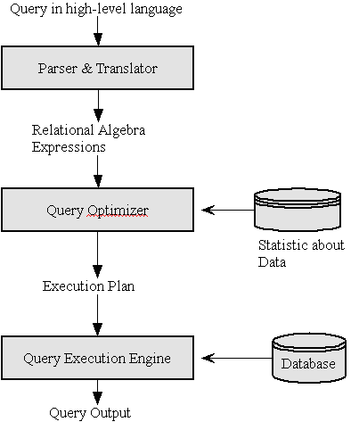
Query Processing
Query processing is a set of activities involving in getting the result of a query expressed in a high-level language.

Slide 3
Query Processing
Parser & Translator :
Parsing and translating a given high-level language query into its immediate form i.e. relational algebra expressions
The parser need to check for the syntax of the query and also check for the semantic of the query
The syntactic checking verifies that keywords, object names, operators, delimiters, and so on are placed correctly in your SQL statement.
semantic checking verifies that references to database objects and host variables are valid and that host-variable datatypes are correct.
A parse-tree of the query is constructed and then translated into relational algebra expression

Slide 4
Query Processing
Query Optimizer :
A relational algebra expression of a query specifies only partially how to evaluate a query,
There are several ways to evaluate an relational algebra expression
i.e. SELECT Salary FROM EMPLOYEE WHERE Salary >= 50000 ;
The possible relational algebra expressions for this query are:
ΠSalary(σSalary>=50000(EMPLOYEE))
σSalary>=50000(ΠSalaryEMPLOYEE)
Different algorithms are employed to retrieve the tuples i.e. sequential search or indexing

Slide 5
Query Processing
Query Execution Plan :
Specifies how to evaluate a query
Made up of the relational algebra expression and the detailed algorithms to evaluate each operation in that expression
Among all semantically equivalent expressions, the one with the least costly evaluation plan is chosen
Cost estimate of a plan is based on statistical information in the system catalogs.
The process of choosing a suitable query execution plan is known as query optimization
Query Execution Engine :
Once the query plan is chosen, the Query Execution Engine lastly take the plan, executes that plan and returns the answer of the query

Slide 6
Relational Algebra
A procedural query language, which takes instances of relations as input and yields instances of relations as output
Uses operators to perform queries
An operator can be either unary or binary
Performed recursively on a relation and intermediate results are also considered relations.
The fundamental operations of relational algebra are as follows
Select
Project
Union
Set different
Cartesian product
Rename

Slide 7
Query Processing
Select Operation (σ) :
Selects tuples that satisfy the given predicate from a relation
Notation − σ_{p}(r)
Where σ stands for selection predicate and r stands for relation. p is prepositional logic formula which may use connectors like and, or, and not. These terms may use relational operators like − =, ≠, ≥, < , >, ≤.
Examples:
σsubject = "database"(Books)
σsubject = "database" and price = "450"(Books)
σsubject = "database" and price = "450" or year > "2010"(Books)

Slide 8
Query Processing
Project Operation (∏) :
Projects column(s) that satisfy a given predicate
Notation − ∏_{A1, A2, An} (r)
Where A₁, A₂ , A_{n} are attribute names of relation r.
Examples:
∏subject, author (Books)
Union Operation (∪) :performs binary union between two given relations and is defined as r ∪ s = { t | t ∈ r or t ∈ s}
Notation r U s
Where r and s are either database relations or relation result set (temporary relation).
Example:
∏ author (Books) ∪ ∏ author (Articles)

Slide 9
Query Processing
Set Difference (−) :
The result is the tuples, which are present in one relation but are not in the second relation Examples:
Notation r − s
Example: ∏ author (Books) − ∏ author (Articles)
Cartesian Product (Χ) :
Combines information of two different relations into one
Notation r Χ s
Where r and s are relations and their output will be defined as − r Χ s = { q t | q ∈ r and t ∈ s}
Example:
σauthor = 'tutorialspoint'(Books Χ Articles)

Slide 10
Query Processing
The Intersection ( ∩) :
finds tuples in both the relations
Notation r ∩s
Example:
Π customer-name (Borrower) ∩ Π customer-name (Depositor)
The natural join :
Binary operation and a combination of certain selections and a Cartesian product into one operation
Notation r |X| s
It forms a Cartesian product of its two arguments. Then performs a selection forcing equality on those attributes those appear in both the relations. And finally removes duplicates attributes.
Example:

Slide 11
CONTINUE;

