Slide 1
Serializability

Slide 2
Serializability
When multiple transactions are running concurrently then there is a possibility that the database may be left in an inconsistent state.
Serializability is a concept that helps us to check which schedules are serializable.
A serializable schedule is the one that always leaves the database in consistent state.

Slide 3
Serializability
When multiple transactions are being executed by the operating system in a multiprogramming environment, there are possibilities that instructions of one transaction are interleaved with some other transaction
Schedule − A chronological (sequential) execution sequence of a transaction is called a schedule. A schedule can have many transactions in it, each comprising of a number of instructions/tasks.
Serial Schedule − It is a schedule in which transactions are aligned in such a way that one transaction is executed first. When the first transaction completes its cycle, then the next transaction is executed. Transactions are ordered one after the other. This type of schedule is called a serial schedule, as transactions are executed in a serial manner.

Slide 4
Concurrent Transactions
In a multi-transaction environment, serial schedules are considered as a benchmark.
The execution sequence of an instruction in a transaction cannot be changed, but two transactions can have their instructions executed in a random fashion.
This execution does no harm if two transactions are mutually independent and working on different segments of data.
But in case these two transactions are working on the same data, then the results may vary.

Slide 5
Checking Serializabity
Let T1 and T2 be two transactions that transfer funds from one account to another. Transaction T1 transfers $50 from account A to account B. It is defined as:
T1: read(A);
A := A − 50;
write(A);
read(B);
B := B + 50;
write(B)
Transaction T2 transfers 10 percent of the balance from account A to account B. It is defined as:
T2: read(A);
temp := A * 0.1;
A := A − temp;
write(A);
read(B);
B := B + temp;
write(B)

Slide 6
Checking Serializabity
Suppose the current values of accounts A and B are $1000 and $2000, respectively. Suppose also that the two transactions are executed one at a time in the order T1 followed by T2.
Figure 1 Schedule 1 – A serial schedule in which T1 is followed by T2

Slide 7
Checking Serializabity
If the transactions are executed one at a time in the order T2 followed by T1, then the corresponding execution sequence is that of Figure 2.
Figure 2 Schedule 2 – A serial schedule in which a T2 is followed by T1

Slide 8
Checking Serializabity
One possible schedule appears in Figure 3.
Figure 3 Schedule 3 – A concurrent schedule equivalent to schedule 1

Slide 9
Checking Serializability
Consider the schedule of Figure 4
Figure 4 Schedule 4 – A concurrent schedule resulting in an inconsistent state
It is the job of the database system to ensure that any schedule that is executed will leave the database in a consistent state. The concurrency-control component of the database system carries out this task.

Slide 10
Conflict Serializability
Serial schedules are serializable, but if steps of multiple transactions are interleaved, it is harder to determine whether a schedule is serializable.
It is difficult to determine exactly what operations a transaction performs and how operations of various transactions interact.
We will consider only two operations: read and write
Between a read(Q) instruction and a write(Q) instruction on a data item Q, a transaction may perform an arbitrary sequence of operations on the copy of Q that is residing in the local buffer of the transaction

Slide 11
Conflict Serializability
A schedule is called conflict serializable if it can be transformed into a serial schedule by swapping non-conflicting operations.
Conflicting operations: Two operations are said to be conflicting if all conditions satisfy:
They belong to different transactions
They operate on the same data item
At Least one of them is a write operation

Slide 12
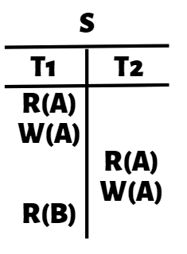
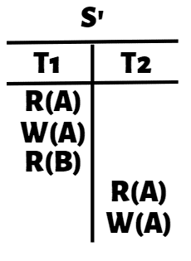

Conflict Equivalent Schedule
A schedule is called conflict serializable if it can be transformed into a serial schedule by swapping non-conflicting operations.

Slide 13
Conflict Serializability
Let us consider a schedule S in which there are two consecutive instructions, I and J , of transactions Ti and Tj , respectively (i ≠ j)
If I and J refer to different data items, then we can swap I and J without affecting the results of any instruction in the schedule
if I and J refer to the same data item Q, then the order of the two steps may matter
Since we are dealing with only read and write instructions, there are four cases that we need to consider:

Slide 14


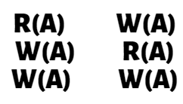


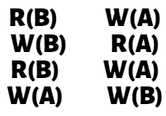
Conflict Serializability

Slide 15
Conflict Serializability
1. I = read(Q), J = read(Q). The order of I and J does not matter, (same value of Q is read by Ti and Tj)
2. I = read(Q), J = write(Q). If I comes before J , then Ti does not read the value of Q that is written by Tj in instruction J . If J comes before I, then Ti reads the value of Q that is written by Tj. (order of I and J matters)
3. I = write(Q), J = read(Q). (order of I and J matters)
4. I = write(Q), J = write(Q). (order doesn’t affect Ti & Tj) However, the value obtained by the next read(Q) instruction of S is affected, since the result of only the latter of the two write instructions is preserved in the database.

Slide 16
Conflict Serializability
Check adjacent Non-conflicting pair

Slide 17
Conflict Serializability
I and J conflict if :
They are operations belong to different transactions
Access the same data item
At least one of these instructions is a write operation
Consider Schedule in the form of only read and write operations:
Schedule 1
Schedule 2: Only read and write operations

Slide 18
Conflict Serializability
Let I and J be consecutive instructions of a schedule S. If I and J are instructions of different transactions and I and J do not conflict, then we can swap the order of I and J to produce a new schedule S’
S is equivalent to S’, since all instructions appear in the same order in both schedules except for I and J
The write(A) instruction of T2 in schedule 3 does not conflict with the read(B) instruction of T1, we can swap these instructions to generate an equivalent schedule
Schedule 3: Only read and write operations
Schedule 4: After swapping

Slide 19
Conflict Serializability
Schedules 3 and 5 both produce the same final system state.
We continue to swap non conflicting instructions:
Swap the read(B) instruction of T1 with the read(A) instruction of T2.
Swap the write(B) instruction of T1 with the write(A) instruction of T2
Swap the write(B) instruction of T1 with the read(A) instruction of T2
Schedule 5
Schedule 6: Final Schedule

Slide 20
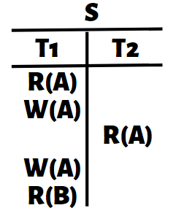

Conflict Serializability
CONFLICT
No change in
Position of Instruction

Slide 21
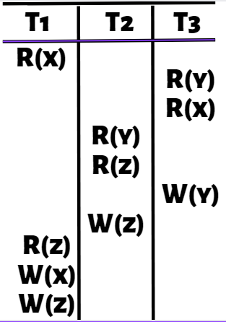
Conflict Serializability
Precedence Graph
Loop/Cycle exist?
There is no loop/
cycle in the graph
T1
R – W
W – R
W – R
T2
T3
Schedule is conflict serializable schedule
Check conflict pairs in other
transaction and draw edge

Slide 22
Conflict Serializability

