Slide 1
Unit2

Slide 2
Practice problems

Slide 3
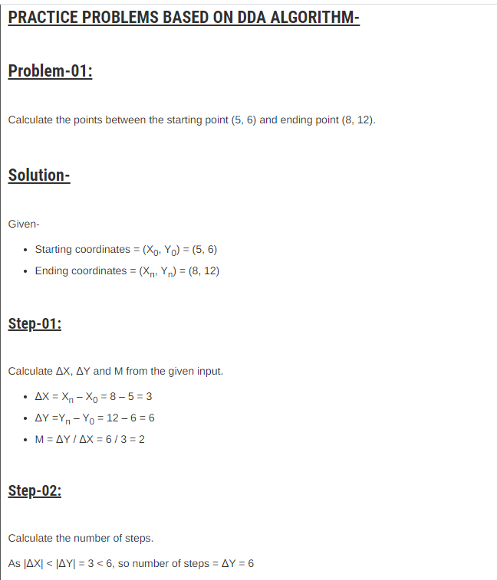

Slide 4
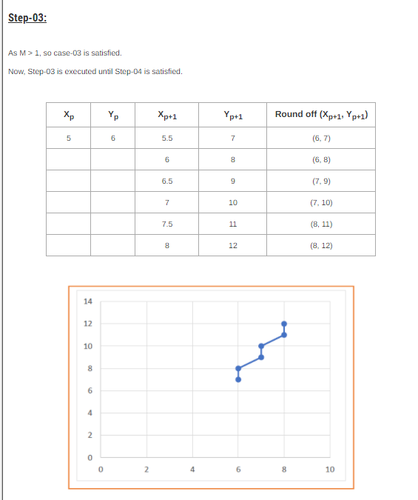

Slide 5
Try urself??

Slide 6
Problem-02:
Calculate the points between the starting point (5, 6) and ending point (13, 10).

Slide 7
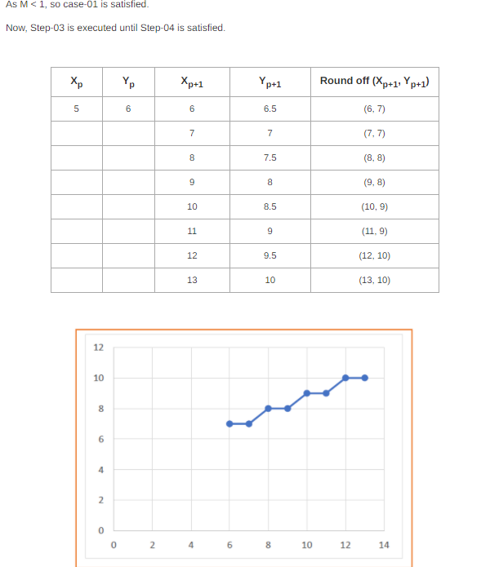

Slide 8
Problem-03:
Calculate the points between the starting point (1, 7) and ending point (11, 17).

Slide 9
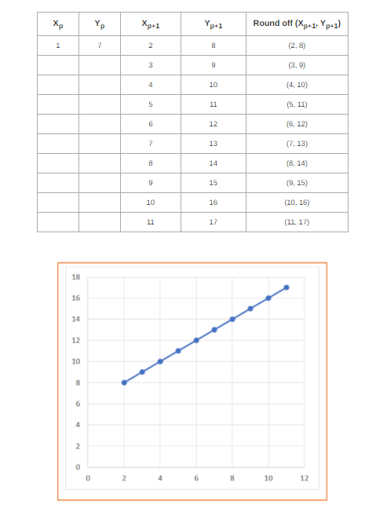

Slide 10
DDA ref video link
https://youtu.be/W5P8GlaEOSI

