Slide 1
Unit 1

Slide 2
Topics
Introduction to computer graphics
1.1 Overview of Computer Graphics –Introduction to opengl
1.2 Advantages of interactive computer graphics
1.3 Applications of computer graphics
1.4 Graphics Devices
1.4.1 Touch Panels
1.4.2 Light Pens
1.4.3 Joystick, Stylus
1.4.4 Cathode Ray Tube
1.4.5 Colour CRT Monitors(Beam Penetration, Shadow Mask Technique)
1.4.6 Direct View Storage Tube
1.4.7 Plasma Panel Display
1.4.8 Flat panel Display
1.5 Vector Scan and Random Scan Display
1.5.1 Raster Scan Display
1.5.2 Frame Buffer Organization-types of Frame Buffers
1.5.3 Display File Interpreter

Slide 3
What is CG?
Computer graphics is an art of drawing pictures on computer screens with the help of programming.
It involves computations, creation, and manipulation of data.
In other words, we can say that computer graphics is a rendering tool for the generation and manipulation of images.

Slide 4
Computer graphics deals with all aspects of creating images with a computer
Hardware
Software
Applications

Slide 5


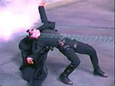
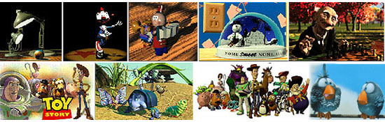
What drives computer graphics?
Movie Industry
Leaders in quality and artistry
Not slaves to conceptual purity
Big budgets and tight schedules
Reminder that there is more to
CG than technology
Hey, How'd they do that?
Defines our expectations

Slide 6

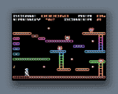
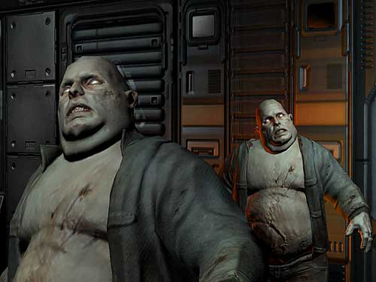
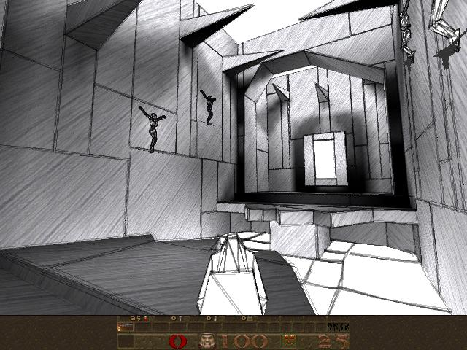
What drives computer graphics?
Game Industry
The newest driving force in CG
Why? Volume and Profit
This is why we have commodity GPUs
Focus on interactivity
Cost effective solutions
Avoiding computating and other tricks
Games drive the baseline

Slide 7
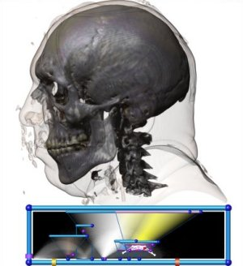
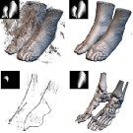
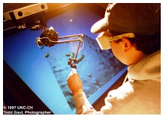
What drives computer graphics?
Medical Imaging and Scientific Visualization
Tools for teaching and diagnosis
No cheating or tricks allowed
New data representations and modalities
Drive issues of precision and correctness
Focus on presentation and interpretation of data
Construction of models from acquired data
Nanomanipulator, UNC
Joe Kniss, Utah
Gordon Kindelman, Utah

Slide 8
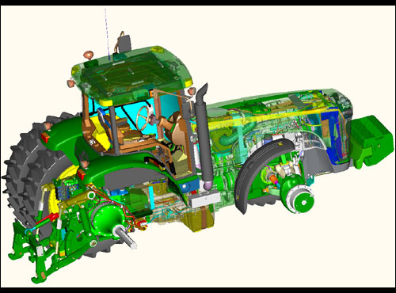
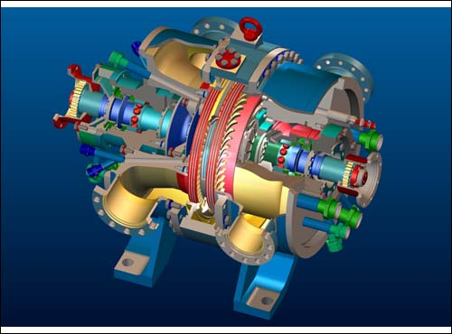
What drives computer graphics?
Computer Aided Design
Mechanical, Electronic, Architecture,...
Drives the high end of the hardware market
Integration of computing and display resources
Reduced design cyles == faster systems, sooner

Slide 9
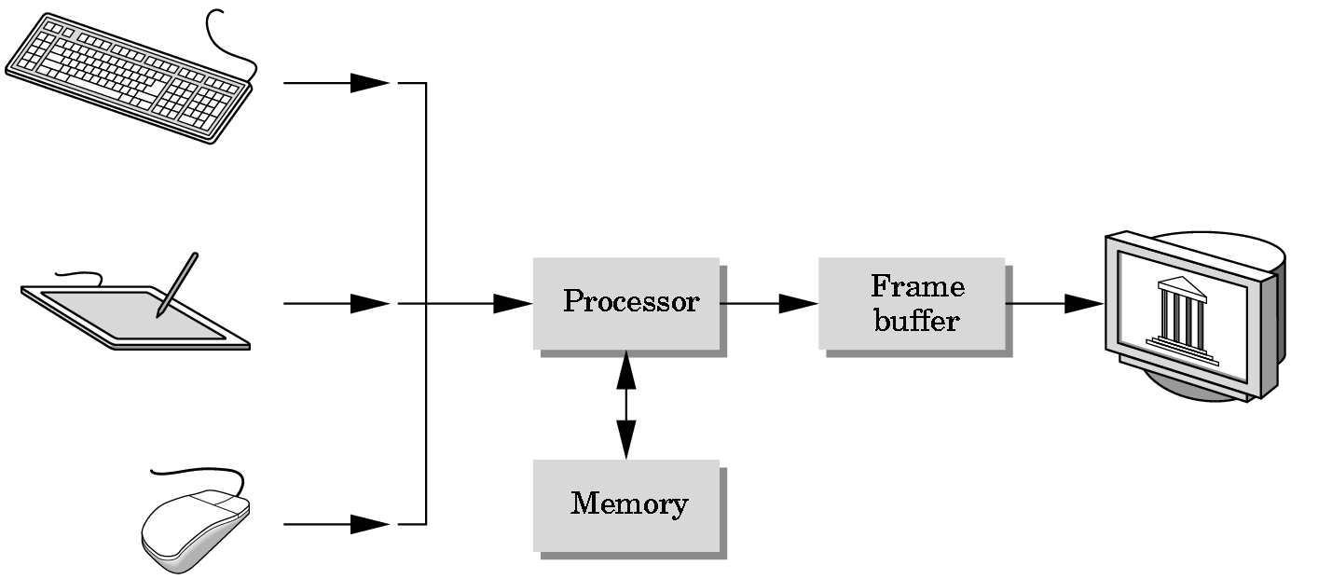
Basic Graphics System
Output device
Input devices
Image formed in FB

Slide 10
What is OpenGL?
Open Graphics Library (OpenGL) is a cross-language (language independent), cross-platform (platform-independent) API for rendering 2D and 3D Vector Graphics(use of polygons to represent image).
OpenGL API is designed mostly in hardware.

Slide 11
OpenGL (Open Graphics Library) is the computer industry's standard application program interface ( API ) for defining 2-D and 3-D graphic images.
Prior to OpenGL, any company developing a graphical application typically had to rewrite the graphics part of it for each operating system platform and had to be cognizant of the graphics hardware as well.
With OpenGL, an application can create the same effects in any operating system using any OpenGL-adhering graphics adapter.

Slide 12
Advantages of interactive computer graphics
Interactive Computer Graphics: Interactive Computer Graphics involves a two way communication between computer and user. Here the observer is given some control over the image by providing him with an input device for example the video game controller of the ping pong game. This helps him to signal his request to the computer.

Slide 13
The computer on receiving signals from the input device can modify the displayed picture appropriately.
To the user it appears that the picture is changing instantaneously in response to his commands.
He can give a series of commands, each one generating a graphical response from the computer. In this way he maintains a conversation, or dialogue, with the computer.

Slide 14
