Slide 1
Unit 2

Slide 2
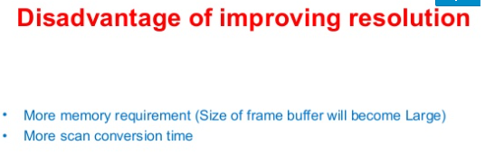

Slide 3
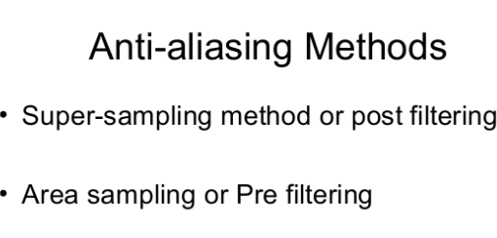

Slide 4
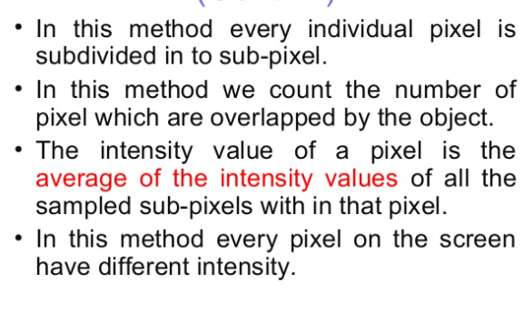
Super Sampling Method

Slide 5
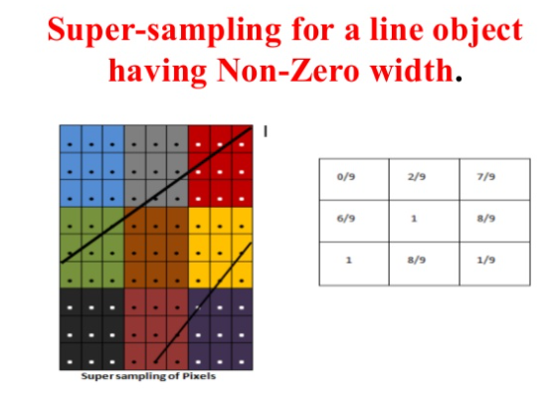

Slide 6
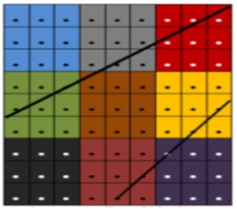
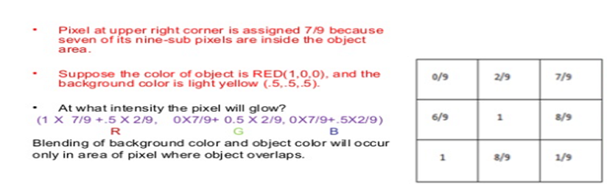

Slide 7
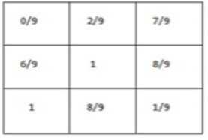
Here we are averaging the color of pixel by
Portion of pixel where object passes * object color +
Portion of pixel where object does not pass * background color
For eg Second row Bottom left pixel 6/9
(R,G,B) (1,0,0)
averaging the color of pixel
(1* 6/9 +.5* 3/9,
0*6/9+.5*3/9,
0*6/9+.5*3/9)

Slide 8
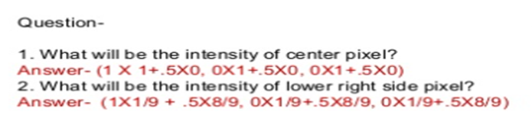

Slide 9
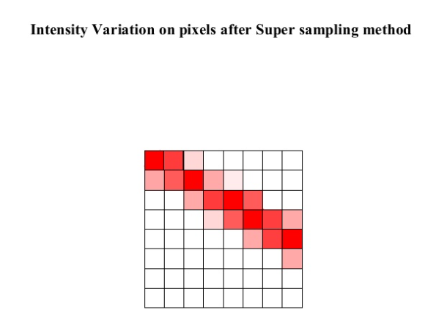

Slide 10
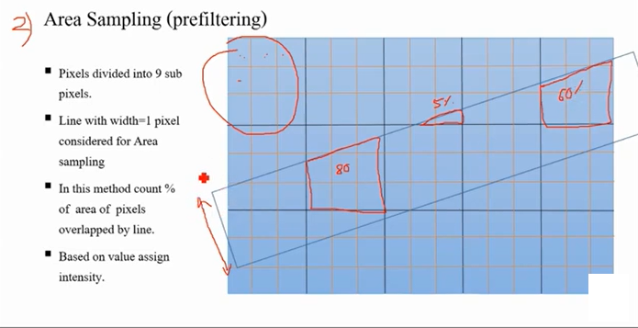

Slide 11
Pre-filtering (Area Sampling)
In area sampling, pixel intensities are calculated proportional to areas of overlap of each pixel with objects to be displayed.
Here pixel color is computed based on the overlap of scene’s objects with a pixel area.

Slide 12
For example: Suppose, a line passes through two pixels.
The pixel covering bigger portion(90%) of line displays 90% intensity while less area(10%) covering pixel displays 10-15% intensity.
If pixel area overlaps with different color areas, then the final pixel color is taken as an average of colors of the overlap area.
This method is also known as pre-filtering as this procedure is done BEFORE generating the rasterized image.
It’s done using some graphics primitive algorithms.

Slide 13
Ref video for anti aliasing
https://youtu.be/R3AgvpOA2qw
https://youtu.be/C_yh7gw7tbg
https://www.slideshare.net/AnkitGarg22/line-drawing-algorithm-and-antialiasing-techniques

