Slide 1
Unit2

Slide 2
Bresenham Line Algorithm Summary
The Bresenham line algorithm has the following advantages:
An fast incremental algorithm
Uses only integer calculations
Comparing this to the DDA algorithm, DDA has the following problems:
Accumulation of round-off errors can make the pixelated line drift away from what was intended
The rounding operations and floating point arithmetic involved are time consuming

Slide 3
Circle drawing algorithms
DDA algorithm
Bresenhams algorithm
Midpoint Algorithm

Slide 4
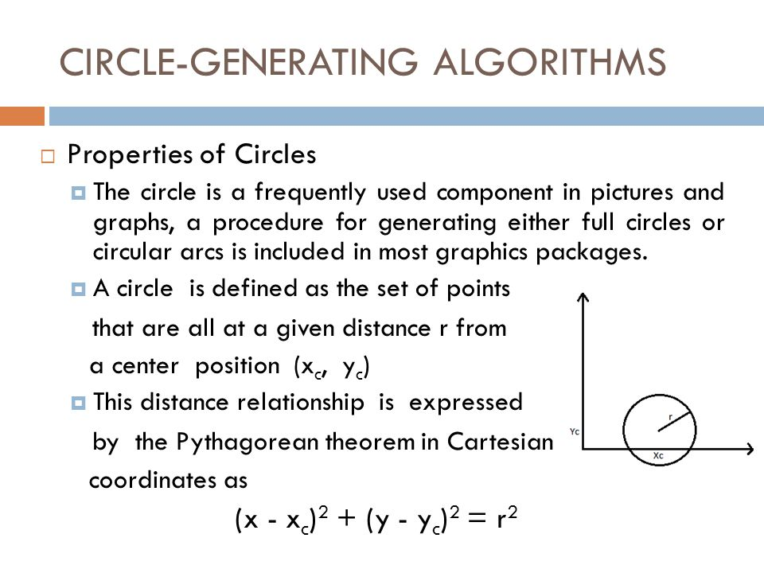

Slide 5
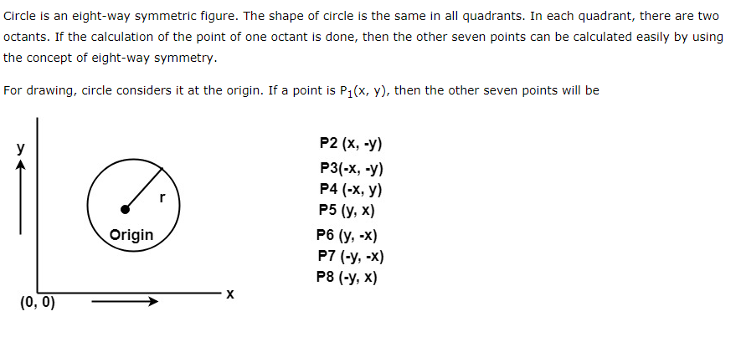

Slide 6
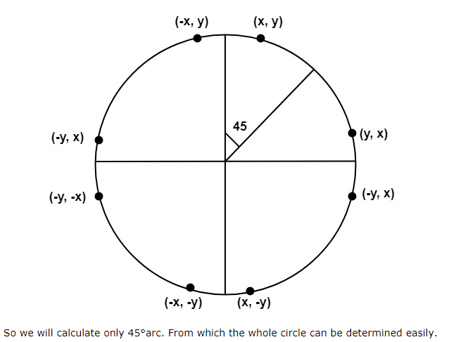

Slide 7
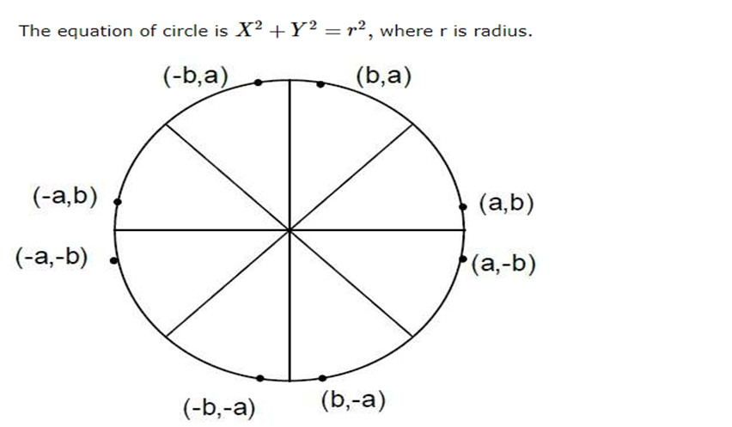

Slide 8
Circle Generation is a tricky task for computer because we have to choose pixels along a circular path.
Selection of right pixel for illumination requires more computation time as compare to Line drawing algorithm.
Selection of appropriate pixels is based on decision parameter which is same as line drawing algorithm but computation is different.

Slide 9
If we want to display circle on screen then the putpixel function is used for eight points as shown below:
putpixel (x, y, color) putpixel (x, -y, color) putpixel (-x, y, color) putpixel (-x, -y, color) putpixel (y, x, color) putpixel (y, -x, color) putpixel (-y, x, color) putpixel (-y, -x, color)

Slide 10
Example: Let us determine a point (2, 7) of the circle then other points will be
(2, -7),
(-2, -7),
(-2, 7),
(7, 2),
(-7, 2),
(-7, -2),
(7, -2)

Slide 11
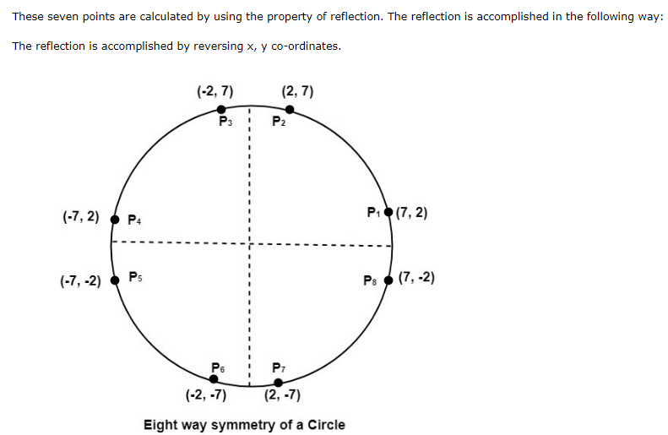

Slide 12
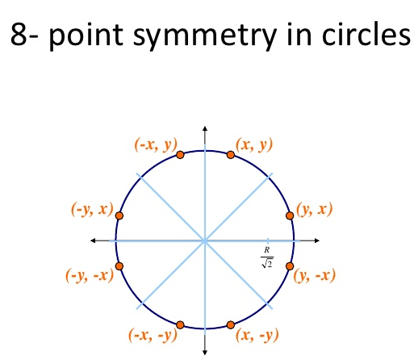

Slide 13
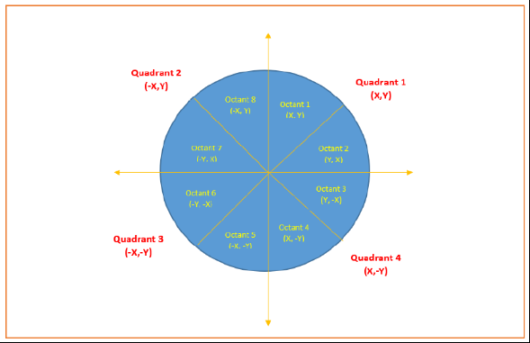

Slide 14
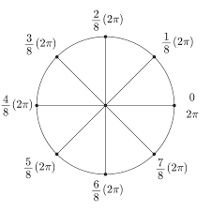

Slide 15
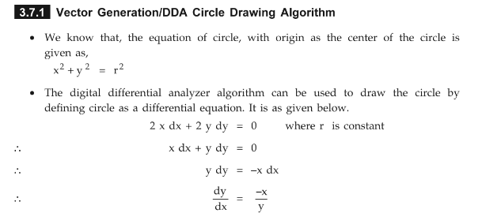
DDA circle generation algm

Slide 16
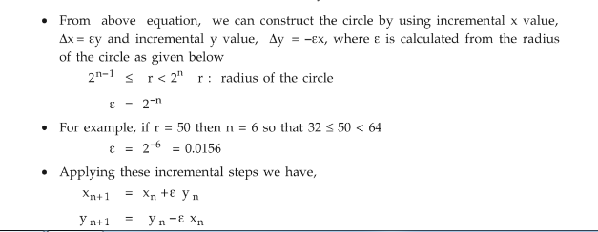

Slide 17
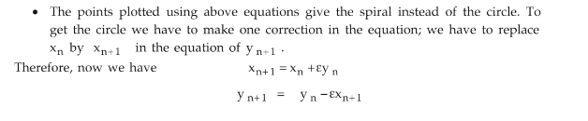

Slide 18
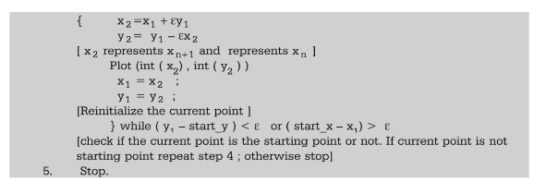
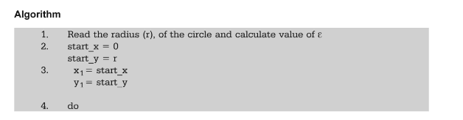

Slide 19
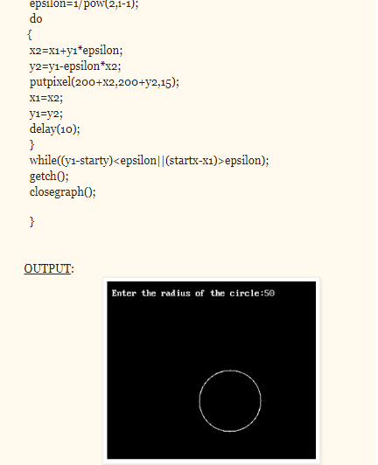
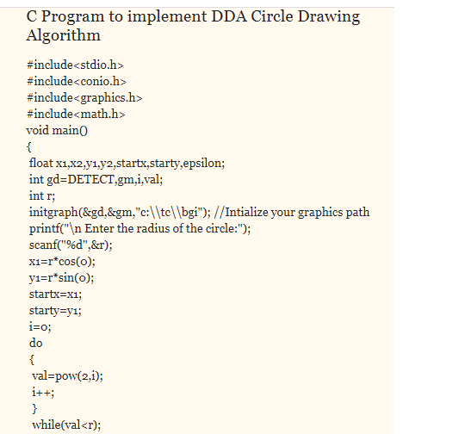

Slide 20
Correction
x1= r sin 0 (sin0=0) x1=0
Y1=r cos 0 (cos 0=1) y1=r
0,r
r,0

Slide 21
DDA algorithm Ref video links
https://youtu.be/fkj5jES6_7s
https://youtu.be/R2VrVaJclxg

