Slide 1
Unit 2

Slide 2
Bresenham’s Circle Drawing Algorithm
Bresenham’s Circle Drawing Algorithm is a circle drawing algorithm that selects the nearest pixel position to complete the arc.
The unique part of this algorithm is that is uses only integer arithmetic which makes it, significantly, faster than other algorithms using floating point arithmetic in classical processors.

Slide 3
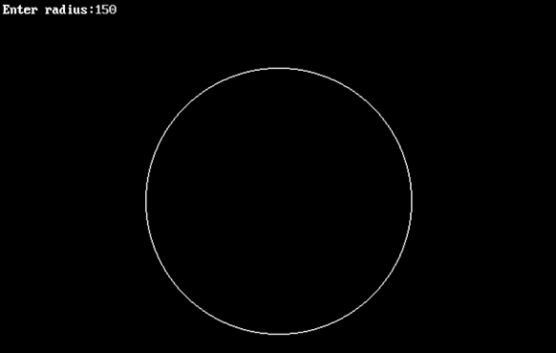

Slide 4
Given the centre point and radius of circle,
Bresenham Circle Drawing Algorithm attempts to generate the points of one octant.
The points for other octacts are generated using the eight symmetry property.

Slide 5
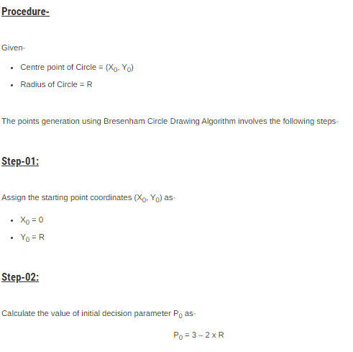

Slide 6
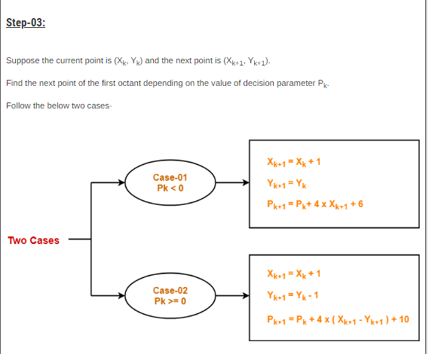

Slide 7
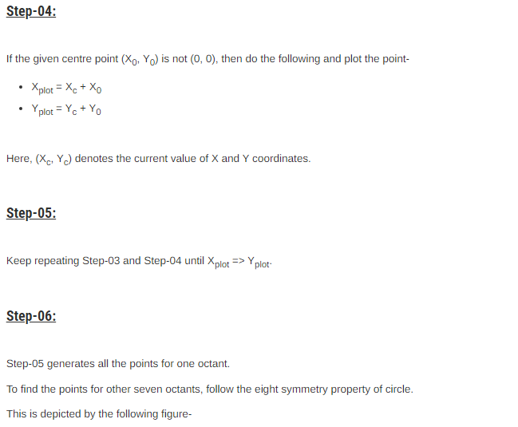

Slide 8
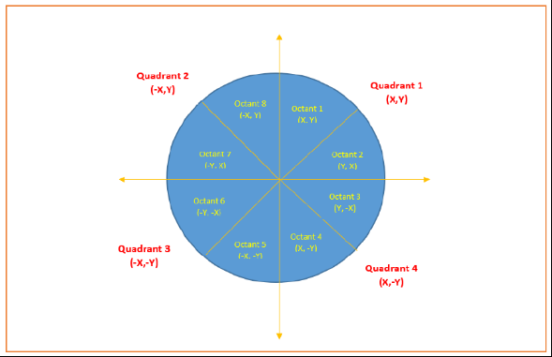

Slide 9
PRACTICE PROBLEMS BASED ON BRESENHAM CIRCLE DRAWING ALGORITHM-

Slide 10
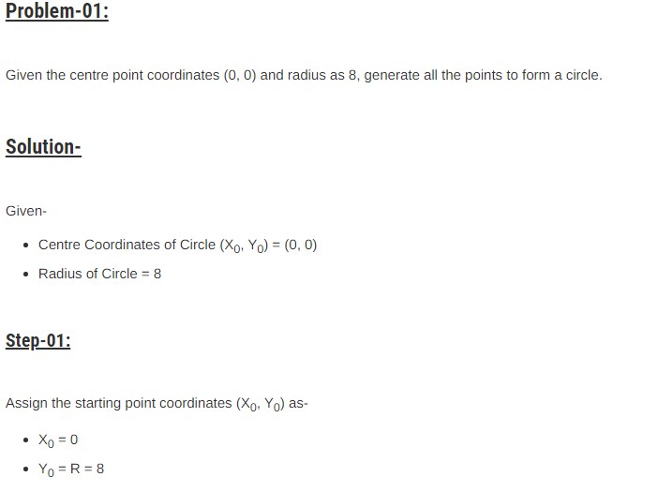

Slide 11
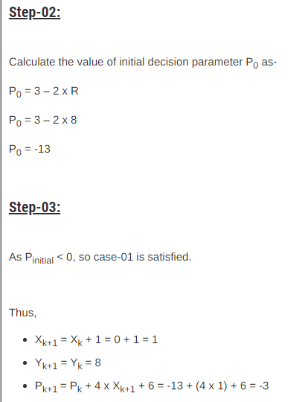

Slide 12
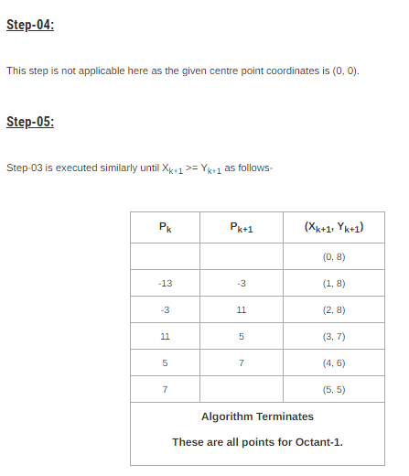

Slide 13
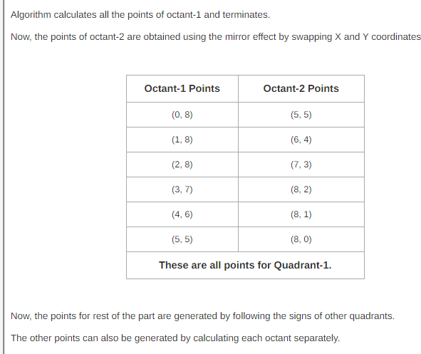

Slide 14
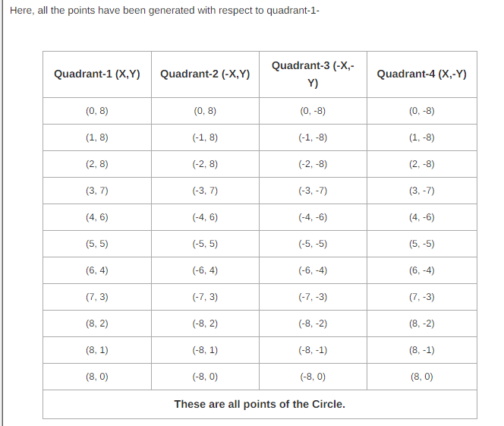

Slide 15
2nd problem

Slide 16
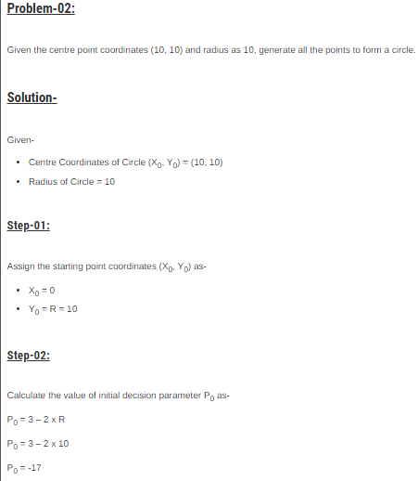

Slide 17
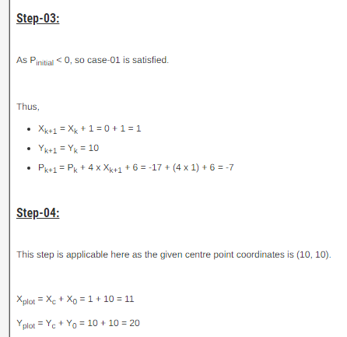

Slide 18
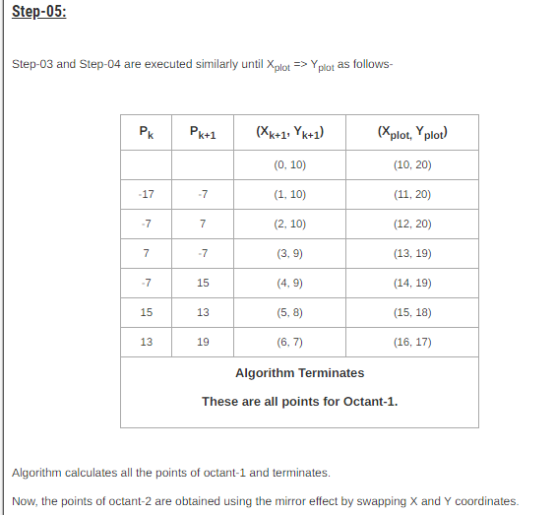

Slide 19
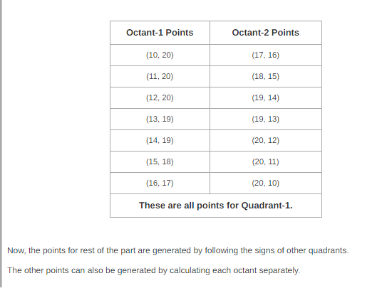

Slide 20
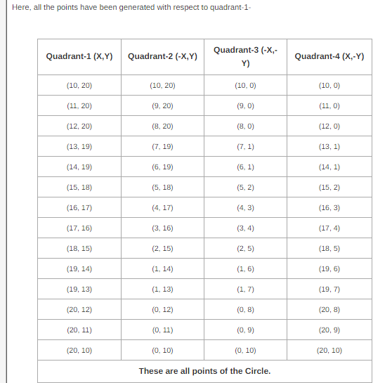

Slide 21
