Slide 1
Unit 7

Slide 2
B-Spline Curve

Slide 3
Concept of B-spline curve came to resolve the disadvantages having by Bezier curve.
Both curves are parametric in nature.
In Bezier curve , when we change any of the control point respective location the whole curve shape gets change.

Slide 4
But in B-spline curve, only a specific segment of the curve-shape gets changes or affected by the changing of the corresponding location of the control points.

Slide 5
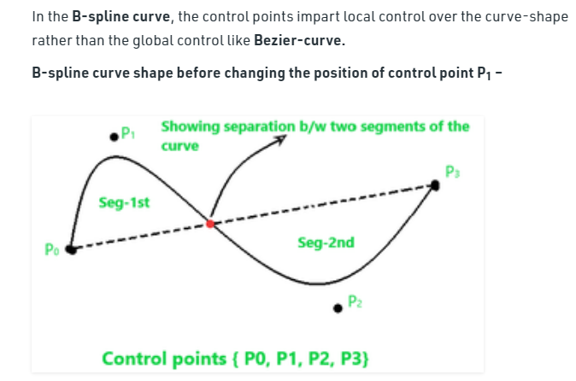

Slide 6
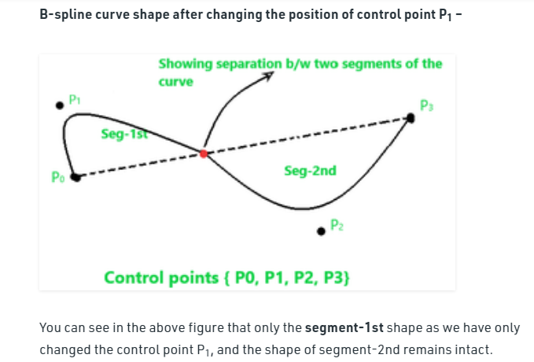

Slide 7
Properties of B-spline curve

Slide 8
1. The degree of B-spline curve polynomial does not depend on the number of control points which makes it more reliable to use than Bezier curve.
The degree of the polynomial defining the curve segment is one less that the number of defining polygon point.
Therefore, for 4 control points, the degree of the polynomial is 3, i.e. cubic polynomial.

Slide 9
2. The curve generally follows the shape of defining polygon.

Slide 10
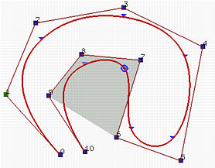
3.The curve line within the convex hull of its defining polygon.

Slide 11
Variation Diminishing Property:
Means no straight line intersects a B-spline curve more times than it intersects the curve's control polyline.

Slide 12
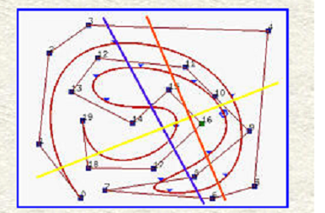

Slide 13
In the above figure, the blue line intersects both the control polyline and the B-spline curve 6 times, while the yellow line also intersects the control polyline and the B-spline curve 5 times. However, the orange line intersects the control polyline 6 times and the curve 4 times.

Slide 14
Both Bezier and B-Spline curves are used for drawing and evaluating smooth curves, especially in computer graphics and animations.
• B-Spline are considered a special case of Bezier curves
• B-Spline offer more control and flexibility than Bezier curves

