Slide 1
Unit 7
Introduction to segmentation- Segment Table

Slide 2
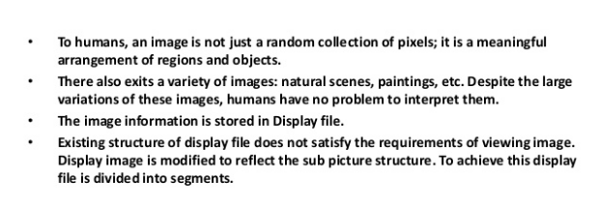

Slide 3
To view an entire image or a part of image with various attributes, we need to organize image information in a particular manner since existing structure of display file does not satisfy our requirements of viewing an image.

Slide 4
To achieve this display, file is divided into Segments.
Each segment corresponds to a component and is associated with a set of attributes and image transformation parameters like scaling, rotation.

Slide 5
Presence of Segment allows :
Subdivision of picture.
Visualization of particular part of picture.
Scaling, rotation and translation of picture.

Slide 6
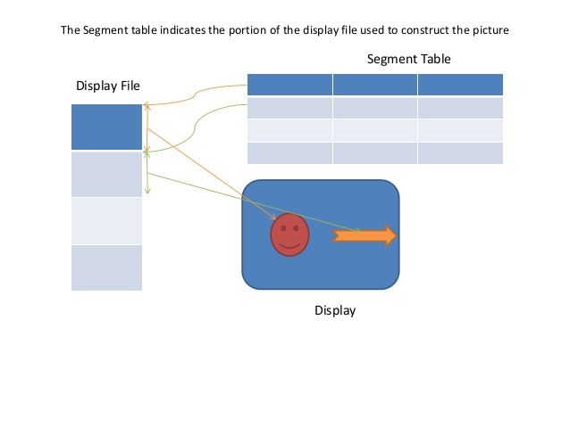

Slide 8
Types of Segments
Posted Segment : When visible attribute of segment is set to 1, it is called Posted segment. This is included in active segment list.
Unposted Segment : When visible attribute of segment is set to 0, it is called Unposted segment. This is not included in active segment list.

Slide 9
4 basic Functions for Segmenting the display
Segment Creation
Closing a Segment
Deleting a Segment
Renaming a Segment

